Slide 1

BITDIMO
A social network application to travel and explore

Slide 2
AGENDA
01
INTRODUCTION
FUNCTIONS
05
MILESTONES
02
IDEA
06
Q&A
03
04
SYSTEM ARCHITECTURE

Slide 3


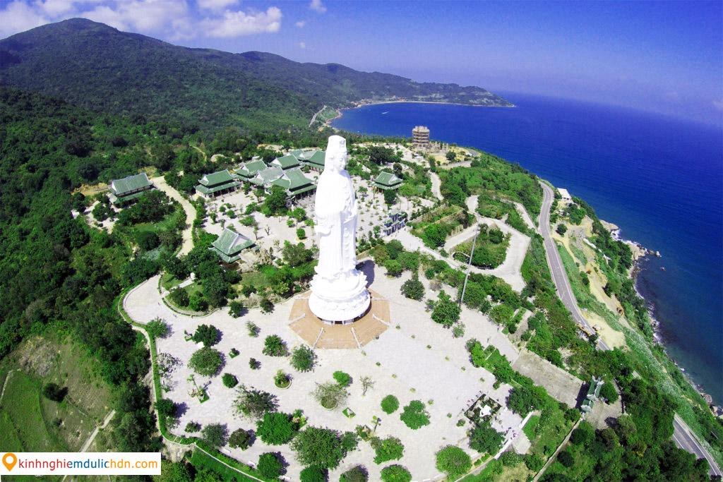
I. INTRODUCTION
DRAGON BRIDGE
BA NA HILL
LINH UNG PAGODA
HIGHLIGHTS

Slide 4


TRENDING PLACES

Slide 5
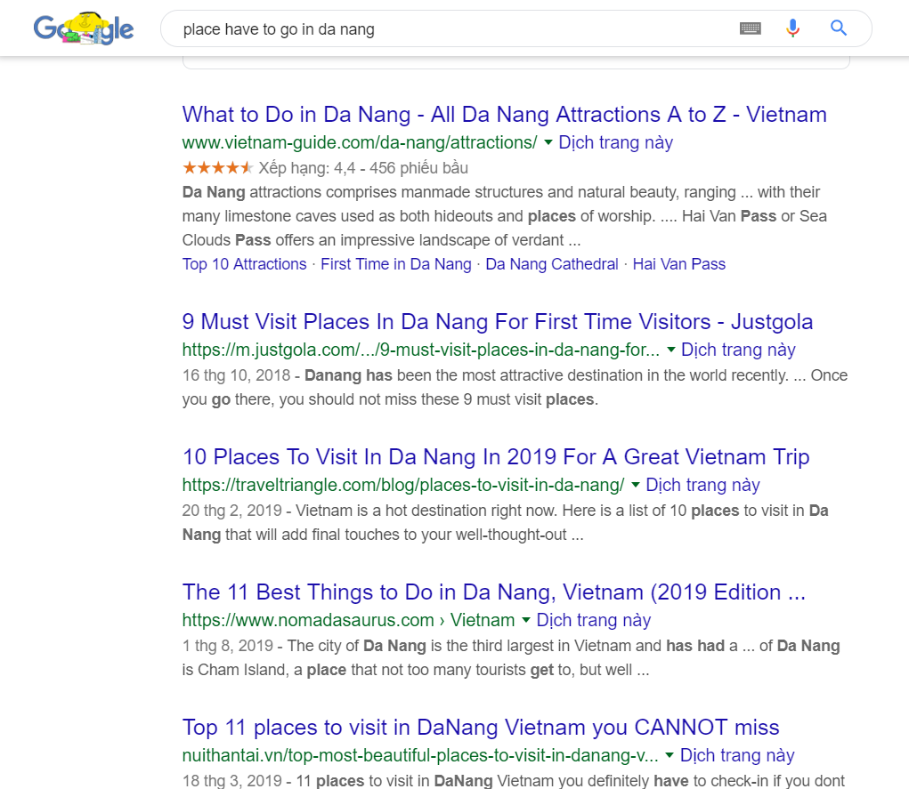
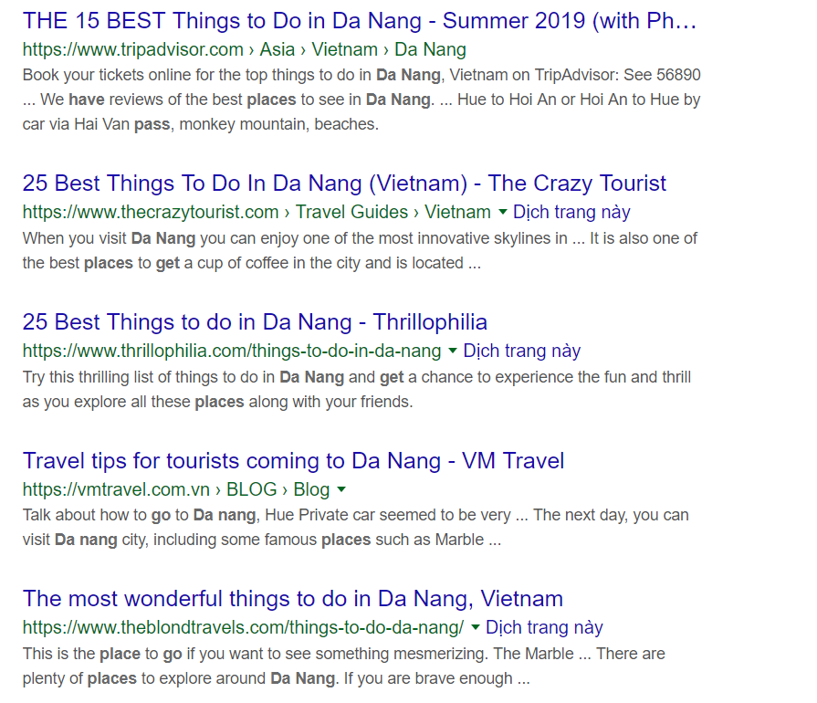
RESULT OF SEARCHING ON GOOGLE

Slide 6
II. IDEA
WHAT WE REALIZE THAT WE NEED
INFORMATION IS ABUNDANT
SOCIAL NETWORK
WITHOUT TOUR GUIDES
REDUCE TIME AND COST
EFFECTIVE AND INTERESTING FUNCTIONS

Slide 7


III. FUNCTIONS
HIGHLIGHTS
Users can seek the famous and outstanding places.
EXPLORE
More trending and new places that we want to explore. Users post stories and reviews with pictures, video.
JOURNEY
You can watch the landscape of the way get to the destination such as the street, the trees, the climate,... through a combination of a video and the direction on the Google Map.

Slide 8
AI Recommend System Description
Introduce
Matrix factorization is a class of collaborative filtering algorithms used in recommender systems.
Matrix factorization algorithms work by decomposing the user-item interaction matrix into the product of two lower dimensionality rectangular matrices.
That is implemented by Netflix, MovieLens, …

Slide 9
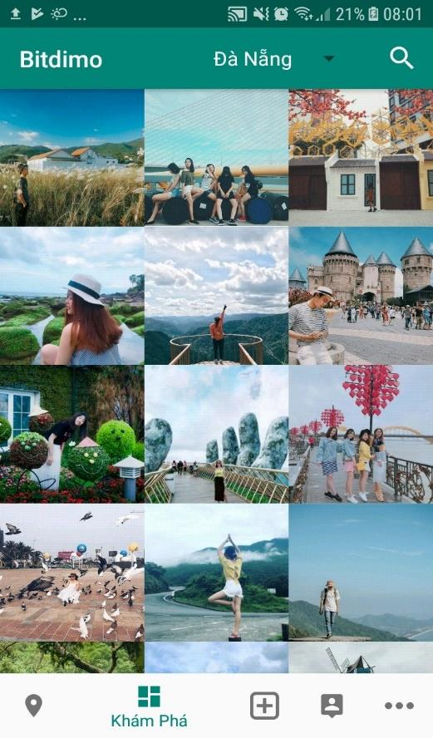


AI Recommend System Description
Overview
Items are posts in Explore
Post articles in Explore
User
Value between users and items.
User interactions
Rate posts

Slide 10
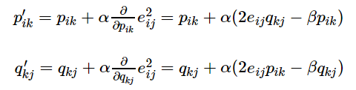
AI Recommend System Description
 | Post 1 | Post 2 | Post 3 | Post 4 | Post 5
Jake | 3 |  | 1 |  | 1
Kendis | 1 |  | 4 | 1
Kristen | 3 | 1 |  | 3 | 1
Bill |  | 3 |  | 4 | 4
R ≈ P×Q = R1
4= 1x1 + 1x3
Rating matrix = R
 | F1 | F2
Jake | 1 | 0
Kendis | 0 | 1
Kristen | 1 | 0
Bill | 1 | 1
 | Post1 | Post2 | Post3 | Post4 | Post5
F1 | 3 | 1 | 1 | 3 | 1
F2 | 1 | 2 | 4 | 1 | 3
X
≈
Item matrix = Q
We do algorithms to find out P and Q matrix
User matrix = P

Slide 11

AI Recommend System Description
r1
 | Post 1 | Post 2 | Post 3 | Post 4 | Post 5
Jake | 3 |  | 1 |  | 1
Kendis | 1 |  | 4 | 1
Kristen | 3 | 1 |  | 3 | 1
Bill |  | 3 |  | 4 | 4
 | Post 1 | Post 2 | Post 3 | Post 4 | Post 5
Jake | 3 | 1 | 1 | 3 | 1
Kendis | 1 | 2 | 4 | 1 | 3
Kristen | 3 | 1 | 1 | 3 | 1
Bill | 4 | 3 | 5 | 4 | 4
We got matrix R1

Slide 12
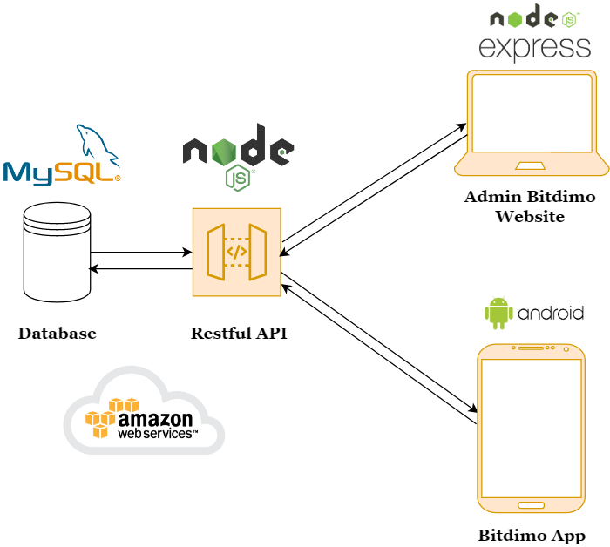
IV. SYSTEM ARCHITECTURE

Slide 13
V. MILESTONES
Build API and Database
Program Bitdimo applications
Protect the senior project
Sep, 2019
Oct, 2019
Nov, 2019
Dec, 2019
Add and edit documents and slides

Slide 14
VI. Q&A
THANK YOU FOR LISTENING
Does anyone have any questions?
Skype: eureka..m0340@enclave.vn
Email: jake@enclave.vn
0969 083 792
ENCLAVE COMPANY

