Slide 1
Paper Presentation
Team No : 10
Group Members :
19101584 Sanzida Akter
18101009 Aanan Ehsan Siam
19101463 K.M. Mahfuzul Monir
Course Code : CSE431 , Course Title : Natural Language Processing
Submitted to : Mr. Annajiat Alim Rasel
Submission Date : 20th October , 2022

Slide 2
Paper Title
Movie Recommendation System Using Sentiment Analysis From Microblogging Data
Paper Link : Movie Recommendation System Using Sentiment Analysis From Microblogging Data

Slide 3
Background of the Proposed System
Traditional approaches:
Collaborative Filtering (CF)
Content-Based Filtering (CBF)
Issue:
The usage of prior user historical data
Habits for performing the task of recommendation
Hybrid System:
The best of concepts used from CF and CBF along with sentiment analysis of tweets from microblogging sites.

Slide 4
Need of the Proposed System
To assist consumers to choose from the vast amount of information
Sort the choices of the customers for giving them better movie watching experience.
Modifying those RSs that have been developed over the past decades

Slide 5
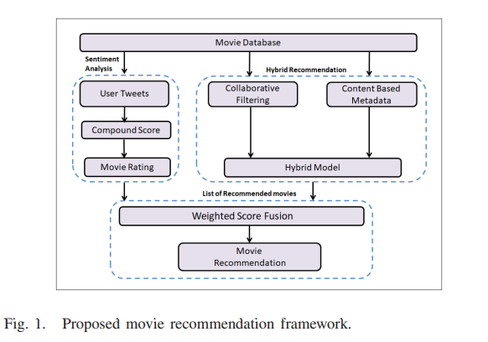
Proposed
Methodology

Slide 6
Dataset
Public Databases
Modified MovieTweetings Database

Slide 7
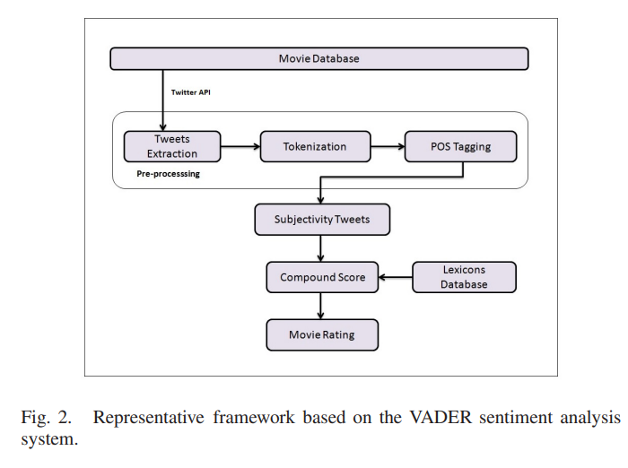
Analysis of User Tweets
Preprocessing of Tweets
Sentiment Analysis of User Tweets
Rating = [1 + (1 + x) × 2] × 2.

Slide 8
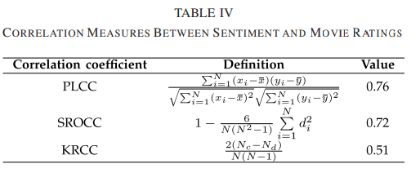
Analysis of User Tweets
Hybrid Recommendation
Weighted Score Fusion

Slide 9

Experimental Result and Analysis
Correlation Between Sentiment and IMDb Movie Ratings
Evaluation Metric
Weight Selection for Weighted Fusion
Comparative Analysis

Slide 10
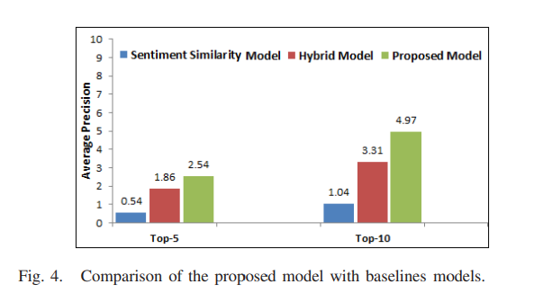
Experimental Result and Analysis

Slide 11
Future Work
Considering more emotional tone
Using Non-English languages for improvement

Slide 12
.
THANK YOU

