Slide 1
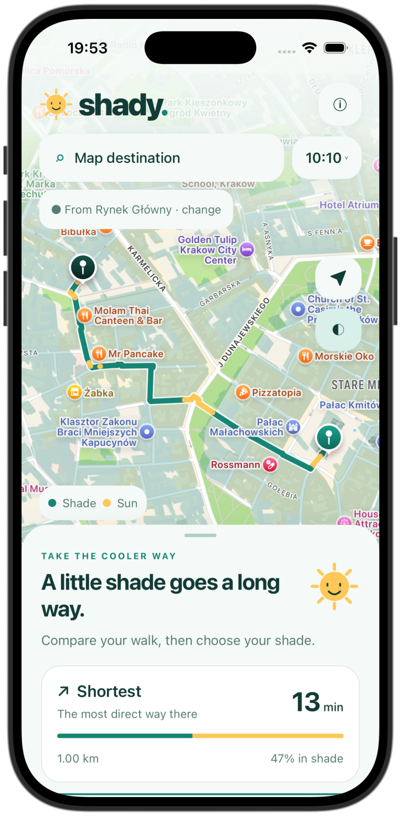
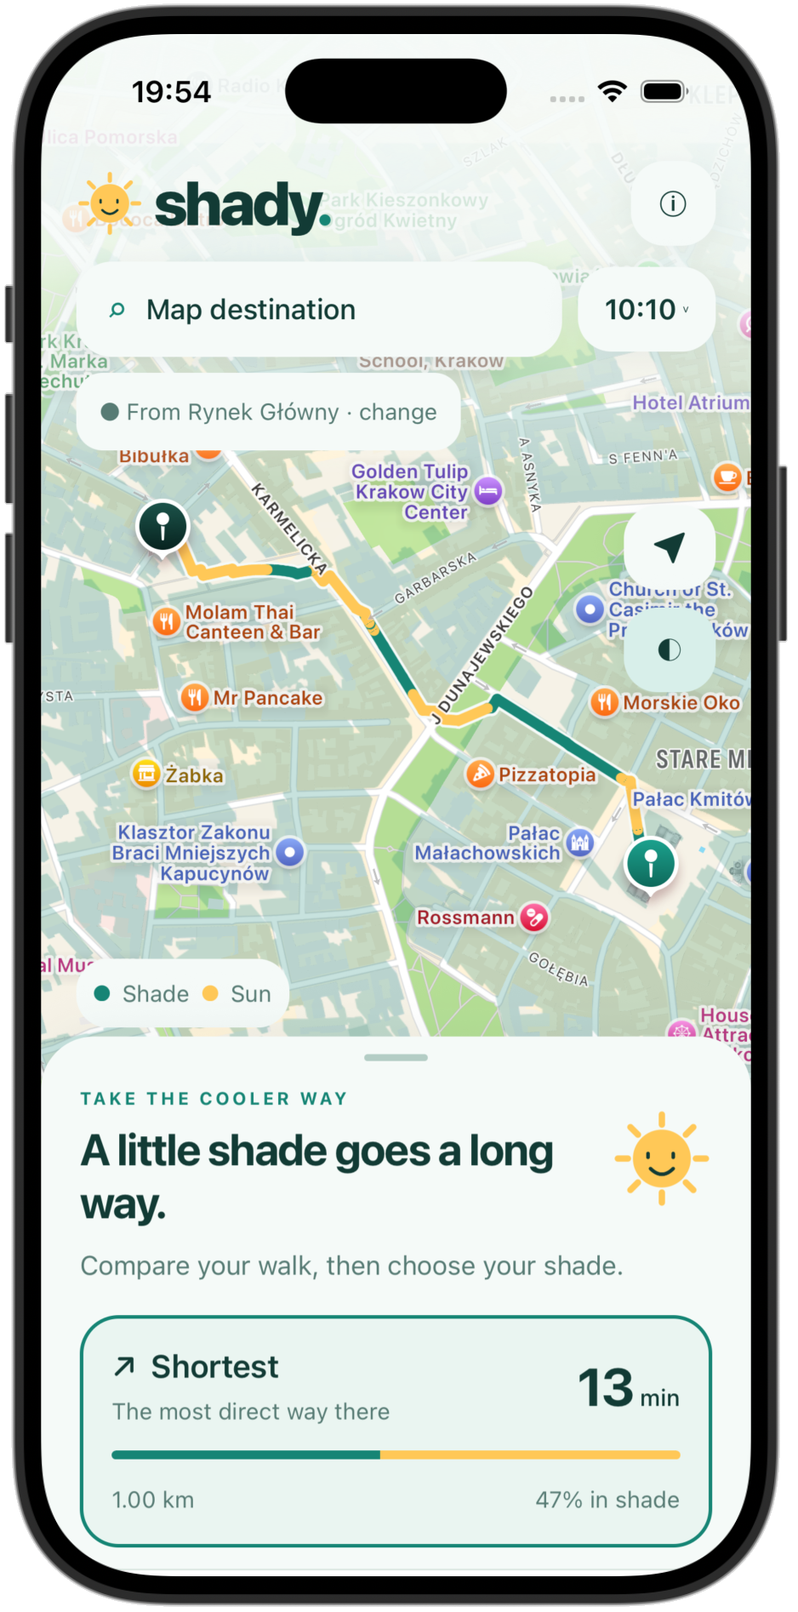


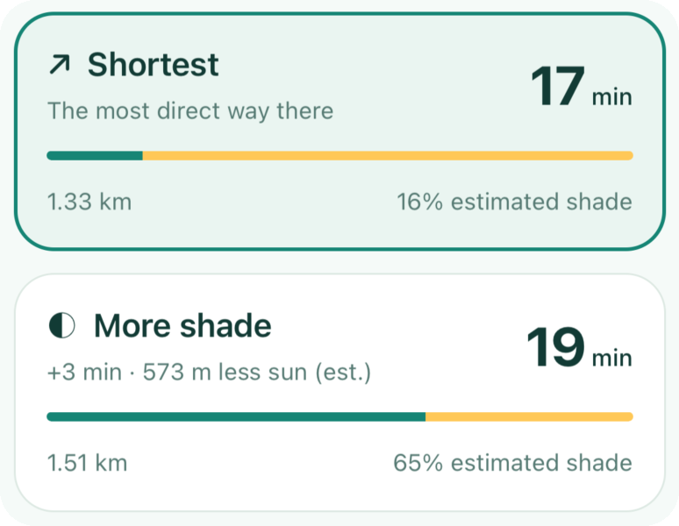
shady.
TAKE THE COOLER WAY
Same destination, a cooler walk.
Shade-aware walking routes for Kraków.
HackYeah 2026 · Smart City
iOS · Android · Web
Notes:
Same destination, a cooler walk. Shady compares the shortest path with a shadier one: here +3 min buys 573 m less sun (16% vs 65% shade).

Slide 2
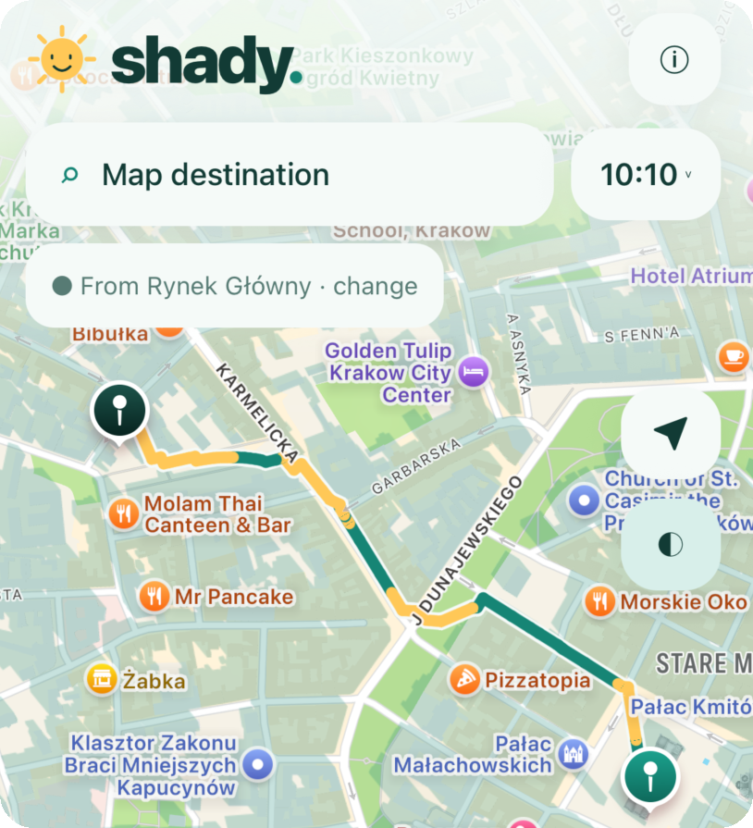
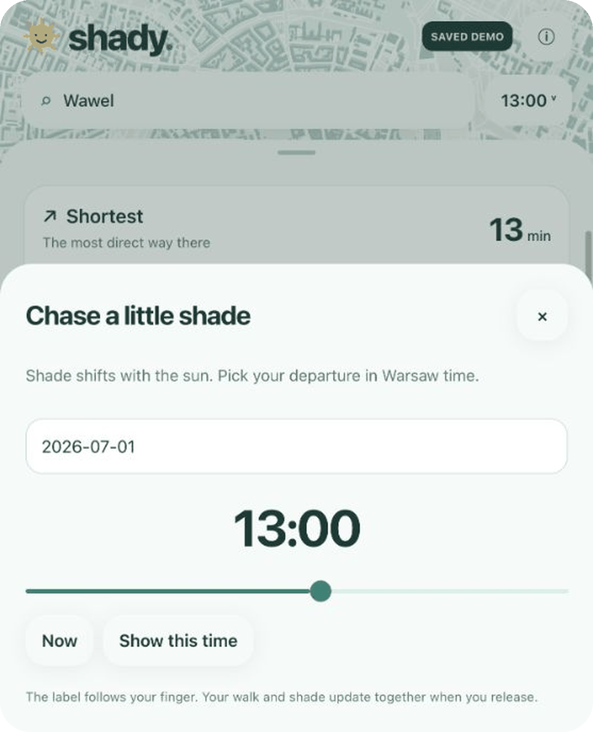
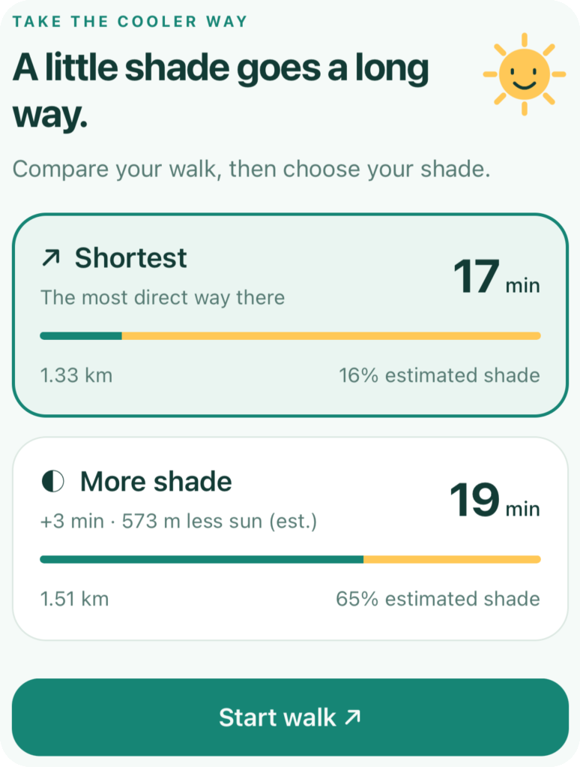
Three taps to a cooler walk
1
2
3
Where to?
When?
Compare & go
Search or long-press
Slide to any time
Pick your shade

Slide 3
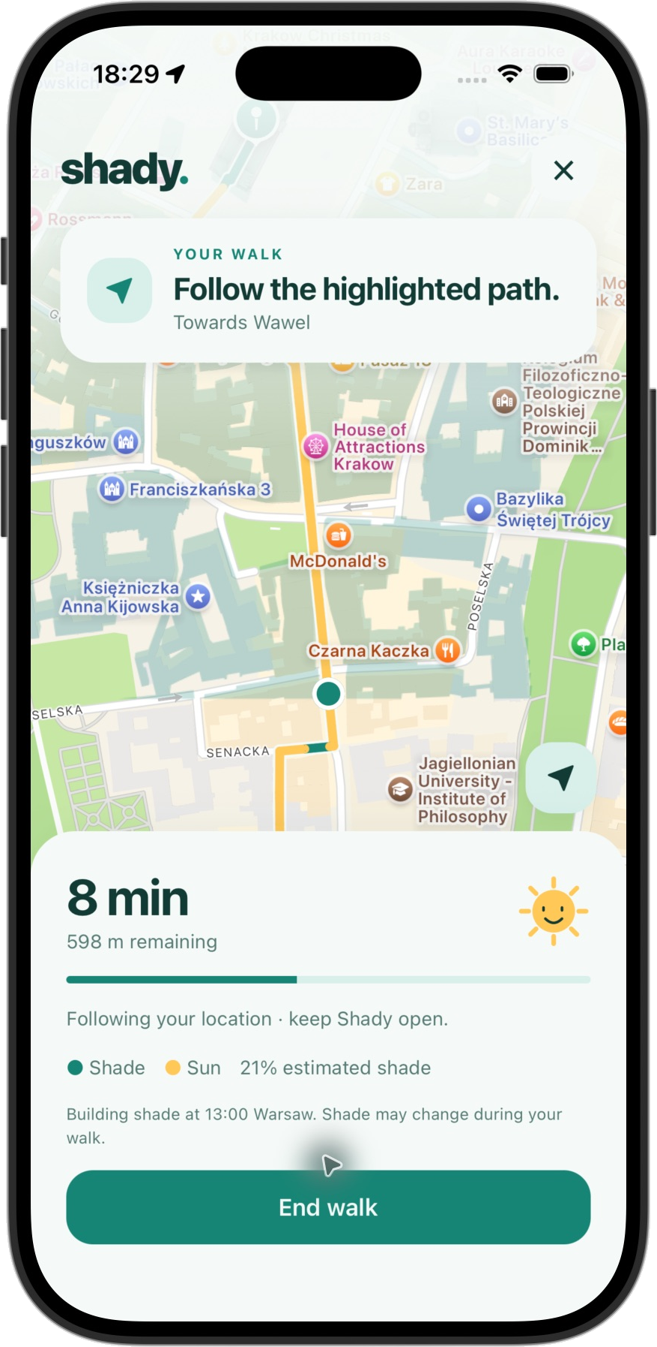
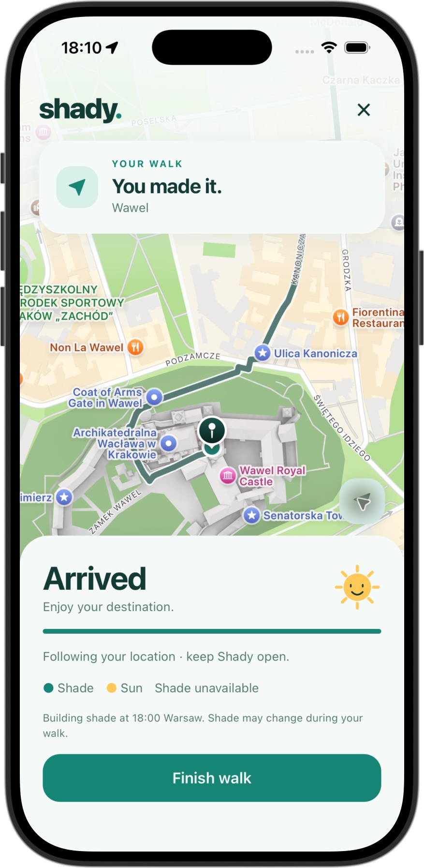






Made for everyday walks
Search or pin
Clear choice
Live GPS walk
Whole city
Works offline
Private by design
On the way
You made it!

Slide 4




Real city. Real data. Real fast
Metres of sun avoided
408k
4,641
walking paths
wooded areas
+25%
0.1 s
max extra distance
per route
Real routes, summer midday

Slide 5






How it works
Open data
Sun position
Shadow map
Smart route
Your phone
OSM + 3D buildings
for your time
buildings & trees
least sun, max +25%
compare & walk
React Native
FastAPI
OSMnx
pvlib
95% tested

Slide 6

shady.
Take the cooler way through Kraków.
github.com/undeluro/shady

