Slide 1
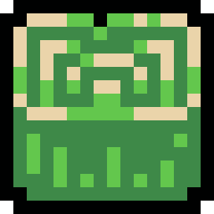







UnderCooked!

Slide 2
Presentation Outline:
1) The overall quality of the software product.
2) Estimates of effort remaining to complete the implementation
3) Clarity and quality of the requirements specification, architecture and implementation
4) Testability

Slide 3
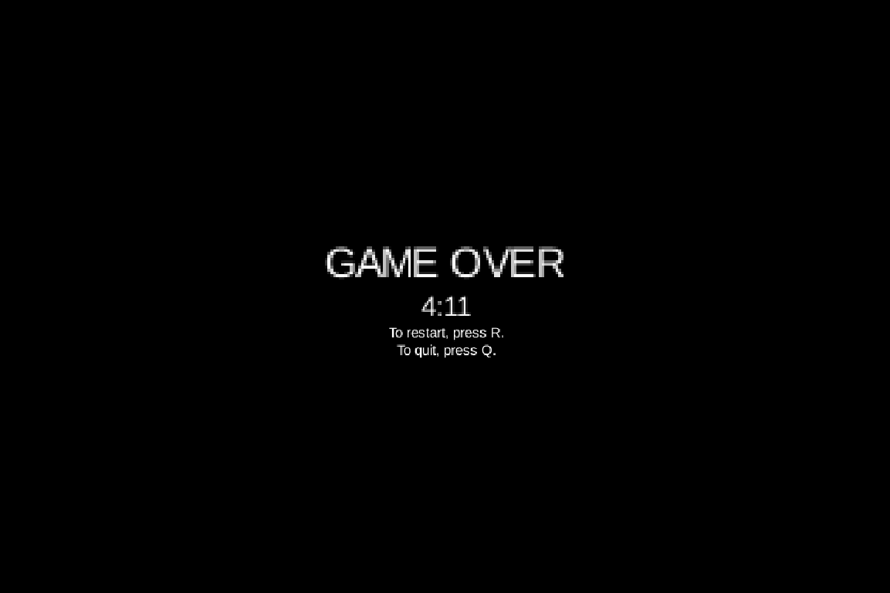
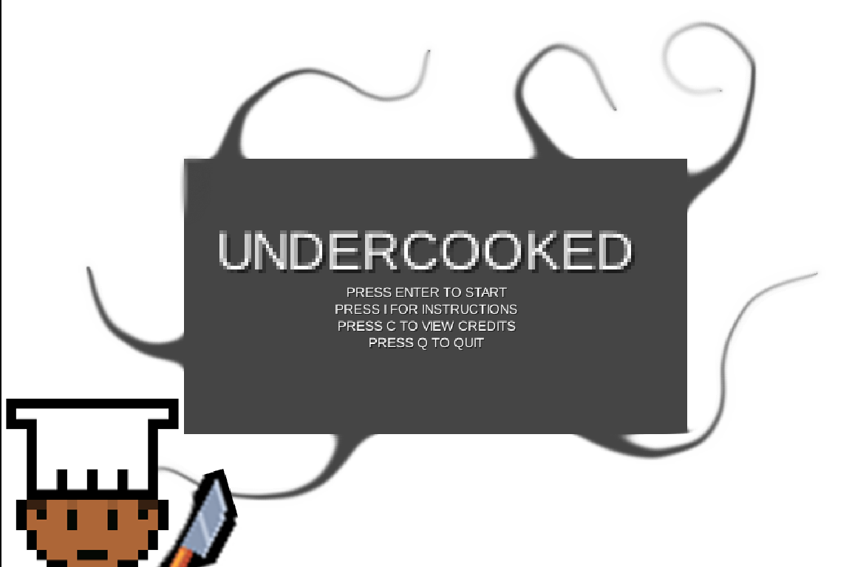
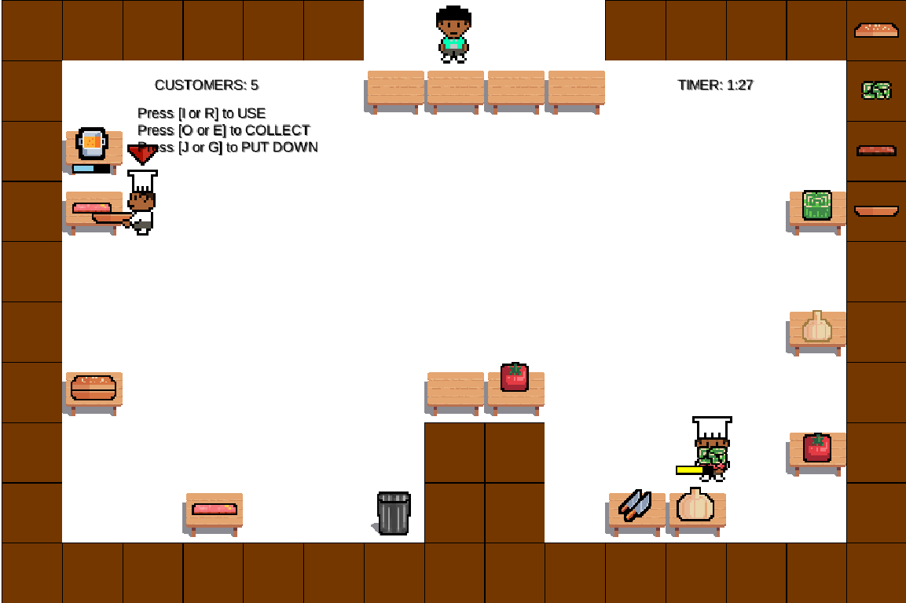
1) Game Demo

Slide 4
1) All of the requirements for Assessment 1 were completed, including Documentation :D
Included Features:
Instructions has been provided throughout the game
Players can move and control both chefs (using SpaceBar)
Chefs can hold a stack of ingredients…
  ...which they can pick up from pantries
  ...which can be processed at stations
Each station type requires players to interact with it in different way to another station, like a minigame, made clear to the user via a progress bar. This is defined in the station’s `interact()` function.
Chefs can request and serve customers dishes. The ingredients required to make each dish is displayed in the HUD.

Slide 5
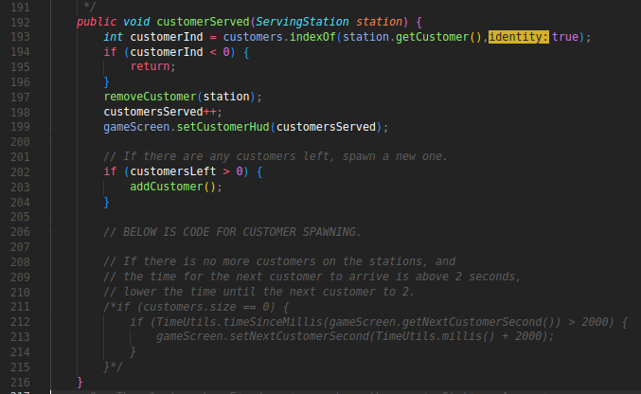
2) What’s required to complete the Assessment 2
Customers arriving at different intervals:
Our original implementation of customers used a timer, which has been left in the code, which will most likely be used to complete this goal.

Slide 6
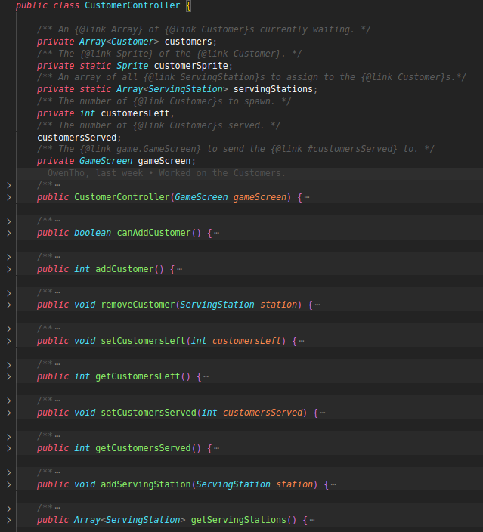
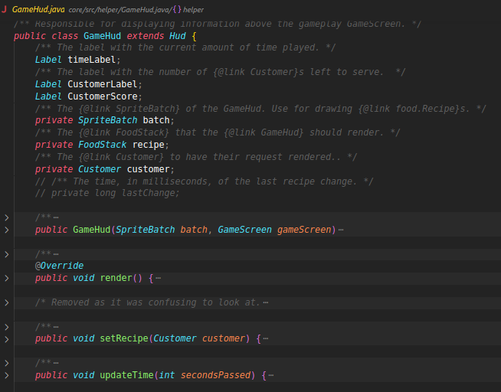
2) What’s required to complete the Assessment 2
The 2nd Game-Mode:
Though there isn’t an explicit 2nd game-mode related code (apart from the timer in the GameHUD), CustomerController contains all the methods relating to the customers in the game.
Use this class with a new attribute `GAMEMODE`, to control how the customers behave in the 2nd gamemode in each function.
You can add reputation points into the GameHUD class, to display it to the player onscreen.

Slide 7
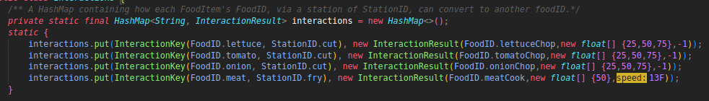
2) What’s required to complete the Assessment 2
Adding and Improving Recipe making:
Each recipe is simply defined as a Stack of Food (FoodStack.java). Customers can request these defined recipes.
We have dicts containing important game information.
  dict<strRecipeName, LibGDX.Array<strFoodStack>> recipes
  dict<(FoodID, StationID), (FoodID, PrepStationInfo*)> interactions
*We realised during development, the stations which process ingredients into other ingredients are very similar. Thus, a single class PreperationStation.java is used for both the frying and cutting station, meaning only interactions dict differentiates them! Meaning...
  Use PrepStationInfo to control the progress bar for each interaction, and what comes out of each interaction

Slide 8
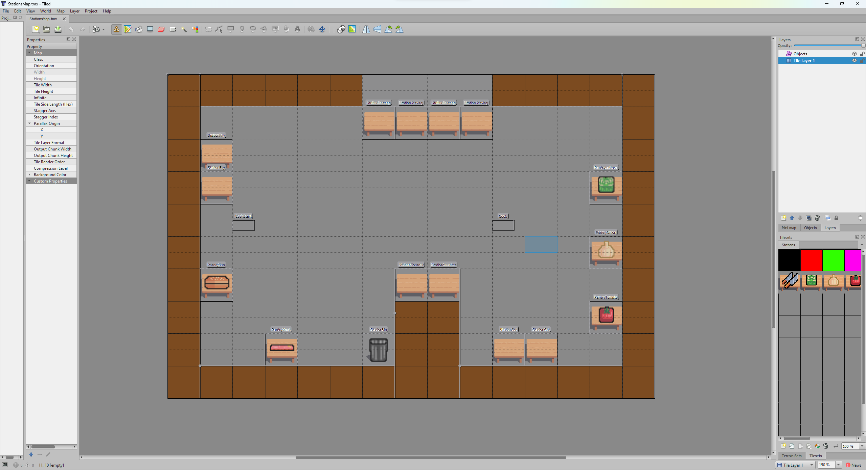
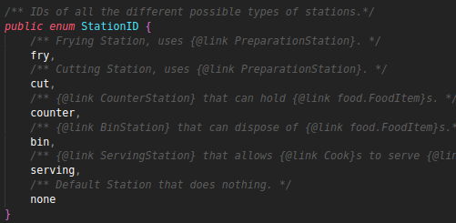
2) What’s required to complete the Assessment 2
Adding Stations:
We used a 3rd party application TileMap to create the map of the game:
So to add a station:
1) Create a new station tile in TileMap
2) Add a new StationID into the StationID enum.

Slide 9
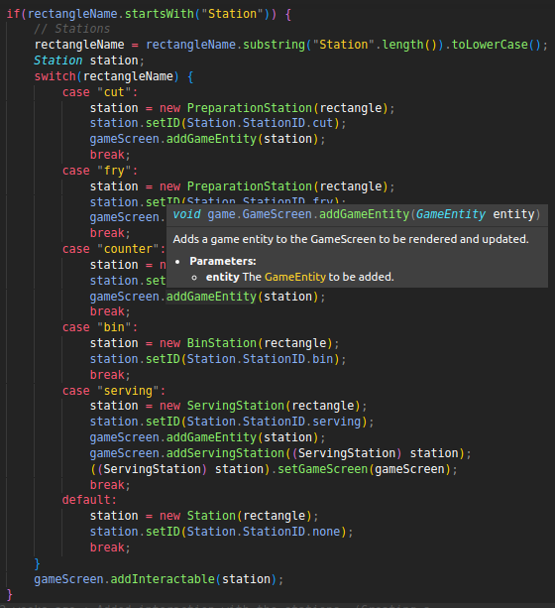
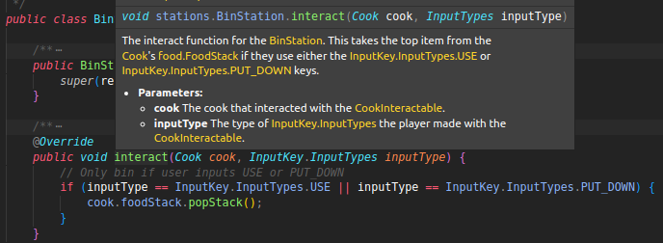
2) What’s required to complete the Assessment 2
Adding Stations:
3) Add a new entry into MapHelper:
  Entries are will most likely be a variation of what’s already there (shown on the right)
4) Add a new entry into interactions! That’s it for simple stations. Very flexible for how simple it is! Adding Pantries is very similar to adding stations.
Possibly, 5)
  If the station requires new functionalities: you may also create a new station class and override interact() with any desired code:

Slide 10
3-4) Clarity and quality of the requirements specification, architecture and implementation and Testing.
Requirements:
All requirements are arranged into a table of requirementIDs, description and parent requirements.
These requirementIDs are referenced throughout the documentation, making it simple to produce concise documentation.
Architecture:
We described our initial ideas in a Class Diagram and Use-case UML, then described what classes/changes were made to the initial design, with additional Class UMLs too.
Implementation:
We designated time and had multiple people to commenting the code, so that it is fully commented, in proper Javadoc style. Simply hover over any method or attribute to get a description of it.
Testing:
We have setup GitHub Actions to carry out gradle build tests on every commit, so errors will be detected quickly.
The website also has GitHub Actions checks, as the website is a GitHub-Page.

Slide 11
Thank you for listening :D

