Slide 1

Getting started Windows Store and Phone Applications, the Universe is Mine!
Notes:
This presentation will be about getting started with Windows Store and phone applications.
Techniques for sharing code between Desktop, Store and phone
Tools available to help
You are all guniepigs for this presentation since I will be giving it again in Nov at 1DevDay Detroit and again for Glugnet in January. Constructive feedback to help me present this in the best possible would be greatly appreciated.

Slide 2

Who am I David Underhill
I am an Software Engineer for TechSmith Corp. I have almost 20 years of professional experience designing, coding, and testing systems and started writing code in middle school on TSR-80 computers for fun long before it became my career. I have been exposed to the entire lifecycle of systems development from the initial idea, gathering requirements, developing a solution, writing code, testing, deployment, and post go live support.
My most recent experience is in writing business applications in C#, C, Xaml, Silverlight, WPF on Windows desktop, Windows store, and Windows phone. I have also had previous experience writing applications in Visual Basic, Cobol, PL/SQL, Sybase T/SQL, C, Perl, Java, and ASP on the Windows, Unix/Linux, Web, and Mainframe platforms. Many of my systems have used Sybase, SQL Server, Oracle, or DB2 as the back end database and various front end and batch languages.
Presentation is on Github: https://github.com/underhilld2/UniversalAppPortalClassLibraries
Email: underhilld2@gmail.com
Twitter: @DavidUnderhill3
https://github.com/underhilld2
http://blog.davescybercave.com
Notes:
Software engineer.
2nd experience at TechSmith.
Support for Foray PPP server and gateway for X.25 networks
Split with Compuserve

Slide 3
How to get setup to do store and phone development
https://dev.windows.com/en-us
https://devcenterbenefits.windows.com/
Sharing Code Across All Windows Desktop, Store and Phone Platforms, the Universe is Mine!
Notes:
Slanted towards phone and store development.
Windows store and phone apps have gone through a number of changes over the last couple of years. The stores started out separate but Microsoft has been working to bring both stores together. Getting a developer license started out at about $100 then 10 and now free. The newest iteration adds a few levels depending on what your app qualifies for. I have not yet spent much time looking at what this means.

Slide 4
Tools for Phone development
Windows phone Power tools - http://wptools.codeplex.com/
Iso Store Spy - https://isostorespy.codeplex.com/
Project My Screen App -http://www.microsoft.com/en-us/download/details.aspx?id=42536
Xaml Spy - http://xamlspy.com/
I have not done much with this tool yet but having access to how the xaml tree is created can help understand what is happening.

Slide 5
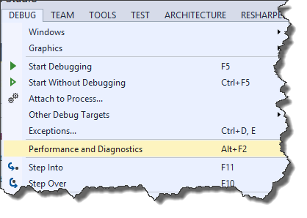
Visual Studio Performance and Diagnostics

Slide 6
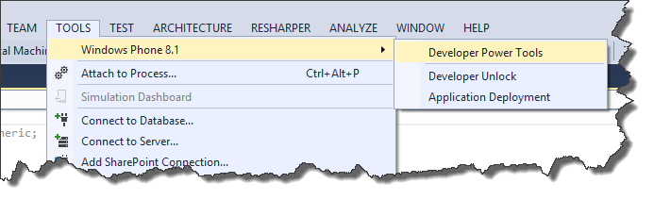
Windows Phone Developer Power Tools (8.1)

Slide 7
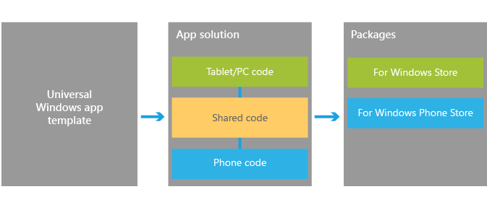
What is a Universal App
Sharing Code Across All Windows Desktop, Store and Phone Platforms, the Universe is Mine!
Notes:
Windows 10 convergence
This excites me the most about the coming years. I think MS kind of got lost when the released Vista and it flopped hard. Windows 7 and 8 were both steps getting us to 8.1. I really feel 8.1 is the major milestone to getting them back on track.
Currently Store and phone are supported and the roadmaps that have been talked about say that Xbox will also be in the list of packages you can create.
Develop once for all Windows devices using a unified Windows runtime and VS tools that allow you to both support experiences unique to a device in XAML, HTML, and DirectX, and share the code that supports those experiences across all devices using C++, C#, or JavaScript. When your work is finished you can you can produce the app packages that you will submit to the Windows Store and Windows Phone Store with a single action to get your app out to customers on any Windows device.
In terms of the Store experience, customers will benefit from an app identity shared across the Windows Store and the Windows Phone Store. Shared identity means that if they purchase your app from the Windows Store, they are capable of installing it on a device from the Windows Phone Store using the same Microsoft account without having to purchase the app again. Optionally, this can also include things like in-app purchases.
To get you started, the following sections will identify key upgrade paths, migration paths, and other critical resources that will help you bring your ideas to the converged Windows 8.1 platform. For more information on universal Windows apps and context on Microsoft’s vision for developer opportunity on Windows devices, please see our blog post Introducing universal Windows apps.

Slide 8
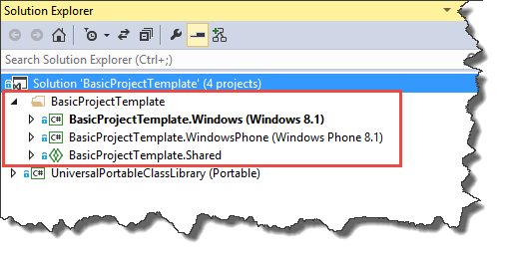
Demo 1 - Parts of the universal app
Notes:
Universal app is made up of 3 parts, the Windows Store project, the Windows Phone project, and the shared project.

Slide 9
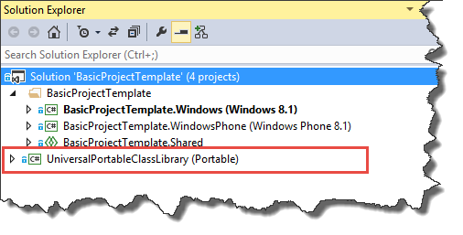
Demo 2 - Parts of the universal app
Notes:
Universal app is made up of 3 parts, the Windows Store project, the Windows Phone project, and the shared project.

Slide 10
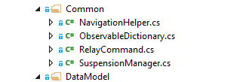
Helpers that come for free

Slide 11
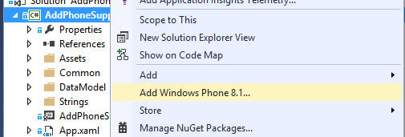
Add phone support existing store app
Notes:
Demo adding phone suport

Slide 12
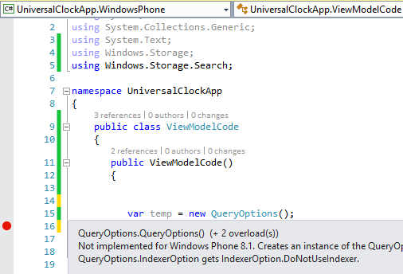
Another Thing to watch out for
#if WINDOWS_APP
var temp = new QueryOptions();
#endif
Notes:
Demo!
Be careful trusting intelisense. In store and phone apps there are cases where a class is valid for store but not phone and there is nothing in intelisense to warn you if phone is not supported.
Strongly agree here, it's confusing because you never know for sure when an API you use will blow up on either platform, unless you try it out (or read the docs, TBH). One of such examples is in Windows.Storage namespace:
KnownFolders.MediaServerDevices exists on both platforms, but using it in Windows Phone would blow up "unexpectedly".
On the other hand, ApplicationData.Current.LocalCacheFolder exists only on Windows Phone and you can't compile a Store project until you #ifdef it out.
Both APIs return a StorageFolder so it's not like they are completely different things. Hiding unsupported APIs would make this work much more transparently for developers...

Slide 13
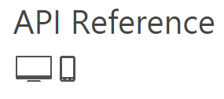
Where are we with feature parity
Minimum supported client | Windows 8 [Windows Store apps, desktop apps]
Minimum supported server | Windows Server 2012 [Windows Store apps, desktop apps]
Minimum supported phone | Windows Phone 8.1 [Windows Phone Silverlight 8.1 and Windows Runtime apps]
Namespace | Windows.Media.CaptureWindows::Media::Capture [C++]
Metadata | Windows.winmd
Capabilities | webcammicrophone
Notes:
Demo here show msdn page
Where are we with feature parity
What I have found is that we are really close on feature parity between universals 8.1 store and phone and then Silverlight 8.1 apps but not completely there.
http://msdn.microsoft.com/library/
http://msdn.microsoft.com/en-us/library/windows/apps/xaml/windows.media.capture.mediacapture.aspx
http://msdn.microsoft.com/en-us/library/windows.phone.media.capture.aspx
http://msdn.microsoft.com/en-us/library/windows/apps/xaml/windows.applicationmodel.package.aspx

Slide 14
Where are we with feature parity
Minimum supported client | None supported
Minimum supported server | None supported
Minimum supported phone | Windows Phone 8
End of phone support | Windows Phone 8.1 [Windows Phone Silverlight 8.1 apps only]
Namespace | Windows.Phone.Media.CaptureWindows::Phone::Media::Capture [C++]
Metadata | Windows.winmd
Notes:
Where are we with feature parity
What I have found is that we are really close on feature parity between universals 8.1 store and phone and then Silverlight 8.1 apps but not completely there.
http://msdn.microsoft.com/library/
http://msdn.microsoft.com/en-us/library/windows.phone.media.capture.aspx
http://msdn.microsoft.com/en-us/library/windows/apps/xaml/windows.applicationmodel.package.aspx

Slide 15
Keys to making cross platform app
Decoupled code!
Follow Solid princples
Using good development patterns

Slide 16
MVVM Pattern
MVVM Light
Prism
MvvmCross
Catel.MVVM
Caliburn.Micro
http://nugetmusthaves.com/Tag/MVVM
Notes:
Xamarin

Slide 17
Portable Class Libraries
Portable class libraries can be used and can share some classes but you have to be careful. In addition to .Net versions, how phone actually work is different table. The PCL will support the lowest common denominator.
So if you select .Net 4.0 then you can create a pcl that will work in an 8.1 application but only supports feature available for .Net 4.0 and Phone 8.0.

Slide 18
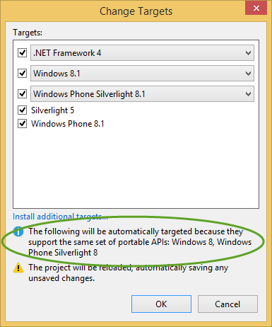
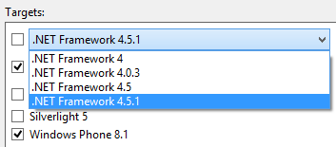
PCL Support

Slide 19
Examples
IValueConverter – Xaml is a mess between versions of .net and platforms.
Windows phone and store use an IValueConverter defined below
But WPF and Silverlight phone is defined this way
Notes:
WPF, Silverlight,
http://msdn.microsoft.com/en-us/library/system.windows.data.ivalueconverter(v=vs.110).aspx
Windows Store, phone documentation
http://msdn.microsoft.com/en-US/library/windows/apps/windows.ui.xaml.data.ivalueconverter.aspx
IValueConverter – Xaml is a mess between versions of .net and platforms.
Windows phone and store use an IValueConverter defined below
object Convert(object value, Type targetType, object parameter, string language);
object ConvertBack(object value, Type targetType, object parameter, string language);
But WPF and Silverlight phone is defined this way
object Convert(object value, Type targetType, object parameter, CultureInfo culture);
object ConvertBack(object value, Type targetType, object parameter, CultureInfo culture);
Obviously, the CultureInfo has changed in future versions of Xaml. This does make sense from the stand point of originally, I am sure the designers were thinking that you would only use a converter to change text around. But with the way binding works in Xaml you can use converters for all kinds of things like changing bool to Visibility or maybe the color of the text. In these cases, language really has no relevance to it is a useless parameter.
Also, CultureInfo was added in .Net 4.5 so what if we have conversion logic that is already being used in .Net 4.0?
And should you be able to create a portable class library or a normal class library that is common between WPF and Silverlight Phone?

Slide 20
View Model Locator

