Slide 1
Public Key Distribution
Manavjeet Singh (2018295) & Rhythm Gupta (2018082)

Slide 2
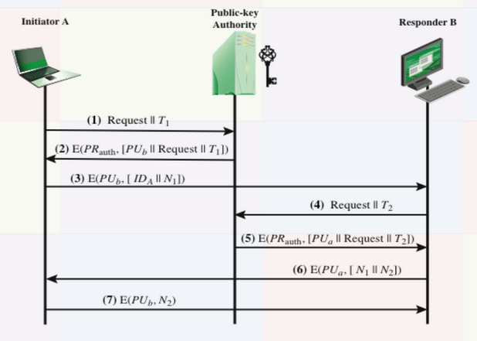
Information available with PKDA, A and B
pkda_keyInfo
K_{Pub}A , K_{Pub}B, K_{Pri}PKDA
a_keyInfo
K_{Pri}A, K_{Pub}PKDA
b_keyInfo
K_{Pri}B, K_{Pub}PKDA

Slide 3
A asking for K_{Pub}B
Request = ID_{B}
T1 = Current time encoded in hexadecimal

Slide 4
PKDA response
PU_{B} -> Public Key corresponding to received ID
Send E(PU_{B} | Request from A) with PR_{pkda} using RSA algorithm
a_keyInfo
K_{Pri}A, K_{Pub}PKDA

Slide 5
A prompts B for a connection
Decrypt message from PKDA using public key of PKDA to get public key of B,
N1 is a randomly generated nonce
Message to B encrypted with B’s public key

Slide 6
B asking for K_{Pub}A
Decrypted message from A to get its ID.
Requests PKDA for public key of A in same format as discussed earlier
T2 : Current Time

Slide 7
Reply from PKDA
PU_{B} -> Public Key corresponding to received ID
Send E(PU_{B} | Request from B) with PR_{pkda} using RSA algorithm
Decrypted message from A to get its ID.
Requests PKDA for public key of A in same format as discussed earlier
T2 : Current Time

Slide 8
Authentication and Further Communication
Now that both A and B have received each other’s public key, both authenticate each other and start further communication
N2 is a randomly generated nonce

Slide 9
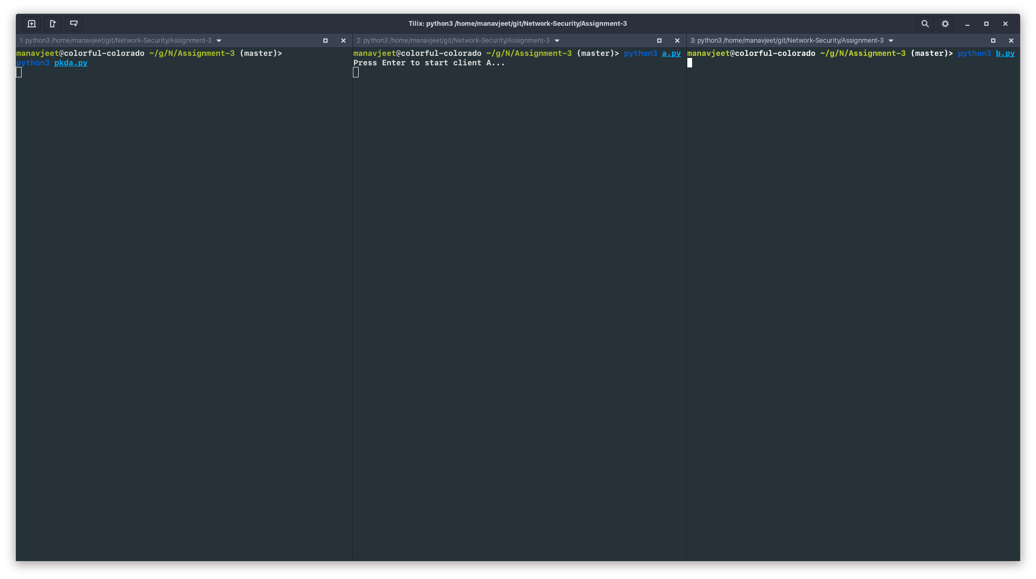
Running Example
Run pkda.py, a.py and b.py one by one

Slide 10
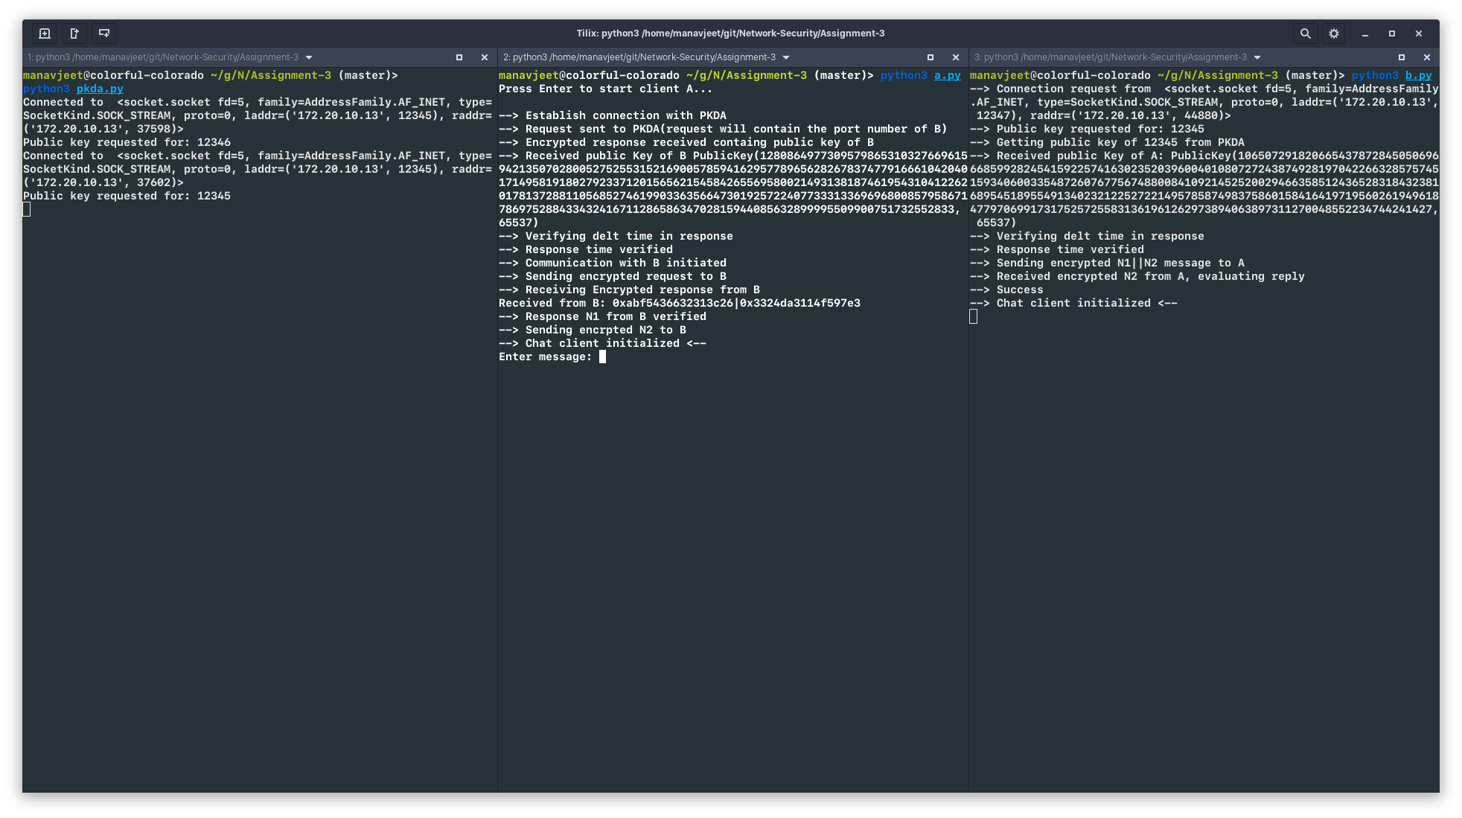
Running Example
Press enter on a.py to initiate the connection as described in figures above.

Slide 11
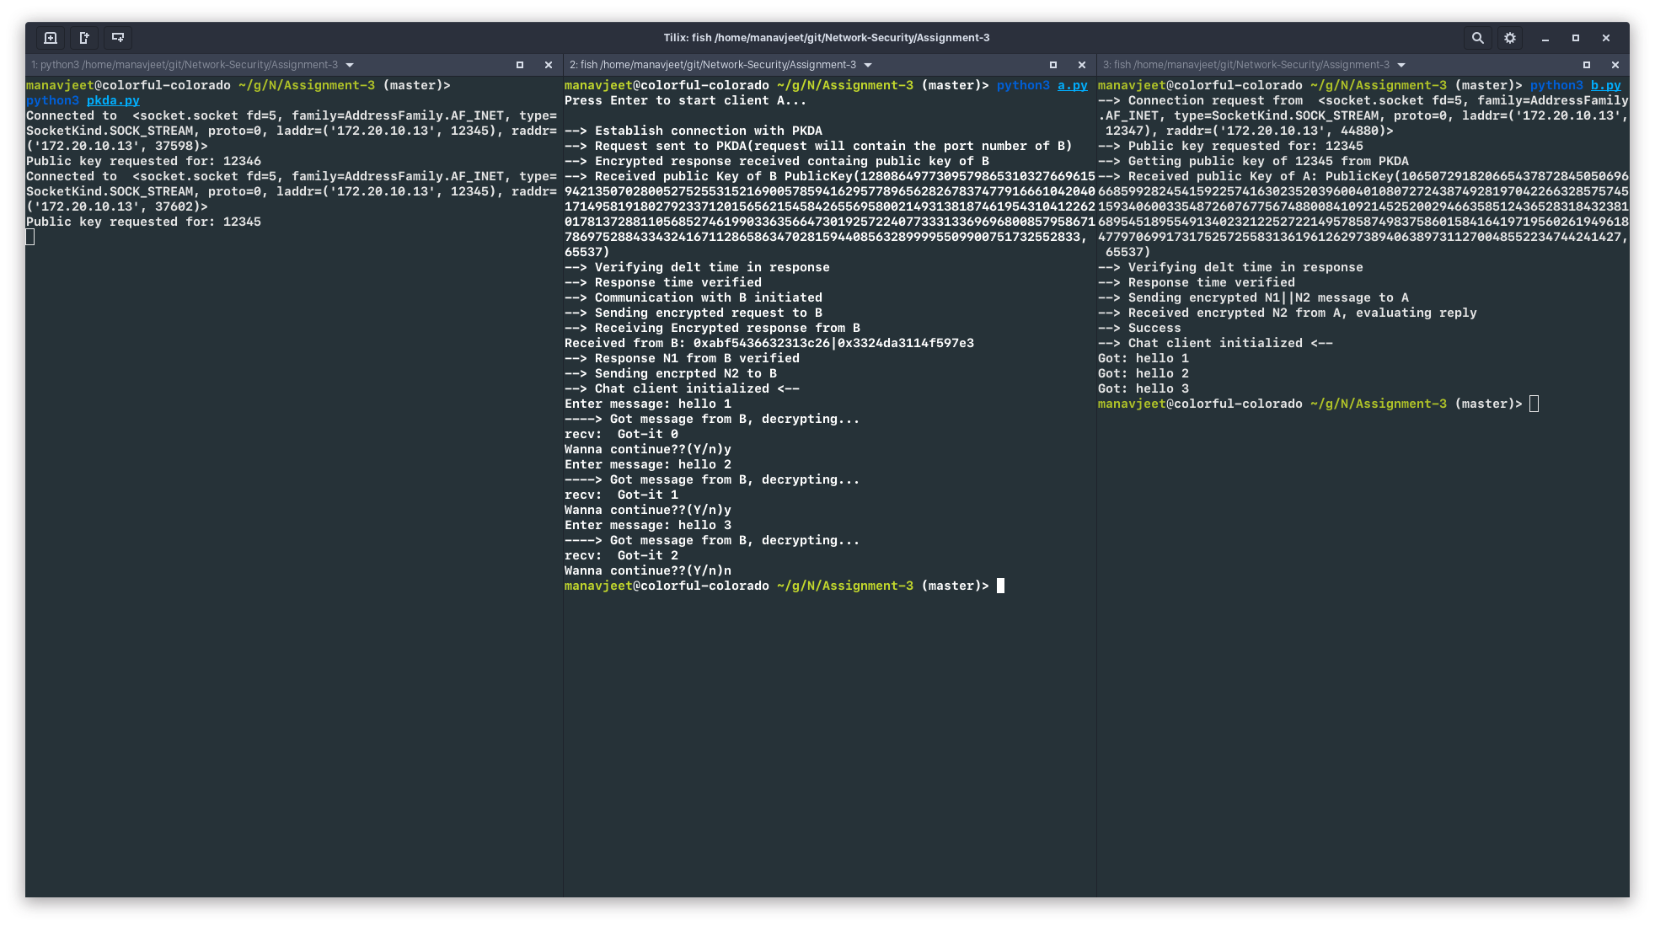
Running Example
Chat client is initiated after A and B know each others public keys.
Enter messages you want to pass between them.

