Slide 1
Advanced Encryption Standard
Manavjeet Singh(2018295)
Rhythm Gupta(2018082)

Slide 2
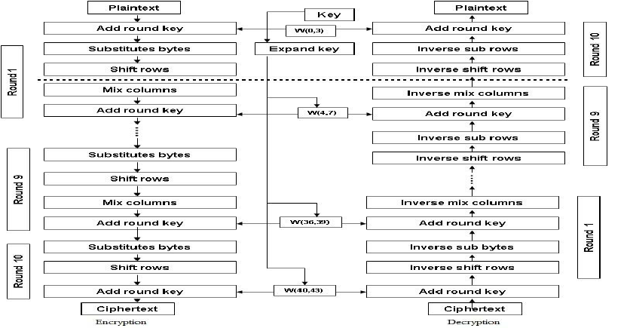
Advanced Encryption Standard (AES)
Symmetric key block cipher
Works on fixed length plaintexts and key
Based on multiple rounds of substitution and permutation
Published in 2001
Used worldwide for several critical applications

Slide 3
External Libraries Used
Bitarray : For storing 128 bit plaintext / key and efficiently carrying out bit-level operations.
Pyfinite : For carrying out multiplications in GF (2^8)
Installation:
Pip3 install bitarray
Pip3 install pyfinite

Slide 4
Executing Encryption and Decryption
Input file
Create an ASCII text file following the given format
First line of a file is the key and,
Second line is the Plaintext/Ciphertext
Should be saved the same folder as ‘main.py’.
Running
Execute ‘python3 main.py’
Enter the name of the file you need to import
Input 1 to encrypt and 2 to decrypt.

Slide 5
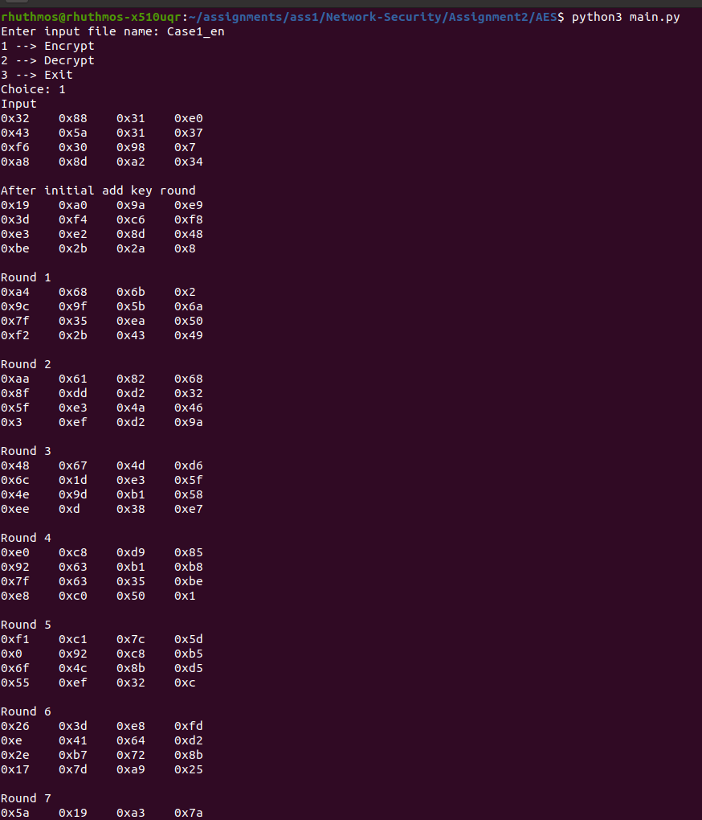
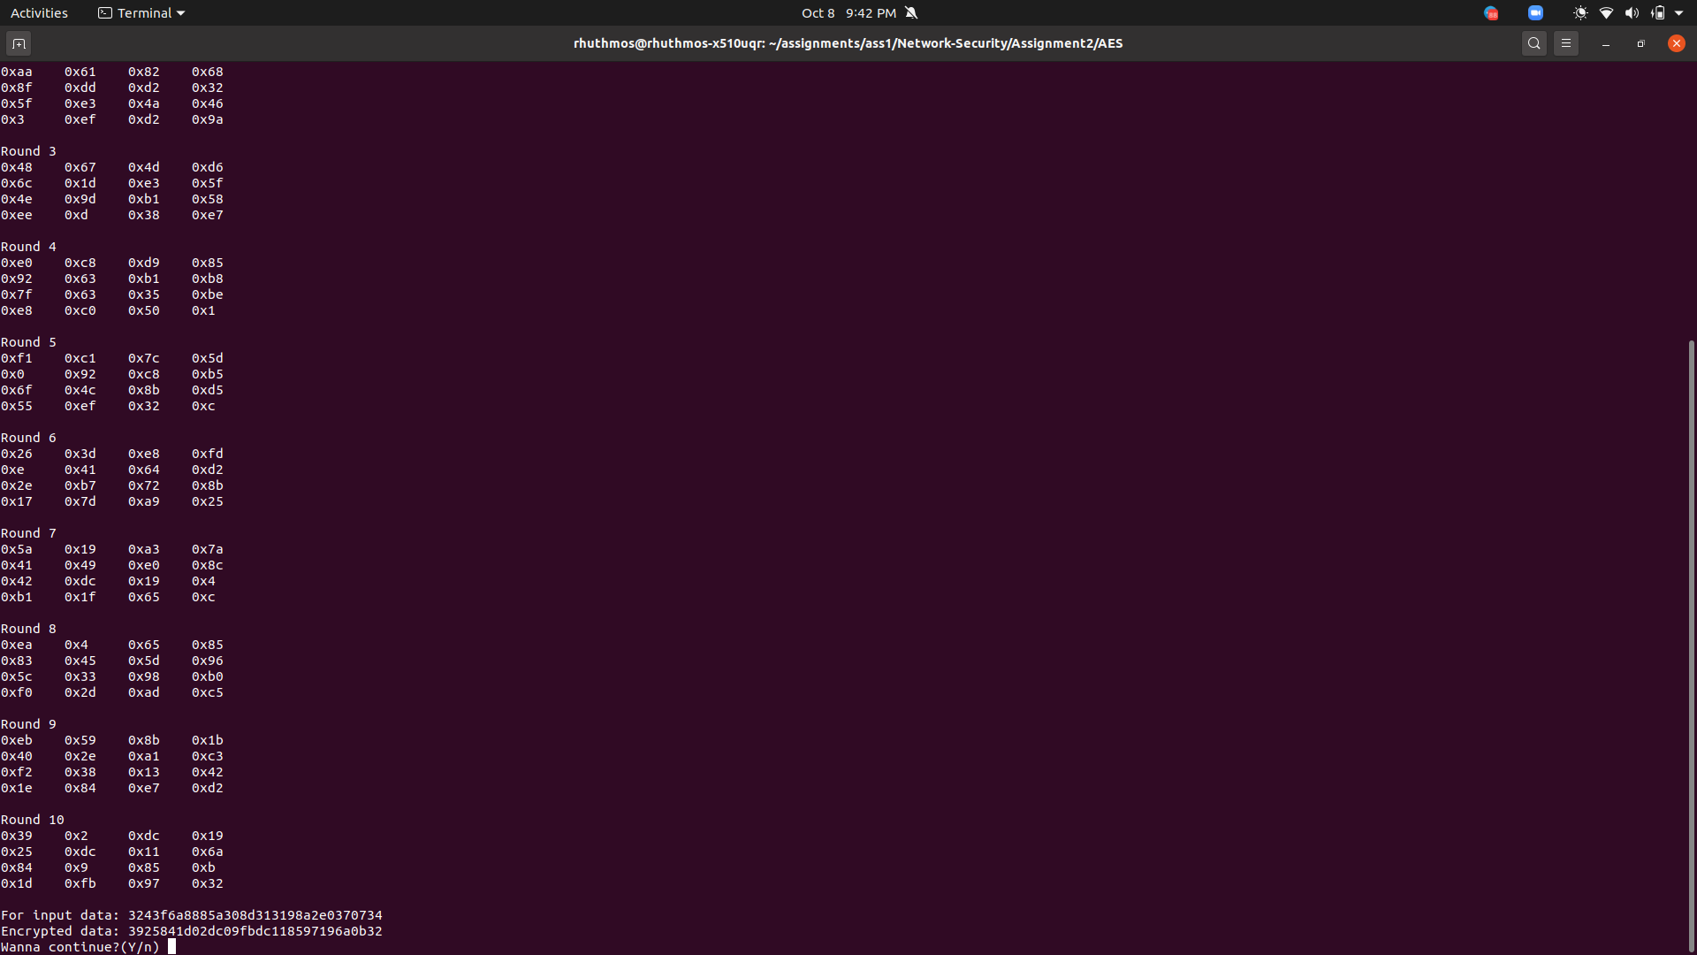
Working Example
Encryption

Slide 6
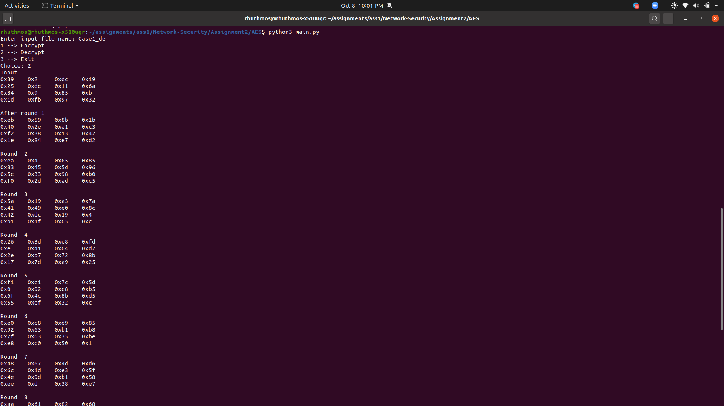
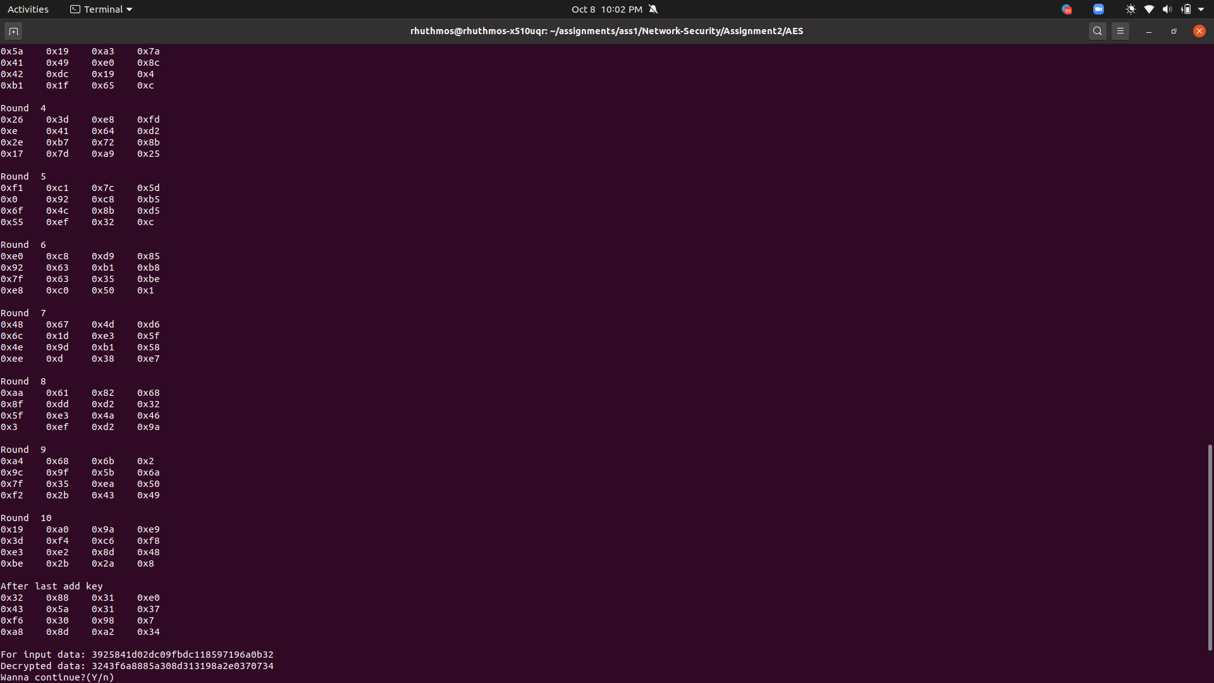
Working Example
Decryption

Slide 7
Round comparisons
Output of encryption round i and decryption round 10-i

