Slide 1
Discrete event simulation

Slide 2
Summary
Intro
Simulating parallelism
Simulating time
Simulating events
Simulating randomness
Simulating communication
Exercises
PyDESK Demo

Slide 3
Simulation
Simulation is the imitation of the behavior of a real-world system over time.(Wikipedia)
BEHAVIOR
TIME

Slide 4
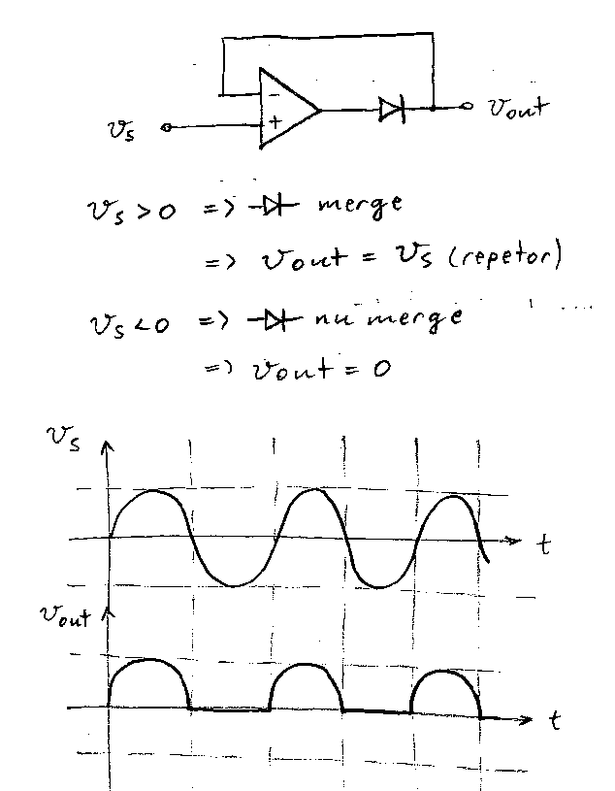
Pen and Paper Simulation
Simple systems can be simulated on paper

Slide 5
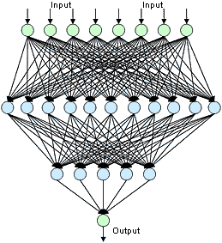
Complex systems
Complex systems require lots of paper

Slide 6

Complex systems
Too much paper

Slide 7
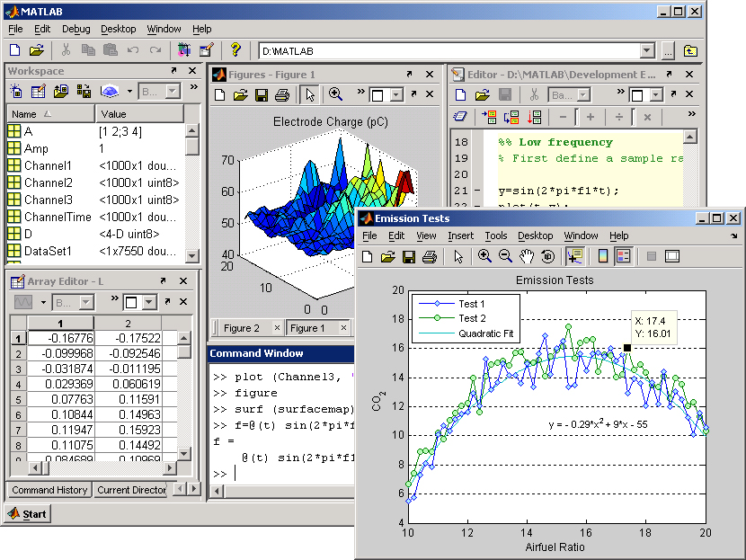
Computer simulation

Slide 8
Types of simulation
Agent based modeling
Process based simulation
Mathematical modeling
Continuous simulation(system dynamics)
Discrete Event Simulation
etc.

Slide 9
Discrete event simulation
The behavior of a system is represented as a chronological sequence of events
time

Slide 10
Requirements for DES software
Simulation output must derive ONLY from the initial conditions
No input from the real world is allowed during simulation
Simulation output should be the same for identical initial conditions
Discrete event simulation is a deterministic process

Slide 11
DES concerns
Simulating parallelism
Simulating time
Simulating discrete events
Simulating randomness
Simulating communication

Slide 12
Simulating parallelism
Parallelism is a form of computation in which many calculations are carried out simultaneously

Slide 13
Ideal case
uP1
P1
uP2
P2
uP3
P3
...
uPn
Pn

Slide 14
Real world
N_of_p >> N_of_up
uP1
P1
uP2
P2
P3
...
Pn

Slide 15
Context switch
N_of_up = 1
P1
P2
P3
...
Pn

Slide 16
Context switch
N_of_up = 2
P1
P2
P3
...
Pn

Slide 17
Process scheduling
Process scheduler
P2
P3
...
Pn

Slide 18
Process scheduling(2)
There are two types of process scheduling:
  Preemptive scheduling(preemption)
  Non-preemptive scheduling(cooperative scheduling)

Slide 19
Preemptive scheduling
The process scheduler forces other processes to pause execution and make a context switch
Process scheduler
P2
P3
...
Pn

Slide 20
Preemptive scheduling
Pros
  Fast response time for processes that need the CPU
  Scalability
  Processes waiting for I/O responses don't block other processes
Cons
  Race conditions
  Threads can't run continuously(at full speed) because they are always being forced out of context asynchronously

Slide 21
Non-preemptive scheduling
The process scheduler forces other processes to pause execution and make a context switch
Process scheduler
P2
P3
...
Pn

Slide 22
Non-preemptive scheduling
Pros
  No race conditions
  Processes can run at full speed(almost)
Cons
  Not scalable
  High response time from processes that change context too seldom
  Processes waiting for I/O block other processes
  Only one process can run at a time. Can't leverage the advantages of multi-core architectures

Slide 23
Threads vs. Processes
Processes don't share the same context(memory space, CPU register values, stack, etc.)
Threads share the same context
Multiple threads can run within a process
Multiple threads can run within a thread
P1
P2
P1
T1
T2

Slide 24
What the OS uses
Most modern OSs use preemptive scheduling
Linux Kernel
if(need_resched() )
schedule();
P2
P3
...
Pn

Slide 25
What Linux uses
Linux uses preemptive scheduling in both kernel mode and user mode
To create new processes fork() is used
To create new threads pthread_create() from the pthread library can be used(it's included in glibc)
Both fork and pthread_create use the clone() system call
All preemtive multithreading libraries that run in Linux(e.g. Java) end up using clone()

Slide 26
What Linux uses
To create new processes fork() is used
childPID = fork();
if(childPID >= 0) // fork was successful
{
if(childPID == 0) // child process
{
var_lcl++;
var_glb++;
printf("\n Child Process :: var_lcl = [%d], var_glb[%d]\n", var_lcl, var_glb);
}
else //Parent process
{
var_lcl = 10;
var_glb = 20;
printf("\n Parent process :: var_lcl = [%d], var_glb[%d]\n", var_lcl, var_glb);
}
}
else // fork failed
{
printf("\n Fork failed, quitting!!!!!!\n");
return 1;
}

Slide 27
What Linux uses
To create new threads pthread_create() from the pthread library can be used(it's included in glibc)
#include <iostream.h>
#include <pthread.h>
#include <stdlib.h>
void *task(void *arg) {
for (;;) {
cout << (char *)arg;
cout.flush();
}
return NULL;
}
int main() {
pthread_t t1;
if ( pthread_create(&t1, NULL, task, (void *)"1") != 0 ) {
cout << "pthread_create() error" << endl;
abort();
}
task((void *)"2");
}

Slide 28
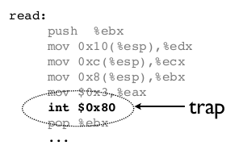
System calls
Processes can make “system calls” to

Slide 29
System calls
fork(), pthread and all other preemptive multithreading libraries(e.g. Java, Qt, etc.) use the clone() system call to create a child process
The clone() system call allows programmers to use preemptive scheduling

Slide 30
Race conditions
Interleaved actions(race conditions)
Thread 1
Thread 2
X = ???
f(x)
int x = 0;
g(x)
Sollution : Mutexes
or Semaphores

Slide 31
Execution order
Unpredictable execution order
Thread 1
Thread 2
“f got x”
“g got x”
Who gets to x first?
f(x)
int x = 0;
g(x)

Slide 32
Problem
There is no way of anticipating when system calls are executed
There is no way of anticipating when processes/threads are being forced out of context
When threads access resources concurrently race conditions can occur
Conclusion1 : preemption causes uncertainty
Conclusion2 : preemption is bad for determinism
Conclusion2 : preemption is bad for DES

Slide 33
Problem(2)
Preemption is used for performance and scalability
It's done at the expense of precision and predictability
Linux Kernel
P2
P3
...
Pn

Slide 34
Coroutines
Coroutines are subroutines which allow multiple entry points for suspending and resuming execution at certain locations
Coroutines can be seen as high-level cooperative threads
C1
C2
C3
...
Cn

Slide 35
Coroutines in Python
Coroutines are features of certain programming languages(they are not managed by the OS)
def my_coroutine():
print “Step1”
yield 1
print “Step2”
yield 2
print “Step3”
yield 3
print “Step 4”
def main():
mc = my_coroutine()
for i in range(3):
x=mc.next()
print x
Step1
1
Step2
2
Step3
3
Step4
output:

Slide 36
Simulating threads
Coroutines can be used to simulate threads
def thread1():
print “thread1 : Step1”
yield
print “thread1 : Step2”
def thread2():
print “thread2 : Step1”
yield
print “thread2 : Step2”
t1 = thread1()
t2 = thread2()
t1.next()
t2.next()
t1.next()
t2.next()
output:
thread1 : Step1
thread2 : Step1
thread1 : Step2
thread2 : Step2

Slide 37
Simulating threads
Coroutines can be used to simulate threads
def evaluate():
for t in threads:
t.next()
def simulate():
while True:
evaluate()

Slide 38
Simulating threads
Iterative evaluation
C1
C2
C3

Slide 39
Simulating threads
Shuffled iterative evaluation
def evaluate():
threads.shuffle()
for t in threads:
t.next()
C1
C2
C3

Slide 40
Problem
Iterative evaluations run in a single OS preemptive thread
They can't leverage the advantages of multi-core architectures
Simulations can become very slow
Using preemption can destroy determinism
Solution: use preemption but with care
Make sure that no race conditions will occur

Slide 41

Problem
Make sure that the preempted code segments respect Bernstein's conditions:
  Let P_{i} and P_{j} be two program segments with inputs I_{i} and I_{j} and outputs O_{i} and O_{j}
  P_{i} and P_{j} can be executed in parallel if:

Slide 42
Simulating threads
def evaluate():
for t in threads:
start t.next()
for t in threads:
join t
Preemptive evaluation
C1
C2
C3

Slide 43
Questions?
Specman uses iterative evaluation??
SystemVerilog uses preemptive evaluation???
OSCI SystemC uses preemptive evaluation?

Slide 44
SV example
int v[5] = {1,2,3,4,5};
for(int i=0;i<4;i++) begin
$display("Starting thread %d",i);
fork
begin
$display("v[%d]=%d",i,v[i]);
#1;
end
join_none
end
v[4]=5
v[4]=5
v[4]=5
v[4]=5
v[4]=5

Slide 45
Questions?
Specman uses iterative evaluation
SystemVerilog uses preemptive evaluation???
OSCI SystemC uses preemptive evaluation

Slide 46
Questions?
Specman uses iterative evaluation
SystemVerilog uses preemptive evaluation???
OSCI SystemC uses preemptive evaluation

Slide 47
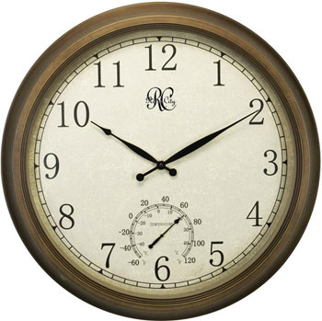
Simulating time
Wall clock time is the human perception of the passage of time
Thread.currentThread().sleep(1000);//sleep for 1000 ms

Slide 48

Simulating time
Simulated time
wait(1000 ms);
<=>
simulation_time+=1000 ms;

Slide 49
Simulating time
Simulated time
wait(1000 years);
<=>
simulation_time+=1000 years;
We make it look as if 1000 years have passed
Simulation time can pass faster or slower than wall clock time depending on how long it takes the simulator to advance the simulation time

Slide 50
Applications
Financial models – they work with large periods of time(days, months, years)
Digital system models – they work with small periods of time(ms, ns, ps, fs)

Slide 51
Simultaneity
Thread 1
Thread 2
t=0s
f(x)
g(x)
t=15s

Slide 52
Simultaneity
With native threads and real time: possible on multi-core/multi-processor architectures but very unlikely(impossible in practice)
With coroutines and simulated time: we can make it look as if it happens :-)
def thread1():
  wait(1s)
  action1()
def thread2():
  wait(1s)
  action2()

Slide 53
Time over multiple threads
Many threads – one global time counter
How do we update it?
def thread1():
  wait(1s)
  action1()
  wait(3s)
def thread2():
  wait(10s)
  action2()
  wait(1s)
def thread3():
  wait(3s)
  action3()
  wait(5s)
The Simulator updates the simulation time not the threads
Threads must pass control to the Simulator when they want to consume time

Slide 54
Example
def thread1():
  wait(1s)
  action1()
  wait(3s)
def thread2():
  wait(10s)
  action2()
  wait(1s)
def thread3():
  wait(3s)
  action3()
  wait(5s)
0s
1s
3s
4s
8s
10s
11s
GTC
w1s
w3s
w1s
END
a1
T1
w10s
w9s
w7s
w6s
w2s
w1s
END
a2
T2
w3s
w2s
w5s
4ws
END
a3
T3

Slide 55
Time over multiple threads
def update():
  min_time = minimum time waited by all threads
  global_time_counter += min_time
  for each thread in threads_that_wait_time:
    if time_waited[thread] == min_time:
      schedule_resume(thread)
    else:
      time_waited[thread] -= min_time

Slide 56
Time over multiple threads
def evaluate():
  for each thread in threads:
    if thread is scheduled for resumption:
      resume(thread)

Slide 57
Delta cycle
Evaluate
Update

Slide 58

Simulation algorithm
def simulate():
  while not all threads finished:
    evaluate()
    update()

Slide 59
Simulating events
Emitting events
Waiting on events
Event callbacks
Events over multiple threads

Slide 60
Simulating events
What is an event?
It is a message indicating that something has happened
Button pressed
Door open
Door closed
time

Slide 61
Using events
Events can be emitted
x = 0
emit(x_has_been_reset)
Events can be waited on
wait(x_has_been_reset)
do_something_with(x)

Slide 62
Event callbacks
Events can trigger actions(callbacks)
on(x_has_been_reset):
  do_something()

Slide 63
Events over multiple threads
Events are emitted and waited over multiple threads
How do we simulate them?
def thread1():
  action1()
  emit(ev1)
def thread2():
  wait(ev1)
  action2()

Slide 64
How emit works
Events can have 2 states : emitted, idle
Emit does not suspend thread execution
Emit does not consume time
def emit(event):
  sk.event_states[event] = emitted

Slide 65
How emit works
Emits are resolved during the evaluation phase
def evaluate():
  for each thread in threads:
    if thread is scheduled for resumption:
      resume(thread) # this is where emits might be called

Slide 66
How wait works
Waits are resolved during the update phase
Waits suspend thread executions
Waits might consume time
def update():
  # time management code ...
  for each thread in threads_that_wait_events:
    if events_waited[thread].state == emitted:
      schedule_resume(thread)

Slide 67
Simple example
def thread1():
  action1()
  emit(ev1)
def thread2():
  wait(ev1)
  action2()
Evaluate: action1() is executed
Evaluate: ev1 is emitted
Evaluate: thread2 is suspended waiting for e1
Update: thread1 is marked as finished
Update: thread2 is scheduled for resumption
Evaluate: thread2 is resumed, action2() is executed
Update: thread2 is marked as finished
Evaluate: all threads are finished, simulation ends
END
a1
->ev1
T1
wev1
END
a2
T2

Slide 68
Temporal expressions
event my_ev is {e1,10s,2*e2,1s,e3}
e1
10s
e2
1s
e3
my_ev

Slide 69
Temporal assertions
assert e1 => {[5s..10s],2*e2,1s,e3}
e1
7s
e2
1s
e3
Assertion evaluation starts
Assertion passed

Slide 70
Temporal assertions
assert e1 => {[5s..10s],2*e2,1s,e3}
e1
7s
e2
1s
e3
Assertion evaluation starts
Assertion passed

Slide 71
Simulating randomness
We must use pseudo-randomization
We must set an initial seed which will guarantee us that the sequence of generated random numbers will be the same every time we rerun the simulation with the same seed
set_seed(16182)
for i from 1 to 10:
  x=rand()
  print x

Slide 72
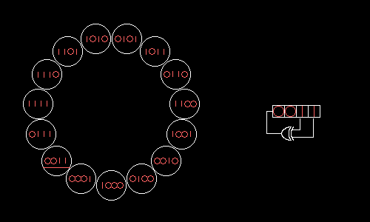
Pseudo randomness
Linear feedback shift registers

Slide 73
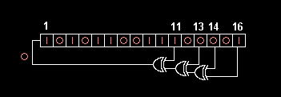
Pseudo randomness
Linear feedback shift registers

Slide 74
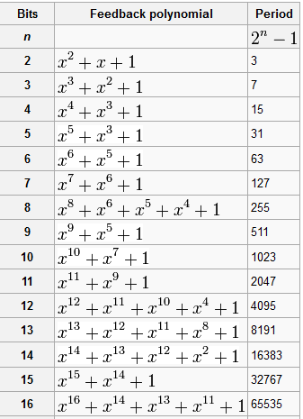
Pseudo randomness
Polynomials for maximal LFSRs

Slide 75
Constrained randomization
Requires a constraint solver
struct my_struct_t {
  x:uint;
  y:uint;
  keep x+y==10;
  keep x !=7;
};
extend sys {
  s : my_struct_t;
  run() is also {
    gen s;
    print s;
  };
};

Slide 76
Boolean satisfiability
Let E(b₁,b₂,...,b_{n}) be a boolean expression
To satisfy E means to find a set of values for b_{i} so that E evaluates to True
SAT solvers = algorithms that find b_{i}

Slide 77
Boolean satisfiability
Restricted forms:
  3SAT : (a1 or b1 or c1) and (a2 or b2 or c2) and …
  2SAT : (a1 or b1) and (a2 or b2) and …
  Horn SAT :
    !a1 or !a2 or … or !an or b
    (a1 and a2 and … an) => b
  XOR SAT : (a1 xor b1) and … and (a2 xor b2)
  etc.
The solver tries to reduce constraints to these restricted forms

Slide 78
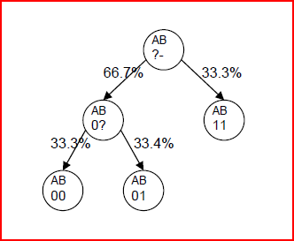
Boolean satisfiability
Example:
a:bit;
b:bit:
keep (a && b) || (!a) ;

Slide 79
Satisfiability Modulo Theories
It's decision problem for logical formulas with respect to combinations of background theories expressed in classical first-order logic with equality
a:int;
b:int:
keep (a>0 && b>0) || (a+b==-1) ;

Slide 80
Satisfiability Modulo Theories
The eager approach: translate arithmetic operations to boolean operations and use a SAT solver to generate solutions
  Disadvantage: SAT will work too hard to figure out “obvious” facts: e.g. x+y==y+x
T-solvers : theory specific solvers that handle conjunctions of predicates from other theories
  p(a1,b1) && p(a2,b2) && ...

Slide 81
Simulating Communication
Method ports
Reactive ports
Buffer ports

Slide 82
Method ports
They help propagate method calls
class Producer:
out_p = out_method_port()
class Consumer:
def in_p_iml(payload):
print payload
in_p = in_method_port(in_p_impl)
class Top:
prod = Producer()
cons = Consumer()
prod.out_p.connect(cons.in_p)
prod.out_p.transfer(“Hello”)

Slide 83
Reactive ports
They help propagate changes to variables
class Producer:
out_p = out_reactive_port()
class Consumer:
in_p = in_reactive_port()
class Top:
prod = Producer()
cons = Consumer()
prod.out_p.connect(cons.in_p)
prod.out_p <= 42
print cons.in_p.value # 42

Slide 84
Buffer ports
They help propagate values via FIFOs
class Producer:
out_p = out_buffer_port()
class Consumer:
in_p = in_buffer_port()
class Top:
prod = Producer()
cons = Consumer()
prod.out_p.connect(cons.in_p)
prod.out_p.put(42)
x = cons.in_p.get()
print x #42

Slide 85
Exercise
def T1():
  while true:
    wait(1s)
    emit(e1)
    a1()
def T2():
  for i from 1 to 2:
    wait(e1)
    a2()
  kill(T1)
  a3()
0s
1s
2s
3s
4s
Time
w1s
w1s
w1s
w1s
END
->e1
a1
->e1
a1
->e1
a1
T1
we1
we1
we1
a2
kill(T1)
a3
END
a2
T2

Slide 86
PyDESK
Discrete event simulator implemented in Python
Simulates parallelism using coroutines
Simulates time
Simulates events
Supports method ports
Supports blocking calls to threads

Slide 87
Applications
HDL Simulators
Virtual Platforms for early software development
Architectural exploration
Performance evaluation
Turn-based strategy games
Back-in-time debugging
Cause analysis
Business model simulation

Slide 88
Further reading
A Curious Course on Coroutines and Concurrency, David Beazley - http://dabeaz.com/coroutines/
Coroutines in C - http://www.chiark.greenend.org.uk/~sgtatham/coroutines.html
SAT - http://en.wikipedia.org/wiki/Boolean_satisfiability_problem
SMT - http://en.wikipedia.org/wiki/Satisfiability_Modulo_Theories

Slide 89
Questions and/or comments
THE END

