Slide 1



Whimson
International, Inc.
March 1, 2030
2:00 P.M.
Whimson International, Inc. Virtual Room
DIVERSITY IN
THE DIGITAL AGE
Ensuring diversity in the virtual workplace
Larissa Charter
VP of Human Resources
Zenith Central Bank
Audio descriptions available.

Slide 2


WORKSHOP REMINDERS
Please mute your microphone unless asked a question.
Turn on your cameras.
While waiting for others to come in, here are some rules and reminders to keep in mind.
Questions sent via the chatroom will be answered after each workshop segment.
2

Slide 3

WORKSHOP STRUCTURE
Our agenda this morning
What is diversity?
Benefits of workplace diversity.
The difference between diversity and inclusion.
Diversity and inclusion in virtual workplaces.
How diversity and inclusion drive company growth.
3

Slide 4



ABOUT ME
I have almost 30 years of experience in the HR industry.
I have seen companies succeed
and fail due to how they approached workplace diversity.
With Canva Presentations, you can collaborate in real-time with your teammates or co-presenters. Share tasks and work simultaneously to create a powerful presentation.
4

Slide 5
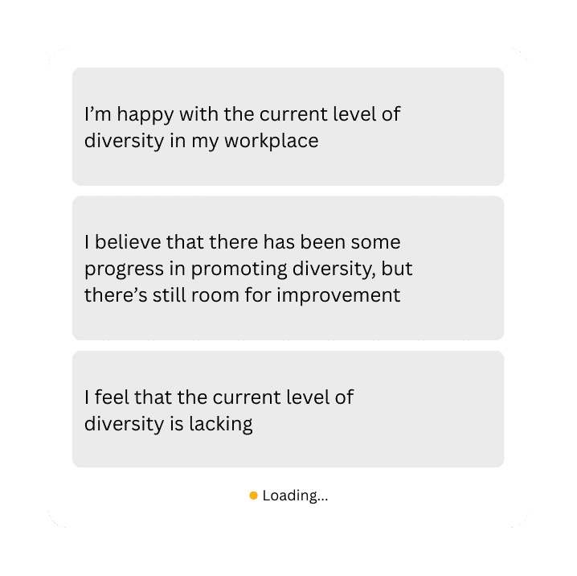

QUESTION ON DIVERSITY
How do you feel about the current level of diversity in your workplace?
NEXT
Tip: Double-click to customize this poll or quiz, or go to the Elements Tab for more options!
6

Slide 6


DIVERSITY
REFERS TO YOUR WORKFORCE
It means employing people from different walks of life.
Present with ease and wow any audience with Canva Presentations. Choose from over a thousand professionally-made templates to fit any objective or topic. Make it your own by customizing it with text and photos.
7

Slide 7

DIVERSITY
IS MORE
THAN RACE.
A diverse workplace includes not just other ethnicities but also different ages, sexual orientations, social standing, and abilities.
8

Slide 8


DIVERSITY HELPS YOU RETAIN TALENT.
Retaining talented employees results in better overall performance.
Present with ease and wow any audience with Canva Presentations. Choose from over a thousand professionally-made templates to fit any objective or topic. Make it your own by customizing it with text and photos.
9

Slide 9

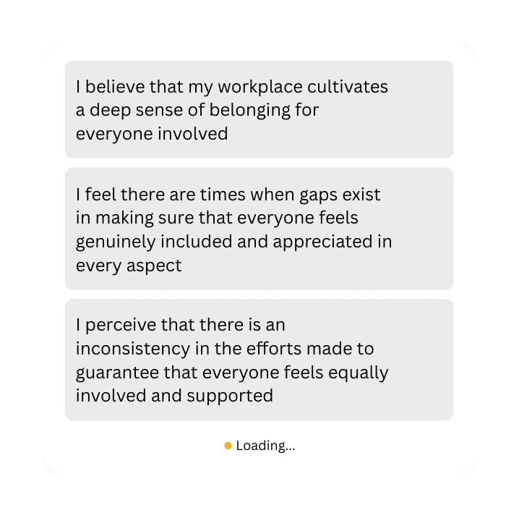

QUESTION ON INCLUSION
How do you feel about the current level of inclusion in your workplace?
NEXT
13

Slide 10

Many businesses focus solely on improving workplace diversity.
75%
fail to see the benefits of diversity because of a lack of inclusive practices
14

Slide 11




EMBRACING INCLUSION IN THE VIRTUAL WORKPLACE
Hear out your employees' needs and accommodate them.
Provide mental health resources and support.
Minimize cutting off speakers during meetings.
15

Slide 12
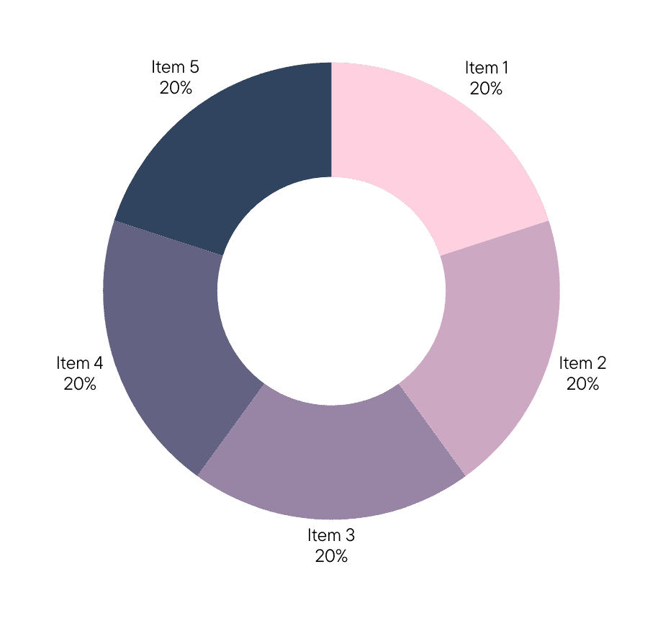
CONFRONTING UNCONSCIOUS BIAS
Awareness is the first step to addressing unconscious bias.
Here are some behaviors employees identified as showing biases and microaggressions.
Visualize complicated and dense information with graphs and charts. These are visual aids that help add more context to the topic you are discussing.
16

Slide 13
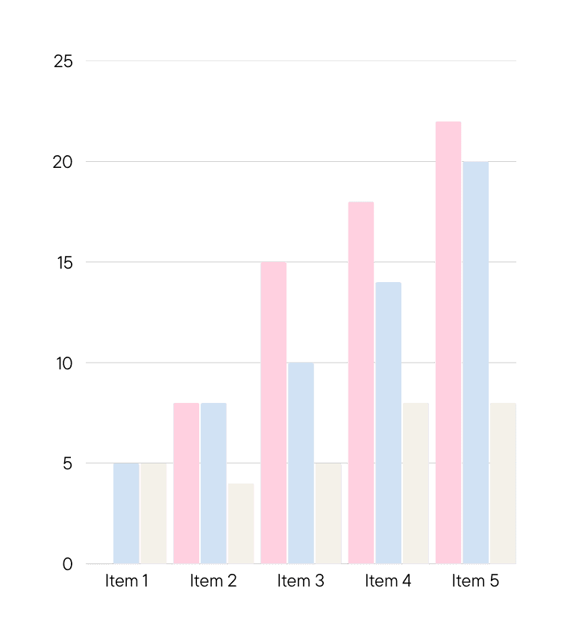
DRIVING GROWTH THROUGH D&I
Practicing diversity and inclusion increases talent retention, employee satisfaction, and productivity.
See how businesses have grown based on their commitment to diversity.
Visualize complicated and dense information with graphs and charts. These are visual aids that help add more context to the topic you are discussing.
17

Slide 14

HAVING A DIVERSE WORKFORCE IS JUST THE FIRST STEP.
Ensuring they feel that they belong and are heard is the next.
18

Slide 15





THE BOTTOMLINE
Diversity means having employees from different demographics.
Inclusion is making all of them feel welcome and included.
Diversity and inclusion raise productivity and satisfaction.
Workplace inclusion starts with addressing biases.
Ensuring virtual workplace diversity and inclusion is a group effort.
19

Slide 16

Whimson
International, Inc.
THANK YOU FOR LISTENING!
Feel free to send in any questions to hello@reallyrdesign.com.

