Slide 1

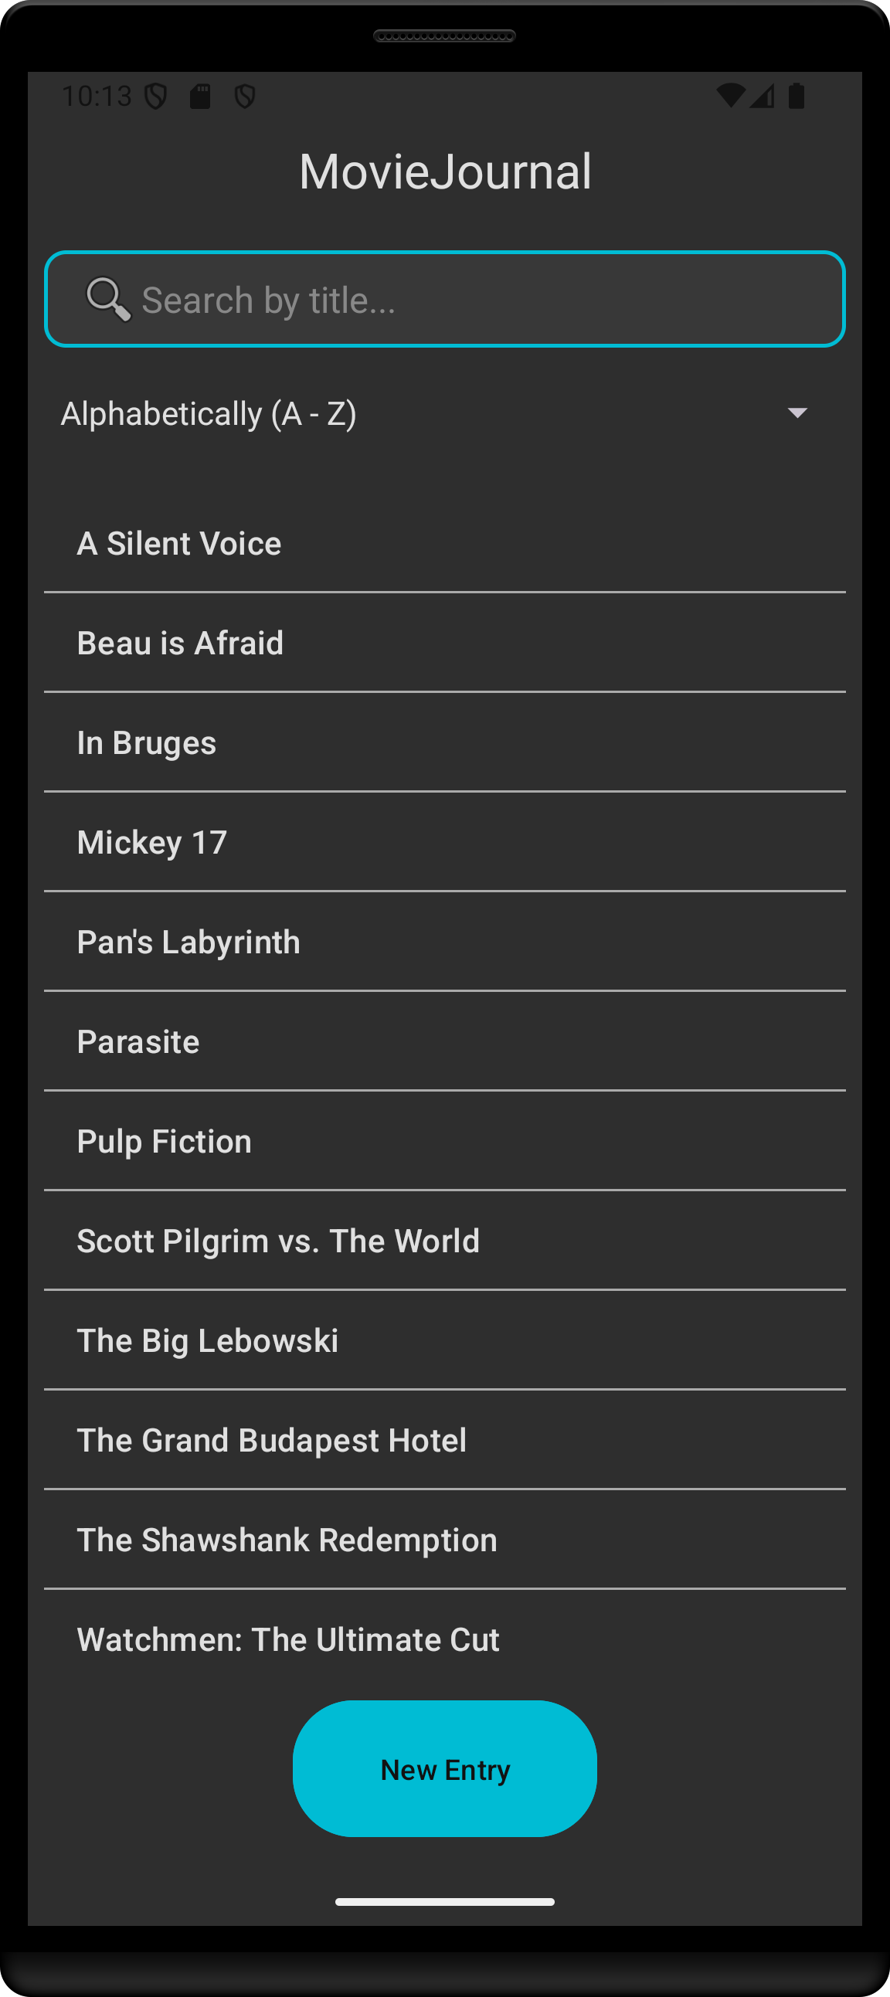




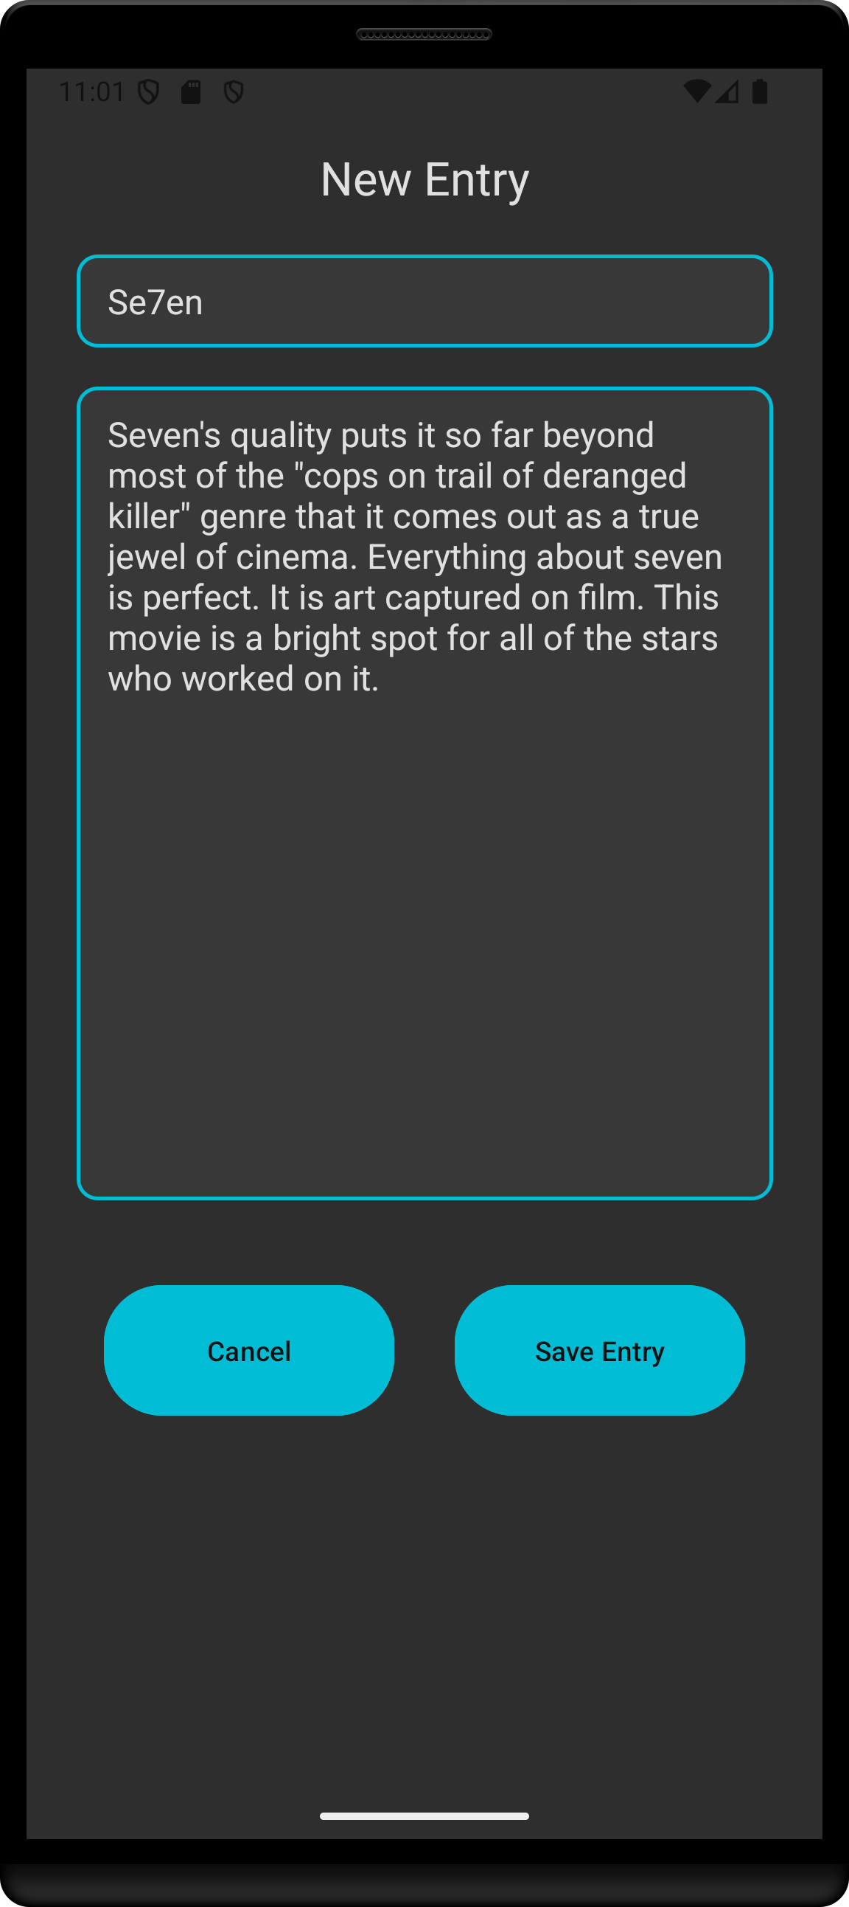
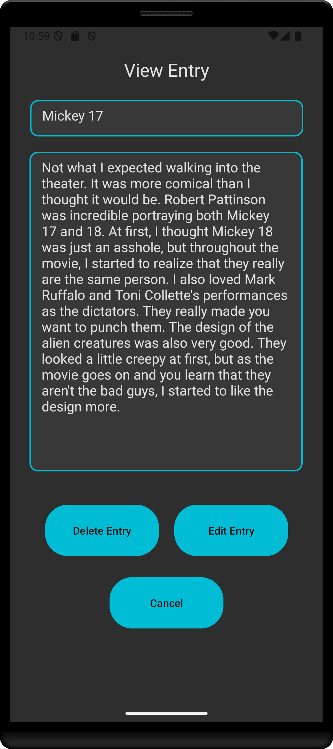
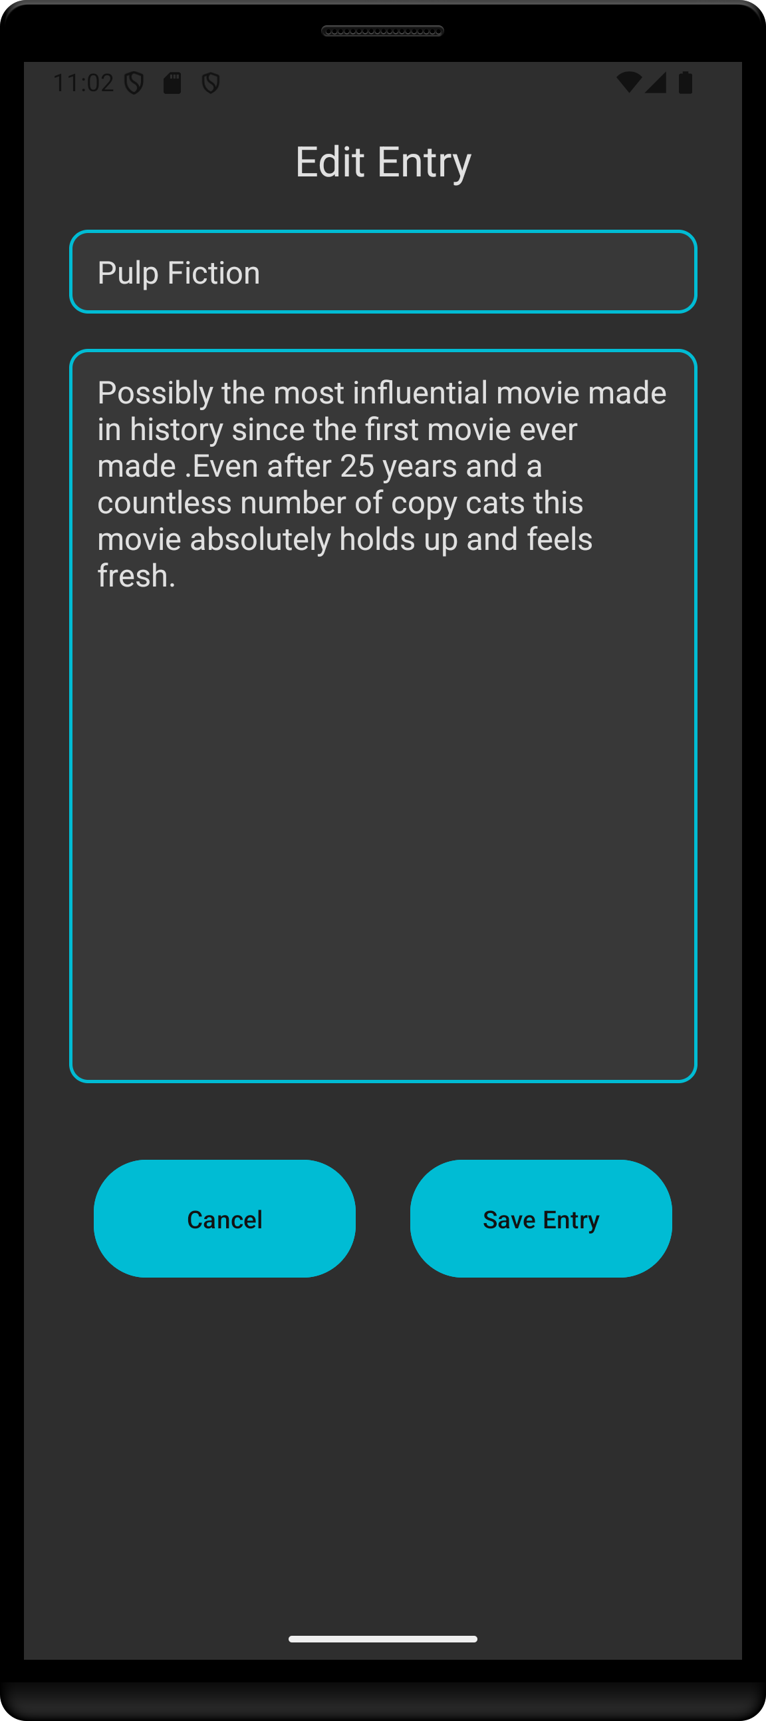

MovieJournal
Problem Statement
Most movie review apps focus on sharing opinions with others, often emphasizing a critical analysis of movies. However, there is no dedicated platform for users to privately log their personal thoughts and reflections on the movies they watch.
Our Solution
MovieJournal is a mobile application designed for individuals who want to keep a personal movie journal.
Unlike traditional movie reviewing platforms, MovieJournal shifts the focus from critique to personal reflection. Instead of rating movies as “good” or “bad”, users can explore how films make them feels, record their emotions, and develop a deeper appreciation for cinema.
An App for Movie Enjoyers
Key Features
Private Journal Entries – Securely log and revisit personal thoughts on movies.
Search & Filtering – Quickly find entries by title and sort by date or alphabetical order.
Minimalist Dark-Themed UI – Designed for an immersive and distraction-free experience.
SQLite Integration - Local database for storing journal entries without needing an internet connection.
Android Development – Build natively in Java with an intuitive mobile interface.
Technologies Used
Java – Core programming language for Android app development.
SQLite – Local database solution for offline storage.
Android SDK – Framework for UI design and system interactions.
Challenges
Android Development – Learning and implementing best practices in a mobile environment
SQLite integration – Managing and optimizing local storage for journal entries
User-Friendly Design – Creating an interface that is both minimalistic and easy to navigate.
Interfaces
Zach Cunningham
Computer Science
Nate Hoffman
Computer Science
New Entry
View Entry
Edit Entry
Advisor: Dr. Fred Annexstein
Computer Science

