Slide 1
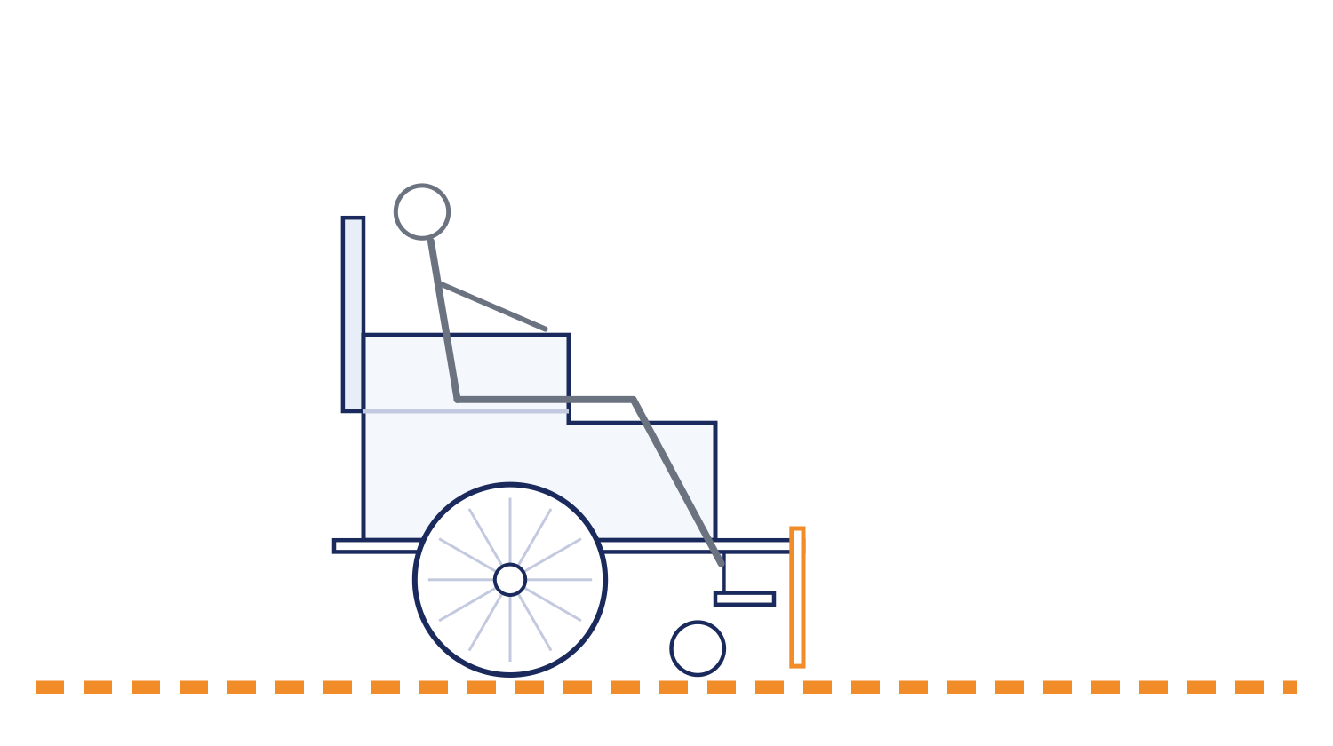
SEVA INNOVATION CHALLENGE 2026 • REFERENCE PITCH DECK
Margadarshak
A wheelchair that takes airport passengers to their gate by itself — built for Indian airports, at a fraction of the imported cost.
Proof of concept
Dispatcher built and tested — 226 automated tests. Demonstrator fleet costed at ₹4,679. Nothing has yet carried a passenger.
the guide line it follows, laid into the terminal floor
Notes:
Title slide. Fill every field exactly as entered in the online application form so reviewers can match the deck to the application.

Slide 2
2
The Problem
What real challenge in society, government service or industry are you solving?
What is the problem?
Who is affected, and where?
Indian airports must provide wheelchair assistance free of charge, and do not have the attendants to deliver it. The root cause is arithmetic, not goodwill: demand is unpredictable and staffing for the peak is unaffordable.
Elderly passengers, persons with disabilities, and women travelling alone — at Goa's two airports, Dabolim and Manohar International, Mopa. Worst affected are those who do not read English, since every fallback is an English sign.
~1,00,000
assistance journeys a year across Goa's two airports (our estimate)
Evidence
Current gaps
Why it matters
DGCA CAR Section 3, Series M, Part I requires airports and airlines to provide assistance free of charge. The figure opposite is our own estimate — roughly 1 in 100 passengers against AAI's published traffic for both airports — and we flag it as an estimate until a pilot measures it.
Assistance today is a person pushing a chair. Once they set off they cannot be told the gate moved, and a passenger delivered to a gate is stranded until somebody remembers them. Imported autonomous chairs exist, but not at a price Indian airports can meet.
A missed flight — and the indignity of asking a stranger for help, then waiting without knowing if anyone is coming.
Seva Innovation Challenge 2026 | Slide 2 of 6
Notes:
Reviewers look for a clearly defined, real and significant problem backed by evidence. One strong statistic is better than many weak ones. Cite the source for every number.

Slide 3
3
Our Solution & Innovation
What have you built or designed, how does it work, and what is new about it?
Our solution in brief
What makes it new?
The passenger scans their boarding pass and sits down. The barcode names the flight; a laptop on the premises looks up the gate live and sends a chair. The chair follows a guide line laid into the floor, obeys a speed limit, and stops for obstacles.
 | Existing approach | Our approach
Cost | Attendant per trip | ₹54,000 per chair
Speed / time | Unpredictable wait | Pre-positioned; wait reported
Reach / access | English signage | 4 languages, Konkani first
Ease of use | Ask, then depend | Scan, then sit
How it works
1
2
3
Input
›
Process
›
Output
Passenger scans their boarding pass
Dispatcher finds the live gate, sends the nearest chair
Chair follows the floor line, re-routing if the gate moves
Key USP
When the airline moves a gate, the chair knows and re-routes mid-journey. A person pushing a wheelchair cannot — they set off committed, and nobody tells them. No patent filed.
Seva Innovation Challenge 2026 | Slide 3 of 6
Notes:
Show clearly how the solution addresses the problem on Slide 2. Compare against what exists today — reviewers score originality and relevance here.

Slide 4
4
Feasibility & Implementation
How ready is the solution, and what will it take to implement it on the ground?
Current stage (mark ✔ where you are today)
Idea
Proof of Concept
Working Prototype
Field Pilot
Ready to Deploy
Technology
Estimated cost
Timeline
Partners
ESP32 controller, IR line sensors, ultrasonic obstacle stop, 2S lithium pack, 4 mm MDF chassis. Dispatcher in Python on one laptop — standard library only, no cloud and no network calls.
₹4,679 for two demonstrator chairs (₹2,721 for one). The production retrofit module is designed at about ₹54,000 per chair. A terminal pilot needs chairs, floor marking and a survey.
3 months: two chairs running a taped guide path at the December exhibition. 6 months: a supervised trial in one terminal zone. 12 months: a measured pilot with an airport operator.
Airports Authority of India (Dabolim) and Manohar International Airport, Mopa. Not yet approached: the regulatory position needs a competent authority, which is part of what we are asking for.
Seva Innovation Challenge 2026 | Slide 4 of 6
Notes:
Be realistic. A clear, costed plan with an identified adopting department scores better than an ambitious but vague one. Mention any validation already done (tests, user feedback, certifications).

Slide 5
5
Impact & Scalability
What change will your solution create, and how can it grow beyond the first location?
~2,000
3×
0
Beneficiaries reached
Saving in cost / time
Jobs or livelihoods
[assistance journeys in a first-year pilot at one terminal]
[passengers per attendant using caravan mode — simulated, not yet measured]
[attendant jobs replaced — these are posts airports cannot fill today]
Social impact
Sustainability
Scale-up plan
Independence for passengers who today must ask a stranger for help and then depend on them. Konkani and Marathi before English, so the service reaches the people the current one fails. Nobody is left waiting at a gate to be remembered.
Bought by the airport operator against an obligation it already carries, then maintained. No cloud fees, no vendor account and no per-journey licence — it runs on one laptop on the premises, and the airport owns and edits its own map.
The guide path is tape and floor tags; the map is JSON the airport edits itself. Replicating means surveying a terminal, not rebuilding software. The same system fits railway stations — a far larger Indian problem.
Seva Innovation Challenge 2026 | Slide 5 of 6
Notes:
Quantify impact wherever possible and state your assumptions. Where relevant, link the solution to an existing Government scheme, mission or the Sustainable Development Goals.

Slide 6
6
Team/Individual & Support Required
Who is behind the idea, and what help do you need from the Challenge?
Photo
Aatriv Thosar
Support we are seeking
Team Lead
[Your qualification / course]
Mentorship & technical guidance
Pilot with a government department
Funding / grant support
Incubation & workspace
Testing, certification or IP support
Certification and a clear regulatory position are what stand between a working dispatcher and a chair that may legally carry a passenger.
Thank you | aatriv38@gmail.com
Seva Innovation Challenge 2026 | Slide 6 of 6
Notes:
List only active team members. Be specific about the support requested — it helps the organisers match you with the right mentor, department or incubator.

