Slide 1


Slide 2


Skill base Assessment Portal
PMAS-Arid Agriculture University- Rawalpindi University Institute of Information Technology
Kashif Lateef 18-ARID-2490
Ehtesham Safeer 18-ARID-2460
M. Zeeshan Khan 18-ARID-2540
Supervisor : Ms.Sidra Tahir

Slide 3

Contents
Introduction
Existing System
Problem Statement
Problem Solution
Project Scope
Project Objective
Diagrams - Use case, Class, Sequence, Component, Activity, Deployment
Tools and Technologies
Task Distribution
Screenshots
Future Project Schedule
University Institute of Information Technology, PMAS-Arid Agriculture University- Rawalpindi

Slide 4
Introduction
Skill Based Assessment Portal provides an online platform of learning system where a virtual classroom with teacher and students connect with each other and to solve any problem .
Teacher can upload assignment and take quizzes from Students. Multiple quizzes will be taken and the system will store the results of each quiz.
A graph will be generated at the end of course which will display the percentage got in each course.
University Institute of Information Technology, PMAS-Arid Agriculture University- Rawalpindi

Slide 5
Existing System
Myrank.com
Google classroom
University Institute of Information Technology, PMAS-Arid Agriculture University- Rawalpindi

Slide 6
Problem Statement
Different e-learning platform provides a lot of advance courses and content for student but there is no proper tutor for that courses who properly guide student. Teacher give lectures and data but there is no proper guideline for student to get guidance and they also don't make any competition between students that can't increase interest in students for that course According to their skills.
There is a need for a user-friendly application which provides leading and content according to user skills and generate graphs for assessment and prediction.
University Institute of Information Technology, PMAS-Arid Agriculture University- Rawalpindi

Slide 7
Proposed Solution
We are going to propose to develop an online assessment portal in which we offer advance courses and virtual classroom where a tutor will share lectures , quiz, assignment and make competition between students. Quiz will be skilled base. The result of quiz tells the percentage of each course. And give platform to teacher that can also check the plagiarism of assignment. At the end of courses a competition organized on website and the winner receive prize or discount from other courses . There are so many e-learning websites. But the main purpose to re-implement the same system to add extra feature.
University Institute of Information Technology, PMAS-Arid Agriculture University- Rawalpindi

Slide 8
Project Scope
E-learning can be applied in two major ways: Presenting education content and facilitating education processes. E-learning tools can operate effectively within both carefully selected and optically integrated course design model and as emergent facilitators of communication and learning in informal contexts.
Admin can login using credentials and manage the whole website. Teacher and student register to create account and login to create virtual classroom to connect with each other. Admin offers other advance courses. Interesting student can enroll about their interest and manage the request raised by student by approving or rejecting it.
University Institute of Information Technology, PMAS-Arid Agriculture University- Rawalpindi

Slide 9
Project Objectives
Enhance the quality of learning and teaching.
Meet the learning style or needs of students.
Improve the efficiency and effectiveness.
Improve user-accessibility and time flexibility to engage learners in the learning process.
University Institute of Information Technology, PMAS-Arid Agriculture University- Rawalpindi

Slide 10
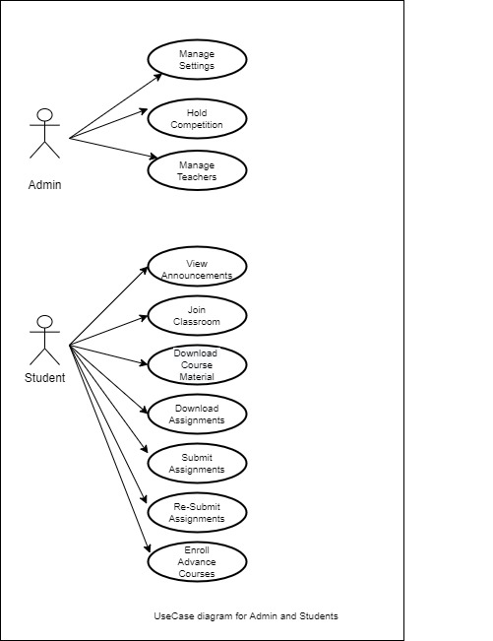
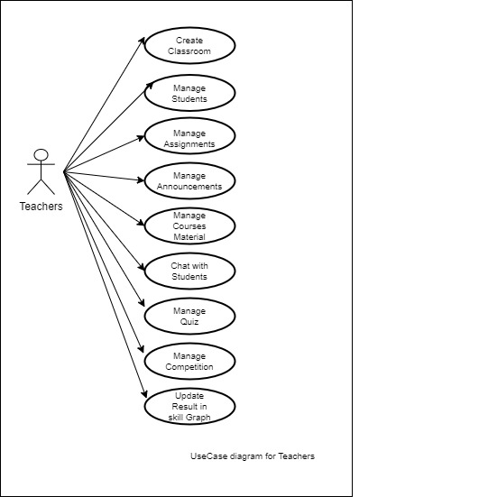
Diagrams -Use Case Diagram
University Institute of Information Technology, PMAS-Arid Agriculture University- Rawalpindi

Slide 11
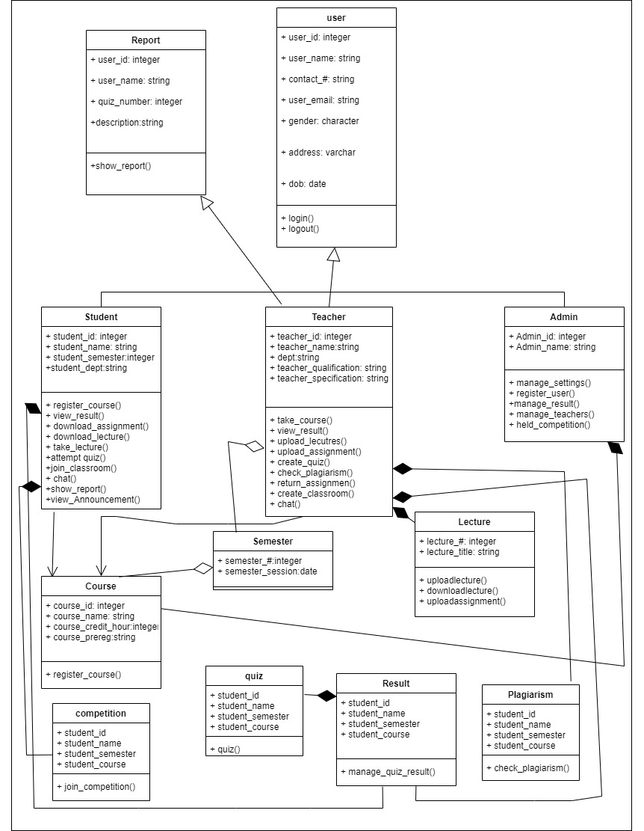
Diagrams –Class Diagram
University Institute of Information Technology, PMAS-Arid Agriculture University- Rawalpindi

Slide 12
Tasks Distribution
Group Members | Responsibilities
Muhammad Zeeshan Khan | Creating Database, Defining Tables in Database Designing Interfaces- Designing and Coding for Contact Us and Feedback Page Connection Establishment Documentation
Ehtesham Safeer | Update, Delete SQL Queries Designing Interfaces- Designing Template/Master Page Coding-front page interfaces
Kashif lateef | Defining Views in Database Designing Interfaces- SignUp Form and SignIn Form Documentation
University Institute of Information Technology, PMAS-Arid Agriculture University- Rawalpindi

Slide 13




Tools & Technologies
University Institute of Information Technology, PMAS-Arid Agriculture University- Rawalpindi

Slide 14
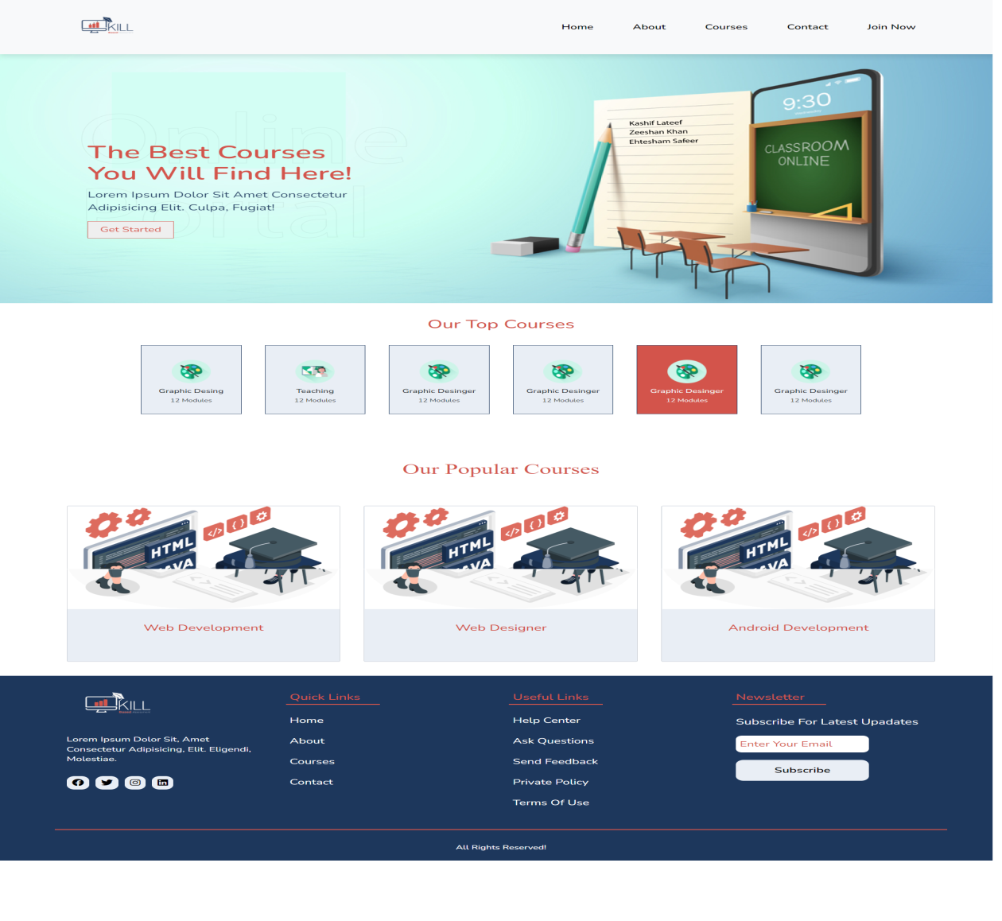
Screen Shots
University Institute of Information Technology, PMAS-Arid Agriculture University- Rawalpindi

Slide 15
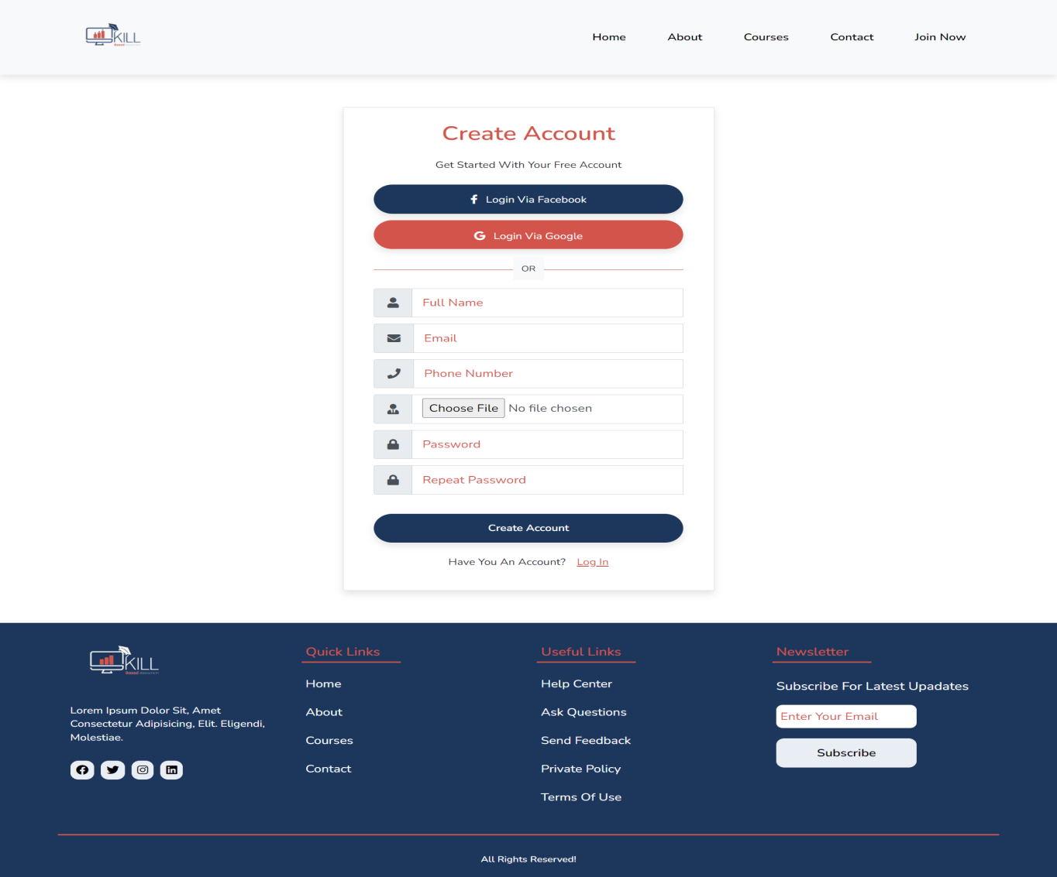
Screen Shots
University Institute of Information Technology, PMAS-Arid Agriculture University- Rawalpindi

Slide 16
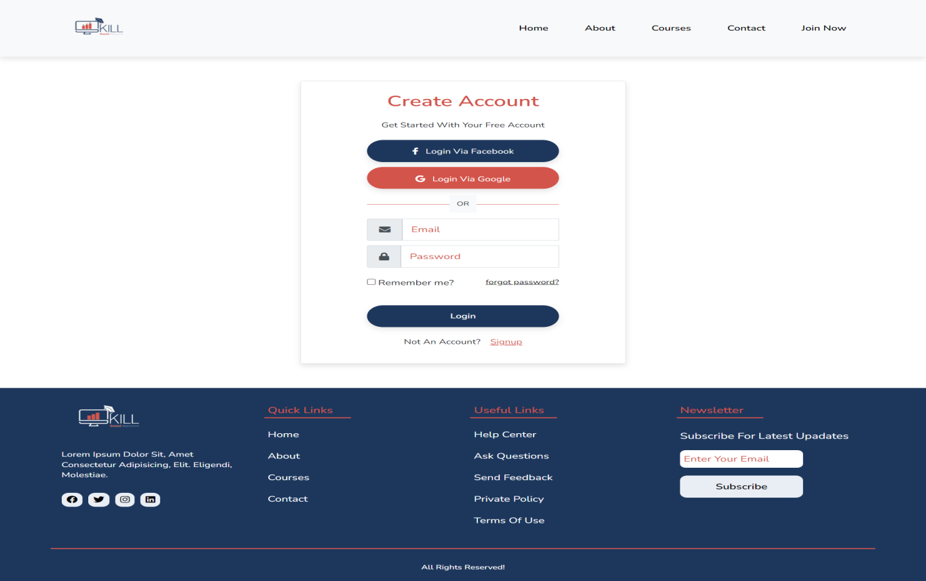
Screen Shots
University Institute of Information Technology, PMAS-Arid Agriculture University- Rawalpindi

Slide 17
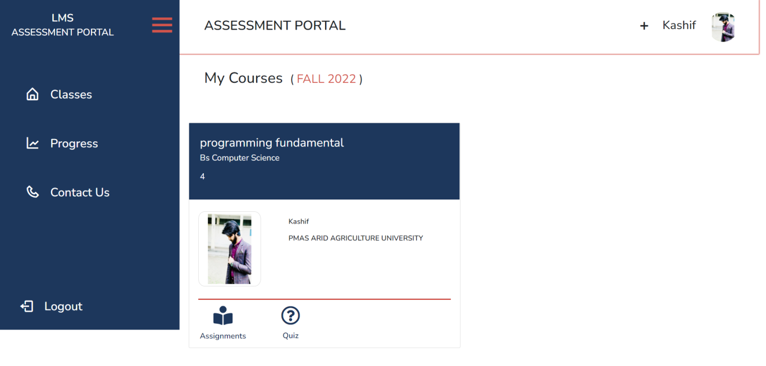
Screen Shots
University Institute of Information Technology, PMAS-Arid Agriculture University- Rawalpindi

Slide 18


