Slide 1
BOT Framework
15min Intro

Slide 2
BOT USE Cases
News bot – Sends personalized breaking news or specific stories from a specific website, every day, in a private messenger message.
Movie reservation bot – Gives access to all information about movies, show times, theater locations fast.
Support Bots – Large Telecom Company introduces Cell/DSL Support Bot
…..

Slide 3
Bot Framework
Bot Framework is a Microsoft operated service and a SDK
Bot Framework is only a part of Services to build a complete bot
LUIS
Speech API
Azure
etc

Slide 4
Bot Architecture
Your bot
Web service
Logic
Bot Builder SDK (Node.js + C#)
LUIS

Slide 5
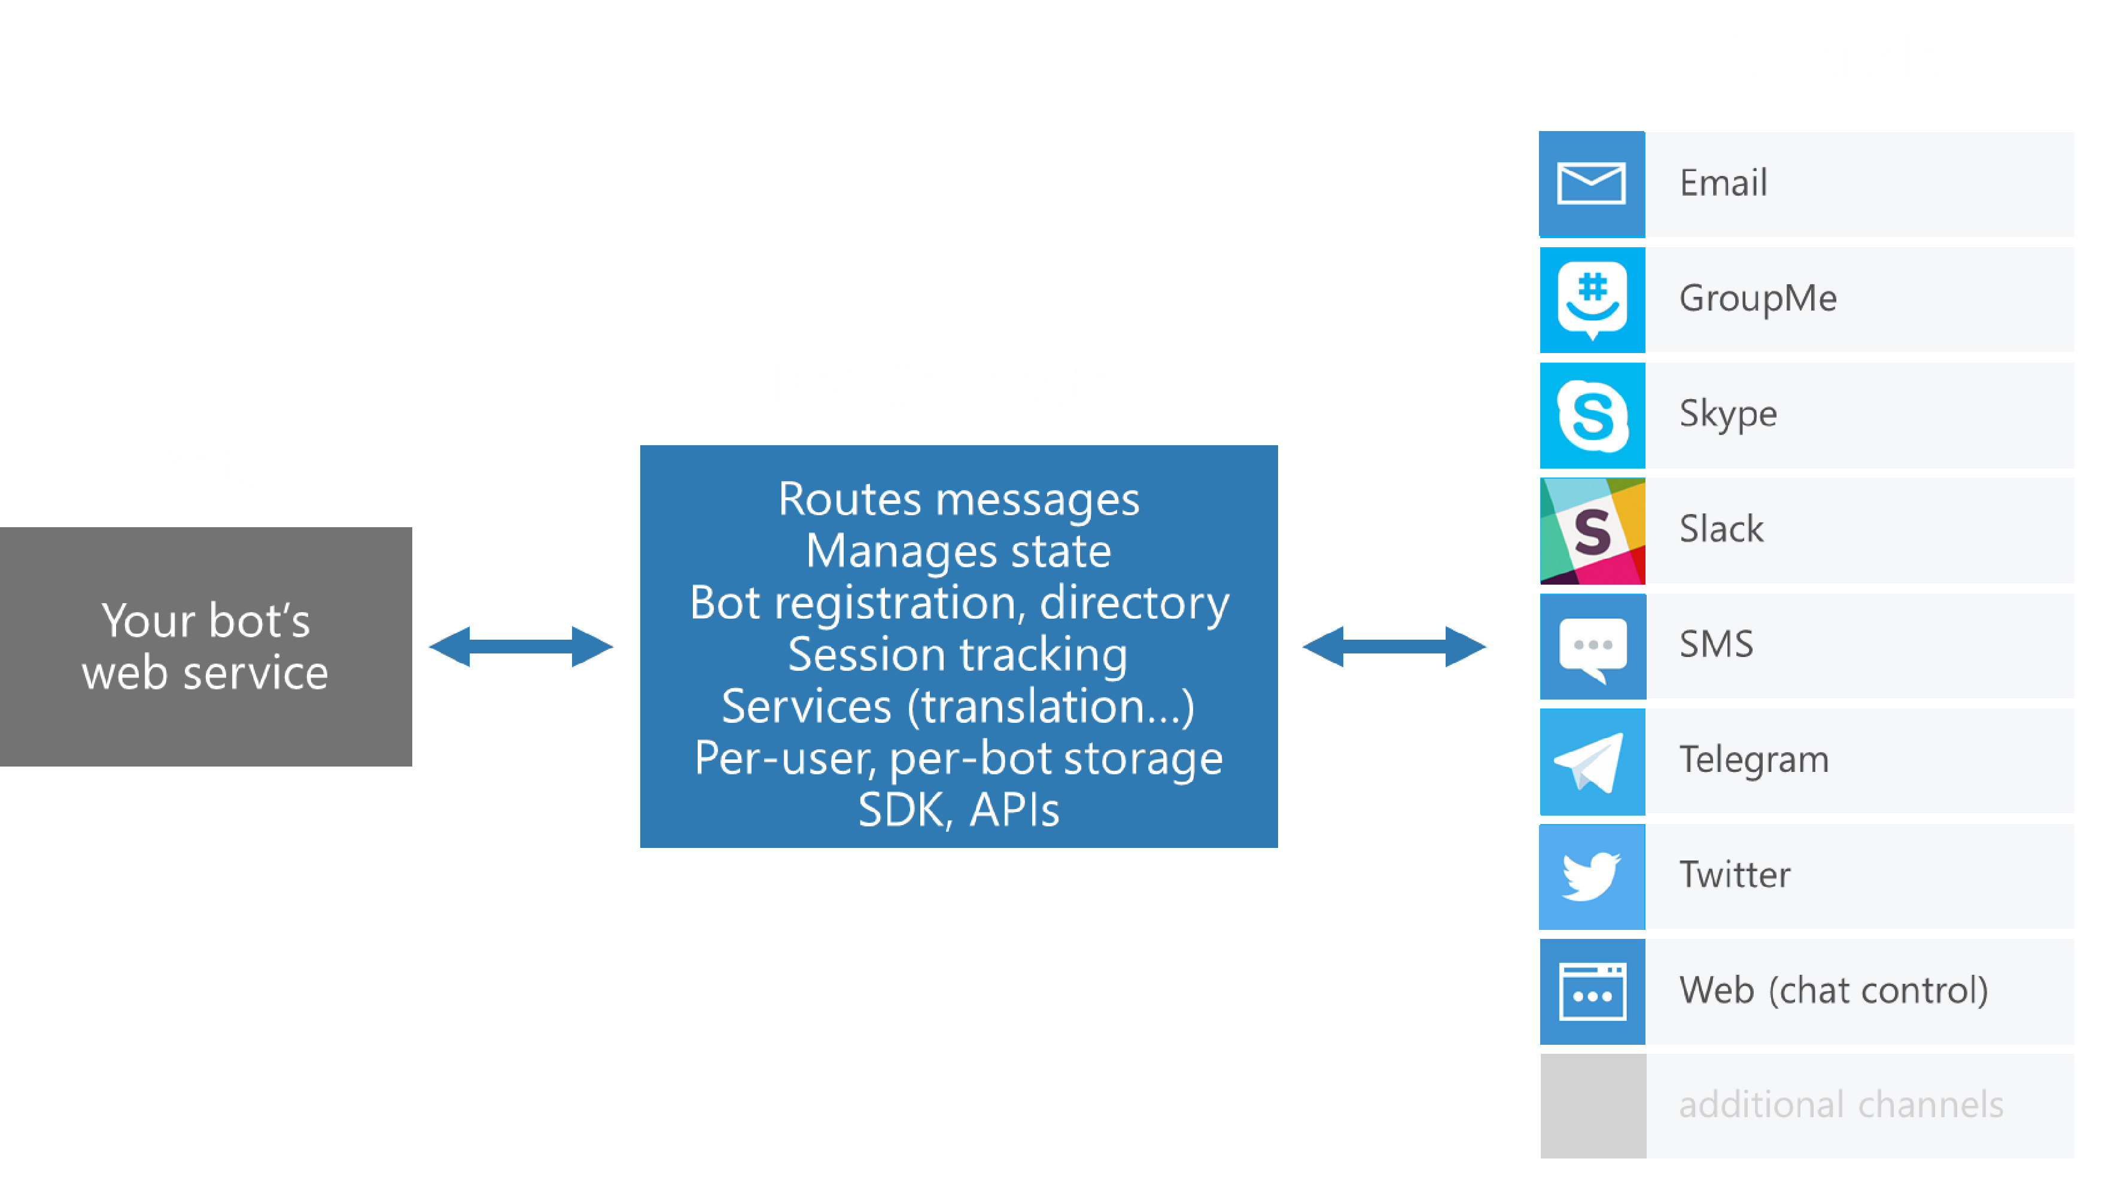
Bot Architecture
Dev portal
Engagment BOT
Bot Connector
Send/receive messages
Store state
Translation
Telemetry
…

Slide 6
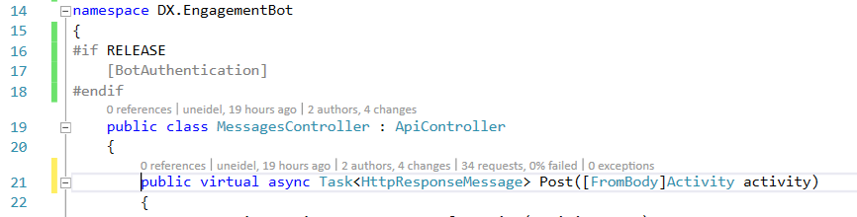
Messaging

Slide 7
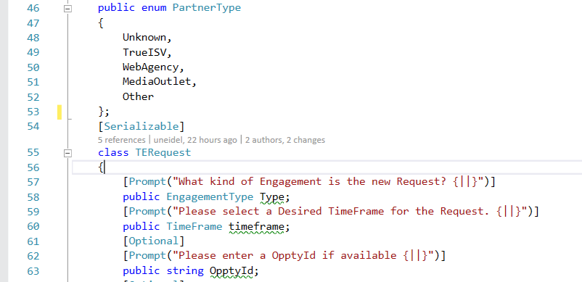
FormFlow

Slide 8
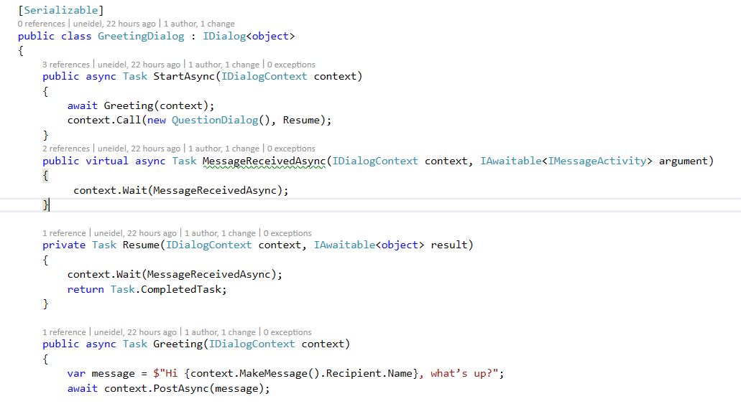
Dialogs

Slide 9
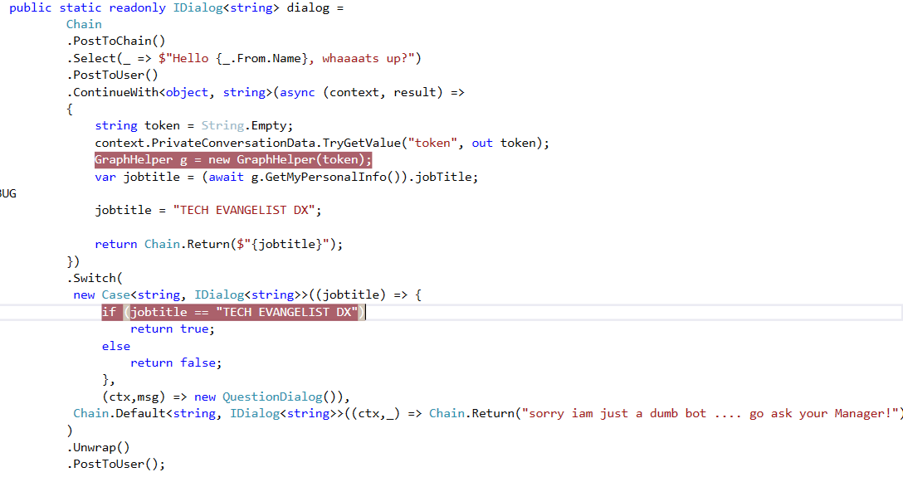
Chaining

Slide 10
Luis - Language Understanding Intelligent Service
offers a fast and effective way of adding language understanding to applications.
Already pre-existing Models
Create an Azure Engagement for Partner MisterX
Intent: CREATEENGAGEMENT
Entity 1
Entity 2
Get me an Azure Engagement for Partner MisterX
I need an Azure TE for Partner MisterX
…..

Slide 11
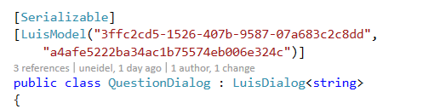
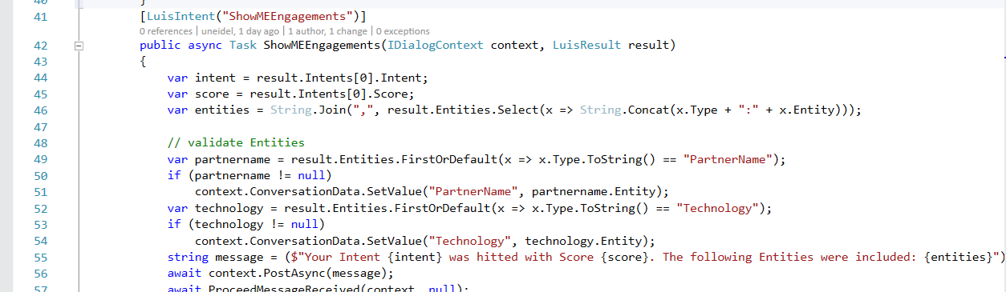
Luis Dialog

Slide 12
Q & A

Slide 13
BACKUP

Slide 14
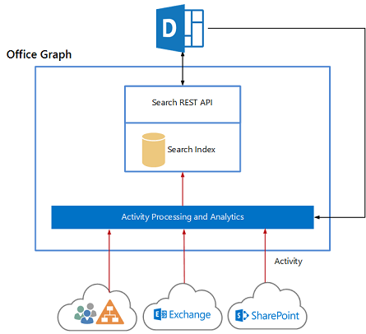
Office Graph

Slide 15
Hi, I need a TE for an Azure Engagement next week
LUIS will help identify the need „TE = Technical Evangelist“ and the Type „Azure“. The Bot will then use the follow up Question specified for this combination.
Sure what specfic Technology do you Require
Click
ML
IaaS
SF
…
Checkup into availability DB (TEs can update their forcast there, e.g. Week25: Full, Week26: 1 Add New, …) and the technology sheet saying who can do what.
ML
Great! Oliver A. can do this Engagement after the 10th Sep. Should I assign him?
Yes
You and Oliver will receive confirmation Emails shortly

Slide 16
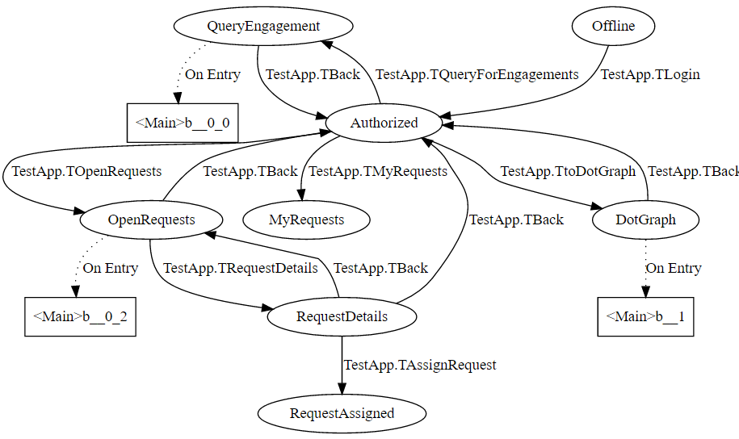
States

Slide 17
AzureWebsite
DXBot
Bot Connector Framework
Browser
DXChat
Appid: 1
Azure AD
Graph

