Slide 1




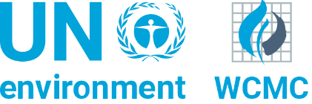

The Group and Organisation Future of Conservation Survey Project
Workshop Slides

Slide 2
Activity: Profiling
Each corner indicated by the facilitator corresponds to one of four profiles, which will be read out
Participants should move towards the corner corresponding to the profile that resonates the most with them
Staying in the middle is not allowed!

Slide 3
Corner 1
Central to this position is a shift towards viewing conservation as being about protecting nature in order to improve human wellbeing (especially that of the poor), rather than for biodiversity’s own sake.
You believe that win-win situations in which people benefit from conservation can often be achieved by promoting economic growth and partnering with corporations.

Slide 4
Corner 2
You support the protection of nature for its own sake. This emphasis on nature’s intrinsic value typically leads advocates of this stand to be critical of markets and economic growth as tools for conservation.
You believe that by embracing markets, we run the risk of ‘selling out nature’ by neglecting species that may be considered to be of little economic value.
Economic growth itself is seen as a major driver of threats to biodiversity.
You typically favour protected areas, particularly in ecosystems with relatively low human impacts, as a primary conservation strategy.

Slide 5
Corner 3
You support conservation based on nature’s intrinsic value along with a market-based approach.
You are less concerned about the role of people as participants and beneficiaries of conservation.
Perhaps one example of this approach is EO Wilson’s recent book ‘Half-Earth’, which advocates the setting aside of half of the Earth’s surface for nature reserves. Aware that this ambitious target would require a drastic decrease in per capita environmental footprint worldwide, Wilson supports free markets as a means to favour those products which generate the maximum profit for the minimum energy and resource consumption.

Slide 6
Corner 4
For you, the impacts of conservation on human wellbeing should be at the forefront of the conservation debate.
This entails both being critical of negative side-effects that conservation activities might have on people who are economically poor and/or politically marginalised, and also employing conservation initiatives as a means of improving human welfare.
You tend to be sceptical of the ability of markets and capitalism to deliver benefits for both nature and people.

Slide 7
Corner 1
New Conservation
Corner 3
Market Ecocentrism
Corner 4
Critical Social Science
Corner 2
Traditional Conservation

Slide 8
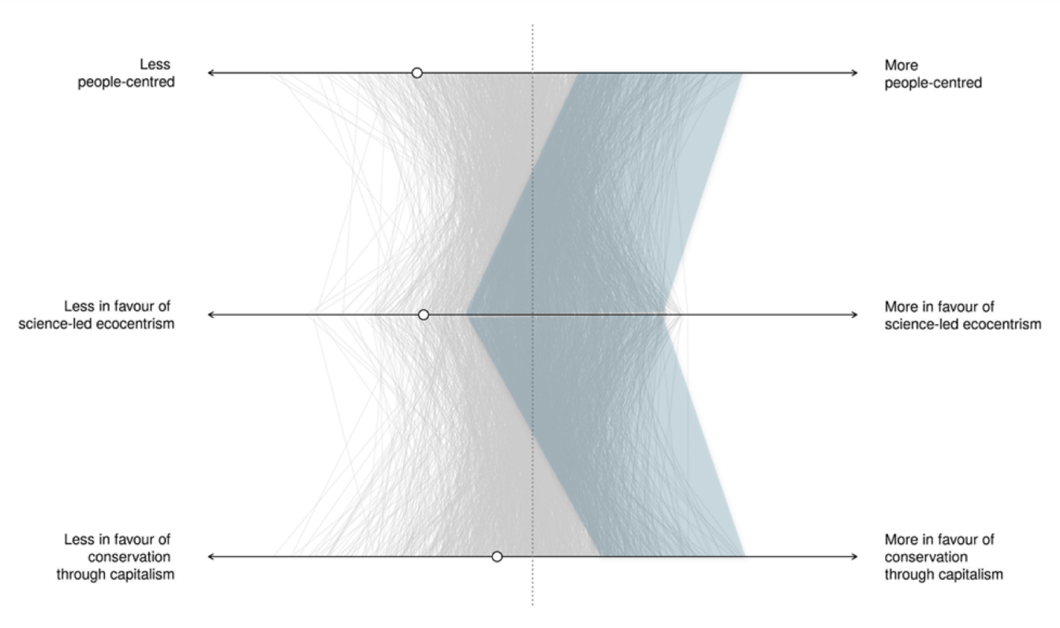
Corner 1
New Conservation

Slide 9
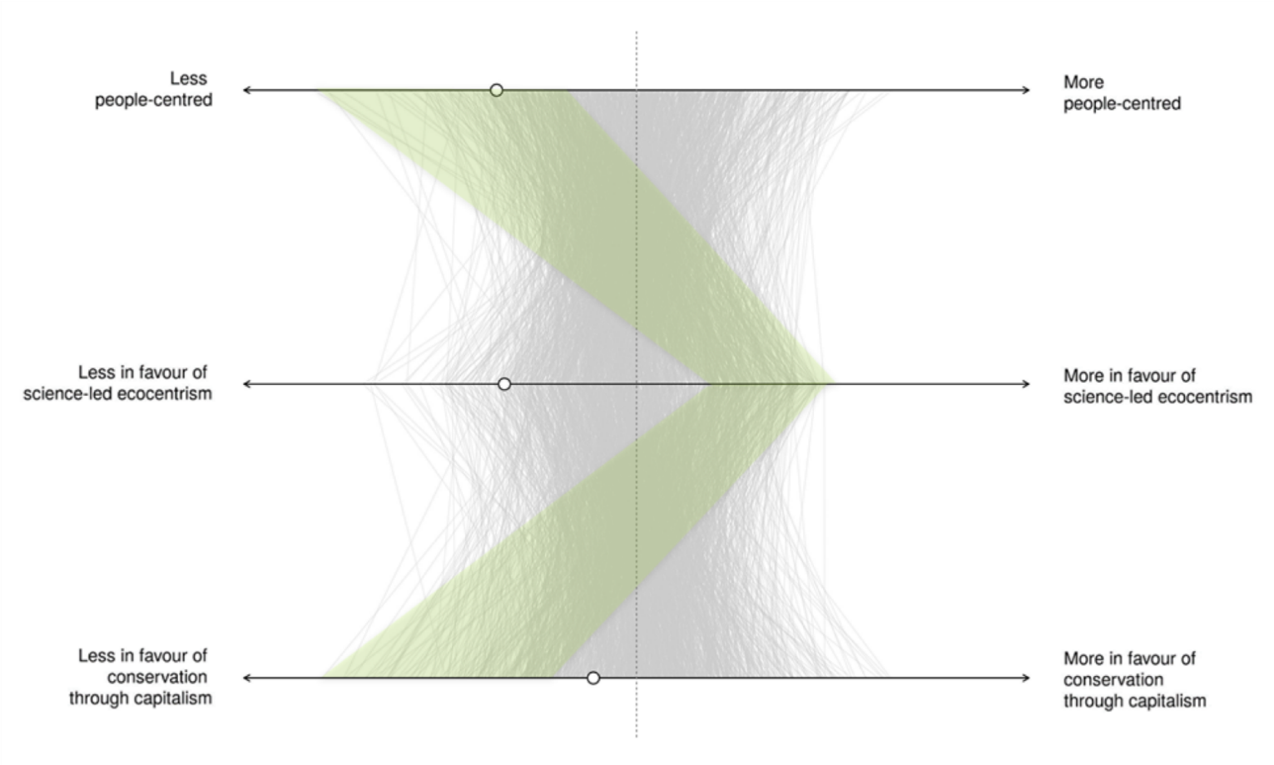
Corner 2
Traditional Conservation

Slide 10
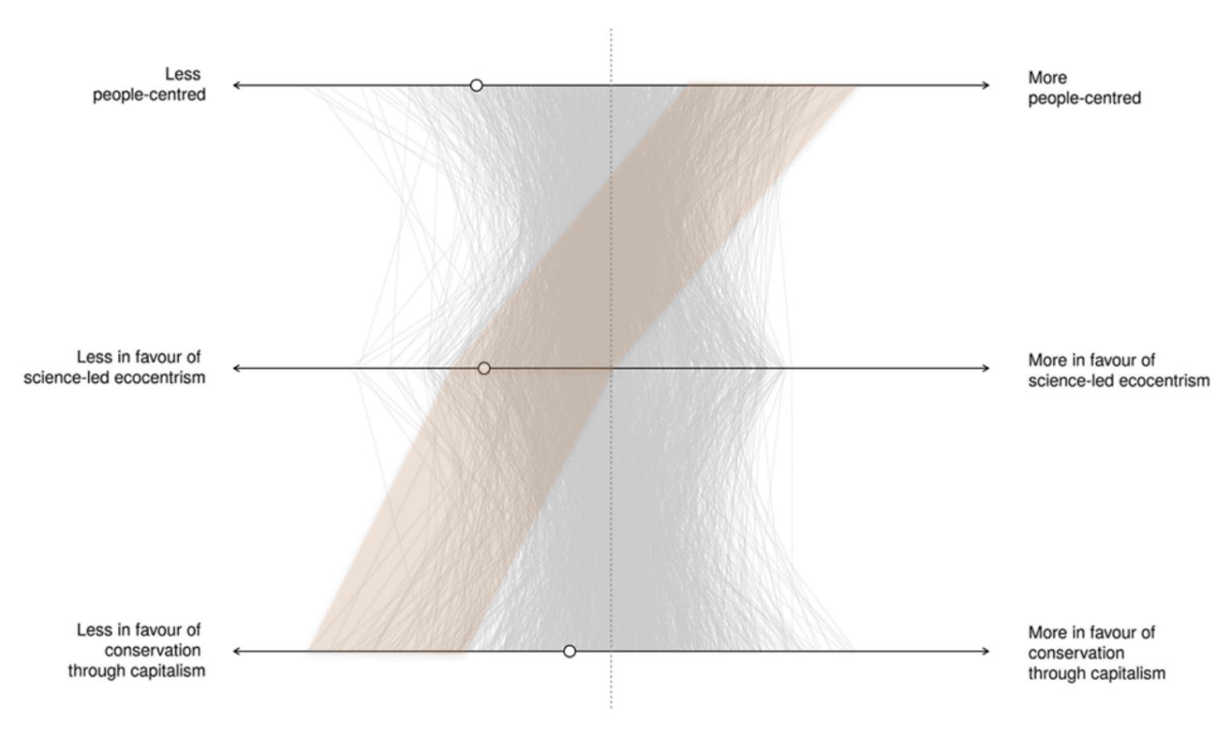
Corner 3
Market Ecocentrism

Slide 11
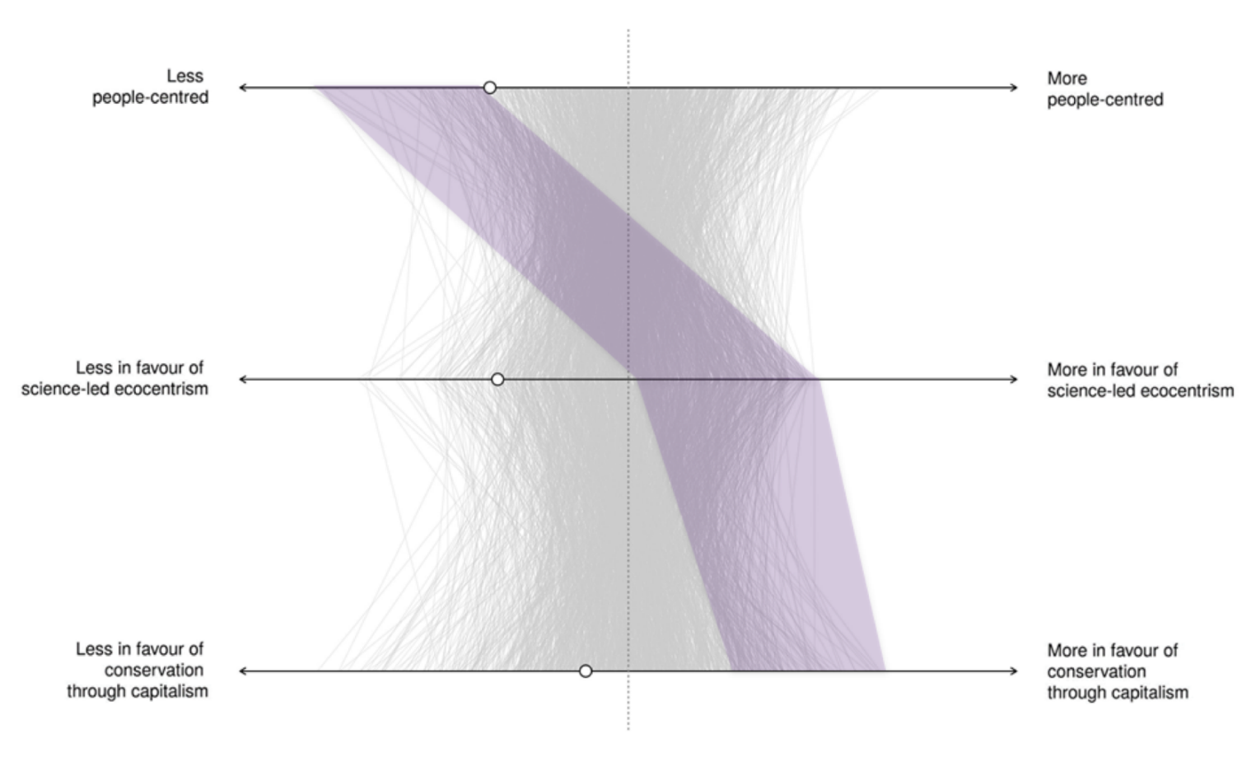
Corner 4
Critical Social Science

Slide 12
Individuals’ conservation values…
How do you think your conservation values influence how you undertake your day to day work?
Are there other conservation values that you think are very important that affect the way you do your work?
Would you expect your colleagues to share your values? Does it matter if they have different values to you?
Does your colleagues’ position affect how you feel about them (professionally)?

Slide 13
Organisation’s conservation values…
Do the conservation values people hold impact their organisation, or vice-versa? How?
What would you feel is the ideal mix or proportion of people in each profile for your organisation to function, and be adequately represented as a whole?
Do you think your organisation portrays one of these values more specifically? Which? What does that mean?

Slide 14
Now to find out where you really are
Go to WEBLINK and complete the survey

Slide 15
Your group’s results
[insert charts here from your GO-FOX results page]

Slide 16
[name of group/organisation]’s conservation values…
Are these the results you expected for this organisation/team?
How do you think your conservation values influence how you undertake your day to day work?
Are there other conservation values that you think are very important that affect the way you do your work?
Would you expect your colleagues to share your values? Does it matter if they have different values to you?

Slide 17
[name of group/organisation]’s conservation values…
Does your colleagues’ position affect how you feel about them (professionally)?
Do the conservation values people hold impact their organisation, or vice-versa? How?
What would you feel is the ideal mix or proportion of people in each profile for your organisation to function, and be adequately represented as a whole?
Do you think your organisation portrays one of these values more specifically? Which? What does that mean?

Slide 18
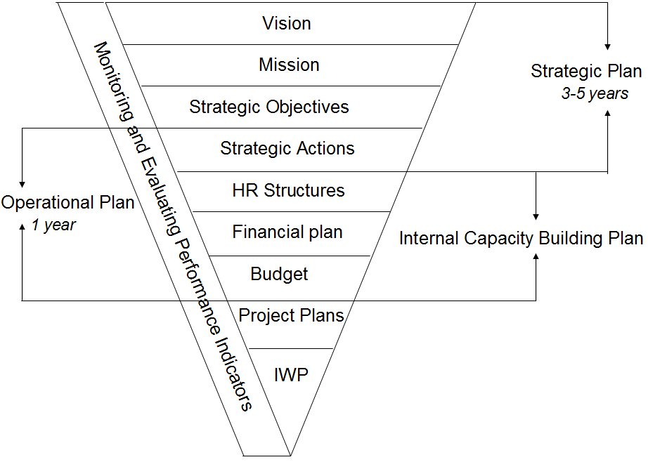
Organisational Values and Mission
Values

Slide 19
Organisational values are…
The shared values that underpin the way you work, behave and your relationships with others
Help determine your strategies and the way in which you work day to day
Provide a basis for making decisions
Set of principles (do’s and don’ts) for:
how the organisation functions
how staff behave when they approach their work
who you will work with (partners etc.)

Slide 20
Activity: Defining values
Based on the previous discussion, think about the values you think should guide your work in contributing to your organisation’s vision, and your behaviour, approaches or ethos in doing so
As one group, write down and organise the values into groups where there are overlaps, duplicates, etc.

Slide 21
A mission statement
States the way in which your organisation intends to contribute towards its vision. Your role in achieving that vision.
Describes what the organisation does, with whom or for whom it does it, and how
Should include:
What do you aim to do/achieve?
Who is it aimed at and done with?
How do you work/methods?
i.e. We are……..We aim to…….We do this by……
It is important because:
It is an easy way to communicate what you do and how you do it
It helps you clarify and focus your work

Slide 22
Example: A mission statement
To conserve threatened species and ecosystems worldwide, choosing solutions that are sustainable, based on sound science and take account of human needs.

Slide 23
Activity: Defining a mission statement
In your groups, think about the following and write down:
Who or what are the primary targets that you expect benefit from your work?
Who, if anyone, will we work with on an on-going basis to achieve this?
Write a statement that contains:
Who you are…
What you aim to…(be specific about who and what – see 1!)
How you do this…
We will then compare these to the existing mission statement and decide if this needs revising to reflect what you have discussed.

