Slide 1
Introducing the Future of Conservation project

Slide 2
Content
The ‘new conservation’ debate.
The Future of Conservation Survey.
Results so far.
The Group and Organisation Future of Conservation Survey (GO-FOX).

Slide 3
1. The ‘new conservation’ debate

Slide 4
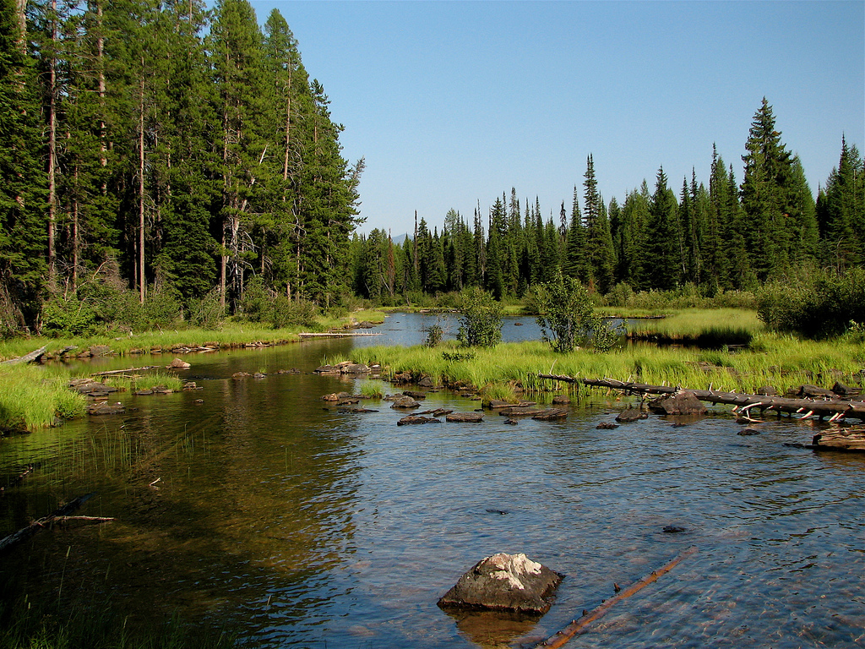
The new conservation debate
Longstanding debates over what, why, and how to conserve.
Main themes include:
Anthropocentrism vs ecocentrism
The role of markets and capitalism in conservation
The value of pristine nature
Recent intensive debate triggered by ‘new conservation’ thinking

Slide 5
New conservation
Pristine nature does not exist in the anthropocene.
Conservation must occur within human-altered landscapes.
The fates of nature and people are profoundly intertwined.
Conservation will only be a durable success if people support it.
Conservation ought to jointly maximise environmental and economic outputs.
Conservationists must work with corporations.
Peter Kareiva
TNC, UCLA
Michelle Marvier
U. Santa Clara

Slide 6
‘Traditional conservation’ response
Michael Soulé
There are important near-pristine areas
Capitalism ignores planetary limits
Nature’s resilience is over-exaggerated
Conservation should focus on protecting nature for nature’s sake
George Wuerthner
Eileen Christ
John Terborgh
Others

Slide 7
Reply to ‘traditional conservation’
Peter Kareiva
New conservation is an expansion of approaches, not an alternative.
It is a strategy, not an ethical statement.
Inclusion of human-centred values enhances conservation.
Michelle Marvier
Emma Marris
Phillip Levin
Others

Slide 8
Criticisms of the debate
Repeats long-standing disputes in conservation.
Binary appearance leaves out other viewpoints.
Narrow demographics of participants: mostly white, North American, senior positions.
Excessively acrimonious and hostile.

Slide 9
2. The Future of Conservation Survey

Slide 10


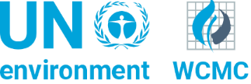

Aims
The Future of Conservation Survey was developed to:
capture the views of the conservation community on the issues raised by the new conservation debate
broaden the range of voices heard and identify differences between groups
encourage self-reflection and discussions of these topics within conservation.
The team
Chris Sandbrook
Janet Fisher
George Holmes
Rogelio Luque Lora
Aidan Keane

Slide 11
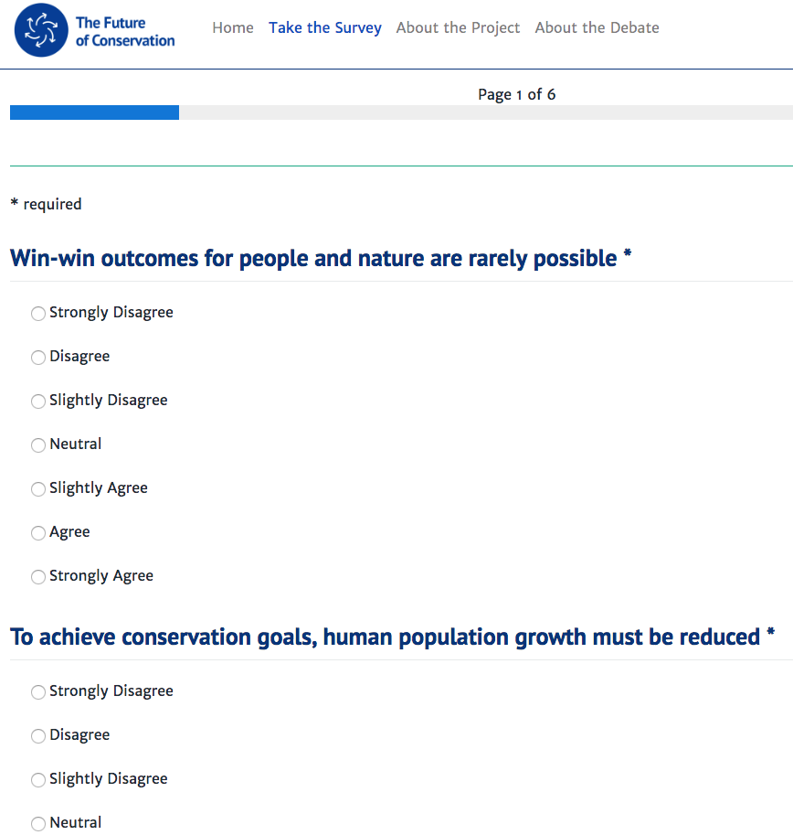
The survey
38 statements, directly derived from the literature on the new conservation debate.
Demographic questions: age, gender, nationality, seniority of conservation position…
Now also in Spanish and French.

Slide 12
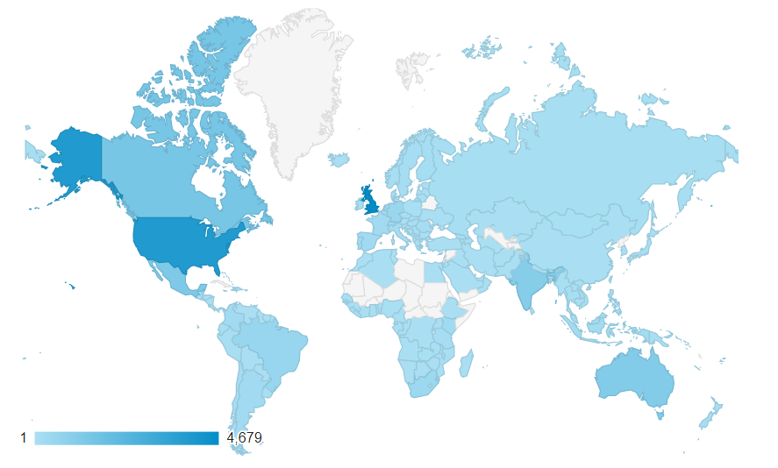
Launched in April 2017
13,900+ responses from 181 countries within first two years
Equal gender balance; but mostly highly educated, Anglocentric, only internet-accessible

Slide 13
3. Results so far

Slide 14
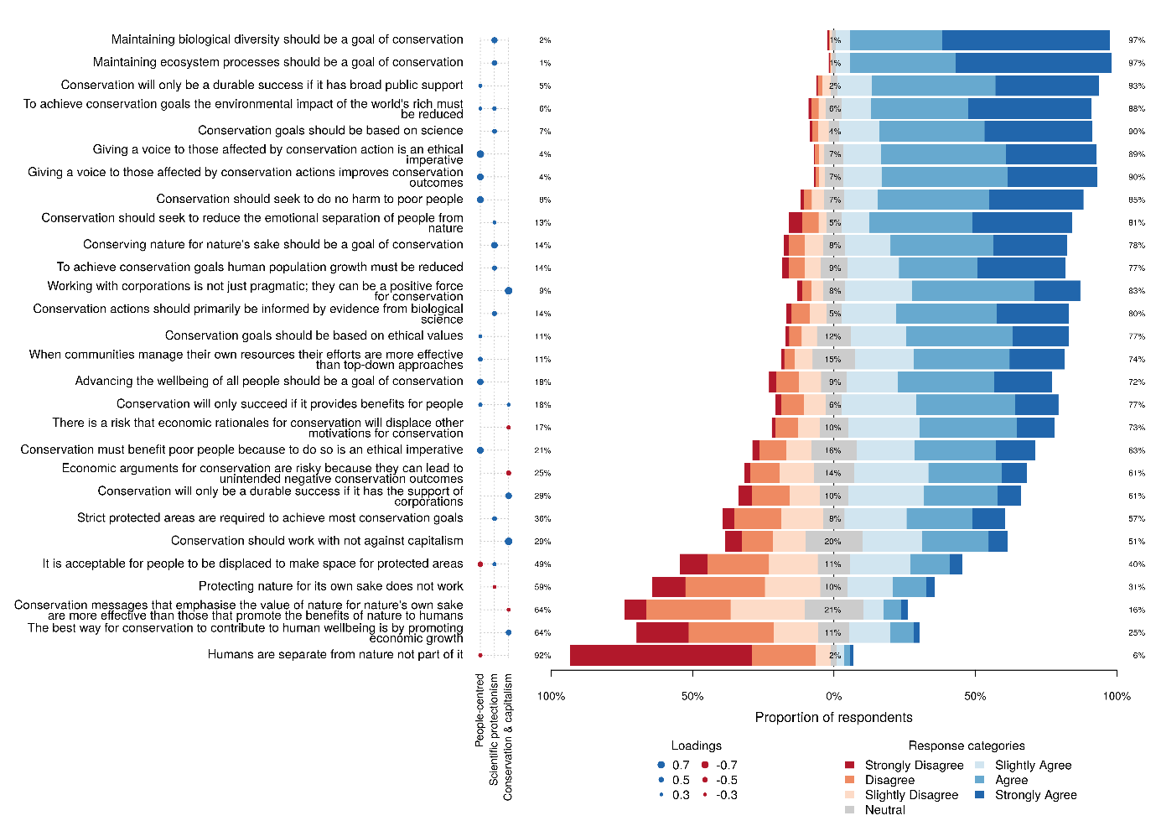
High levels of agreement with the statement
A broad range of responses to the statement
High levels of disagreement with the statement

Slide 15
Three dimensions in the data
People-centred conservation
The role of people in conservation, as participants and stakeholders.
Science-led ecocentrism
The role of science in the conservation of species and ecosystems for their own sake.
Conservation & capitalism
The role of corporations and market based approaches in conservation.

Slide 16
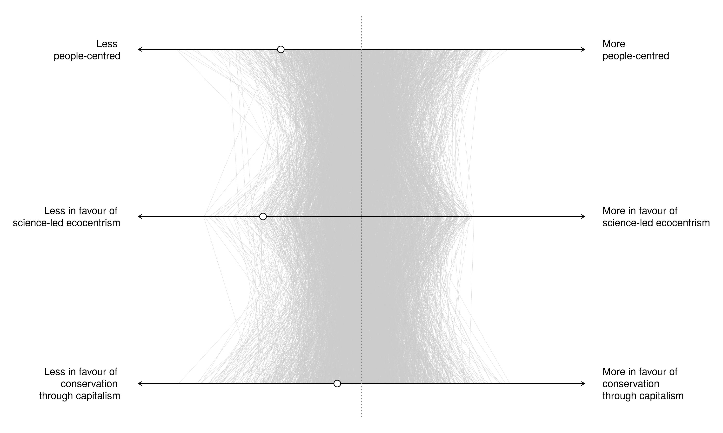
Patterns in the data
Patterns in the data
Neutral point: answered Neither agree nor disagree to all statements.
Most people agree with people-centred conservation & science-led ecocentrism
Conservation through capitalism is more controversial
No overall clusters – a large ‘cloud’ of views
Notes:
Explain that there are no clear clusters in the data – conservation less divided than believed?
Conservation through capitalism the most contentious.

Slide 17
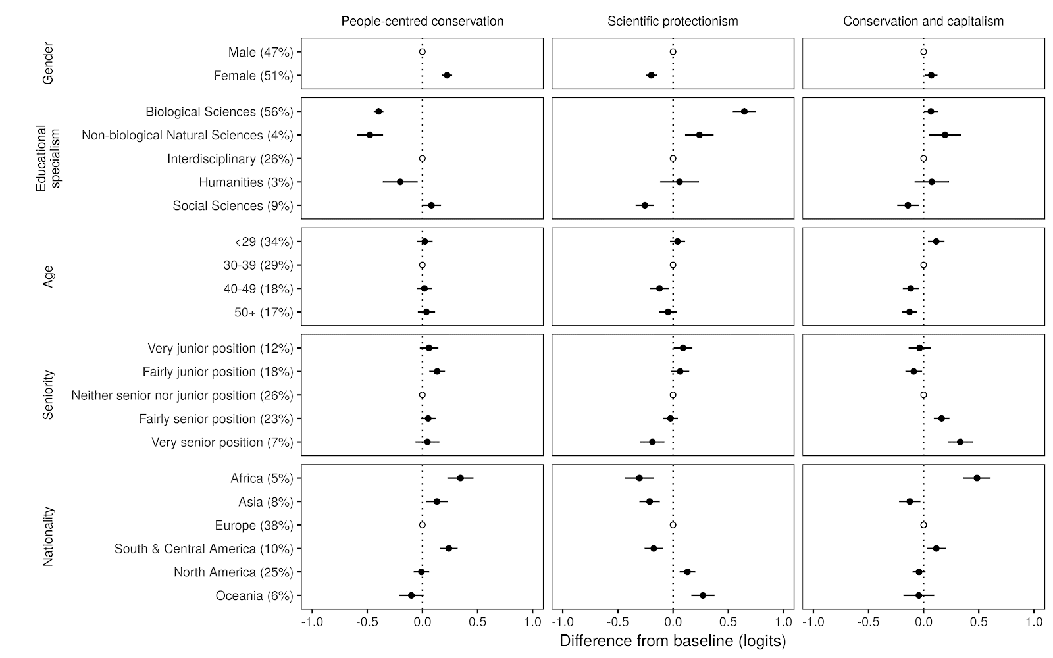
Links to personal characteristics

Slide 18
4. The Group and Organisation Future of Conservation Survey (GO-FOX)

Slide 19
GO-FOX
In response to user-demand we have developed a version of the survey that can be used independently to:
inform strategic planning and encourage reflection on conservation values within organisations.
teach debates over what, why and how to conserve and encourage reflection among students.
We hope you will the tool useful and we welcome your feedback to futureofconservation@gmail.com

