Slide 1
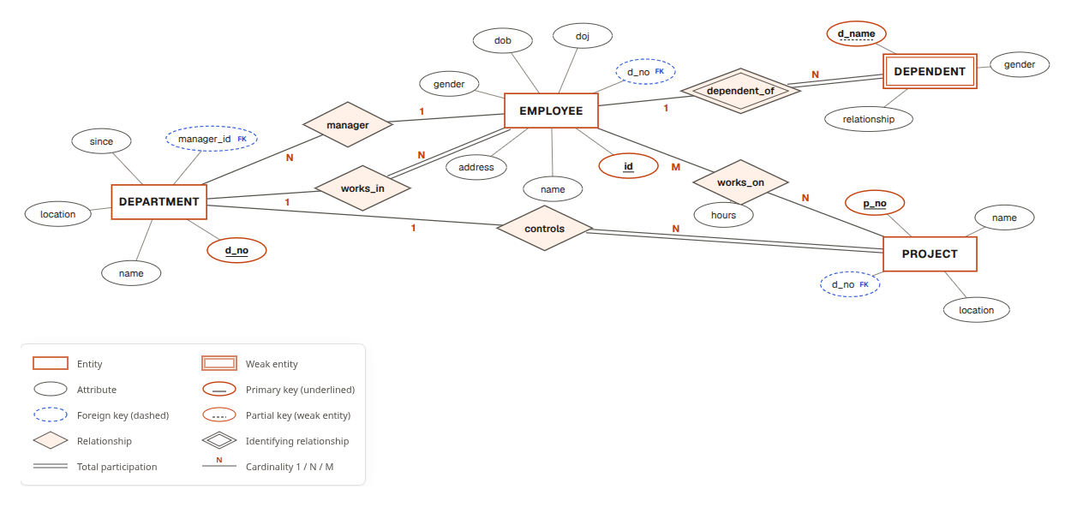
DBForge
DBMS PROJECT / 2026
An agentic control plane that designs, builds, secures and operates real PostgreSQL databases.
PostgreSQL 18 · FastAPI · PydanticAI · Next.js 16
Notes:
DBForge turns a plain-English description into a real, normalised, secured PostgreSQL database and then keeps operating it with an AI copilot. The picture on the right is not a drawing: it was generated by DBForge from the live database of a demo project.

Slide 2




What DBForge does
00 / OVERVIEW
Creates real databases on demand
Chats with your database
Each project is an isolated PostgreSQL database with owner, read-write and read-only roles and encrypted credentials.
A copilot designs schemas from a description, writes SQL, seeds data, tunes queries and explains plans, using real tools.
Never runs risky changes alone
Remembers and undoes
Every change is dry-run for real, risk-scored, and waits for a human approval. PostgreSQL roles enforce it.
Append-only audit log, before-image undo for writes, numbered migrations, and one-click logical backups.
Notes:
Four capabilities. The key idea for a DBMS course: the AI never has the final say. Deterministic code and PostgreSQL itself decide what is correct and what is allowed.

Slide 3
From a mock-up to a working system
00 / WHY A REBUILD
BEFORE / V1
AFTER / V2
“Deploy” only incremented a counter: no database existed
Projects, users and approvals lived in Python dictionaries
Query results and plans were hard-coded strings
UI buttons used timers to fake work
Placeholder JWT secret; any @load.test e-mail could log in
Every project is a real PostgreSQL database with three roles
Persistent control plane: users, encrypted credentials, audit
Real execution, real EXPLAIN ANALYZE, real dry runs
Copilot acts through typed tools against the live database
argon2, httpOnly JWT, CSRF guard, cross-tenant isolation tested
Notes:
The first version looked like a product but did not do the work. The theory tools, closure, normal forms and ER mapping, were sound and were kept. Everything around them was rebuilt so that every screen talks to a real database.

Slide 4
How the pieces fit
01 / ARCHITECTURE
A control plane that holds metadata, and one isolated PostgreSQL database per project.
Notes:
Two kinds of database: the control plane, which knows about users, projects, approvals and the audit log, and the tenant databases, which hold each project's real data.

Slide 5
Request path: from a sentence to a committed change
01 / ARCHITECTURE
Browser
FastAPI
Copilot agent
Deterministic tools
Next.js UI
httpOnly session
auth, CSRF guard
ownership checks
PydanticAI + Nemotron
6 specialist toolsets
closure, normal forms,
ER mapping, algebra
Control plane
Approval gate
Executor
Project database
users, projects,
encrypted creds,
audit, chats
dry run in a
rolled-back txn
risk score
role-scoped pools
before-images
drift check
_ro
every read, the copilot's queries
_rw
approved data changes
_owner
approved migrations only
Reads run as _ro inside READ ONLY transactions. DDL runs as _owner only after a human approves it.
Notes:
Follow the arrows: the browser talks only to the API. The copilot never connects to the database directly; it calls tools. Any change goes to the approval gate, which dry-runs it, and the executor runs approved work with the least-privileged role that can do it.

Slide 6



One database per project, three least-privilege roles
01 / ISOLATION
Role | Can do | Used for
t_…_owner | Owns the schema; DDL | Applying approved migrations
t_…_rw | SELECT, INSERT, UPDATE, DELETE | Approved data changes, apps
t_…_ro | SELECT; forced READ ONLY | Every read, copilot, BI tools
Random 32-character passwords
Encrypted at rest with Fernet (AES + HMAC); decrypted only on reveal.
Cross-tenant CONNECT revoked
A project's credentials cannot even open another database. Tested.
Identifiers come from a random hex prefix, never from user input, so provisioning has nothing to inject into.
Every reveal and rotation audited
Rotation refreshes connection pools without downtime.
Notes:
This answers 'create the database on the go with secure credentials'. Click New project and DBForge creates a real database and three login roles in about a second. The Connect page shows connection strings; the password only appears when you reveal it, and that reveal is logged.

Slide 7
Without DBMS theory, it cannot be built
02 / BUILT ON DBMS CONCEPTS
Every layer of DBForge is a database concept applied. Remove one and a feature stops working.
Notes:
This section answers how DBForge is built, and why it depends on the DBMS syllabus. Each of the next slides shows one concept, where it is used, what would break without it, and the real SQL the project runs.

Slide 8
Built layer by layer, each layer a DBMS concept
02 / HOW IT WAS BUILT
01
02
03
04
05
06
Control plane
Tenancy
Executor
Policy and algebra
Theory tools
Copilot and UI
DDL · keys · constraints
DCL · roles · GRANT
TCL · ACID · locking
SQL parsing · algebra
FDs · NF · ER mapping
catalog · optimiser
users, projects, approvals, audit
a database and 3 roles per project
dry runs, read-only reads, commits
classify statements, σ π ⋈ γ
closure, keys, decomposition
tools over the live database
Each layer only works because the one beneath it enforces a database guarantee.
Notes:
The build order: first the control plane schema, then per-project databases and roles, then the executor that uses transactions, then the SQL policy and relational algebra, then the DBMS theory tools, and finally the copilot and UI on top. Every layer is a syllabus topic in action.

Slide 9
Integrity constraints are the control plane's rules
02 / CONCEPT 1 OF 10
SYLLABUS
Relational model · keys · integrity constraints · SQL DDL
CREATE TABLE projects (
project_id UUID PRIMARY KEY DEFAULT gen_random_uuid(),
owner_id UUID NOT NULL REFERENCES users ON DELETE CASCADE,
name TEXT NOT NULL,
db_name TEXT NOT NULL UNIQUE,
status TEXT NOT NULL DEFAULT 'provisioning' CHECK (status
IN ('provisioning','ready','failed','deleted'))
);
-- a name is unique per owner, but reusable after deletion
CREATE UNIQUE INDEX projects_owner_name_live
ON projects (owner_id, name) WHERE status <> 'deleted';
CREATE TABLE approvals (
approval_id UUID PRIMARY KEY DEFAULT gen_random_uuid(),
project_id UUID NOT NULL REFERENCES projects ON DELETE CASCADE,
risk TEXT NOT NULL CHECK (risk IN ('low','medium','high')),
status TEXT NOT NULL DEFAULT 'pending'
);
WHERE IN DBFORGE
The control plane that stores users, projects, approvals and the audit log is itself a relational schema. Its rules live in PRIMARY KEY, FOREIGN KEY, UNIQUE and CHECK constraints, not in Python.
WITHOUT IT
Two projects could share one database name, an approval could hold an invalid status, and deleting a user would leave orphaned projects.
backend/core/control_schema.sql
Notes:
Integrity constraints are the control plane's rules. Syllabus: Relational model · keys · integrity constraints · SQL DDL. The control plane that stores users, projects, approvals and the audit log is itself a relational schema. Its rules live in PRIMARY KEY, FOREIGN KEY, UNIQUE and CHECK constraints, not in Python. Without it: Two projects could share one database name, an approval could hold an invalid status, and deleting a user would leave orphaned projects. The SQL on the slide is taken from backend/core/control_schema.sql.

Slide 10
Authorisation creates each project's database
02 / CONCEPT 2 OF 10
SYLLABUS
CREATE ROLE t_cd19_ro LOGIN NOSUPERUSER NOCREATEDB
CONNECTION LIMIT 20 PASSWORD '<32 random characters>';
CREATE DATABASE t_cd19 OWNER t_cd19_owner;
REVOKE ALL ON DATABASE t_cd19 FROM PUBLIC;
GRANT CONNECT ON DATABASE t_cd19 TO t_cd19_rw, t_cd19_ro;
-- every future table: ro may read, rw may change rows
ALTER DEFAULT PRIVILEGES FOR ROLE t_cd19_owner IN SCHEMA public
GRANT SELECT ON TABLES TO t_cd19_ro;
ALTER DEFAULT PRIVILEGES FOR ROLE t_cd19_owner IN SCHEMA public
GRANT SELECT, INSERT, UPDATE, DELETE ON TABLES TO t_cd19_rw;
ALTER ROLE t_cd19_ro SET default_transaction_read_only = on;
ALTER ROLE t_cd19_ro SET statement_timeout = '5000ms';
Database security · authorisation · roles · GRANT / REVOKE (DCL)
WHERE IN DBFORGE
“Create a database with secure credentials” is literally DCL: one database per project, three login roles, and default privileges so every future table is already protected.
WITHOUT IT
A single leaked password would expose every project, and the copilot's queries could modify or drop data.
backend/tenancy/provision.py
Notes:
Authorisation creates each project's database. Syllabus: Database security · authorisation · roles · GRANT / REVOKE (DCL). “Create a database with secure credentials” is literally DCL: one database per project, three login roles, and default privileges so every future table is already protected. Without it: A single leaked password would expose every project, and the copilot's queries could modify or drop data. The SQL on the slide is taken from backend/tenancy/provision.py.

Slide 11
Views and row-level security implement business roles
02 / CONCEPT 3 OF 10
SYLLABUS
Views · 3-schema architecture (external schema) · fine-grained authorisation
CREATE ROLE t_cd19_r_receptionist NOLOGIN;
GRANT t_cd19_r_receptionist TO t_cd19_ro WITH INHERIT FALSE, SET TRUE;
GRANT SELECT (patient_id, name) ON patient TO t_cd19_r_receptionist;
CREATE VIEW patient_for_receptionist WITH (security_invoker = true)
AS SELECT patient_id, name FROM patient; -- external schema
ALTER TABLE appointment ENABLE ROW LEVEL SECURITY;
CREATE POLICY dbforge_dr_rao ON appointment FOR ALL TO t_cd19_r_dr_rao
USING (doctor_id = 3) WITH CHECK (doctor_id = 3);
BEGIN; SET LOCAL ROLE t_cd19_r_receptionist;
SELECT diagnosis FROM patient; -- ERROR: permission denied
ROLLBACK;
WHERE IN DBFORGE
“Receptionists must not see diagnoses” becomes a PostgreSQL role, column GRANTs, a per-role view, and an optional row filter. The access simulator asks PostgreSQL, not Python.
WITHOUT IT
Access rules would be if-statements in application code, bypassed by anyone holding a connection string.
backend/services/security.py · executor.simulate_access
Notes:
Views and row-level security implement business roles. Syllabus: Views · 3-schema architecture (external schema) · fine-grained authorisation. “Receptionists must not see diagnoses” becomes a PostgreSQL role, column GRANTs, a per-role view, and an optional row filter. The access simulator asks PostgreSQL, not Python. Without it: Access rules would be if-statements in application code, bypassed by anyone holding a connection string. The SQL on the slide is taken from backend/services/security.py · executor.simulate_access.

Slide 12
Transactions make a safe preview possible
02 / CONCEPT 4 OF 10
SYLLABUS
-- dry run: execute for real, measure, then undo (Atomicity)
BEGIN;
CREATE TABLE doctor (doctor_id serial PRIMARY KEY, name text);
CREATE TABLE patient (patient_id serial PRIMARY KEY, name text);
-- introspect the would-be schema, count rows each statement hits
ROLLBACK;
-- every read: a read-only transaction with a cursor and a row cap
BEGIN READ ONLY;
SELECT name, specialty FROM doctor ORDER BY name;
COMMIT;
-- approved migration: every statement or none (Durability on COMMIT)
BEGIN; <up script>; COMMIT;
-- drift check: more rows than approved at commit time -> ROLLBACK
Transactions · ACID · COMMIT / ROLLBACK (TCL)
WHERE IN DBFORGE
Atomicity lets DBForge execute a change for real and then undo it: that dry run is the preview on every approval card. Approved migrations commit all-or-nothing; reads are READ ONLY transactions.
WITHOUT IT
There would be no honest preview: the only way to learn what a DROP or UPDATE does would be to run it.
backend/services/executor.py
Notes:
Transactions make a safe preview possible. Syllabus: Transactions · ACID · COMMIT / ROLLBACK (TCL). Atomicity lets DBForge execute a change for real and then undo it: that dry run is the preview on every approval card. Approved migrations commit all-or-nothing; reads are READ ONLY transactions. Without it: There would be no honest preview: the only way to learn what a DROP or UPDATE does would be to run it. The SQL on the slide is taken from backend/services/executor.py.

Slide 13
Concurrency control stops double execution
02 / CONCEPT 5 OF 10
SYLLABUS
Concurrency control · locking · MVCC · lock waits and timeouts
-- claim an approval exactly once (row-level lock)
BEGIN;
SELECT * FROM approvals WHERE approval_id = $1 FOR UPDATE;
UPDATE approvals SET status = 'approved' WHERE approval_id = $1;
COMMIT;
-- lock the rows being changed while their before-image is read
SELECT to_jsonb(d) FROM doctor d
WHERE specialty = 'cardio' FOR UPDATE;
-- bounded waiting, per role
ALTER ROLE t_cd19_rw SET lock_timeout = '3s';
ALTER ROLE t_cd19_rw SET idle_in_transaction_session_timeout = '30s';
WHERE IN DBFORGE
Two clicks on Approve, or a write racing its own dry run, must not execute twice or touch rows nobody reviewed. Row locks and bounded lock waits handle it; reads see a consistent MVCC snapshot.
WITHOUT IT
An approved migration could run twice, an update could be lost, and a stuck session could hold locks indefinitely.
backend/services/approvals.py · executor.py · provision.py
Notes:
Concurrency control stops double execution. Syllabus: Concurrency control · locking · MVCC · lock waits and timeouts. Two clicks on Approve, or a write racing its own dry run, must not execute twice or touch rows nobody reviewed. Row locks and bounded lock waits handle it; reads see a consistent MVCC snapshot. Without it: An approved migration could run twice, an update could be lost, and a stuck session could hold locks indefinitely. The SQL on the slide is taken from backend/services/approvals.py · executor.py · provision.py.

Slide 14
Logging and recovery give every write an undo
02 / CONCEPT 6 OF 10
SYLLABUS
-- the log may only grow: enforced by the database itself
CREATE TRIGGER audit_log_guard_trg
BEFORE UPDATE OR DELETE ON audit_log
FOR EACH ROW EXECUTE FUNCTION audit_log_guard(); -- RAISE EXCEPTION
-- before-image, captured by the same statement
DELETE FROM patient WHERE patient_id = 7 RETURNING to_jsonb(patient);
-- undo: rebuild typed rows from the logged JSON
INSERT INTO patient (patient_id, name, diagnosis)
OVERRIDING SYSTEM VALUE
SELECT r.patient_id, r.name, r.diagnosis
FROM jsonb_populate_recordset(NULL::patient, $1::jsonb) AS r;
-- sequences are not transactional: rewind them after a dry run
SELECT setval('doctor_doctor_id_seq', 5, true);
Recovery · logs · undo / redo · backups · triggers
WHERE IN DBFORGE
An append-only audit log protected by a trigger, before-images captured inside the same transaction, typed undo from the log, and pg_dump before every high-risk change.
WITHOUT IT
No history, no undo: a DELETE without WHERE would be permanent.
control_schema.sql · executor.py · backups.py
Notes:
Logging and recovery give every write an undo. Syllabus: Recovery · logs · undo / redo · backups · triggers. An append-only audit log protected by a trigger, before-images captured inside the same transaction, typed undo from the log, and pg_dump before every high-risk change. Without it: No history, no undo: a DELETE without WHERE would be permanent. The SQL on the slide is taken from control_schema.sql · executor.py · backups.py.

Slide 15
The optimiser proves an index before it is built
02 / CONCEPT 7 OF 10
SYLLABUS
Query processing · cost-based optimisation · B+-tree indexing
EXPLAIN (FORMAT JSON, VERBOSE, ANALYZE, BUFFERS)
SELECT * FROM event WHERE kind = 42; -- Seq Scan: 60 000 rows
-- what-if: build a B-tree, re-measure, leave no trace
BEGIN;
EXPLAIN (ANALYZE, FORMAT JSON) SELECT * FROM event WHERE kind = 42;
CREATE INDEX event_kind_idx ON event (kind);
ANALYZE event; -- refresh statistics
EXPLAIN (ANALYZE, FORMAT JSON) SELECT * FROM event WHERE kind = 42;
ROLLBACK; -- Index Scan; speed-up measured
WHERE IN DBFORGE
The SQL editor shows real plans. The tuning tool measures a query, builds a candidate B-tree inside a transaction, re-measures, and rolls back: a what-if on the real data.
WITHOUT IT
Index advice would be guesswork, and the copilot could not prove a speed-up.
backend/services/executor.py · benchmark_index
Notes:
The optimiser proves an index before it is built. Syllabus: Query processing · cost-based optimisation · B+-tree indexing. The SQL editor shows real plans. The tuning tool measures a query, builds a candidate B-tree inside a transaction, re-measures, and rolls back: a what-if on the real data. Without it: Index advice would be guesswork, and the copilot could not prove a speed-up. The SQL on the slide is taken from backend/services/executor.py · benchmark_index.

Slide 16
The system catalog drives every diagram
02 / CONCEPT 8 OF 10
SYLLABUS
-- keys and relationships, straight from the data dictionary
SELECT con.conname, con.contype::text, fc.relname AS ref_table,
pg_get_constraintdef(con.oid)
FROM pg_constraint con
JOIN pg_class c ON c.oid = con.conrelid
LEFT JOIN pg_class fc ON fc.oid = con.confrelid;
-- which tables does DELETE FROM patient reach via ON DELETE CASCADE?
WITH RECURSIVE dep(relid, action, depth) AS (
SELECT conrelid, confdeltype::text, 1 FROM pg_constraint
WHERE contype = 'f' AND confrelid = 'patient'::regclass
UNION
SELECT c.conrelid, c.confdeltype::text, d.depth + 1
FROM pg_constraint c JOIN dep d ON c.confrelid = d.relid
WHERE d.action = 'c' AND d.depth < 8)
SELECT relid::regclass FROM dep;
Data dictionary · ER model · ER to relational mapping · recursive queries
WHERE IN DBFORGE
Diagrams, the table editor and the copilot's schema context are read from PostgreSQL's catalog. The ER diagram reverse-maps foreign keys to relationships; a recursive query finds every table a DELETE cascades into.
WITHOUT IT
Diagrams would be drawings that drift from the real database, and cascading deletes would surprise users.
backend/services/introspect.py · executor.CASCADE_SQL
Notes:
The system catalog drives every diagram. Syllabus: Data dictionary · ER model · ER to relational mapping · recursive queries. Diagrams, the table editor and the copilot's schema context are read from PostgreSQL's catalog. The ER diagram reverse-maps foreign keys to relationships; a recursive query finds every table a DELETE cascades into. Without it: Diagrams would be drawings that drift from the real database, and cascading deletes would surprise users. The SQL on the slide is taken from backend/services/introspect.py · executor.CASCADE_SQL.

Slide 17
Functional dependencies are tested on real data
02 / CONCEPT 9 OF 10
SYLLABUS
Functional dependencies · closure · candidate keys · 1NF to BCNF · lossless join
-- does student_id -> student_name hold in the data?
SELECT count(*) FILTER (WHERE d0 > 1) AS violations
FROM (SELECT student_id, count(DISTINCT student_name) AS d0
FROM enrollment GROUP BY student_id) g; -- 0 => holds
-- BCNF part, keyed by its candidate key
CREATE TABLE enrollment_student_id AS
SELECT DISTINCT student_id, student_name, student_email
FROM enrollment;
ALTER TABLE enrollment_student_id ADD PRIMARY KEY (student_id);
-- lossless? join the parts back and compare with the original
SELECT e.student_id, e.course_id, s.student_name, s.student_email,
c.course_title, c.instructor, e.grade
FROM enrollment_course_id_student_id e
JOIN enrollment_student_id s USING (student_id)
JOIN enrollment_course_id c USING (course_id)
EXCEPT SELECT * FROM enrollment; -- 0 rows
WHERE IN DBFORGE
The normalisation lab reads declared FDs from keys, discovers FDs that hold in the data, finds the normal form, generates the decomposition, and verifies it is lossless with a join.
WITHOUT IT
Normalisation would stay a paper exercise, disconnected from the tables the project actually stores.
backend/services/normalization.py
Notes:
Functional dependencies are tested on real data. Syllabus: Functional dependencies · closure · candidate keys · 1NF to BCNF · lossless join. The normalisation lab reads declared FDs from keys, discovers FDs that hold in the data, finds the normal form, generates the decomposition, and verifies it is lossless with a join. Without it: Normalisation would stay a paper exercise, disconnected from the tables the project actually stores. The SQL on the slide is taken from backend/services/normalization.py.

Slide 18
SQL and relational algebra run the application
02 / CONCEPT 10 OF 10
SYLLABUS
-- correlated subquery: pending approvals per project (project list)
SELECT p.name,
(SELECT count(*) FROM approvals a
WHERE a.project_id = p.project_id
AND a.status = 'pending') AS pending
FROM projects p WHERE p.owner_id = $1;
-- aggregation: slowest queries, computed from the audit log
SELECT sql_text, count(*) AS calls, avg(duration_ms) AS mean_ms
FROM audit_log WHERE action = 'query' AND ok
GROUP BY sql_text ORDER BY mean_ms DESC LIMIT 20;
-- upsert: create or replace a business role
INSERT INTO business_roles (project_id, name, db_role, policy)
VALUES ($1, $2, $3, $4)
ON CONFLICT (project_id, name) DO UPDATE SET policy = EXCLUDED.policy;
SQL DML · joins · aggregates · subqueries · relational algebra
WHERE IN DBFORGE
The platform's own screens are SQL queries, and every SELECT a user runs is translated into relational algebra from its syntax tree: π name (σ grade > 80 (student ⋈ enrollment)).
WITHOUT IT
No dashboard, no slow-query list, no algebra view: the app would have nothing to show.
routes_projects.py · executor.slow_queries · security.py
Notes:
SQL and relational algebra run the application. Syllabus: SQL DML · joins · aggregates · subqueries · relational algebra. The platform's own screens are SQL queries, and every SELECT a user runs is translated into relational algebra from its syntax tree: π name (σ grade > 80 (student ⋈ enrollment)). Without it: No dashboard, no slow-query list, no algebra view: the app would have nothing to show. The SQL on the slide is taken from routes_projects.py · executor.slow_queries · security.py.

Slide 19
The SQL that builds and runs DBForge
02 / SQL COMMAND INDEX
Category | Purpose in DBForge | Commands DBForge executes
DDL | Define the schemas | CREATE DATABASE · CREATE TABLE · CREATE TABLE AS · ALTER TABLE · CREATE INDEX · CREATE UNIQUE INDEX … WHERE · CREATE VIEW · CREATE FUNCTION · CREATE TRIGGER · CREATE POLICY · COMMENT ON · DROP DATABASE
DCL | Create the security model | CREATE ROLE · ALTER ROLE … SET · GRANT · GRANT (columns) · GRANT role TO role · REVOKE · ALTER DEFAULT PRIVILEGES · SET LOCAL ROLE · ENABLE ROW LEVEL SECURITY
DML | Power every screen and undo | SELECT … JOIN · GROUP BY / FILTER · correlated subquery · WITH RECURSIVE · EXCEPT · INSERT … RETURNING · INSERT … ON CONFLICT · UPDATE … FROM · DELETE … RETURNING · jsonb_populate_recordset
TCL | Make dry runs and approvals safe | BEGIN · BEGIN READ ONLY · COMMIT · ROLLBACK · SELECT … FOR UPDATE · SET LOCAL statement_timeout · lock_timeout · idle_in_transaction_session_timeout
OPTIMISER | Plans, statistics, recovery tools | EXPLAIN (FORMAT JSON) · EXPLAIN ANALYZE, BUFFERS · ANALYZE · setval · pg_catalog queries · pg_total_relation_size · pg_relation_size · pg_dump -Fc · pg_restore --clean
Notes:
Every command on this slide is executed by DBForge in normal operation. DDL defines the control plane and tenant schemas, DCL creates the per-project security model, DML powers the screens and undo, TCL makes dry runs and approvals safe, and the optimiser commands power the tuning tools.

Slide 20
Nothing risky runs without a human
03 / SAFETY MODEL
Policy in code, enforcement in PostgreSQL, and an approval for every change that matters.
Notes:
This is the most important idea in the project: how an AI can be trusted with a real database.

Slide 21


Two independent layers decide what may run
03 / DEFENCE IN DEPTH
LAYER 1 / DBFORGE POLICY
LAYER 2 / POSTGRESQL
sqlglot syntax tree
Roles and transactions
Every statement parsed and classified: read, write, DDL
Blocks system catalogs, pg_sleep, dblink, COPY, CREATE ROLE
Catches writes hidden inside a SELECT (data-modifying CTEs)
Stacked statements only where a migration expects them
Reads physically run as _ro in READ ONLY transactions
_rw cannot CREATE or DROP; the server refuses
Business roles enforced with GRANTs and row-level security
Even if layer 1 were fooled, PostgreSQL still says no
Notes:
Layer one is DBForge's own policy, built on a real SQL parser. Layer two is the database: the copilot's queries run as a read-only role, so a destructive statement fails inside PostgreSQL regardless of what the parser concluded. Both layers are covered by tests.

Slide 22
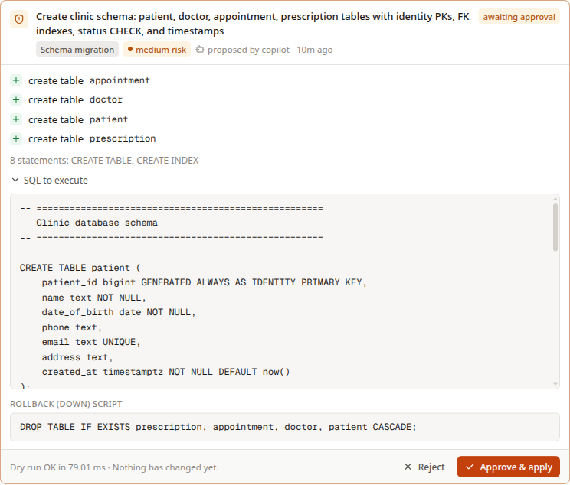
Every change is rehearsed before anyone approves it
03 / THE APPROVAL GATE
01
Dry run for real
Execute inside a transaction, then ROLLBACK. DDL is transactional in PostgreSQL.
02
Measure the impact
Rows touched, before-images, schema diff, cascaded deletes.
03
Score the risk
Low auto-commits; medium and high wait for a person.
04
Commit with a drift check
Rolled back if it now touches more rows than approved.
05
Audit and undo
Append-only log; reverse statement for reversible writes.
Real card: the copilot's 4-table clinic schema, dry-run in 79 ms, not yet applied.
Notes:
Walk through the five steps. Point at the screenshot: create table appointment, doctor, patient, prescription; the exact SQL; the rollback script; 'Dry run OK in 79 ms. Nothing has changed yet.'

Slide 23


Risk is measured by the dry run, not guessed
03 / RISK POLICY
Risk | Examples | What happens
LOW | INSERT; UPDATE or DELETE touching at most 1 row | Auto-commit (optional), still undoable
MEDIUM | 2 to 100 rows; CREATE TABLE / INDEX / VIEW; ALTER ADD | Approval card with preview
HIGH | No WHERE; over 100 rows; DROP; TRUNCATE; ALTER DROP | Red approval + automatic pg_dump backup
Cascades are counted
Sequences are rewound
A DELETE that cascades through ON DELETE CASCADE reports every affected table, counts towards risk, and is not offered as reversible.
Rolled-back inserts still consume serial ids. Each dry run snapshots sequences and rewinds them with a compare-and-set.
Notes:
The risk depends on what the dry run actually touched. The two notes at the bottom are subtle PostgreSQL behaviours we found while testing: cascades silently change other tables, and sequences are not transactional.

Slide 24
Deterministic where correctness matters
04 / THE COPILOT
The language model proposes. Code and PostgreSQL decide.
Notes:
Principle one from the agent specification.

Slide 25


One orchestrator, six specialist toolsets
04 / AGENT DESIGN
Specialist | Tools | Who decides
Design / Schema | design_from_er, analyze_normalization | ER validator, textbook mapping, FD algorithms
Query | get_schema, run_query, explain_query | Read-only role; algebra from the syntax tree
Transaction | propose_change | Approval gate and the human
Security | create_business_role, test_access | PostgreSQL GRANTs and row-level security
Tuning | slow_queries, benchmark_index | EXPLAIN ANALYZE before and after, rolled back
Recovery | recent_activity, request_undo, create_backup | Captured before-images, pg_dump
Live context each turn
Current schema and the status of recent approvals; never credentials.
Data is data
Sees at most 30 rows; told to treat values as data, not instructions.
Survives disconnects
Runs as a detached task; the transcript is always saved.
Notes:
The specialists from AGENTS.md are implemented as toolsets in one agent, so the conversation keeps its context. The right-hand column of the table is the point: each specialist's output is checked by something deterministic.

Slide 26
Standard notation, live data
05 / ER DIAGRAM & PRODUCT
The ER diagram is reverse-engineered from the running database, in Chen notation.
Notes:
Now the parts you can see.

Slide 27
Chen ER diagram, derived from the live schema
05 / ER DIAGRAM
REVERSE MAPPING RULES
Foreign key
1:N relationship (diamond)
Junction table
M:N; extra columns become relationship attributes
Composite PK holding an FK
Weak entity, identifying relationship
NOT NULL foreign key
Total participation (double line)
Unique foreign key
1:1 relationship
Notes:
Rectangles are entities, ellipses attributes, underlined ones primary keys, dashed ones foreign keys, diamonds relationships with 1 and N. DEPENDENT is a weak entity in a double rectangle, linked by the identifying relationship dependent_of. works_on is a many-to-many relationship carrying the hours attribute. None of this was drawn by hand.

Slide 28
Readable without scrolling, even for large schemas
05 / LAYOUT
01
Entities first
02
Diamonds on the midpoint
dagre places entity clusters; the gap between ranks is one diamond width, so a diamond fits between its two entities.
Parallel relationships between the same pair fan out along the normal of the line.
rank gap ≥ max diamond width + 16
offset_k = (k − (m−1)/2) · (h + 26)
03
Attributes in the gaps
04
Fit and focus
Each gap between relationship lines holds as many ellipses as fit; if not, the orbit grows.
The direction with the larger fitted scale wins; big schemas focus on one entity and its neighbours.
cap = ⌊span / minSep⌋ + 1
scale = min(W / w, H / h)
Notes:
The layout is computed, not hand-placed. Minimum separation between two ellipses on an orbit of radius R is two times arcsine of width over two R. Gaps too small for that get no attributes, which is why attributes never sit on a relationship line.

Slide 29
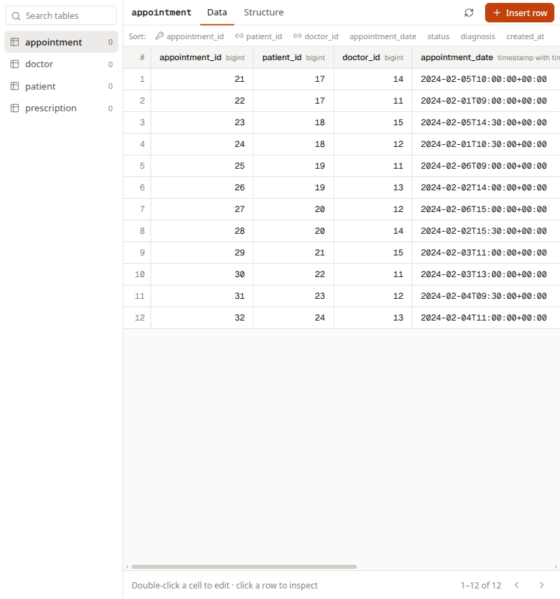
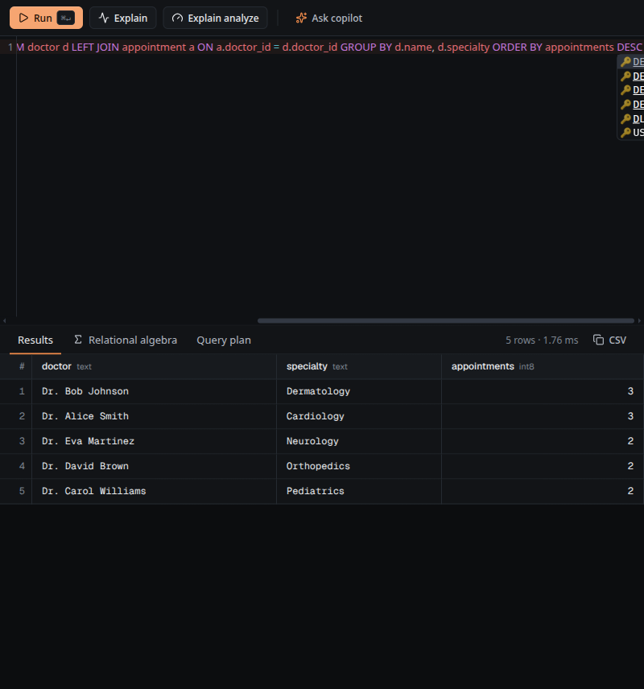
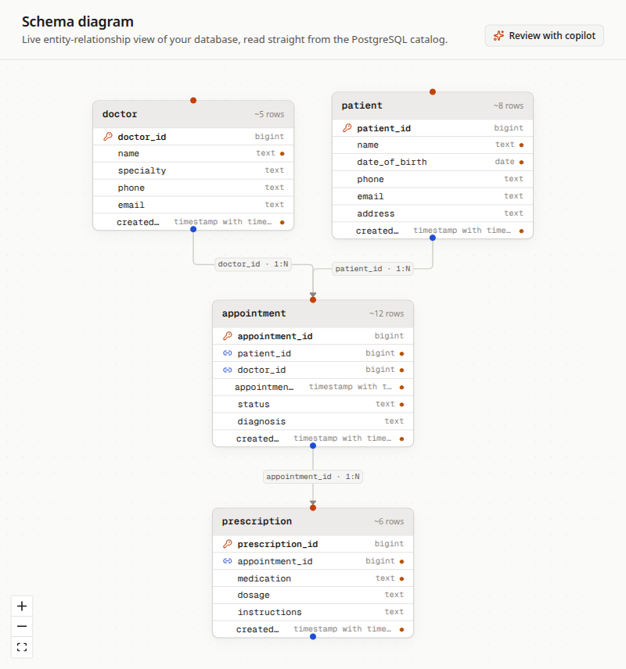
A Supabase-style workspace around the copilot
05 / PRODUCT TOUR
TABLE EDITOR
SQL EDITOR
TABLE DIAGRAM
Inline edits go through the approval gate
Results, relational algebra, real plans
Physical schema from pg_catalog
Notes:
Every screen is backed by live data. Edits in the table editor go through the same approval gate as the copilot's changes. The SQL editor shows the relational algebra computed from the syntax tree, and real EXPLAIN ANALYZE plans.

Slide 30
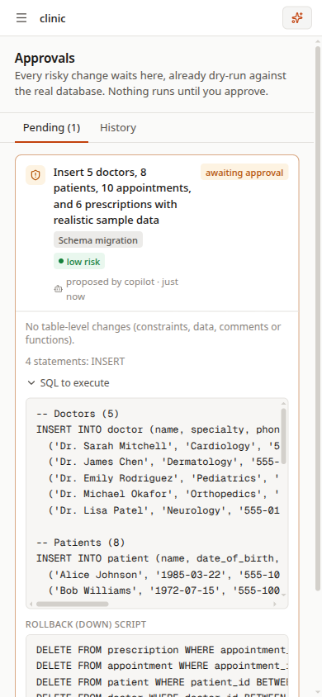
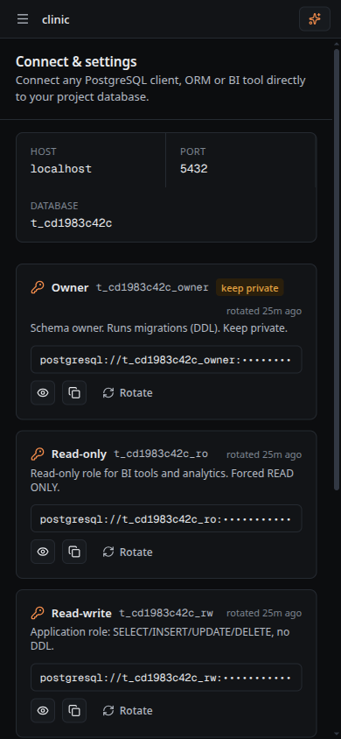
Responsive by construction, not by breakpoints
05 / RESPONSIVE LAYOUT
Copilot docks only if content keeps 640 px
dock = vw − sidebar − panel ≥ 640
Panel width follows the viewport
panel = clamp(0.30 · vw, 340, 760)
Card grids reflow continuously
cols = ⌊(W + gap) / (X + gap)⌋
Fixed sets never leave an orphan
4 items → 1, 2 or 4 columns only
Spacing scales with the container
clamp(1rem, 0.5rem + 2.5cqi, 2rem)
Notes:
Layouts react to the width a component actually gets, using container queries, because opening the copilot changes the space available. The two phone screenshots are real renders at 390 pixels.

Slide 31
Proven against a real PostgreSQL
06 / VERIFICATION
Integration tests create throwaway project databases, attack them, and drop them.
Notes:
Claims are only as good as their tests.

Slide 32
What the test suite proves
06 / EVIDENCE
37
3
0
100%
automated tests, all passing
least-privilege roles per database
rows changed by any dry run
of executed statements audited
Migrations need approval; the dry run leaves nothing behind
Reads are physically read-only, even via a CTE
Multi-row updates need approval; undo restores them
DELETE without WHERE is high risk and reversible
Rejected approvals change nothing
Business roles and row-level security enforced by PostgreSQL
Index benchmarks are what-if only: nothing persists
Backup and restore round-trip; the audit log is tamper-proof
CSRF, authentication and cross-user isolation hold
Table-editor SQL injection is inert
Notes:
Run 'uv run pytest -q' to show all 37 passing. Each line corresponds to one or more tests in tests/integration.

Slide 33


Four real bugs found by running the real thing
06 / ENGINEERING
Dry runs consumed serial ids
FIX
Snapshot sequences, rewind with compare-and-set
A seed that referenced doctor_id = 1 failed after its own dry run.
Cascades were invisible
FIX
Walk FK graph, count rows, mark not reversible
Deleting a patient silently deleted appointments.
Long model pauses killed the stream
FIX
Detached runs, keepalives, client reconnect
The proxy closed idle requests after 30 seconds.
A prompt could be sent twice
FIX
Synchronous in-flight guard
Development mode ran the hand-off effect twice.
Notes:
These were found by driving the real product in a browser against a real database, not by reading code. Each one now has a regression test or a guard.

Slide 34
Syllabus coverage, units 1 to 13
06 / SYLLABUS 1 OF 2
# | Syllabus topic | How DBForge uses it | Status
1 | DBMS basics, 3-schema architecture | Control plane vs project databases; per-role views as external schemas | BUILT ON
2 | ER model: entities, attributes, keys | Chen ER diagram from the live schema; design_from_er | BUILT ON
3 | Cardinality, participation, weak entities, ISA | 1/N/M, total participation, weak entity + identifying relationship | BUILT ON
4 | ER to relational mapping | Textbook rules in tools/mapping; reverse mapping for the diagram | BUILT ON
5 | Relational model, keys, integrity constraints | PK, FK, UNIQUE, CHECK, NOT NULL in every schema | BUILT ON
6 | Relational algebra | σ π ⋈ γ generated from each SELECT's syntax tree | BUILT ON
7 | Relational calculus (TRC / DRC) | Calculus view of a query | PLANNED
8 | SQL: DDL, DML, joins, subqueries, views | Every screen, migration and undo is SQL | BUILT ON
9 | Functional dependencies, closure, cover | Declared + data-observed FDs; closure and minimal cover | BUILT ON
10 | Candidate keys, prime attributes | Computed for every analysed table | BUILT ON
11 | Normalisation 1NF to BCNF | Normal form per table; generated 3NF/BCNF migrations | BUILT ON
12 | Lossless join, dependency preservation | Chase tableau; join-back EXCEPT check on real data | BUILT ON
13 | Indexing, B+-trees | FK indexes in generated DDL; what-if index benchmark | BUILT ON
Notes:
Units 1 to 13 of SYLLABUS_MAPPING.md. 'Built on' means DBForge depends on the concept to work, not just that it can demonstrate it. Relational calculus is the one gap here.

Slide 35
Syllabus coverage, units 14 to 25
06 / SYLLABUS 2 OF 2
# | Syllabus topic | How DBForge uses it | Status
14 | File organisation, storage | Table and index sizes from pg_total_relation_size | PARTLY
15 | Query processing and optimisation | EXPLAIN ANALYZE plans; measured before/after | BUILT ON
16 | Transactions, ACID | Rolled-back dry runs; atomic migrations; drift check | BUILT ON
17 | Schedules, serializability | Two-session precedence-graph lab | PLANNED
18 | Concurrency control: 2PL, MVCC | SELECT … FOR UPDATE claims; READ ONLY snapshots | BUILT ON
19 | Deadlocks | lock_timeout bounds waits; detection demo still to add | PARTLY
20 | Isolation levels and anomalies | READ ONLY reads; anomaly lab still to add | PARTLY
21 | Recovery: log, undo, backups | Append-only audit log, before-image undo, pg_dump / pg_restore | BUILT ON
22 | Security: authorisation, GRANT / REVOKE | Database + 3 roles per project; business roles; RLS | BUILT ON
23 | Triggers, stored procedures | PL/pgSQL function + trigger guard the audit log | BUILT ON
24 | Distributed DB, replication | Read replicas and tenant placement | PLANNED
25 | NoSQL, CAP (overview) | JSONB documents for chat history and policies | PARTLY
Notes:
Units 14 to 25. The planned items, a serializability lab, deadlock and isolation-anomaly demos and replication, are listed as next steps. Partly means the concept is used but not yet shown as a dedicated demo.

Slide 36


Limitations and next steps
06 / HONEST LIMITS
TODAY
NEXT
Nemotron Ultra is accurate but slow: long seeds take 2 to 3 minutes
Specialists are toolsets in one agent, not separate model calls
Rate limiting is in-process (single server)
Undo covers single-table writes with a primary key
Concurrency lab: lost update, deadlock, isolation levels
Schema-evolution view with ER and table diffs
Redis-backed limits and queue for multiple replicas
Faster model option per task (switch with one setting)
Notes:
Be upfront about limits. The model can be swapped by changing AGENT_MODEL in the environment file.

Slide 37
See it run
LIVE DEMO / FIVE MINUTES
01
New project from a description
02
Approve the copilot's schema
Describe a clinic, approve the schema, query it, break it, undo it, and lock it down by role.
03
Seed data, then query with algebra and plan
04
DELETE without WHERE, then undo
05
Receptionist role denied by PostgreSQL
Notes:
Follow docs/HOW_IT_WORKS.md section 9 for the exact demo script. Start the stack with ./scripts/dev.sh and open http://localhost:3000.

