Slide 1
Sales Data Analysis & Business Insights
Data Analytics Internship Project
This presentation explains the process of analyzing sales data to discover important business insights. The project was completed as part of the Apex Planet Data Analytics Internship. It involves collecting and cleaning the dataset, performing exploratory data analysis, building an interactive dashboard, and finally presenting business insights using data storytelling techniques. The main goal of the project is to understand how sales performance varies across product categories, regions, and time periods so that organizations can make better data-driven decisions.
ORGANISSTION : APEX PLANET
BY :YOGESHWAR

Slide 2
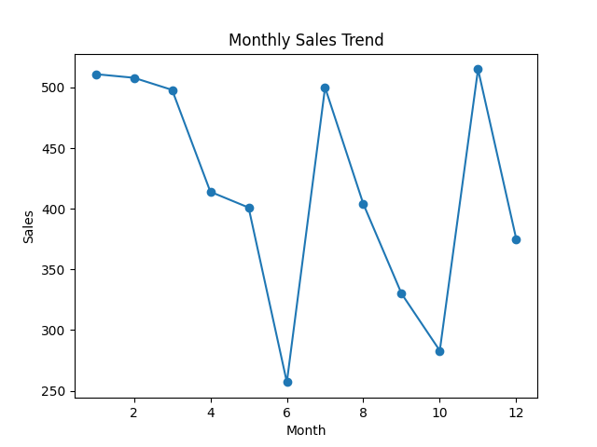
Project Objective
Understanding Business Performance Through Data
The primary objective of this project is to analyze sales data and identify meaningful trends that can help businesses improve their decision-making process. The analysis focuses on understanding how sales, profit, and product categories affect overall business performance. The project also aims to demonstrate how data analytics tools such as Power BI can transform raw datasets into clear visual insights. By studying patterns in the data, organizations can identify opportunities to increase revenue, improve profitability, and enhance operational efficiency.

Slide 3
Dataset Overview
Understanding the Structure of the Dataset
The dataset used in this project contains detailed records of sales transactions. It includes important fields such as order date, product name, category, region, sales value, profit, and quantity of items sold. These variables help in understanding customer purchasing patterns and business performance. By analyzing these attributes, analysts can determine which products generate the highest revenue, which regions contribute the most profit, and how sales change over time. This information is essential for strategic planning and performance evaluation.

Slide 4
Data Cleaning (Task 1)
Preparing Data for Accurate Analysis
Before starting the analysis, the dataset was cleaned to ensure accuracy and reliability. Data cleaning involved identifying missing values, removing duplicate records, and correcting inconsistent formats in the dataset. Date columns were standardized, and numerical columns such as sales, profit, and quantity were verified for correctness. This step is important because incorrect or incomplete data can lead to misleading conclusions. After cleaning, the dataset became ready for further analysis and visualization.

Slide 5
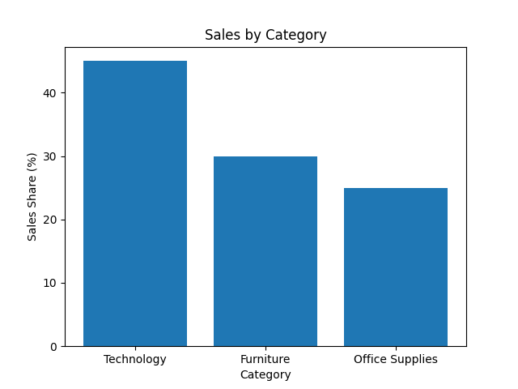
Exploratory Data Analysis (Task 2)
Discovering Patterns and Relationships
Exploratory Data Analysis was conducted to better understand the distribution of the data. Various visualization techniques such as histograms, bar charts, and scatter plots were used to examine relationships between variables. This process helped identify trends such as which product categories generate the highest sales and how profit varies across regions. EDA also helped detect potential outliers and patterns that would later be explored in the interactive dashboard.

Slide 6
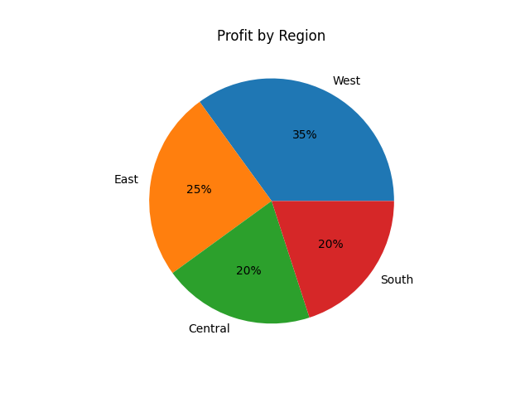
Interactive Dashboard (Task 3)
Visualizing Data with Power BI
A dynamic and interactive dashboard was developed using Power BI to visualize key metrics from the dataset. The dashboard includes KPI cards that display total sales, total profit, and total quantity sold. Additional charts show sales trends over time, category-wise sales distribution, and regional profit comparisons. Interactive filters allow users to explore the data in more detail and focus on specific regions or product categories. This makes the dashboard a powerful tool for business decision-making.

Slide 7
Key Insights from Dashboard
Important Findings from the Analysis
The analysis of the dashboard revealed several meaningful insights about sales performance and business trends. It was observed that the Technology category contributes the largest share of total sales, outperforming other categories such as Furniture and Office Supplies. This indicates that technology products have strong customer demand and play a major role in generating revenue for the business.
The regional analysis shows that some regions generate significantly higher profit compared to others, which suggests stronger market demand, better customer engagement, or more effective sales strategies in those areas. Understanding these regional differences can help businesses focus their marketing efforts and resource allocation in the most profitable markets.
Another important observation is that certain products achieve high sales volumes but generate relatively lower profit margins. This could be due to factors such as high production costs, discount strategies, or competitive pricing. Businesses should carefully evaluate these products and consider adjusting pricing strategies, reducing costs, or improving supply chain.

Slide 8
Statistical Validation
Testing Business Hypotheses
To support the insights obtained from the dashboard, a basic statistical hypothesis test was performed. The null hypothesis assumed that there is no significant difference in sales among product categories. The alternative hypothesis suggested that product categories do influence sales performance. The analysis indicates that differences between categories are meaningful, supporting the idea that businesses should focus on category-based strategies to improve overall revenue.
This statistical validation helps ensure that the insights obtained from the data are not based on random patterns but on measurable differences within the dataset. By applying hypothesis testing, analysts can provide stronger evidence for business decisions. The results highlight that certain product categories consistently outperform others in terms of sales contribution. This means businesses can prioritize these high-performing categories when planning marketing campaigns and product promotions. Additionally, focusing on category-level strategies can help organizations allocate resources more effectively and improve long-term revenue growth

Slide 9

Business Recommendations
Strategic Actions for Improvement
Based on the findings from the analysis, several business recommendations can be proposed. Companies should focus marketing and promotional activities on high-performing product categories such as technology products. Products with high sales but low profit margins should be reviewed to improve pricing or reduce costs. Businesses should also explore opportunities to expand operations in regions that demonstrate strong sales and profitability.

Slide 10

Conclusion
Importance of Data-Driven Decision Making
This project demonstrates how data analytics can convert raw data into meaningful insights that support strategic business decisions. Through data cleaning, exploratory analysis, interactive dashboard creation, and statistical validation, the project provides a clear understanding of sales performance. Using tools like Power BI helps organizations visualize complex data and identify trends that may not be immediately obvious. Overall, the project highlights the importance of data-driven decision-making in modern businesses.

