Slide 1

Non Violent Communication in Intimate Relationships: An Introduction
Elaine Shpungin, Ph.D.
UIUC Psychological Services Center
505 E. Green St., 3rd floor
Mikhail Lyubansky, Ph.D.
Department of Psychology

Slide 2

Non Violent Communication (NVC)
Marshall Rosenberg, Ph.D. (founder)

Slide 3
Nonviolent Communication (NVC):
A guiding philosophy (compassion, power-with, dignity, mutuality)
A communication method that supports the philosophy
An approach that has been successfully applied to:
  interpersonal relationships (couple, parent-child, roommate)
  social and personal change efforts (therapy, coaching, advocacy, persuasive communication)
  business practices (in organizations, agencies)
  communities and systems (schools, prisons)
  conflict resolution (within and between groups)

Slide 4
Imagine if…
Scenario 1
Imagine you are rushing to make it to a 9am meeting with a specific person you know. (Write down name of person)
You get there 8:58. The other person arrives 9:10.
Please write down (briefly):
  What are you feeling and thinking?
  Why?
  How might you act toward person as a result?

Slide 5
Imagine if…
Scenario 2
Imagine you are rushing to make it to a 9am meeting.
You get there 9:10 just as the other person is rushing in, also at 9:10.
Please write down (briefly):
  What are you feeling and thinking?
  Why?
  How might you act toward person as a result?

Slide 6
NVC Model
Evaluations
Strategies
Feelings
Needs

Slide 7
NVC MODEL
APPLIED TO SCENARIO 1
Evaluations
Disorganized
Strategies
Doesn’t care
Frown
Feelings
Make promise to self
Untimely
Needs
Disappointed
Use sarcasm
Incompetent
Anxious
Untrustworthy
Demand apology
Trust, Respect
Productivity
Jerk
Annoyed
Angry
Threaten
Avoid
Frustrated
Express feelings
Selfish
Speak in clipped tones
Rude
Clueless

Slide 8

The goal of Nonviolent Communication is to:
- listen beyond Strategies and Evaluations to the Needs underneath
- speak to the Needs of those involved
- create strategies that meet everyone’s needs (no compromise)
Evaluations
Strategies
Feelings
Needs

Slide 9
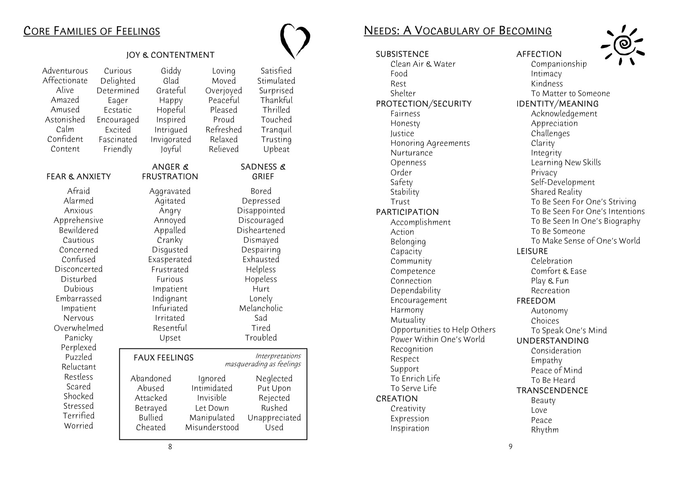

Slide 10
NVC Intimate Communication Makeover
Observations
Needs-based empathy
Needs-based honesty
Needs-based self-reflection
Regret, Mourning
Self Acceptance
Needs-based requests
Evaluations
Criticisms
Judgments
Self-blame
Guilt
Shame
Demands
Coercion
Threats

Slide 11
NVC Makeover Components (some definitions)
Observations: Describing a behavior or event without evaluation words, just as a video-camera would show it.
E: “I notice your car is in the middle of the driveway”
Needs Based Empathy: Connecting to and being present with the needs of the other (their hopes, wants, what might be important to them).
E: “Were you hoping to make your life a little easier by not having to deal with bushes?”
M: “Are you feeling frustrated b/c we talked about this last time and it happened again?”
Needs Based Honesty: Sharing your own needs without blame or expectation - when the other person is truly ready to hear you.
E: “It’s important to me that I can count on you following through with agreements so that I can trust you and count on you.”
Needs-based Self-Reflection: Connecting to and being present with your immediate, as well as “larger” needs (hopes, wants, what is important to you).
M [internal dialogue]: I’m feeling annoyed because I want the trust between us to be strong enough to resist small failures to follow through.
Needs-based Requests: Clear communication about a strategy that would help meet a need of yours (different from a demand)
What might a request look like?.

Slide 12
Role play with Rosenberg
Class Demonstration?

Slide 13
Further Resources
Center for Nonviolent Communication
www.cnvc.org (includes workshop schedule, trainer info, and complete list of books and videos)
Conflict Hotline (live role plays with NVC coach)
www.youtube.com (type in “conflict hotline”)
NVC Academy (telecourses, audio-courses, and free materials)
www.nvctraining.com

