Slide 1
Project proposal
Team number 12
Arnav Kumar
Prathamesh Koranne

Slide 2
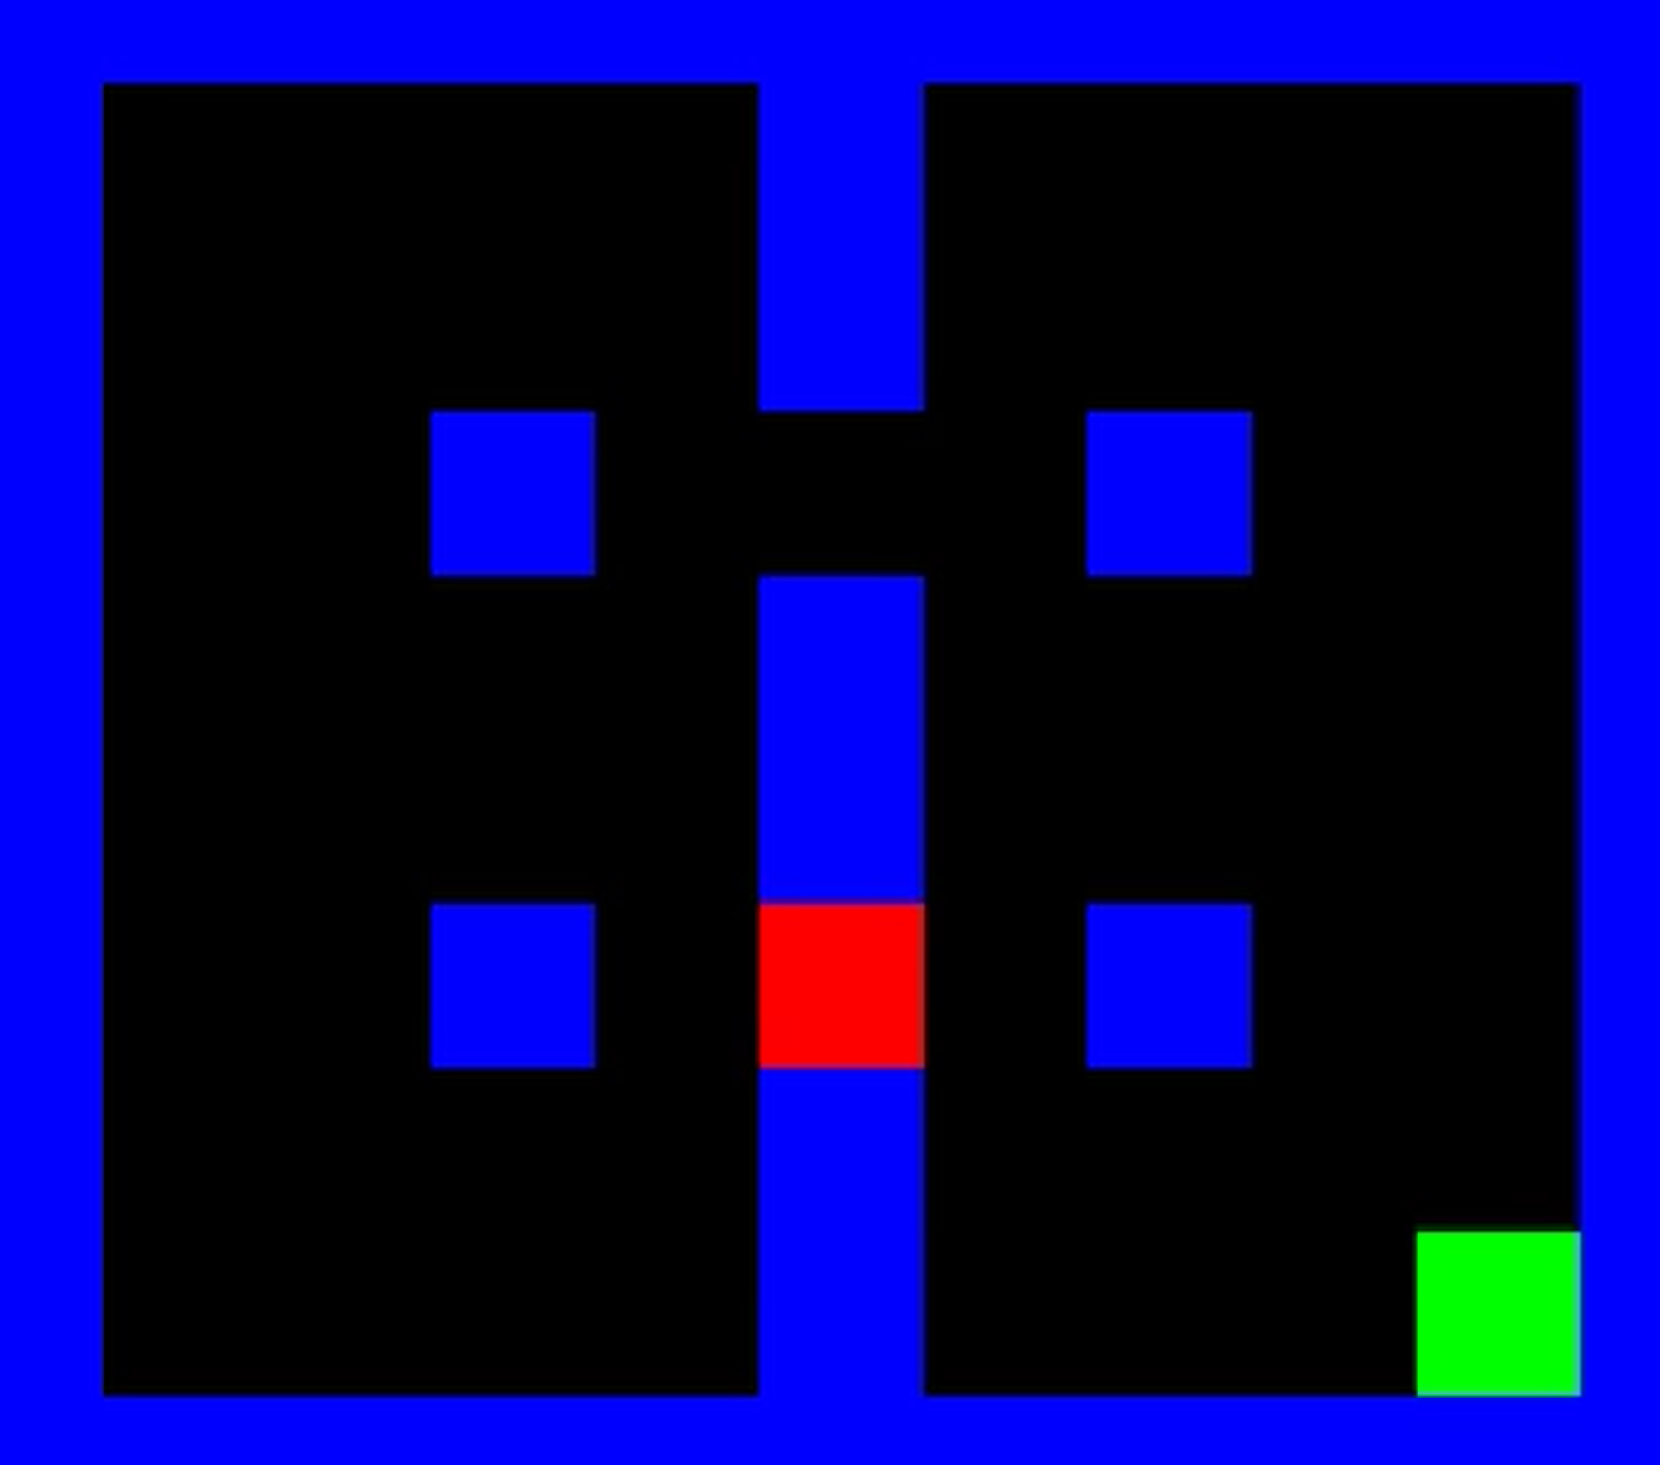
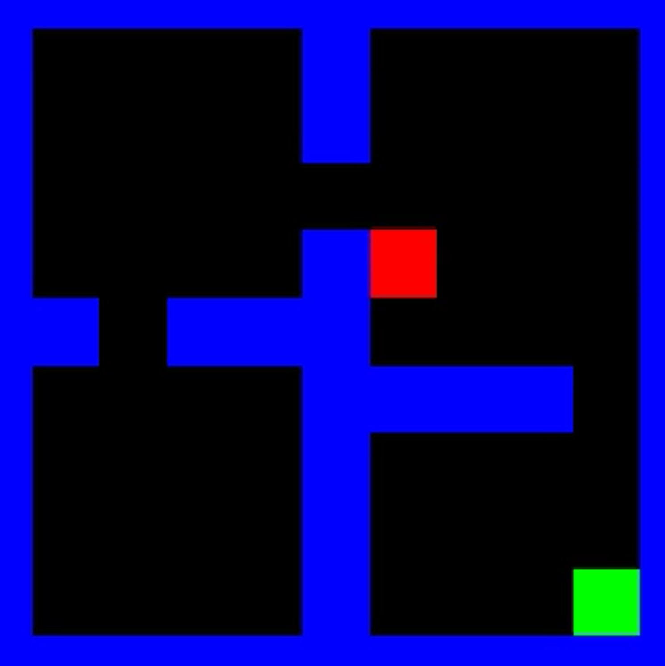
Goal
Solve 2 medium maps as defined on the GitHub repository

Slide 3
Proposed approach
Algorithm :- TD-Lambda
Heuristics:-
Distance based
Strategic position based
Collisions

Slide 4
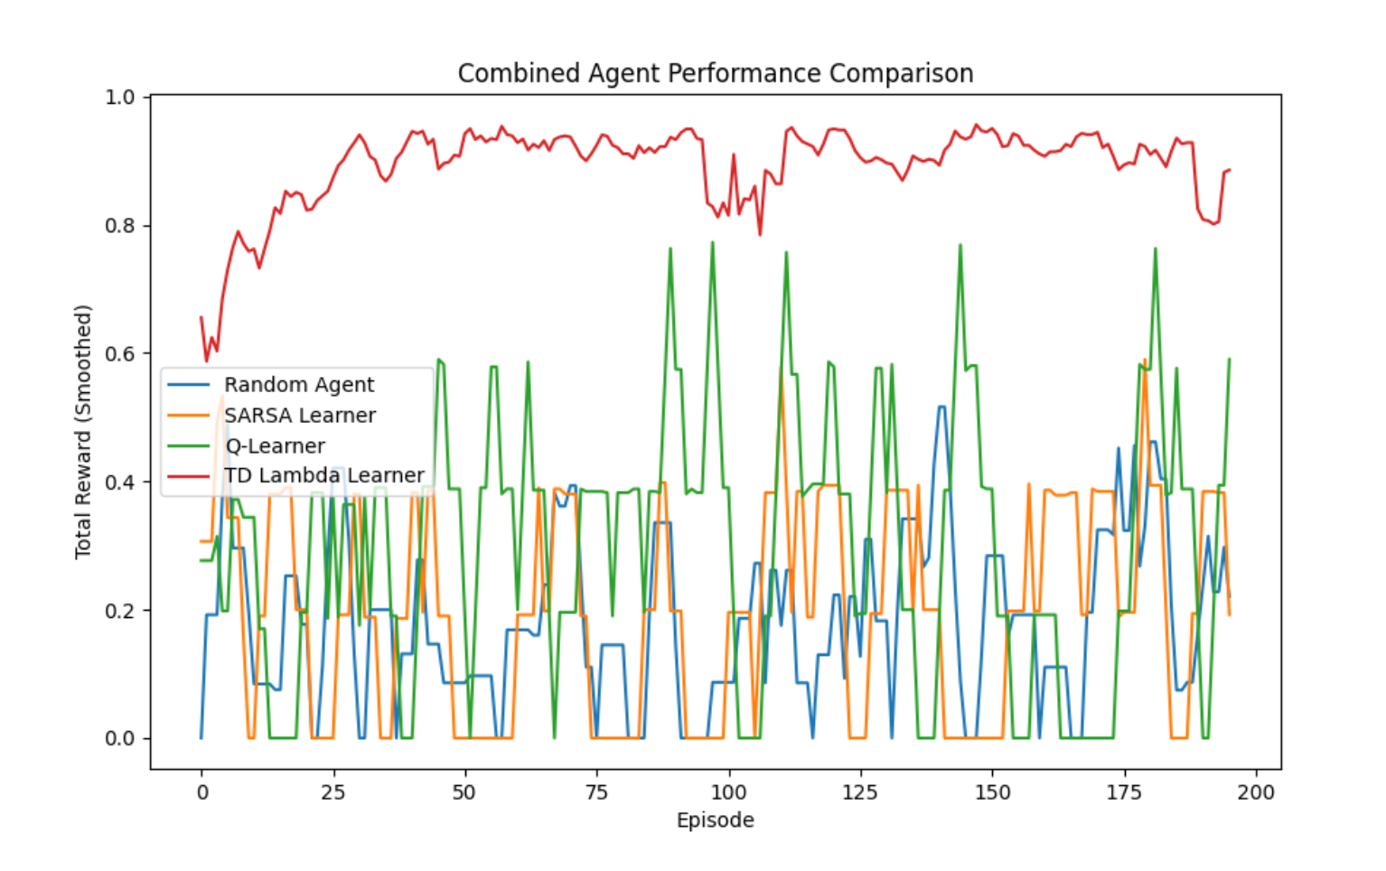
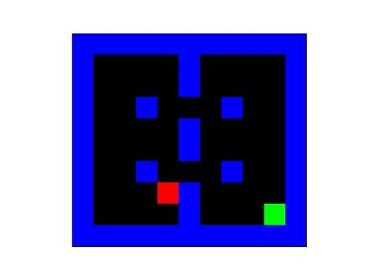
Feasibility study and results

Slide 5
Future plan and improvements
Hierarchical initialisation
Hyper parameter tuning

