Slide 1

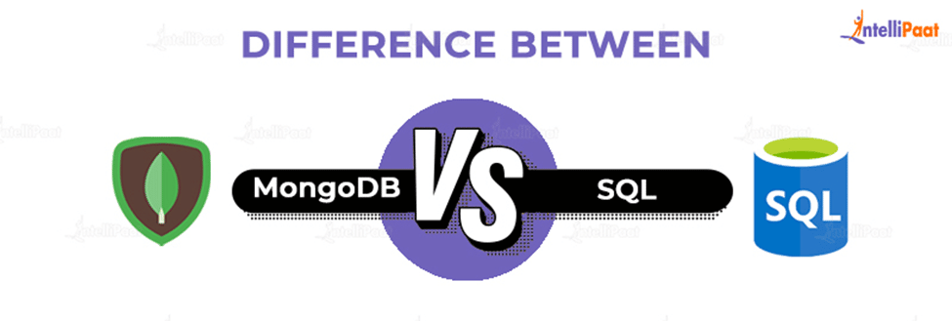

Slide 2





MONGO D.B
High Performance Data can be quickly stored, manipulated, and retrieved without any compromise on data integrity.
Scalability The scalability of MongoDB handles a growing amount of data capably.
Availability
Data is highly available with MongoDB as it makes multiple copies of the same data and sends copies of data across different servers.
Flexibility
MongoDB can easily be combined with different Database Management Systems, both SQL and NoSQL types.

Slide 3

S Q L
Cloud Database Support
Cloud database support makes SQL Server highly available, fast failover with minimum uptime.
Ease of Management
Microsoft SQL Servers can easily be used with Windows and Linux systems.
High Security
Data in SQL Server is encrypted and highly secured. Schemas and Tables can be password protected easily and can be accessed with permissions only
End-to-End Business Data Solutions Microsoft SQL Server offers tools for Data Administration, ETL solutions, Online Analytical Processing(OLAP), and Data Mining purposes.

Slide 4

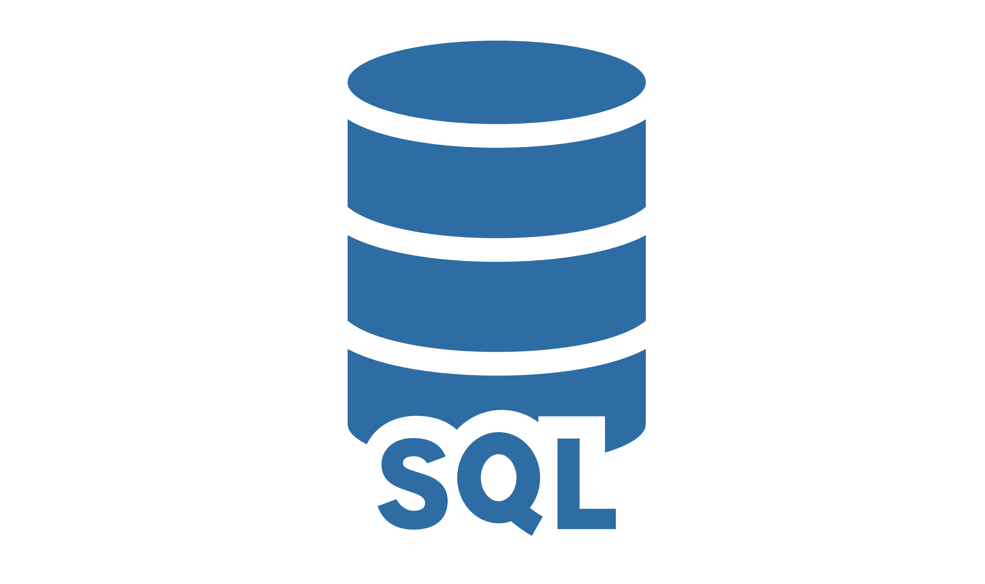
* Non-Relational Database: Document-oriented (key-value structure).
JavaScript, Python, Java, PHP, C++, C, Ruby, Perl
Open-Source.
Dynamic Schema.
MongoDB Query Language.
Relational Database: Tables format.
C, C++
License required.
Fixed Schema.
SQL Query Language.

Slide 5

Merci!

