Slide 1
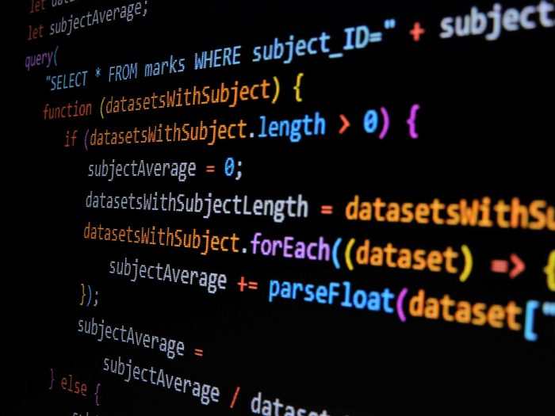
full stack javascript project
All About the app

Slide 2





App name : YOURDAILY Dev : Bouazzi Mondher
Movie Review
Profile
Search for movies by title and look for reviews.
Every User have his own profile page
Posts
Sign In / Sign Up
Website where users can share posts and thoughts and also review movies Added by an Admin.
Everyones Posts in one page where Users can read it and share it

Slide 3
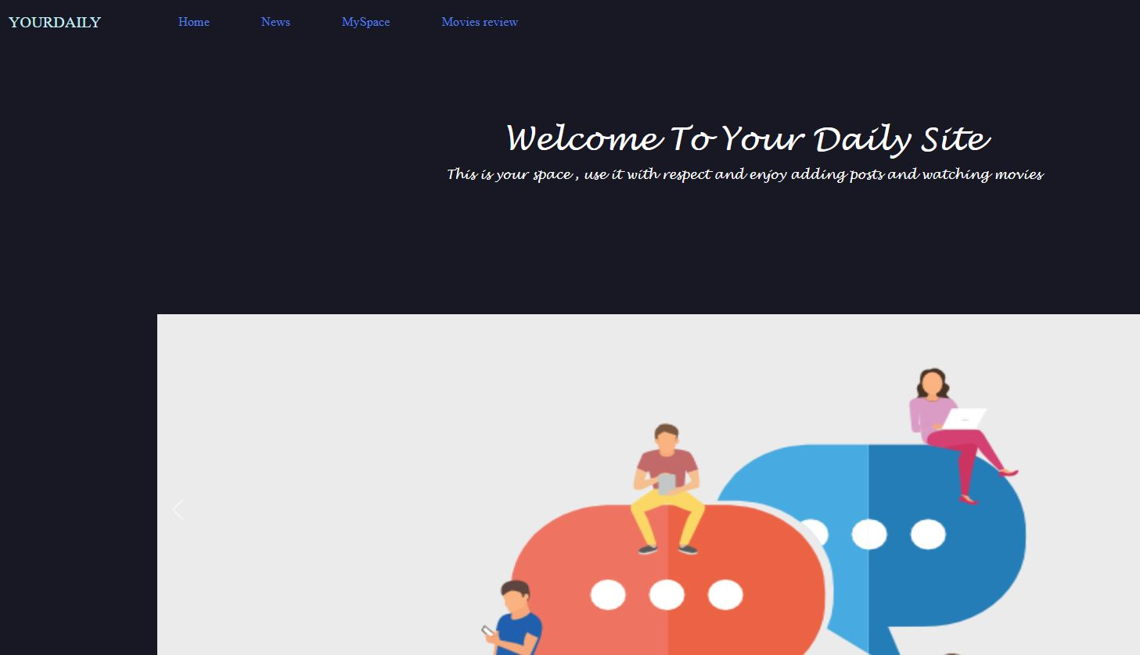
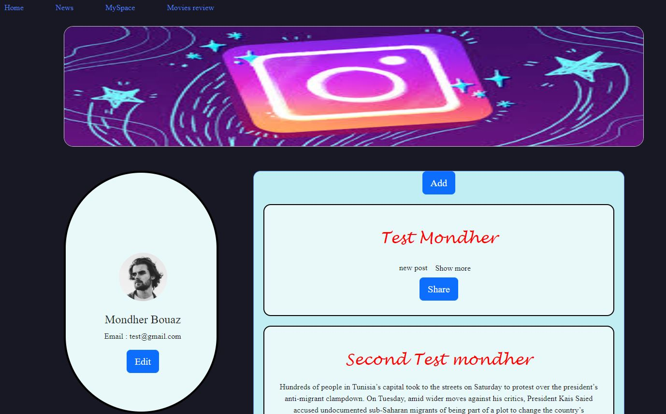
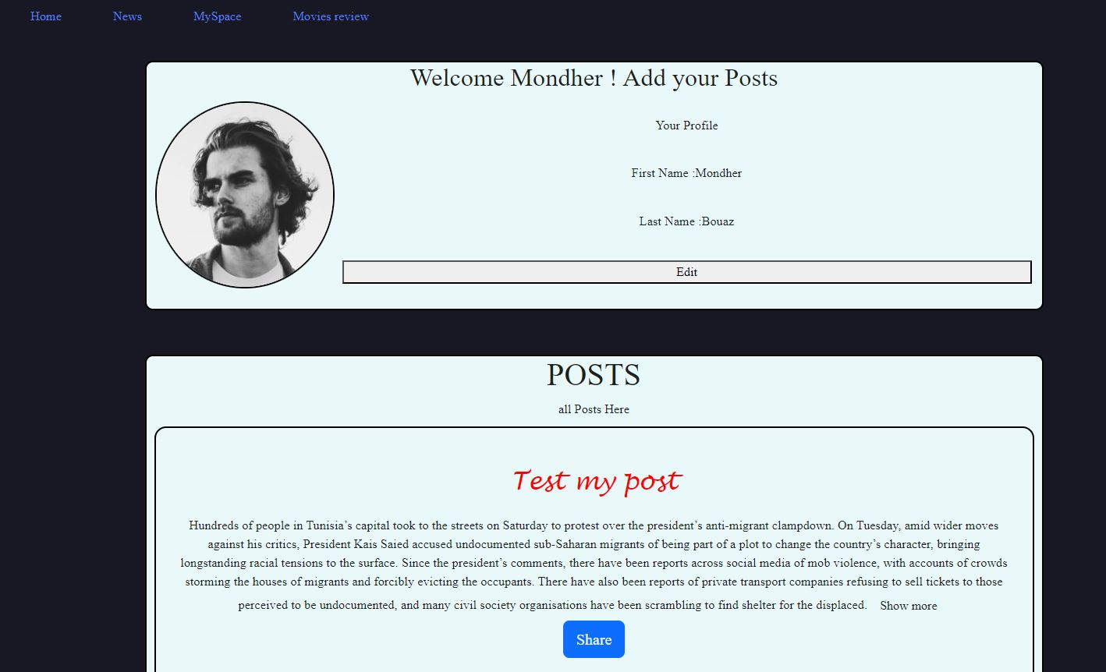
Some Photos

Slide 4
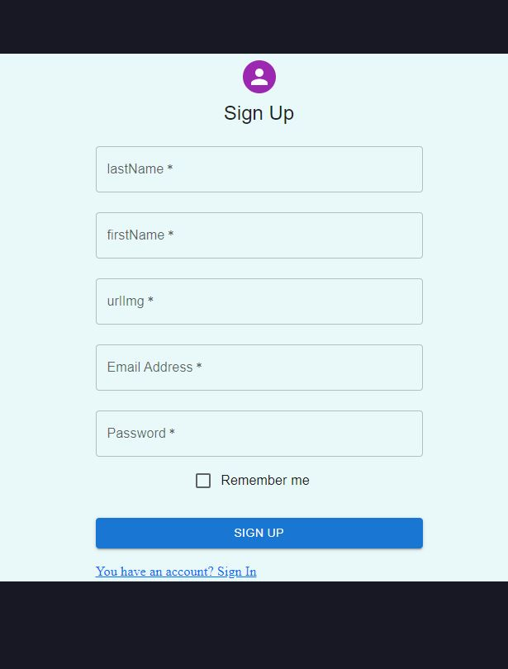
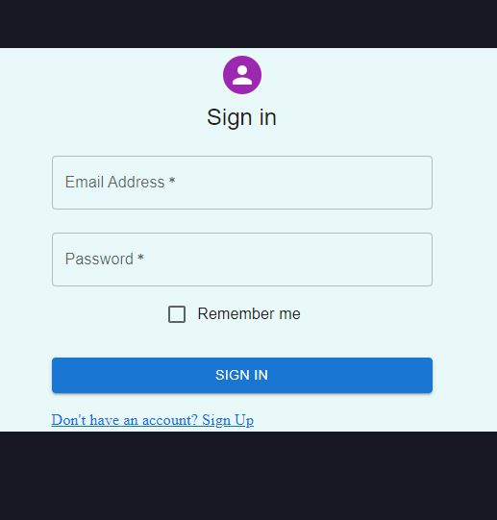
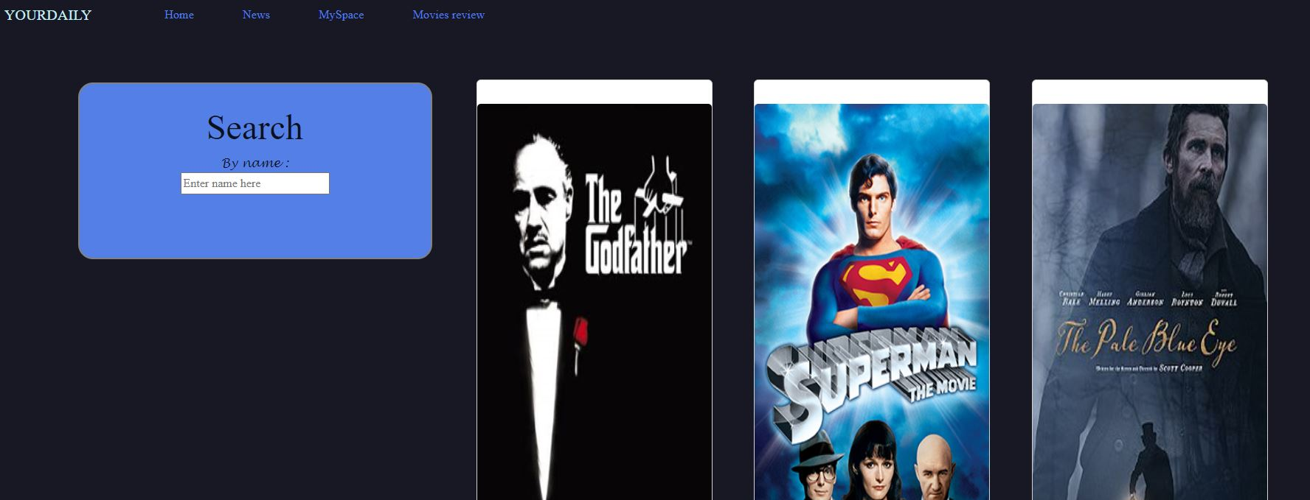

Slide 5
Thank You For This Scientific Adventure Of Coding .. And Thanks For Our Instructor Saif Boubaker.

