Slide 1
Web Service Architecture

Slide 2
Table of Contents
What’s Web Service?
Web Service Model
Different types of Web services
Architecture Overview
  SOAP
  WSDL
  UDDI
Conclusion
Notes:
Keyword: Java API for XML Web Services (JAX-WS).
JAX-WS stands for Java API for XML Web Services. JAX-WS is a technology for building web services and clients that communicate using XML. JAX-WS allows developers to write message-oriented as well as RPC-oriented web services.
In JAX-WS, a web service operation invocation is represented by an XML-based protocol such as SOAP. The SOAP specification defines the envelope structure, encoding rules, and conventions for representing web service invocations and responses. These calls and responses are transmitted as SOAP messages (XML files) over HTTP.
Although SOAP messages are complex, the JAX-WS API hides this complexity from the application developer. On the server side, the developer specifies the web service operations by defining methods in an interface written in the Java programming language. The developer also codes one or more classes that implement those methods. Client programs are also easy to code. A client creates a proxy (a local object representing the service) and then simply invokes methods on the proxy. With JAX-WS, the developer does not generate or parse SOAP messages. It is the JAX-WS runtime system that converts the API calls and responses to and from SOAP messages.
With JAX-WS, clients and web services have a big advantage: the platform independence of the Java programming language. In addition, JAX-WS is not restrictive: a JAX-WS client can access a web service that is not running on the Java platform, and vice versa. This flexibility is possible because JAX-WS uses technologies defined by the World Wide Web Consortium (W3C): HTTP, SOAP, and the Web Service Description Language (WSDL). WSDL specifies an XML format for describing a service as a set of endpoints operating on messages.

Slide 3
What’s Web Service?
A Web service is a method of communication between two electronic devices over World Wide Web. A Web service is a software function provided at a network address over the web or the cloud;… (Wiki).
…
Notes:
Utility computing:

Slide 4
Web Services: The Next Horizon for e-business
Allow companies to reduce the cost of doing e-business, to deploy solutions faster
  Need a common program-to-program communications model
Allow heterogeneous applications to be integrated more rapidly, easily and less expensively
Facilitate deploying and providing access to business functions over the Web

Slide 5
Table of Contents
What’s Web Service?
Web Service Model
Different types of Web services
Architecture Overview
  SOAP
  WSDL
  UDDI
Conclusion
Notes:
Keyword: Java API for XML Web Services (JAX-WS).
JAX-WS stands for Java API for XML Web Services. JAX-WS is a technology for building web services and clients that communicate using XML. JAX-WS allows developers to write message-oriented as well as RPC-oriented web services.
In JAX-WS, a web service operation invocation is represented by an XML-based protocol such as SOAP. The SOAP specification defines the envelope structure, encoding rules, and conventions for representing web service invocations and responses. These calls and responses are transmitted as SOAP messages (XML files) over HTTP.
Although SOAP messages are complex, the JAX-WS API hides this complexity from the application developer. On the server side, the developer specifies the web service operations by defining methods in an interface written in the Java programming language. The developer also codes one or more classes that implement those methods. Client programs are also easy to code. A client creates a proxy (a local object representing the service) and then simply invokes methods on the proxy. With JAX-WS, the developer does not generate or parse SOAP messages. It is the JAX-WS runtime system that converts the API calls and responses to and from SOAP messages.
With JAX-WS, clients and web services have a big advantage: the platform independence of the Java programming language. In addition, JAX-WS is not restrictive: a JAX-WS client can access a web service that is not running on the Java platform, and vice versa. This flexibility is possible because JAX-WS uses technologies defined by the World Wide Web Consortium (W3C): HTTP, SOAP, and the Web Service Description Language (WSDL). WSDL specifies an XML format for describing a service as a set of endpoints operating on messages.

Slide 6
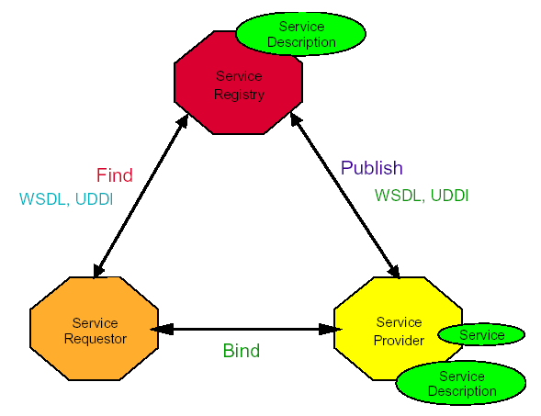
Web Service Model (1/3)

Slide 7
Web Service Model (2/3)
Roles in Web Service architecture
  Service provider
    Owner of the service
    Platform that hosts access to the service
  Service requestor
    Business that requires certain functions to be satisfied
    Application looking for and invoking an interaction with a service
  Service registry
    Searchable registry of service descriptions where service providers publish their service descriptions

Slide 8
Web Service Model (3/3)
Operations in a Web Service Architecture
  Publish
    Service descriptions need to be published in order for service requestor to find them.
  Find
    Service requestor retrieves a service description directly or queries the service registry for the service required.
  Bind
    Service requestor invokes or initiates an interaction with the service at runtime.

Slide 9
Table of Contents
What’s Web Service?
Web Service Model
Different types of Web services
Architecture Overview
  SOAP
  WSDL
  UDDI
Conclusion

Slide 10
Different types of Web services
“Big” Web services
RESTful Web services
Notes:
On the conceptual level, a service is a software component provided through a network-accessible endpoint. The service consumer and provider use messages to exchange invocation request and response information in the form of self-containing documents that make very few assumptions about the technological capabilities of the receiver.
On a technical level, web services can be implemented in various ways. The two types of web services discussed in this section can be distinguished as “big” web services and “RESTful” web services.
“Big” Web services
Big web services use XML messages that follow the SOAP standard, an XML language defining a message architecture and message formats. Such systems often contain a machine-readable description of the operations offered by the service, written in the Web Services Description Language (WSDL), an XML language for defining interfaces syntactically.
RESTful Web services
Representational State Transfer (RESTful) web services. REST is well suited for basic, ad hoc integration scenarios. RESTful web services, often better integrated with HTTP than SOAP-based services are, do not require XML messages or WSDL service–API definitions.

Slide 11
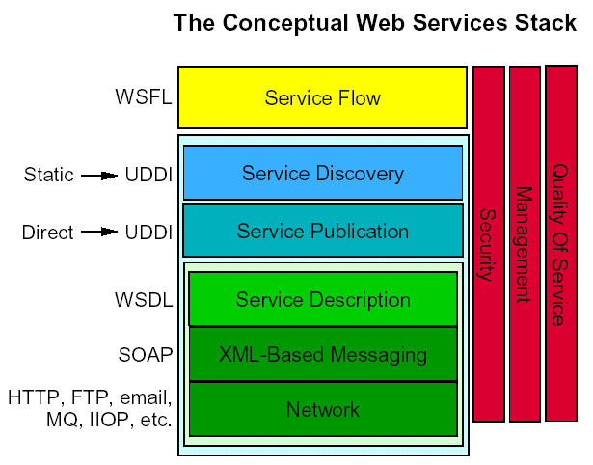
Web Service Stack

Slide 12
SOAP: Simple Object
Access Protocol
What is SOAP?
  SOAP is a communication protocol
  SOAP is for communication between applications
  SOAP is a format for sending messages
  SOAP is designed to communicate via Internet
  SOAP is platform independent
  SOAP is language independent
  SOAP is based on XML
  SOAP is simple and extensible
  SOAP will be developed as a W3C standard

Slide 13
SOAP: Simple Object
Access Protocol
SOAP 1.0: Microsoft, Userland, DevelopMentor
  Specific to COM and HTTP
SOAP 1.1: includes contributions from IBM and Lotus
  Substitutable transport binding (not just HTTP)
  Substitutable language binding (e.g. Java)
  Substitutable data encoding
  Completely vendor-neutral
  Independent of: programming language, object model, operating system, or platform
SOAP 1.2: current working draft from w3.org “XML Protocol” working group

Slide 14
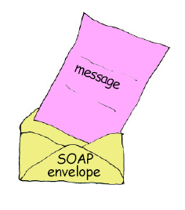
SOAP Message Structure
Application-specific
message vocabulary
Request and Response messages
  Request invokes a method on a remote object
  Response returns result of running the method
SOAP specification defines an “envelop”
  “envelop” wraps the message itself
  Message is a different vocabulary
  Namespace prefix is used to distinguish the two parts
SOAP Envelop vocabulary

Slide 15
SOAP Request Message
SOAP Envelope
Namespace
<?xml version="1.0"?>
<soap:Envelope
xmlns:soap="http://www.w3.org/2001/12/soap-envelope"
soap:encodingStyle="http://www.w3.org/2001/12/soap-encoding">
<soap:Body xmlns:m="http://www.stock.org/stock">
</soap:Body>
</soap:Envelope>
<m:GetStockPrice>
<m:StockName>IBM</m:StockName>
</m:GetStockPrice>
Message
SOAP Envelope
Message
Namespace

Slide 16
SOAP Response Message
<?xml version="1.0"?>
<soap:Envelope
xmlns:soap="http://www.w3.org/2001/12/soap-envelope"
soap:encodingStyle="http://www.w3.org/2001/12/soap-encoding">
<soap:Body xmlns:m="http://www.stock.org/stock">
</soap:Body>
</soap:Envelope>
<m:GetStockPriceResponse>
<m:Price>34.5</m:Price>
</m:GetStockPriceResponse>
Message
Result
returned in
Body
SOAP Envelope

Slide 17
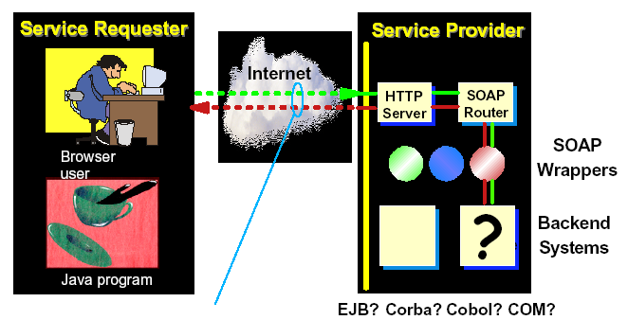
Simple standard XML Message
SOAP hides the technical choices and implementation details from both parties

Slide 18
Why SOAP?
Other distributed technologies failed on the Internet
  Unix RPC – requires binary-compatible Unix implementations at each endpoint
  CORBA – requires compatible ORBs
  RMI – requires Java at each endpoint
  DCOM – requires Windows at each endpoint
SOAP is the platform-neutral choice
  Simply an XML wire format
  Places no restrictions on the endpoint implementation technology choices

Slide 19
SOAP Usage Models
RPC-like message exchange
  Request message bundles up method name and parameters
  Response message contains method return values
  However, it isn’t required by SOAP
SOAP specification allows any kind of body content
  Can be XML documents of any type
  Example:
    Send a purchase order document to the inbox of B2B partner
    Expect to receive shipping and exceptions report as response

Slide 20
Web Services Description Language
What is WSDL?
  WSDL is written in XML
  WSDL is an XML document
  WSDL is used to describe Web services
  WSDL is also used to locate Web services
  WSDL is not yet a W3C standard
Operational information about the service
  Location of the service
  Service interface
  Implementation details for the service interface

Slide 21
WSDL Document Structure (1/2)
<portType> element
  Defines a web service, the operations that can be performed, and the messages that are involved
<message> element
  Defines the data elements of an operation
  consists of one or more parts.
  The parts can be compared to the parameters of a function call in a traditional programming language

Slide 22
WSDL Document Structure (2/2)
<types> element
  Defines the data type that are used by the web service
  For maximum platform neutrality, WSDL uses XML Schema syntax to define data types
<binding> element
  Defines the message format and communication protocols used by the web service

Slide 23
Universal Description, Discovery and Integration (UDDI)
What is UDDI?
  Directory service where businesses can register and search for Web services
    Directory for storing information about web services
    Directory of web service interfaces described by WSDL
  UDDI communicates via SOAP
What is UDDI Based On?
  Uses W3C Internet standards such as XML, HTTP, and DNS protocols
  UDDI uses WSDL to describe interfaces to web services

Slide 24
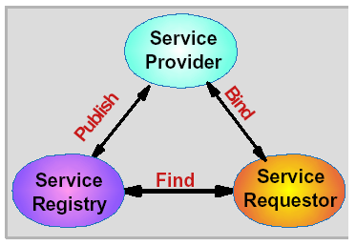
UDDI Roles and Operations
Service Registry
  Provides support for publishing and locating services
  Like telephone yellow pages
Service Provider
  Provides e-business services
  Publishes these services through a registry
Service requestor
  Finds required services via the Service Broker
  Binds to services via Service Provider

Slide 25

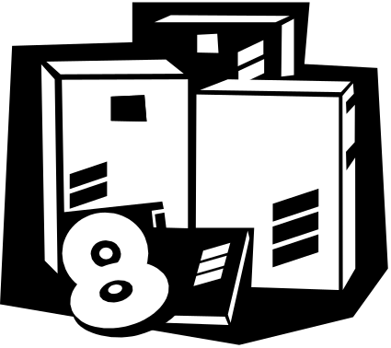
The Big Picture
UDDI Registry
WSDL
Document
Registry refers client to WSDL document
WSDL provides data to interact with web service
Client queries registry to locate service
Client accesses WSDL document
Web service returns SOAP-message response
Client sends SOAP-message request
Client
Web Service Code

Slide 26
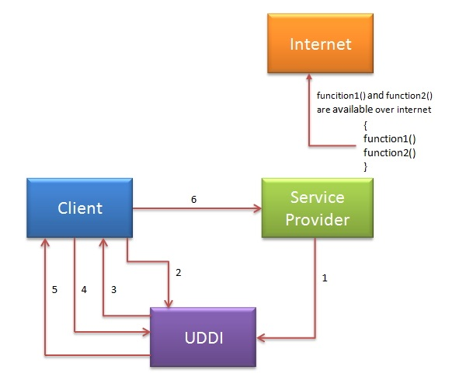
Notes:
Service provider register its WSDL to UDDI and client can access it from UDDI:UDDI stands for Universal Description, Discovery and Integration.It is a directory service. Web services can register with a UDDI and make themselves available through it for discovery.So following steps are involved.
Service provider registers with UDDI.
Client searches for service in UDDI.
UDDI returns all service providers offering that service.
Client chooses service provider
UDDI returns WSDL of chosen service provider.
Using WSDL of service provider,client accesses web service.

Slide 27
Creating a Simple Web Service and Clients with JAX-WS
JAX-WS is bundled with JDK 1.6, which makes Java web service development easier to develop. This tutorial shows you how to do the following tasks:
Create a SOAP-based RPC style web service endpoint by using JAX-WS.
Create a Java web service client manually.
Create a Java web service client via wsimport tool.
Notes:
Reference from: http://www.mkyong.com/webservices/jax-ws/jax-ws-hello-world-example/

Slide 28
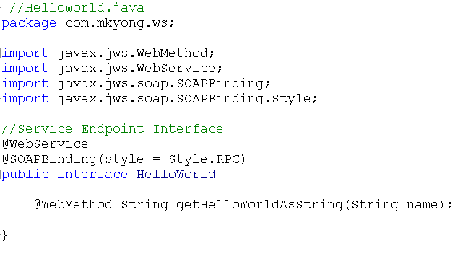
1. Create a Web Service Endpoint Interface

Slide 29
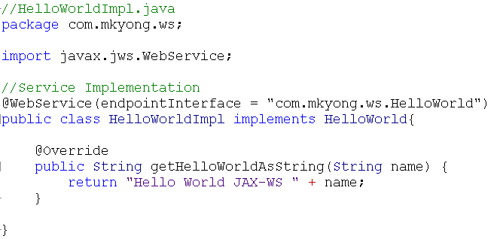
2. Create a Web Service Endpoint Implementation

Slide 30
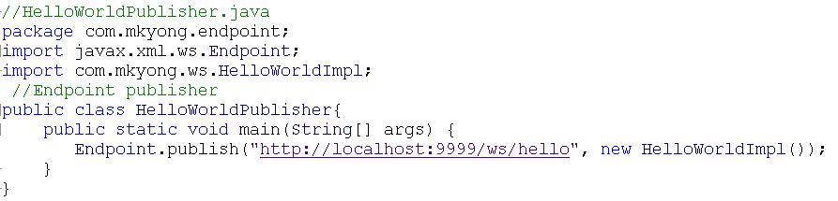
3. Create a Endpoint Publisher

Slide 31
3. Create a Endpoint Publisher
Run the endpoint publisher, and your “hello world web service” is deployed in URL “http://localhost:9999/ws/hello?wsdl“.

Slide 32
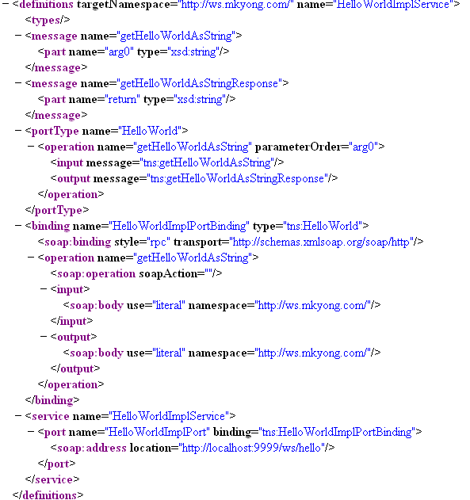

Slide 33
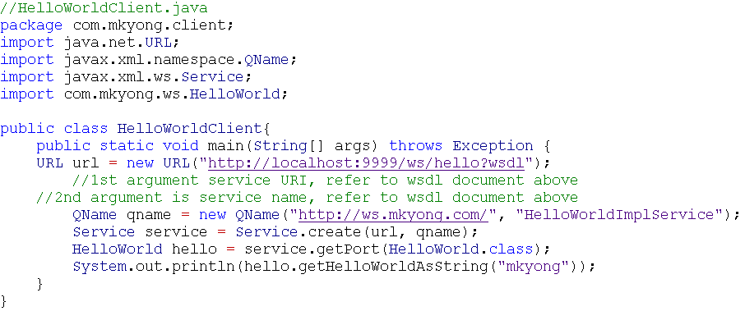
Web Service Clients
Without tool, you can create a Java web service client like this :

Slide 34
Web Service Clients
Without tool, you can create a Java web service client like this :

Slide 35
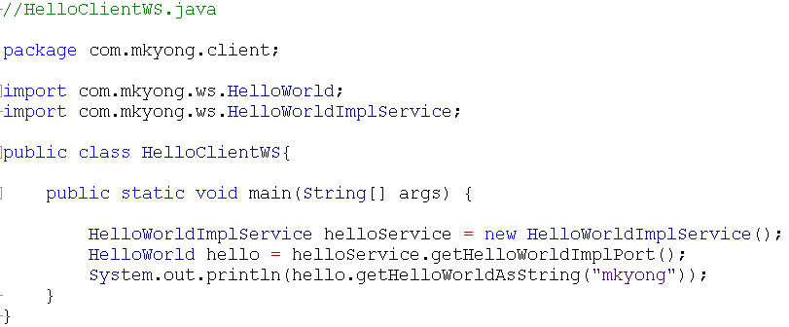
Java Web Service Client via wsimport tool

