Slide 1
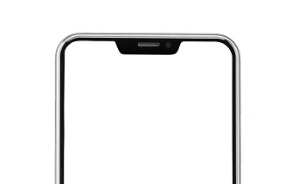
Personalized event recommendation app for UT students
Team: Veja, Alex, Maurice

Slide 2
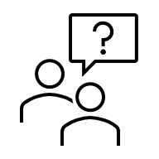

Motivation
Problem
University mailing lists are noisy and overwhelming
Students often miss events relevant to their program or interests
Solution
Extract event information from unstructured university emails
Match events to student profiles and interests
Display a personalized feed of relevant events (talks, workshops, career fairs)
All in a clean, intuitive interface

Slide 3
Getting structured data
Download & save emails as txt files.
Use Qwen2.5-7B-Instruct model via Huggingface to extract structured data from email text.
Title, Description, Start & End Date / Time, Organizer, Location, Speaker, Link

Slide 4
Storing data
Supabase (PostgreSQL + API + Auth)
Central database for all structured event and student data
There is an autogenerated REST API in there
Row Level security (especially when it comes to mails, nothing goes out)
You can have several tables in there
WHY Supabase?
- SQL based (easy to query & refine)
- Integrated authentification & permissions
- Web UI so we can always look at the data

Slide 5
Capacity Supabase (free tier)
Database (500MB) Postgres
Storage (files) : 1 GB (for attachments like images or something)
Monthly bandwith: generous (1–2 GB API traffic before throttling)
Easy upgradeable (scales to tens of GB for a few € / month)
But honestly, for our prototype : hundreds of thousands of events, plenty for testing.

Slide 6
Matching logic
Pipeline Overview:
Text construction: weighted concatenation → title (×4) > subtitle (×2) > description
Embedding:
Model: "paraphrase-multilingual-mpnet-base-v2" (SBERT)
Encodes events + interest descriptions into a shared 768-D space
Score = cosine similarity
Freshness: exponential time decay → boosts upcoming events
Fusion: score = 0.9 × similarity + 0.1 × freshness

Slide 7
Matching logic continued
Optional rerank: "cross-encoder/mmarco-mMiniLMv2-L12-H384-v1": to correct semantic mismatches SBERT might miss
MMR (Maximal Marginal Relevance) diversity (λ = 0.3): to ensure topic variety among top candidates
Other rules for now: skip past events, cap ≤ 2 per day/organizer, ensure ≥ 1 cultural if relevant

Slide 8
Tech stack and UI
Backend: Python, FastAPI
Frontend: Design via Figma & Execution via Typescript, React, Ant UI-Kit
Feature ideas so far:
Profile setup: (study program, interests)
Image generation with AI for event icons
“Recommended for you” list, filters
Export .ics for each event, share link (maybe?)
Additional if there is time: feedback buttons to track interest of user (e.g. “Like/Hide”)

Slide 9
Automation idea
Dockerized ETL fetches mails -> parses -> uploads to Supabase
Container can run identically everywhere
We even could deploy it on an small VM (AWS) with cron schedule
Dashboard queries Supabase directly via client library – RLS ensures secure access.

Slide 10
Project timeline and goals
Environment setup
Data extraction and structuring
Parse mails
Extract key event fields
Data storing
Implement personalization
Match user interests with events
Rank most relevant events
Prototype UI
Enhance user experience
Improve layout and interactivity
Design

