Slide 1
Revenue optimization
Final Presentation
DS405 Machine Learning Applicatios in business and economics
Alexander Unger, Franziska Nagel

Slide 2
First, we need to understand our customers
Notes:
First, we need to understand our customers. The target variable indicates whether a customer places another order within 90 days. As we can see, the majority of customers do not reorder, while only a small fraction return. This imbalance immediately suggests that treating all customers equally would be inefficient and motivates a more targeted approach

Slide 3
Our initial situation is a decision problem with asymmetric costs based on a binary outcome
Sending vouchers out to everyone
Not send vouchers out at all
Either we spend to much money our loose potential customers
Notes:
We have two outcomes: Churner vs Reorder, strong class imbalance, asymmetric costs, naïve strategy fails (sent to everyone, send to no one)
Content:
Sending vouchers to everyone is expensive
Not sending vouchers loses potential customers
Goal: maximize expected revenue, not accuracy
Key sentence:
“This is a cost-sensitive classification problem, where wrong decisions have asymmetric financial consequences.”
→“So the real question is not whether a customer will reorder, but how likely they are to reorder.”

Slide 4
How do we decide who gets a voucher?
Decison | True outcome | Revenue
Send voucher | No reorder | + 1.25 €
Send voucher | Reorder | - 5 €
No voucher | Any | 0 €
Voucher decisions are made using predicted reorder probabilities and their expected revenue impact
Notes:
Although this is a classification task, only customers who receive a voucher affect revenue. Because the costs of wrong decisions are asymmetric, our goal is not to maximize accuracy but to maximize expected revenue. The model therefore predicts reorder probabilities, which we translate into voucher decisions using a custom revenue function. We send vouchers only when the expected gain outweighs the expected loss, and we optimize the probability threshold accordingly.
Given this probability and the costs, is it profitable to send a voucher?

Slide 5
Naive voucher strategies destroy value
benchmark
Notes:
To evaluate the value added by our model, we compare it against simple baseline strategies. Sending vouchers to everyone leads to substantial losses because many customers would reorder anyway. Never sending vouchers yields zero revenue but misses opportunities. A random strategy performs poorly as well. Our model is only useful if it clearly outperforms these baselines in terms of expected revenue
This chart compares simple baseline strategies. Sending vouchers to everyone results in substantial losses because many customers would reorder anyway. Never sending vouchers creates no value but misses opportunities. A random strategy also performs poorly. These results show that naive or untargeted voucher strategies destroy value and motivate the need for a targeted, model-based approach.
This creates a benchmark:
“Our model is only useful if it beats these baselines in revenue.”

Slide 6

Gradient Boosting is the best-performing model
1
We tuned the model’s hyperparameters to maximize revenue
Hyperparameters:
subsample: 0.6,
n_estimators: 600,
min_samples_split: 5
min_samples_leaf: 1
max_features: None
max_depth: 4
learning_rate: 0.01
2
We boosted expected revenue to 2077.50 €
Notes:
What it means:
Each model outputs P(reorder=1)
You compute the ensemble probability as the mean across models
This often improves stability and performance vs any single model
Fit each base model
Predict probabilities on validation and average them
Choose revenue-optimal threshold for the ensemble
Choose revenue optimal threshold for ensemble:
You search thresholds
Pick the threshold that maximizes total validation revenue
Then you compute:
best threshold
total revenue
average revenue
send-rate (how many get vouchers)
“Instead of relying on a single model, we combine three strong models to improve the stability of probability estimates. Each model predicts the likelihood of a customer reordering, and we average these probabilities. Based on the combined prediction, we send vouchers only when doing so is expected to generate positive revenue. This approach increases expected revenue to over €2,000 on the validation set.”

Slide 7
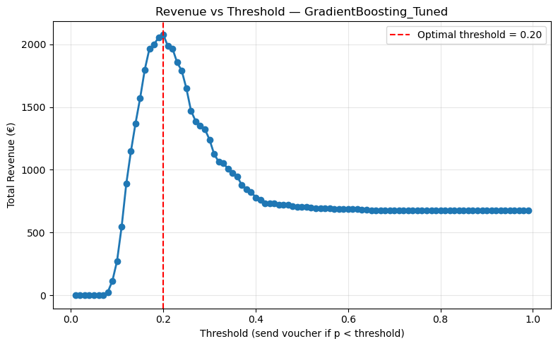
A revenue-optimal threshold determines who receives a voucher
Action
 | Don‘t send | Send
No Reorder | 2016 | 4578
Reorder | 784 | 729
True Label
Notes:
“Our model predicts reorder probabilities for each customer. We then vary the probability threshold that determines whether a voucher is sent and compute the resulting total revenue. The curve on the right shows that revenue is maximized at a threshold of about 0.29. At this point, the trade-off between gaining additional reorders and avoiding unnecessary vouchers is optimal. The confusion matrix on the left shows the resulting voucher decisions: vouchers are sent to customers with low predicted reorder probability, while others receive none.”

Slide 8
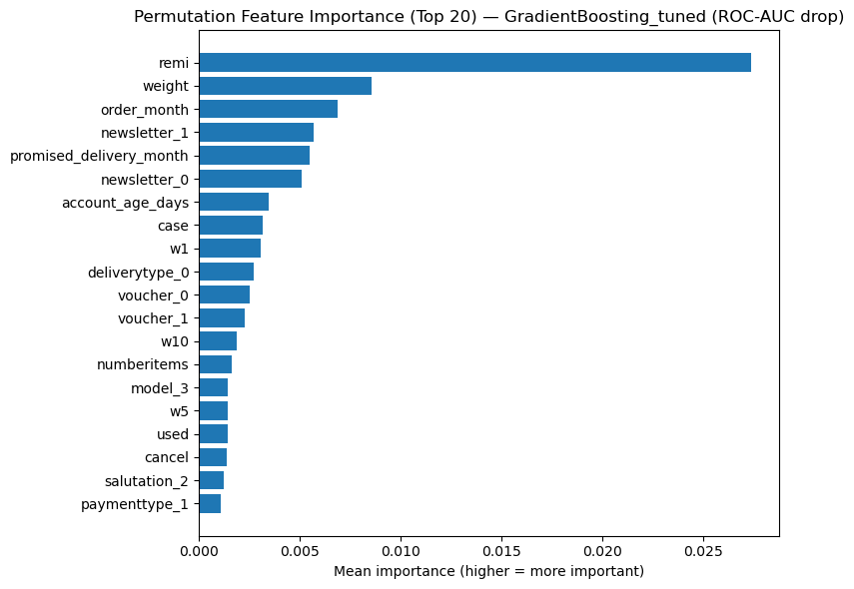
Customer behavior and returns drive reorder predictions
Global
Key insights
Return behavior (remi) is the strongest signal
Operational factors (e.g. weight, delivery) also influence reorders
Seasonal effects (order month) matter
Notes:
For each feature I shuffle its values in the validation set and measure how much the models ROC-AUC drops. If ROC AUC drops a lot, the feature is important for ranking.
It is to be seen that : remi is clearly the strongest driver of ranking performance (biggest ROC-AUC drop).
Strong secondary drivers include: promised_delivery_month, order_month, newsletter_0/1, weight, w1, case, voucher_1
Many of these are behavioral/order-content variables (returns/remissions, weight, item mix) and timing variables (order_month / promised_delivery_month).
“This plot shows permutation feature importance for our selected gradient boosting model. Return behavior is by far the strongest predictor of reordering, followed by seasonal effects such as order month. Operational features like weight and delivery characteristics also contribute, but to a lesser extent. Overall, the model relies on intuitive and interpretable customer behavior signals rather than arbitrary noise.”

Slide 9
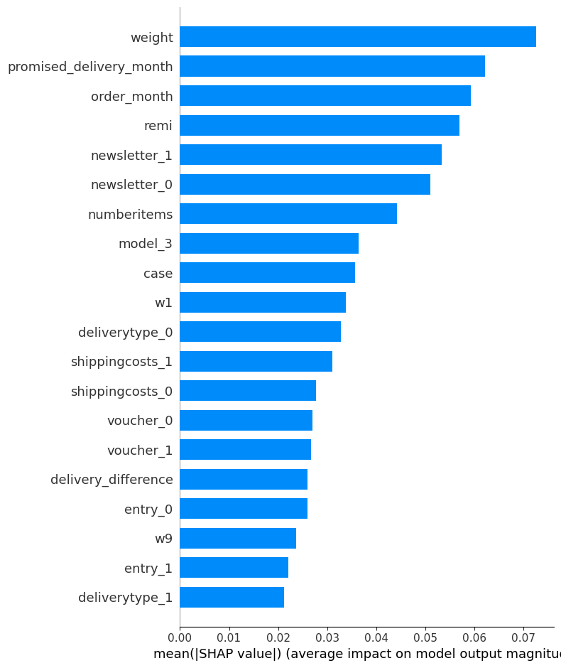
SHAP feature importance
Global
Key insights
Bars show average impact of each feature on predicted reorder probability
Both customer behavior and order characteristics matter
No single feature dominates
Notes:
Gradient boosting
The mean absolute SHAP for each feature.
On average how much does this feature move the model output away from the baseline
The bigger the bar it indicates that the feature tends to have a large impact on predicted probabilities across many customers.
Top drivers by SHAP magnitude: promised_delivery_month, weight, order_month, entry_1, newsletter_0, numberitems, case, w1, newsletter_1, remi, voucher_1, delivery_difference.
SHAP indicates which variables most strongly shift predicted reorder probability for individual customers. Timing, shipment characteristics (weight), and basket structure (numberitems, product category indicators) dominate the model’s decision logic.
This SHAP summary plot explains how the selected model forms its predictions. Each bar shows the average contribution of a feature to the predicted reorder probability. We see that order size, timing, and return behavior all play an important role. Importantly, no single feature fully determines the decision — the model combines many intuitive signals to estimate the likelihood of reordering.”

Slide 10
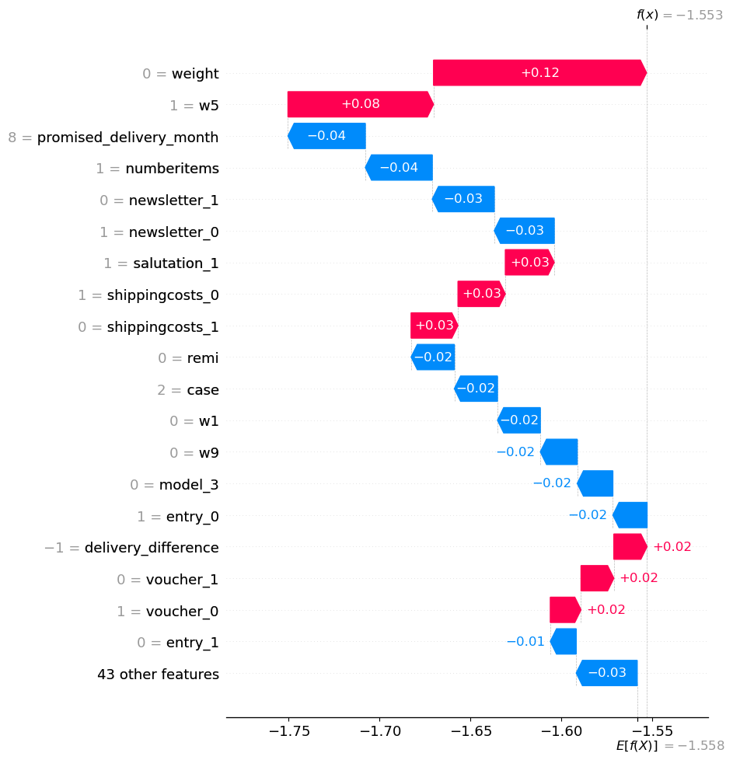
Explaining an individual voucher decision
Local
Key insights
Several features reduce the predicted probability of reordering
Weight and w5 contribute positively to the predicted reorder probability
The final predicted probability falls below the revenue-optimal threshold
A voucher is therefore sent to this customer
Notes:
Example customer: p(reorder)=0.175 < t=0.20 -> SEND voucher
For this single instance domain is the strongest driver down. Being in this particular domain category is associated (in the model) with lower reorder likelihood for this customer.
Timing and entry status are also pulling the score down.
The strongest upward push is w5. This product-category signal is associated with higher reorder likelihood.
Moreover weight = 0 pushes the likelihood to rebuy higher for this customer
“This plot explains an individual prediction for one customer. Each bar shows how a feature pushes the predicted reorder probability up or down relative to the average customer. In this case, several factors decrease the likelihood of reordering, resulting in a low predicted probability. Since this probability is below our revenue-optimal threshold, the model recommends sending a voucher.”

