Slide 1
Using Google Search Data to Nowcast German Unemployment
Alexander Unger
Universität Tübingen
Master Seminar Econometrics

Slide 2
Structure
Motivation & Prior Research
01
Data & Timing Logic
02
Econometric Models
03
Nowcasting Results
04
Discussion & Conclusion
05

Slide 3
Motivation
Problem
- Key labor indicators (e.g. unemployment) are published with delay
Information gaps are most severe during crises (e.g. COVID-19)
Idea
High-frequency digital traces capture labor-market stress in real time
Google search activity reflects information-seeking before official releases
Why is Germany so special ?
German unemployment is measured using a fixed reference point
Timing of high-frequency indicators is therefore crucial
Research gap
Little recent evidence for Germany using up-to-date Google trends data
Unclear whether aggregation looses predictive information compared to high frequency

Slide 4
Research Questions
Do biweekly GT improve nowcasts of german unemployment compared to a simple AR benchmark
Does the biweekly aggregation discard usefull signals that are captured in high frequency models such as MIDAS
Is early- month or previous-month search activity more informative for nowcasting

Slide 5
Data
Seasonally unadjusted monthly German unemployment rate
June 2011 - January 2023
Google trends search indicators
Weekly frequency
Constructed for multiple job-related keywords

Slide 6
Google Trends construction
GT provides relative indices (0-100)
Weekly data only available for short horizons
Long samples require preprocessing
Thats why following is constructed :
Overlapping window stiching
Rescaling in overlapping regions
Produces consistley weekly series

Slide 7
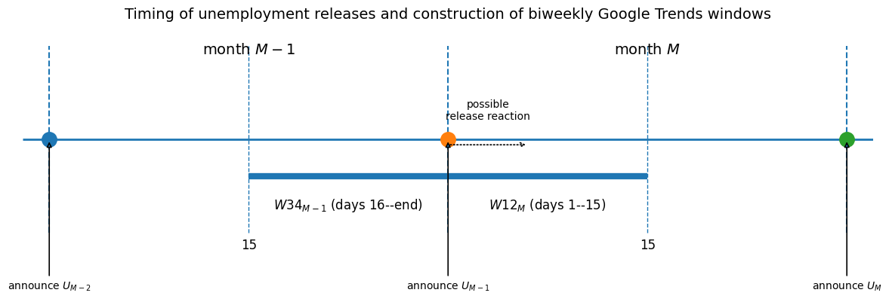
Biweekly aggregation and timing
Unemployment in U_{M-1} released at the end of Month M-1
Release lies between two intra month windows
Two information series
---- W34_{M-1} : is not affected by the release
--- W12_{M} : may affect the release

Slide 8
GT keywords
Based on Askitas & Zimmerman (2010)
Updated to reflect current search behaviour
Focus on:
Administrative contact (Arbeitsamt, Jobbörse)
Job search platforms (StepStone, Indeed)
Application activity (Bewerbung)

