Slide 2
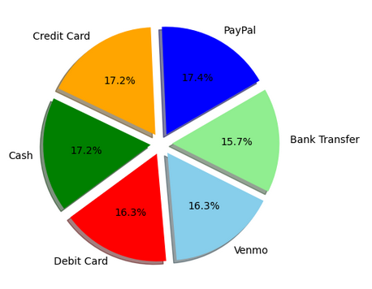
Methods of Payment
Here we have rough percentages of the payment methods on 3900 entries of our data. An interesting point to notice is that our dataset differentiates between PayPal and Venmo, when Venmo is an entity owned by PayPal currently. This might indicate that our data was collected before the acquisition happened. Secondly, the data fails to differentiate similarly between major credit card entities. Thirdly, what if any is the difference between a Venmo transaction and a cash transaction or bank transfer? Venmo is simply a transaction agent, like PayPal, that connects merchants with consumers’ forms of payment.

Slide 3
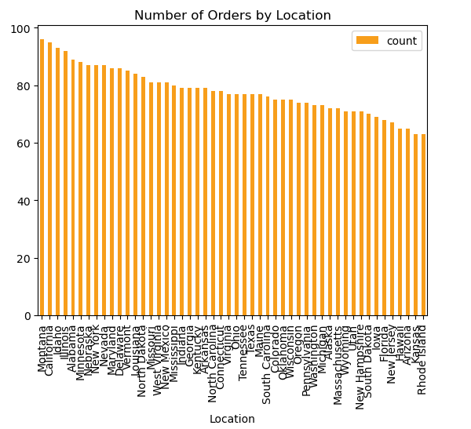
Orders by Location
This allows us to compare numbers of orders per location. Taking this dataset and creating a graphic for each location was not within the scope of this analysis due to the heavy repetition and limited insight gained.

Slide 4
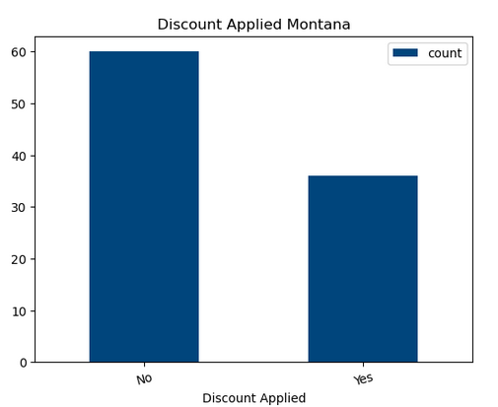
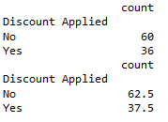
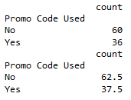
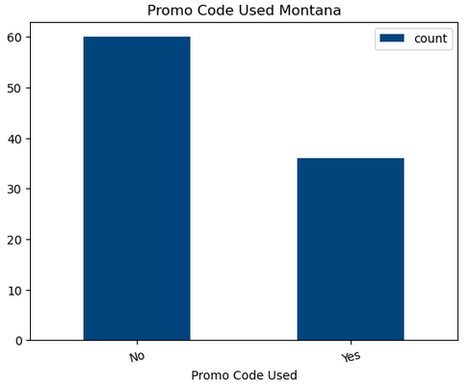
Location: Montana Discount/Promo Analysis
Once we dug into the Discount and Promo Code columns, we discovered that they were likely the exact same dataset repeated. Further analysis will operate on this assumption for other locations.

