Slide 1
WELL-TO-WIRE ENERGY ASSESSMENT · REV 1 (SOURCED)
650 kilotonnes of ammonia,
one strait, two destinies.
P1 · HYDROGEN ROUTE
P2 · AMMONIA ROUTE
Crack at MMHE (Johor) → 16″ H₂ pipeline → H₂-fired CCGT in Singapore
Ship NH₃ to Singapore → store → 100% ammonia-fired CCGT
54.4%
50.7%
usable
usable
Same ammonia from India. Question: what fraction of its chemical energy (LHV) survives as electricity at the Singapore busbar — and which design is technically better?
01
THE QUESTION
MYSGH2 · PERMUTATION STUDY

Slide 2
WHERE THE TWO PATHS DIVERGE
Same ship, same tank — then the chain splits
India→Johor ≈ India→Singapore (same strait) and both store refrigerated NH₃. Those stages are common-mode and cancel. The ranking is decided only downstream of storage.
Cracker
H₂ pipe
H₂ CCGT
54.4%
COMMON
SPLIT
NH₃→H₂ 89%
16″ to SG
H-class 62%
to wire
Green NH₃
Sea, India
NH₃ storage
650 ktpa
28 kt carrier
refrigerated
(no crack)
(no pipe)
NH₃ CCGT
50.7%
direct
NH₃ in SG
40MW 51%
to wire
P1 adds two conversion steps (cracker + pipeline) but earns access to a far better turbine. P2 keeps it simple but is stuck with a small turbine. That trade is the whole story.
02
SYSTEM MAP
MYSGH2 · PERMUTATION STUDY

Slide 3
THE REFERENCE — WHAT 650 KTPA IS WORTH
One yardstick: the LHV of the ammonia loaded in India
650
WHY IT'S A FAIR BASIS
▸
Identical input
Both permutations carry the same 650 ktpa from India.
ktpa green ammonia · 28 kt carriers
▸
Common-mode cancels
Sea leg + refrigerated NH₃ storage are ~equal (Johor and Singapore share the strait) → ≈0.995 for both.
× 18.6 MJ/kg (NH₃ LHV)
▸
Everything traceable
= 12.09 PJ/yr ≡ 100%
Each loss is a sourced efficiency or a flagged assumption — no invented numbers.
Convert once, compare in percentages. Electricity at the busbar ÷ 12.09 PJ = the single figure of merit.
03
REFERENCE BASIS
MYSGH2 · PERMUTATION STUDY

Slide 4
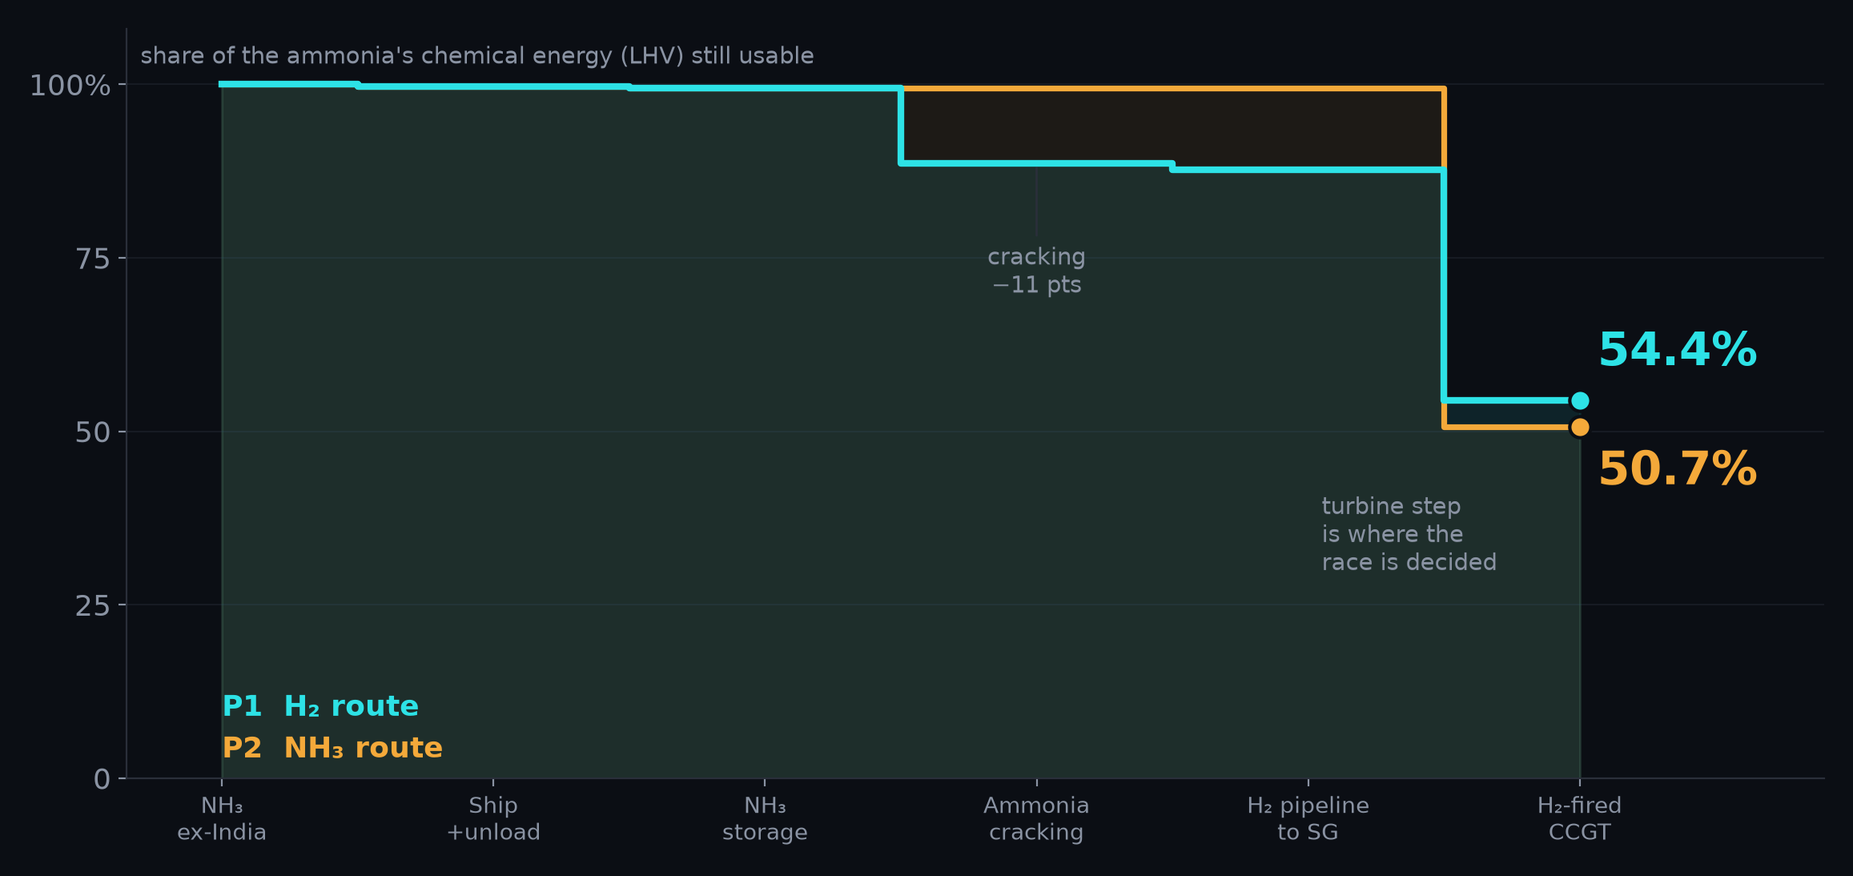
THE ENERGY CASCADE
Follow the energy down — P1 ends higher
READOUT
P1 · H₂
54.4%
≈ 1,826 GWh/yr
P2 · NH₃
50.7%
≈ 1,704 GWh/yr
Δ +3.7 pts to P1
≈ +122 GWh/yr
Cracker costs P1 ~11 pts — then the turbine pays it back with interest.
04
ENERGY WATERFALL
MYSGH2 · PERMUTATION STUDY

Slide 5
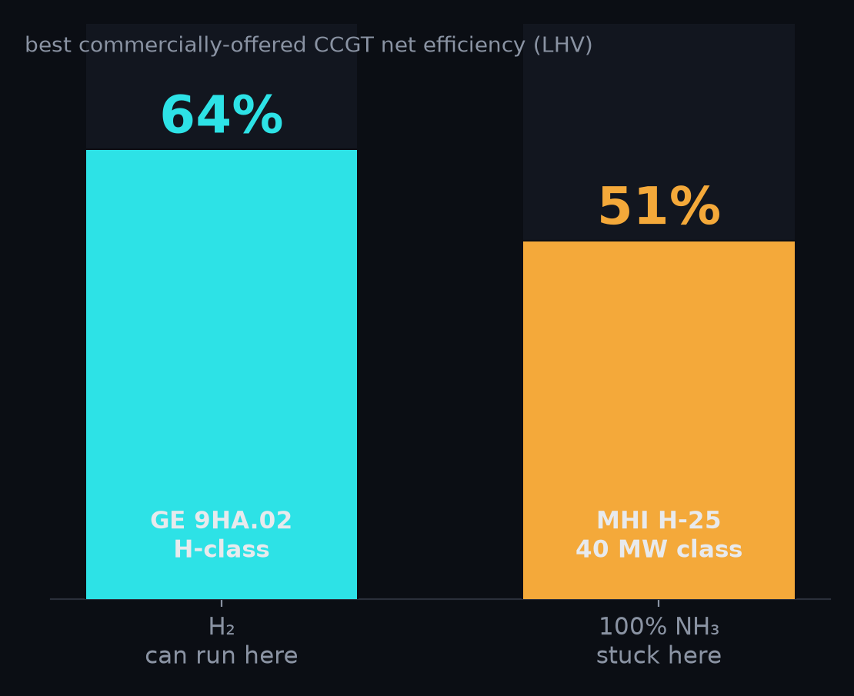
THE DECISIVE ASYMMETRY
Hydrogen and ammonia don't get the same engine
WHAT'S ACTUALLY ON THE MARKET
H₂
Large H-class CCGT (GE 9HA.02): 64.0% net on gas, 50% H₂ now, roadmap to 100%.
NH₃
100% ammonia only commercialised on a 40 MW-class machine (MHI H-25, ~2025): ~51% GTCC.
⇒
The ~13-point turbine gap outweighs the ~11-point cracking penalty. Hydrogen wins because of the engine it unlocks.
Sources: GE Vernova / Turbomachinery Magazine (9HA.02); Mitsubishi Power / MHPS (H-25, world-first 100% NH₃ 40MW GT).
05
TURBINE CLASS
MYSGH2 · PERMUTATION STUDY

Slide 6
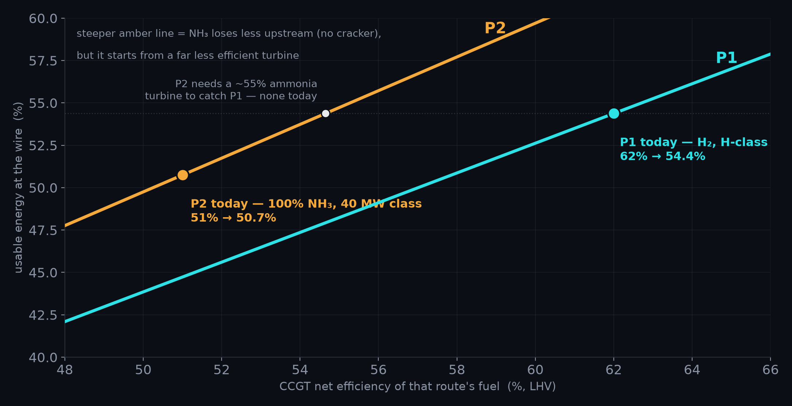
THE SENSITIVITY — AND THE CAVEAT
P2's only path to winning: a turbine that doesn't exist yet
TWO READINGS
TODAY
Real machines (H₂ 62% / NH₃ 51%):
P1 54.4% > P2 50.7%. Hydrogen wins.
PARITY (hypothetical)
If a large 100% NH₃ turbine reached ~63%: P2 63% > P1 55%. Ammonia would win — cracking becomes pure deadweight.
So the bet is on turbine roadmaps, not chemistry.
06
SENSITIVITY
MYSGH2 · PERMUTATION STUDY

Slide 7
BEYOND EFFICIENCY — THE FULL SCORECARD
P1 now leads on energy and on most other axes
P1 · H₂ ROUTE
P2 · NH₃ ROUTE
Usable-energy %
54.4% ◄ leads
50.7%
Power-block maturity
H-class, 50→100% H₂ ◄
100% NH₃ only ~2025
Turbine efficiency class
~64% available ◄
~51% available
Combustion
no carbon, no N₂O ◄
NOx + N₂O, NH₃ slip
Where the hazard sits
NH₃ stays in Johor ◄
NH₃ store+burn in SG
Process simplicity
cracker + pipeline
fewer steps ◄
Strategic fit (SG H₂)
delivers H₂ ◄
delivers power only
P2's sole advantage is fewer steps. Everything else — efficiency, maturity, safety siting, emissions, strategy — points to P1.
07
SCORECARD
MYSGH2 · PERMUTATION STUDY

Slide 8
THE VERDICT
Build P1.
Crack in Johor, pipe hydrogen, fire it in an H-class CCGT.
More efficient, on real data
≈54.4% vs ≈50.7% to the busbar — hydrogen's H-class turbine more than offsets the cracking step.
More mature & cleaner
Commercial H₂ turbines, carbon- and N₂O-free combustion; the ammonia hazard stays on the Malaysian side.
On-strategy
Delivers hydrogen — the project's premise and Singapore's import posture — not just ammonia-to-power.
ONE NUMBER TO LOCK
08
Get OEM net-efficiency quotes for a 100% H₂ H-class CCGT and a 100% NH₃ CCGT at the project unit size. If a large ammonia turbine ever hits ~55%+, revisit P2 — until then, P1 wins on every axis.
RECOMMENDATION
MYSGH2 · PERMUTATION STUDY

