Slide 1


cdist
next generation configuration management

Slide 2


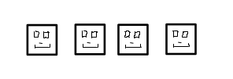
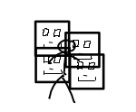

The problem

Slide 3
Motivation
Increase performance of staff
  Implement once – configure many times
Reduce # mistakes
  Make stuff reproducable
Create central point for configurations
  Serves as documentation, too

Slide 4
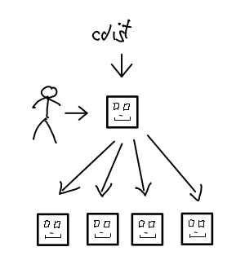
What cdist changes

Slide 5

Life with cdist
Sysadmin
Chairman

Slide 6
Demo

Slide 7
Technical Overview

Slide 8
Big picture
cdist
manifest
type
gencode-local
explorer
parameter
gencode-remote
manifest/init
explorer

Slide 9
Cdist Technical Features
Configured in Shell script
SSH for auth* & transport
Zero dependency CM
Highly scalable
Push based
Manpages
More on the website...

Slide 10
References
University: ETH Zurich (www.ethz.ch)
Swiss Phone Book local.ch (www.local.ch)
ungleich GmbH (www.ungleich.ch)
Panter AG (www.panter.ch)
Various others worldwide

Slide 11
Support
FOSS project
IRC: #cstar (freenode)
Mailinglist
Github: Issue tracking
Commercial Support (http://www.ungleich.ch)

Slide 12
cdist
next generation configuration management

