Slide 1

cdist
next generation configuration management
Notes:
Vielen Dank für die Chance
Folien auf Englisch – ursprünglich geplant

Slide 2
Topics
Configuration Management
Introduction to cdist
  History
  Design Goals
  Features
How to use cdist
Notes:
Übersicht über was

Slide 3
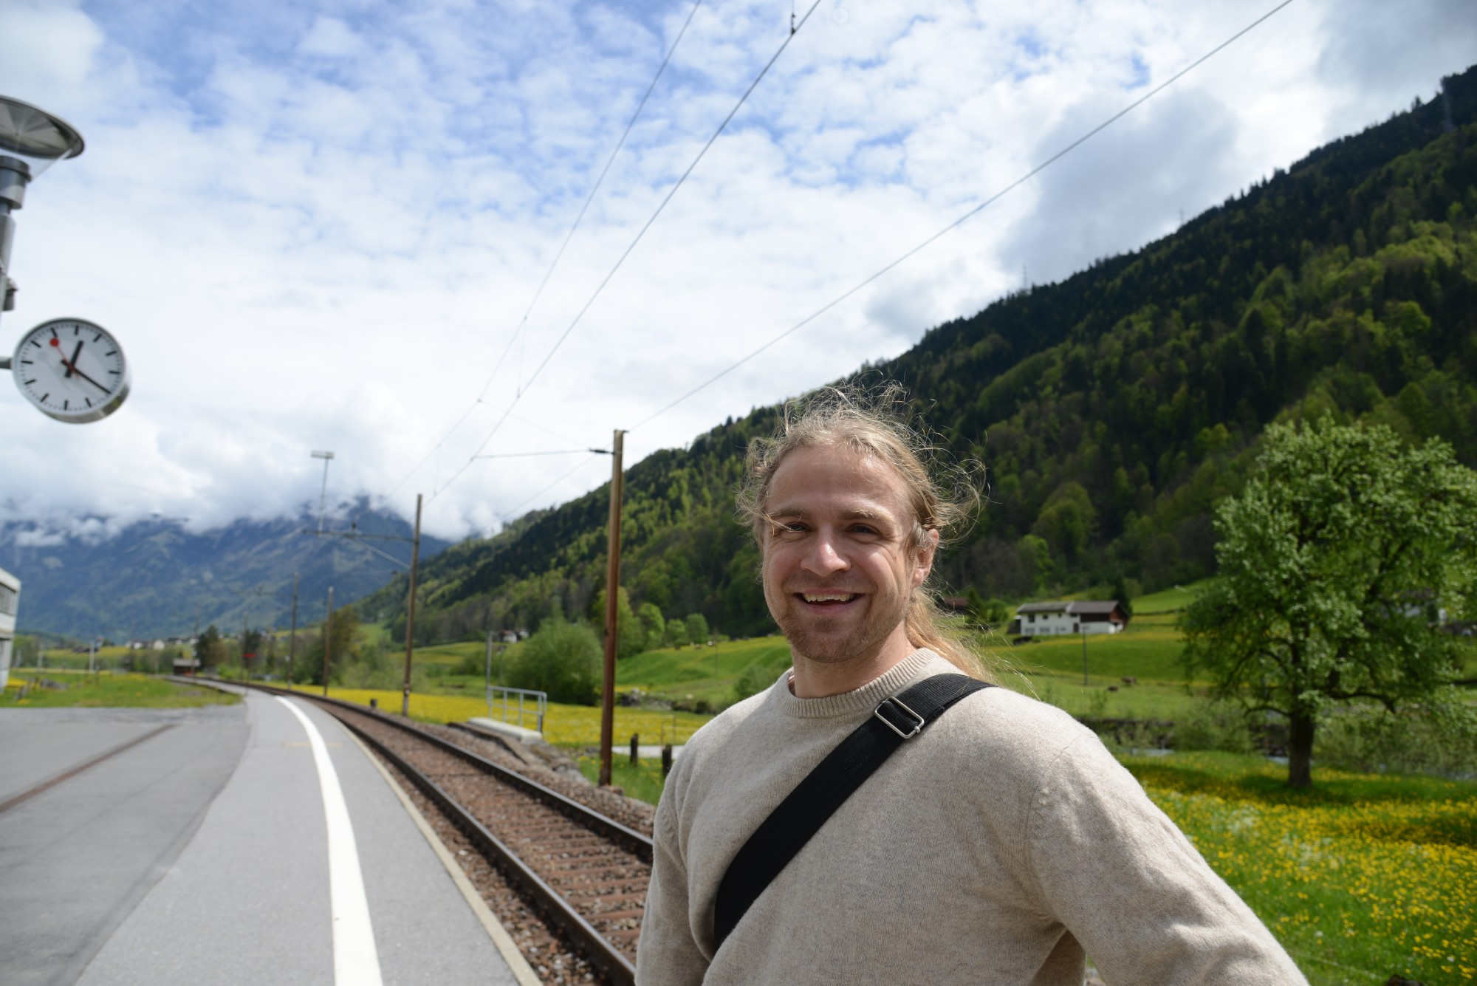
Who’s that guy?
Notes:
Nico Schottelius
Schweiz
Grosse, skalierbare, schöne Systeme
Spass am Gerät
Politisch Semi-Korrekt

Slide 4
Next generation configuration management?
Huh?
Notes:
Vielleicht gefragt was es bedeutet

Slide 5
Configuration Management
Manage configurations in a well defined way.
Reproducable
Documentation
Idempotent
Scaling out
Notes:
Was Konfigurationsmanagement für mich bedeutet
* Reproduzierbar
* Dokumentationscharakter
* Idempotent – Mehrfachlaufbar
* Skalierbar – Mehr Rechenleistung, mehr Rechner parallel konfigurierbar

Slide 6
Configuration Management - NG
Lessons learned from the mistakes others did
Easy to use – no facepalm effect
Simple design – no grey hair effect
Push Support – for coordinated changes
DRY – Reuse existing technologies
FOSS – GPL, not half commercial
Installation support – in 4.0pre branches
Not affiliated with $distro $vendor $evil_vendor_lockin
Notes:
Cdist recht jung (2011)
Fehlern der anderen lernen
* Einfach zu nutzen ohne Kopfschmerzen
* Design einfach - Probleme debugbar
* das Rad nicht neu erfunden – mehr später
* immer FOSS bleiben
* ab 4.0 Installation
* unabhängig

Slide 7
Cdist history
2010-11-10: LISA'10 BoFs
2011-03-07: First public release of cdist
2011-09-16: Rewrite cdist core in python
2013-01-01: Founded ungleich GmbH
2014-05-05: Released cdist 3.1.5
Notes:
Kurzer Überblick
2010 diskutiert an Large …
2011 erste release in Shell Skript
2011 rewrite in Python
2013 Firma gegründet
Vor ein paar Tagen: Release 3.1.5

Slide 8
Design Goals
Minimale requirements to environment
  DB (filesystem)
  Target hosts (sh, ssh)
  Technologies (fs, sh, ssh)
Known DSL (sh)
Scalable
Notes:
Design Ziele
* Minimale Anforderungen
* Datenbank Dateisystem
* Zielrechner posix shell und ssh
* Bekannte Programmiersprache: Shell-Skript
* Skalierfähig – In Universität entwickelt

Slide 9
Cdist Features
Secure (SSH)
Well documented
Push based
Simple
Open Source
Scalable
Shell Script
Zero
Dependency
Proven
Technologies
Notes:
Neben den erwähnten Features
Zero dependency – keine Pakete auf dem Zielsystem nötig

Slide 10
cdist is very simple
Notes:
Hauptfeature von cdist – es ist sehr einfach.

Slide 11
Configuration
% mkdir -p ~/.cdist/manifest
% $EDITOR ~/.cdist/manifest/init
case “$__target_host” in
localhost)
__file /tmp/cdist-rocks
;;
esac
Notes:
Ein Manifest – cdist erstellt (wenn nicht vorhanden) leere Datei

Slide 12
Configuration Run
% cdist config -v localhost
INFO: localhost: Running global explorers
INFO: localhost: Running initial manifest /home/users/nico/.tmp/tmpn9mbqn/out/conf/manifest/init
INFO: localhost: Running object manifests and type explorers
INFO: localhost: Running manifest and explorers for __file/tmp/cdist-rocks
INFO: localhost: Generating and executing code
INFO: Resolving dependencies...
INFO: localhost: Generating and executing code for __file/tmp/cdist-rocks
INFO: localhost: Finished successful run in 4.075293779373169 seconds
INFO: Total processing time for 1 host(s): 4.618075609207153
Notes:
Sobald diese Datei angelegt, kann cdist ausgeführt werden

Slide 13
Behind the scenes...
Notes:
Was ist hinter der Bühne passiert?

Slide 14
The big picture
Initial manifest
manifest
explorer
explorer
type
parameter
gencode-*
code-*
Notes:
Aufbau von cdist
* initiale manifest - mapping hosts zu types
* explorer – erkundigen zielsystem
* type – funktionalität zusammengefasst (ssh keys, ruby on rails)

Slide 15
Manifest
Shell script
Define what to use
% $EDITOR ~/.cdist/manifest/init
case “$__target_host” in
localhost)
__file /tmp/cdist-rocks
;;
esac
Notes:
Im Manifest – Nutzung von Types
Hier: __file type
__ da wir in der Shell sind und Types wie Programme ausgeführt werden

Slide 16
Explorer
Acquire state of the system
% cdist config -v localhost
INFO: localhost: Running global explorers
INFO: localhost: Running initial manifest...
Examples of explorers:
  hostname
  interfaces
  os
Notes:
Analysieren Status vom Zielsystem

Slide 17
Types
Notes:
Einführung cdist types

Slide 18
Type
A type bundles functionality
Consist of
  Manifest
  Explorer
  Manpage
  Parameter
  gencode-local, gencode-remote
Notes:
Type besteht aus

Slide 19
Create Type
% mkdir -p ~/.cdist/type/_speech
% mkdir ~/.cdist/type/_speech/parameter
% echo colour > ~/.cdist/type/_speech/parameter/required
% $EDITOR ~/.cdist/type/_speech/manifest
colour=$(cat "$__object/parameter/colour")
__file "$__object_id" --source - << eof
The speech is $colour today!
eof
% echo "__speech /tmp/speech --colour green" >> ~/.cdist/manifest/init
Notes:
Neuen Type erzeugen
Names __speech
Parameter colour, der zwanghaft angegeben werden muss
Manifest, in dem der __file type genutzt wird

Slide 20
Type Being Used
% cdist config -v localhost
INFO: localhost: Running global explorers
INFO: localhost: Running initial manifest /home/users/nico/.tmp/tmp89xo__/out/conf/manifest/init
INFO: localhost: Running object manifests and type explorers
INFO: localhost: Running manifest and explorers for __file/tmp/cdist-rocks
INFO: localhost: Running manifest and explorers for __speech/tmp/speech
INFO: localhost: Running manifest and explorers for __file/tmp/speech
INFO: localhost: Generating and executing code
INFO: Resolving dependencies...
INFO: localhost: Generating and executing code for __file/tmp/cdist-rocks
INFO: localhost: Generating and executing code for __file/tmp/speech
INFO: localhost: Generating and executing code for __speech/tmp/speech
INFO: localhost: Finished successful run in 4.90235710144043 seconds
INFO: Total processing time for 1 host(s): 5.402170896530151
% cat /tmp/speech
The speech is green today!
Notes:
So sieht es aus, wenn

Slide 21
Type: Parameter
Optional (optional_multiple)
Required (required_multiple)
Boolean
% __file /etc/shadow \
--mode 0600 --owner root --group shadow
% __ssh_authorized_keys root \
--key "$(cat ~/.ssh/id_rsa.pub)" \
--key "ssh-rsa AXYZAAB3NzaC1yc2..."
% __directory /home/services/nfs \
--parents
Notes:
Cdist types verschiedene Parameter
* optional
* zwanghaft
* boolean

Slide 22
Type: Gencode
Shell script
Outputs code to be executed
  Local
  Remote
__package_pip:
echo pip install \"$name\"
__directory:
absent)
echo rm -rf \"$destination\"
;;
Notes:
Gencode genutzt
Dynamisch Code zu erzeugen
Zielsystem oder auf dem Rechner wo cdist läuft

Slide 23
Everything you ever need to know
Notes:
Kurze Einführung in cdist.
Alles was wichtig ist
Rest Vertiefung.

Slide 24
Contact
IRC: #cstar (freenode)
Twitter: @NicoSchottelius
Mailinglist
Github: Issue tracking
Commercial Support (http://www.ungleich.ch)
Notes:
Für cdist interessiert
Erreichbar via IRC, Twitter, Mailingliste
Bugs auf github
Kommerzieller Support via ungleich GmbH

Slide 25
Questions?
Notes:
Das war es – jetzt wäre guter Zeitpunkt um Fragen zu stellen.

Slide 26
Backup Slides
(for the too interested parties)

Slide 27
Cdist SLIDES

Slide 28
How to use cdist
Download cdist
  Via git
  Via pypi
  Archlinux: via AUR
Installation is optional
% cdist -V
2.1.0

Slide 29
Using Type
% cat ~/.cdist/manifest/init
case "$__target_host" in
localhost)
__file /tmp/cdist-rocks
;;
esac
__speech /tmp/speech --colour green

Slide 30
Cdist Features
Configured in Shell script
SSH for auth* & transport
Zero dependency CM
Highly scalable
Push based
Manpages
More on the website...

Slide 31
INTRO SLIDES

Slide 32
Development Objectives
Central point for configuration
Reproduceable (omnipotent)
Configuration = Documentation
...

Slide 33
History
Sysadmin @ ETH Zurich (2008-2011)
Used existing CM
  Found many bugs
Tried other CM
  Not suited
  Seemed to be too complex

Slide 34
Sexy SLIDES

Slide 35
Anforderungen
Simple = Super
Einfach verständlich, einfach nutzbar
FOSS
Einfaches (CLI) basierte Tools für die Verwaltung

Slide 36
The big big picture
sexy
backends
cdist
host
net-ipv4

Slide 37
The small big picture
sexy
db
backends
host
host
mac
net-ipv4
net-ipv4

Slide 38
How to use sexy
Download sexy
  Via git
% sexy -V
sexy 1.9.13-1-g7fc7b8b

Slide 39
mac usage
[17:32] brief:~% sexy mac -h
usage: sexy mac [-h] [-d] [-v]
{free-add,free-list,generate,prefix-get,prefix-set} ...
optional arguments:
-h, --help show this help message and exit
-d, --debug Set log level to debug
-v, --verbose Set log level to info, be more verbose
Mac Commands:
{free-add,free-list,generate,prefix-get,prefix-set}
free-list List free mac addresses
[17:32] brief:~%

Slide 40
host usage
[17:32] brief:~% sexy host -h
usage: sexy host [-h] [-d] [-v]
{add,cores-get,cores-set,del,disk-add,disk-size-get,disk-list,memory-get,memory-set,nic-add,nic-del,nic-addr-get,nic-list,list,type-get,vm-host-get,vm-host-list,vm-host-set,apply}
...
optional arguments:
-h, --help show this help message and exit
-d, --debug Set log level to debug
-v, --verbose Set log level to info, be more verbose
Host Commands:
{add,cores-get,cores-set,del,disk-add,disk-size-get,disk-list,memory-get,memory-set,nic-add,nic-del,nic-addr-get,nic-list,list,type-get,vm-host-get,vm-host-list,vm-host-set,apply}
[17:35] brief:~%

Slide 41
net-ipv4 usage
[17:51] brief:~% sexy net-ipv4 -h
usage: sexy net-ipv4 [-h] [-d] [-v]
{add,bootfilename-get,bootfilename-set,bootserver-get,bootserver-set,broadcast-get,mask-get,mask-dotted-quad-get,router-get,router-set,host-add,host-del,host-list,host-ipv4-address-get,host-mac-address-get,list,apply}
...
optional arguments:
-h, --help show this help message and exit
-d, --debug Set log level to debug
-v, --verbose Set log level to info, be more verbose
Host Commands:
{add,bootfilename-get,bootfilename-set,bootserver-get,bootserver-set,broadcast-get,mask-get,mask-dotted-quad-get,router-get,router-set,host-add,host-del,host-list,host-ipv4-address-get,host-mac-address-get,list,apply}
[17:51] brief:~%

Slide 42
Ziele (sexy)
Inventarverwaltung für Rechner
Übersicht über Rechner und Eigenschaften
Einfaches (CLI) basierte Tools für die Verwaltung
Virtuelle and echte Maschine verwaltbar
...

Slide 43
LISA SLIDES

Slide 44
LISA'10 BoFs
CM, how I would love it
  Easy to use (everyday!)
  Reuses existing tools
  Provides good documentation
  Scales out (> 10k clients are no problem)
  Push and Pull architecture

Slide 45
Back in the mountains...
That idea at LISA...need to do some coding …
  2011-03-07: first public release of cdist
  2011-09-16: Rewrite cdist core in python
  2012-12-09: Release of cdist 2.1

Slide 46
This is not a speech

