Slide 1

cdi.st
configuration as a service
Notes:
Vielen Dank für die Chance
Folien auf Englisch – ursprünglich geplant

Slide 2

Who’s that guy?
Notes:
Nico Schottelius
Schweiz
Grosse, skalierbare, schöne Systeme
Spass am Gerät
Politisch Semi-Korrekt

Slide 3
Topics
Configurations → Configuration Management
Configuration as a Service (CaaS)
cdist: configuration management
Notes:
Übersicht über was

Slide 4
History
Manual Configurations (~1960)
Configuration Management (~1993)
Configuration as a Service (CaaS) (2014)
Notes:
Geschichte
Manuell seit dem es Computer gibt
Konfigurationsmanagement etwa 1993
Seit diesem Jahr

Slide 5
Configuration
A configuration is set of parameters with values that describes a target state.
Notes:
Vor Configuration as a service
Konfiguration ist eine Zusammenstellung von Parametern mit Werten, die den gewünschten Zustand beschreiben.

Slide 6
Configuration Examples
Virtual machine web01 runs on host42
Backup for web01 contains /home
User “app” exists on web01
Application Server Ruby on Rails is installed on web01
Load Balancing is configured for web01 .. web20 Servers
Notes:
Beispiele
Virtuelle Maschine
Backup
Benutzer
Applikationsserver
Load Balancing

Slide 7


Applying Configurations

Slide 8
Configuration Management

Slide 9
Why Configuration Management?

Slide 10
Configuration Management
Manage configurations in a well defined way.
Reproducible
Documentation
Idempotent
Scaling out
Notes:
Was Konfigurationsmanagement für mich bedeutet
* Reproduzierbar
* Dokumentationscharakter
* Idempotent – Mehrfachlaufbar
* Skalierbar – Mehr Rechenleistung, mehr Rechner parallel konfigurierbar

Slide 11

Using Configuration Management

Slide 12

Developer – no Sysadmins

Slide 13
Developer does not know CM

Slide 14
No Configuration Management
Because...
Developer does not know
  How to configure
  How to use Configuration Management
Developers should not know
Notes:
Was Konfigurationsmanagement für mich bedeutet
* Reproduzierbar
* Dokumentationscharakter
* Idempotent – Mehrfachlaufbar
* Skalierbar – Mehr Rechenleistung, mehr Rechner parallel konfigurierbar

Slide 15
Developers cannot configure

Slide 16
cdi.st
configuration as a service
Notes:
Vielen Dank für die Chance
Folien auf Englisch – ursprünglich geplant

Slide 17
CaaS: Definition (2014)
Configuration as a Service, CaaS:
Apply configurations to your systems with minimum knowledge required for the configuration or the configuration management system.
Notes:
FRAGE
Vorstellen, was Configuration as a service ist?

Slide 18
Avoid Complexity

Slide 19
Configuration as a Service

Slide 20
XaaS
X as a Service:
Have somebody else do it automatically for you.
Self Service.
Notes:
FRAGE
Vorstellen, was Configuration as a service ist?

Slide 21
How it works
Grant cdi.st access to my systems

Slide 22
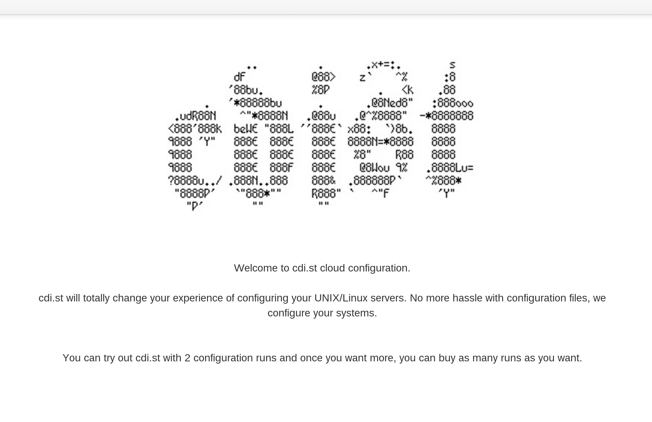
Select Configurations
Notes:
Vorabansicht cdi.st cloud configuration

Slide 23
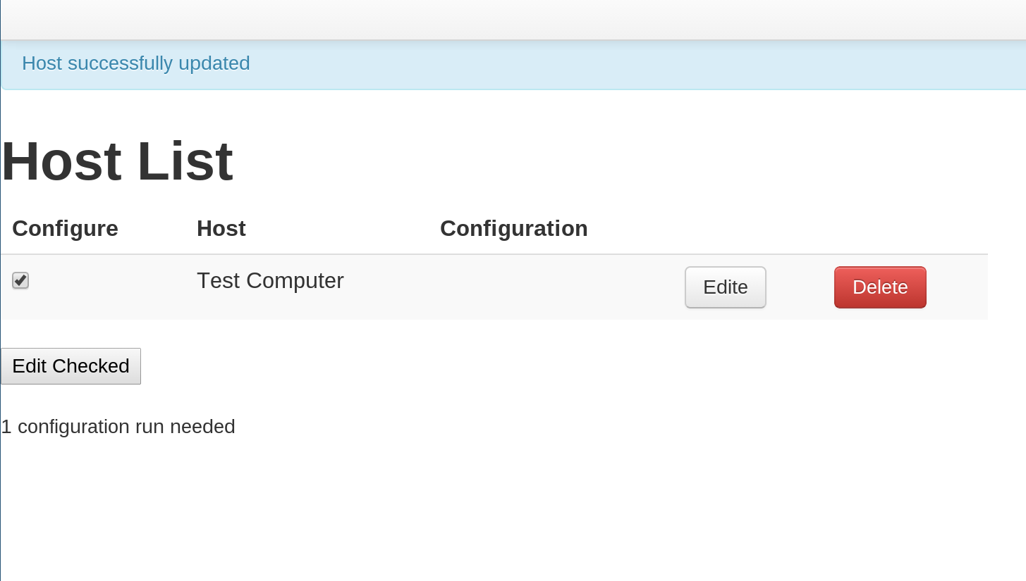
Configure Selected Hosts
Notes:
Hostübersicht
Auswahl Konfigurationen

Slide 24


Have Services Running

Slide 25
cdi.st
background information
Notes:
Vielen Dank für die Chance
Folien auf Englisch – ursprünglich geplant

Slide 26
cdi.st
Website based on Ruby on Rails
Backend based on cdist
Notes:
Übersicht über was

Slide 27



Configurations
Huge existing set of configurations
Ruby on Rails Hosting
cdist configuration management
Web Servers
Database Server
…
Notes:
Übersicht über was

Slide 28
cdist
next generation configuration management
Notes:
Vielen Dank für die Chance
Folien auf Englisch – ursprünglich geplant

Slide 29
What is cdist?
Next Generation Configuration Management
Less Bugs
Learned from mistakes others made
More
  flexible
  efficient
  fun
Notes:
Übersicht über was

Slide 30
Next generation configuration management?
Huh?
Notes:
Vielleicht gefragt was es bedeutet

Slide 31
Configuration Management - NG
Lessons learned from the mistakes others made
Easy to use – no facepalm effect
Simple design – no grey hair effect
Push Support – for coordinated changes
DRY – Reuse existing technologies
FOSS – GPL, not half commercial
Installation support – in 4.0pre branches
Not affiliated with $distro $vendor $evil_vendor_lockin
Notes:
Cdist recht jung (2011)
Fehlern der anderen lernen
* Einfach zu nutzen ohne Kopfschmerzen
* Design einfach - Probleme debugbar
* das Rad nicht neu erfunden – mehr später
* immer FOSS bleiben
* ab 4.0 Installation
* unabhängig

Slide 32

Why cdist?
Requires only ssh on the target host
Core functionality supports different OS
Development started at ETH Zurich
Made in Switzerland
Scalable Design
Notes:
Übersicht über was

Slide 33
cdist history
2010-11-10: LISA'10 BoFs
2011-03-07: First public release of cdist
2011-09-16: Rewrite cdist core in python
2013-01-01: Founded ungleich GmbH
…: Many releases, growing community
2014-05-05: Released cdist 3.1.5
Notes:
Kurzer Überblick
2010 diskutiert an Large …
2011 erste release in Shell Skript
2011 rewrite in Python
2013 Firma gegründet
Vor ein paar Tagen: Release 3.1.5

Slide 34
cdist Features
Secure (SSH)
Well documented
Push based
Simple
Open Source
Scalable
Shell Script
Zero
Dependency
Proven
Technologies
Notes:
Neben den erwähnten Features
Zero dependency – keine Pakete auf dem Zielsystem nötig

Slide 35
The big picture
Initial manifest
manifest
explorer
explorer
type
parameter
gencode-*
code-*
Notes:
Aufbau von cdist
* initiale manifest - mapping hosts zu types
* explorer – erkundigen zielsystem
* type – funktionalität zusammengefasst (ssh keys, ruby on rails)

Slide 36
cdi.st
configuration as a service: summary
Notes:
Vielen Dank für die Chance
Folien auf Englisch – ursprünglich geplant

Slide 37
Enable Users
Notes:
Wenn Configuration as a Service → no system engineer
NÄCHSTE FOLIE
2014-05-19_cdi.st-zkb_linux_erfa.odp

Slide 38
No System Engineer Required
Notes:
Wenn Configuration as a Service → no system engineer
NÄCHSTE FOLIE
2014-05-19_cdi.st-zkb_linux_erfa.odp

Slide 39
No Configuration Management
Notes:
Wenn Configuration as a Service → no system engineer
NÄCHSTE FOLIE
2014-05-19_cdi.st-zkb_linux_erfa.odp

Slide 40
Reduce Complexity
Past
Users depend on System Engineer
Lot of knowledge required
Investment into development
CaaS
Users can configure themselves
Users defines target state
Reuse existing configurations
Notes:
Abhängigkeit weniger
Weniger Wissen
Statt Konfiguration entwickeln

Slide 41
Outcome
Enable users to configure their systems
Reduced complexity
Focus on core competences
Growing number of configurations
Notes:
Warum?
Arbeit vereinfachen
Neue Sachen machen
Komplexität verringern – weniger Wissen nötig
Konzentration auf Kernkompetenzen
Ungleich = Konfigurationen
Cloud == ok

Slide 42
I want to use cdi.st
cdi.st public release planned for August 2014
Beta running at customers since June 2014
Send mail to cdi.st@ungleich.ch
Notes:
Warum?
Arbeit vereinfachen
Neue Sachen machen
Komplexität verringern – weniger Wissen nötig
Konzentration auf Kernkompetenzen
Ungleich = Konfigurationen
Cloud == ok

Slide 43
Thank you
Follow us on Twitter: @ungleich
cdi.st@ungleich.ch
http://www.ungleich.ch
Notes:
Für cdist interessiert
Erreichbar via IRC, Twitter, Mailingliste
Bugs auf github
Kommerzieller Support via ungleich GmbH

Slide 44
Configuration
% mkdir -p ~/.cdist/manifest
% $EDITOR ~/.cdist/manifest/init
case “$__target_host” in
localhost)
__file /tmp/cdist-rocks
;;
esac
Notes:
Ein Manifest – cdist erstellt (wenn nicht vorhanden) leere Datei

Slide 45
Configuration Run
% cdist config -v localhost
INFO: localhost: Running global explorers
INFO: localhost: Running initial manifest /home/users/nico/.tmp/tmpn9mbqn/out/conf/manifest/init
INFO: localhost: Running object manifests and type explorers
INFO: localhost: Running manifest and explorers for __file/tmp/cdist-rocks
INFO: localhost: Generating and executing code
INFO: Resolving dependencies...
INFO: localhost: Generating and executing code for __file/tmp/cdist-rocks
INFO: localhost: Finished successful run in 4.075293779373169 seconds
INFO: Total processing time for 1 host(s): 4.618075609207153
Notes:
Sobald diese Datei angelegt, kann cdist ausgeführt werden

Slide 46
Behind the scenes...
Notes:
Was ist hinter der Bühne passiert?

Slide 47
Manifest
Shell script
Define what to use
% $EDITOR ~/.cdist/manifest/init
case “$__target_host” in
localhost)
__file /tmp/cdist-rocks
;;
esac
Notes:
Im Manifest – Nutzung von Types
Hier: __file type
__ da wir in der Shell sind und Types wie Programme ausgeführt werden

Slide 48
Explorer
Acquire state of the system
% cdist config -v localhost
INFO: localhost: Running global explorers
INFO: localhost: Running initial manifest...
Examples of explorers:
  hostname
  interfaces
  os
Notes:
Analysieren Status vom Zielsystem

Slide 49
Types
Notes:
Einführung cdist types

Slide 50
Type
A type bundles functionality
Consist of
  Manifest
  Explorer
  Manpage
  Parameter
  gencode-local, gencode-remote
Notes:
Type besteht aus

Slide 51
Create Type
% mkdir -p ~/.cdist/type/_speech
% mkdir ~/.cdist/type/_speech/parameter
% echo colour > ~/.cdist/type/_speech/parameter/required
% $EDITOR ~/.cdist/type/_speech/manifest
colour=$(cat "$__object/parameter/colour")
__file "$__object_id" --source - << eof
The speech is $colour today!
eof
% echo "__speech /tmp/speech --colour green" >> ~/.cdist/manifest/init
Notes:
Neuen Type erzeugen
Names __speech
Parameter colour, der zwanghaft angegeben werden muss
Manifest, in dem der __file type genutzt wird

Slide 52
Type Being Used
% cdist config -v localhost
INFO: localhost: Running global explorers
INFO: localhost: Running initial manifest /home/users/nico/.tmp/tmp89xo__/out/conf/manifest/init
INFO: localhost: Running object manifests and type explorers
INFO: localhost: Running manifest and explorers for __file/tmp/cdist-rocks
INFO: localhost: Running manifest and explorers for __speech/tmp/speech
INFO: localhost: Running manifest and explorers for __file/tmp/speech
INFO: localhost: Generating and executing code
INFO: Resolving dependencies...
INFO: localhost: Generating and executing code for __file/tmp/cdist-rocks
INFO: localhost: Generating and executing code for __file/tmp/speech
INFO: localhost: Generating and executing code for __speech/tmp/speech
INFO: localhost: Finished successful run in 4.90235710144043 seconds
INFO: Total processing time for 1 host(s): 5.402170896530151
% cat /tmp/speech
The speech is green today!
Notes:
So sieht es aus, wenn

Slide 53
Type: Parameter
Optional (optional_multiple)
Required (required_multiple)
Boolean
% __file /etc/shadow \
--mode 0600 --owner root --group shadow
% __ssh_authorized_keys root \
--key "$(cat ~/.ssh/id_rsa.pub)" \
--key "ssh-rsa AXYZAAB3NzaC1yc2..."
% __directory /home/services/nfs \
--parents
Notes:
Cdist types verschiedene Parameter
* optional
* zwanghaft
* boolean

Slide 54
Type: Gencode
Shell script
Outputs code to be executed
  Local
  Remote
__package_pip:
echo pip install \"$name\"
__directory:
absent)
echo rm -rf \"$destination\"
;;
Notes:
Gencode genutzt
Dynamisch Code zu erzeugen
Zielsystem oder auf dem Rechner wo cdist läuft

Slide 55
Everything you ever need to know
Notes:
Kurze Einführung in cdist.
Alles was wichtig ist
Rest Vertiefung.

Slide 56
cd.ist
configuration as a service
Notes:
Vielen Dank für die Chance
Folien auf Englisch – ursprünglich geplant

Slide 57
Questions?
Notes:
Das war es – jetzt wäre guter Zeitpunkt um Fragen zu stellen.

Slide 58
Backup Slides
(for the too interested parties)

Slide 59
Cdist SLIDES

Slide 60
Design Goals
Minimum requirements to environment
  DB (filesystem)
  Target hosts (sh, ssh)
  Technologies (fs, sh, ssh)
Known DSL (sh)
Scalable
Notes:
Design Ziele
* Minimale Anforderungen
* Datenbank Dateisystem
* Zielrechner posix shell und ssh
* Bekannte Programmiersprache: Shell-Skript
* Skalierfähig – In Universität entwickelt

Slide 61
How to use cdist
Download cdist
  Via git
  Via pypi
  Archlinux: via AUR
Installation is optional
% cdist -V
2.1.0

Slide 62
Using Type
% cat ~/.cdist/manifest/init
case "$__target_host" in
localhost)
__file /tmp/cdist-rocks
;;
esac
__speech /tmp/speech --colour green

Slide 63
Cdist Features
Configured in Shell script
SSH for auth* & transport
Zero dependency CM
Highly scalable
Push based
Manpages
More on the website...

Slide 64
INTRO SLIDES

Slide 65
Development Objectives
Central point for configuration
Reproduceable (omnipotent)
Configuration = Documentation
...

Slide 66
History
Sysadmin @ ETH Zurich (2008-2011)
Used existing CM
  Found many bugs
Tried other CM
  Not suited
  Seemed to be too complex

Slide 67
cinv SLIDES

Slide 68
Anforderungen
Simple = Super
Einfach verständlich, einfach nutzbar
FOSS
Einfaches (CLI) basierte Tools für die Verwaltung

Slide 69
The big big picture
cinv
backends
cdist
host
net-ipv4

Slide 70
The small big picture
cinv
db
backends
host
host
mac
net-ipv4
net-ipv4

Slide 71
How to use cinv
Download cinv
  Via git
% cinv -V
cinv 1.9.13-1-g7fc7b8b

Slide 72
mac usage
[17:32] brief:~% cinv mac -h
usage: cinv mac [-h] [-d] [-v]
{free-add,free-list,generate,prefix-get,prefix-set} ...
optional arguments:
-h, --help show this help message and exit
-d, --debug Set log level to debug
-v, --verbose Set log level to info, be more verbose
Mac Commands:
{free-add,free-list,generate,prefix-get,prefix-set}
free-list List free mac addresses
[17:32] brief:~%

Slide 73
host usage
[17:32] brief:~% cinv host -h
usage: cinv host [-h] [-d] [-v]
{add,cores-get,cores-set,del,disk-add,disk-size-get,disk-list,memory-get,memory-set,nic-add,nic-del,nic-addr-get,nic-list,list,type-get,vm-host-get,vm-host-list,vm-host-set,apply}
...
optional arguments:
-h, --help show this help message and exit
-d, --debug Set log level to debug
-v, --verbose Set log level to info, be more verbose
Host Commands:
{add,cores-get,cores-set,del,disk-add,disk-size-get,disk-list,memory-get,memory-set,nic-add,nic-del,nic-addr-get,nic-list,list,type-get,vm-host-get,vm-host-list,vm-host-set,apply}
[17:35] brief:~%

Slide 74
net-ipv4 usage
[17:51] brief:~% cinv net-ipv4 -h
usage: cinv net-ipv4 [-h] [-d] [-v]
{add,bootfilename-get,bootfilename-set,bootserver-get,bootserver-set,broadcast-get,mask-get,mask-dotted-quad-get,router-get,router-set,host-add,host-del,host-list,host-ipv4-address-get,host-mac-address-get,list,apply}
...
optional arguments:
-h, --help show this help message and exit
-d, --debug Set log level to debug
-v, --verbose Set log level to info, be more verbose
Host Commands:
{add,bootfilename-get,bootfilename-set,bootserver-get,bootserver-set,broadcast-get,mask-get,mask-dotted-quad-get,router-get,router-set,host-add,host-del,host-list,host-ipv4-address-get,host-mac-address-get,list,apply}
[17:51] brief:~%

Slide 75
Ziele (cinv)
Inventarverwaltung für Rechner
Übersicht über Rechner und Eigenschaften
Einfaches (CLI) basierte Tools für die Verwaltung
Virtuelle and echte Maschine verwaltbar
...

Slide 76
LISA SLIDES

Slide 77
LISA'10 BoFs
CM, how I would love it
  Easy to use (everyday!)
  Reuses existing tools
  Provides good documentation
  Scales out (> 10k clients are no problem)
  Push and Pull architecture

Slide 78
Back in the mountains...
That idea at LISA...need to do some coding …
  2011-03-07: first public release of cdist
  2011-09-16: Rewrite cdist core in python
  2012-12-09: Release of cdist 2.1

Slide 79
This is not a speech

