Slide 1

cdist cloud configuration
configuration as a service: Ruby on Rails
Notes:
Guten Morgen
Cdist cloud configuration
Oder auch configuration as a service

Slide 2
Ruby on Rails
Configuration as a Service (CaaS)
A self service portal that enables developers to turn their (virtual) machine into a Ruby on Rails host.
Notes:
FRAGE
Vorstellen, was Configuration as a service ist?

Slide 3
Enable Users Developers
Virtual Machine
User
Cdist Cloud Configuration
Notes:
Blick auf den Ablauf
Benutzer kann alles selber machen
Keine Blocker / Abhängigkeiten

Slide 4
The Basic Concept
User
Webapp
DB
cdist
Target Node

Slide 5
Webapp Design
django
django
django
Postgres
ssh / cdist
Backend
ssh / cdist
Backend
ssh / cdist
Backend

Slide 6




The tech stack
Ruby on Rails
Nginx
  Tunings for RoR
  Connection to Unicorn
Unicorn
  Tunings for standard use cases
  Hot restart
A documentation

Slide 7
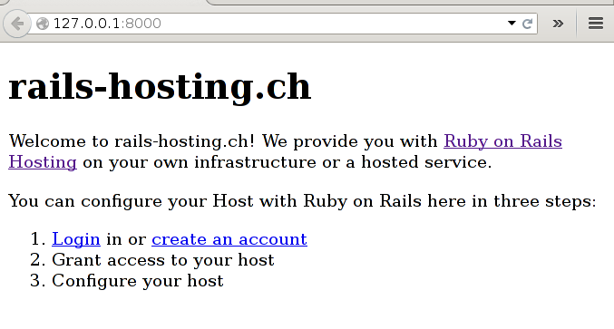
rails-hosting.ch prototype

Slide 8
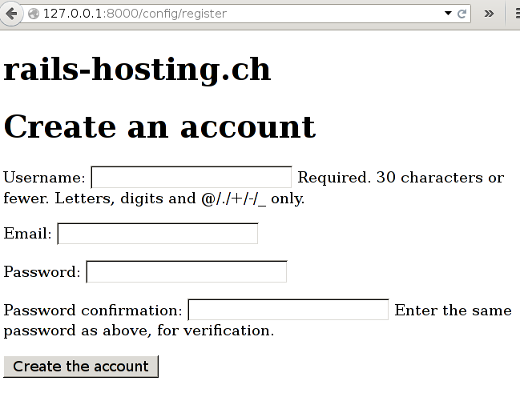
rails-hosting.ch prototype (2)

Slide 9
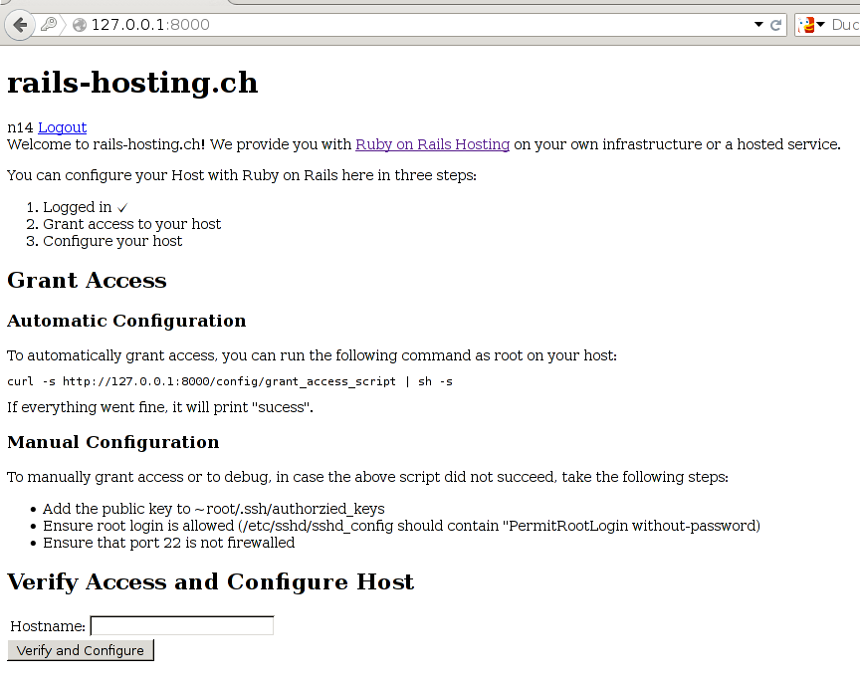
rails-hosting.ch prototype (3)

Slide 10
The future
UI/UX Design (2014)
Beta Tester phase (Q1 2015)
  Contact me, if you want to join
Go Live/Prod (Q2 2015)
Scale out variant (Q3 2015)
More services (Q4 2015)
  Python/Django
  Java/Jetty
Notes:
Warum?
Arbeit vereinfachen
Neue Sachen machen
Komplexität verringern – weniger Wissen nötig
Konzentration auf Kernkompetenzen
Ungleich = Konfigurationen
Cloud == ok

Slide 11
Contact
FolloTak to us @ irc://irc.freenode.net/#cstar
Follow us on Twitter: @NicoSchottelius @ungleich
Tak to us @ irc://irc.freenode.net/#cstar
Discuss @ cdist@l.schottelius.org
Develop @ http://github.com/telmich/cdist
Get in touch @ cdi.st@ungleich.ch
See what we do @ http://www.ungleich.ch
Notes:
Für cdist interessiert
Erreichbar via IRC, Twitter, Mailingliste
Bugs auf github
Kommerzieller Support via ungleich GmbH

