Slide 1
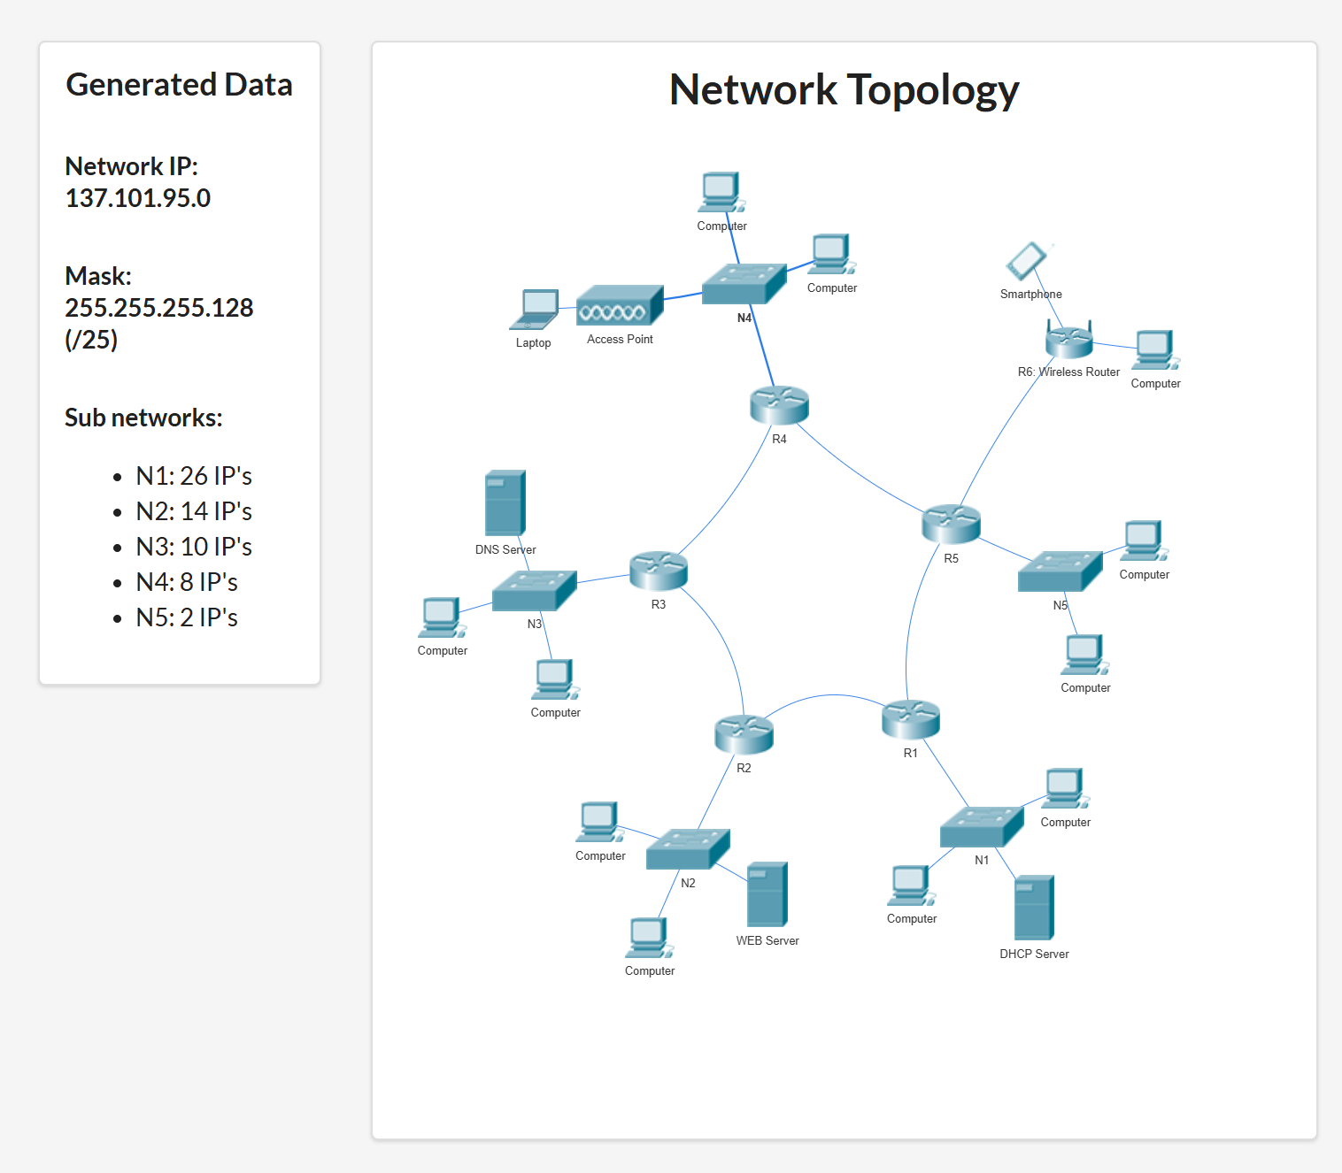
N
3
4
N
4
5
N
1
5
N
2
3
N
1
2

Slide 2
adresa de retea: 137.101.95.0/ 25 netmask: 255.255.255.128 adresa ip inceput: 137.101.95.0 adresa ip final: 137.101.95.127 Nr IP-uri totale = 128 IP-uri
Adrese IP ramase:
-
Retea | Nr IP-uri | Dimensiunea retelei | Adresa de retea | adresa de broadcast
N1 | 26 + Adresa de retea + broadcast + default gateway | 32 | 137.101.95.0/27 | 137.101.95.31
N2 | 14 + 3 | 32 | 137.101.95.32/27 | 137.101.95.63
N3 | 10 +3 | 16 | 137.101.95.64/28 | 137.101.95.79
N4 | 8 + 3 | 16 | 137.101.95.80/28 | 137.101.95.95
N5 | 2 + 3 | 8 | 137.101.95.96/29 | 137.101.95.103
N12 | 2 + adresa de retea + broadcast | 4 | 137.101.95.104/30 | 137.101.95.107
N15 | 2 + 2 | 4 | 137.101.95.108/30 | 137.101.95.111
N23 | 2 + 2 | 4 | 137.101.95.112/30 | 137.101.95.115
N34 | 2+ 2 | 4 | 137.101.95.116/30 | 137.101.95.119
N45 | 2 + 2 | 4 | 137.101.95.120/30 | 137.101.95.123
NWifi | 2 + 2 | 4 | 137.101.95.124/30 | 137.101.95.127

