Slide 1
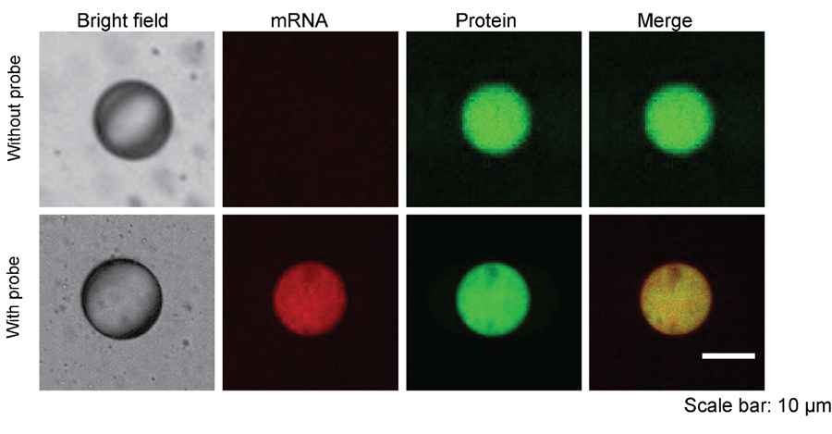
Sample + biosensor
Collection channel
Encapsulated sample
Oil
Detection of mRNA and protein expression

