Slide 1
QUIZ GAME (5 QUESTIONS)
OUTPUTS (ALL SCENARIOS)
CODE (FUNCTIONS)
CODE (MAIN PROGRAM)

Slide 2
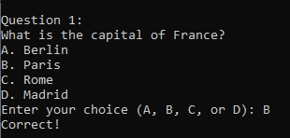
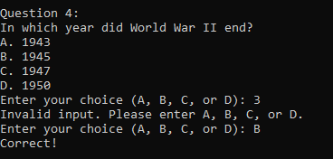
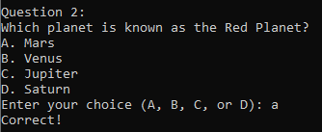
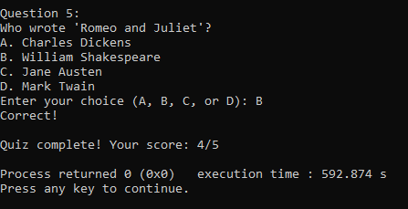
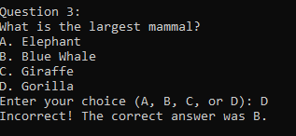
outputs
CORRECT ANSWER IN CAPITAL LETTER: INVALID ANSWER (ERROR HANDLING):
CORRECT ANSWER IN SMALL LETTER:
SCORE IS DISPLAYED AFTER THE FINAL QUESTION:
INCORRECT ANSWER:

Slide 3
CODE (Functions)
#include <stdio.h>
#include <ctype.h>
// Structure to represent a question
typedef struct {
char question[100];
char options[4][50];
int correctOption;
} Question;
// Function to display a question
void displayQuestion(Question q) {
printf("%s\n", q.question);
for (int i = 0; i < 4; i++) {
printf("%s\n", q.options[i]);
}
}

Slide 4
CODE (Functions)
// Function to get user's answer
char getUserAnswer() {
char input[10];
printf("Enter your choice (A, B, C, or D): ");
fgets(input, sizeof(input), stdin);
return toupper(input[0]);
}
// Function to check if the user's answer is correct
int isAnswerCorrect(Question q, char userAnswer) {
return (toupper(userAnswer) == 'A' + q.correctOption);
}

Slide 5
CODE (MAIN PROGRAM)
int main() {
int score = 0;
// Array of questions
Question questions[] = {
{"What is the capital of France?", {"A. Berlin", "B. Paris", "C. Rome", "D. Madrid"}, 1},
{"Which planet is known as the Red Planet?", {"A. Mars", "B. Venus", "C. Jupiter", "D. Saturn"}, 0},
{"What is the largest mammal?", {"A. Elephant", "B. Blue Whale", "C. Giraffe", "D. Gorilla"}, 1},
{"In which year did World War II end?", {"A. 1943", "B. 1945", "C. 1947", "D. 1950"}, 1},
{"Who wrote 'Romeo and Juliet'?", {"A. Charles Dickens", "B. William Shakespeare", "C. Jane Austen", "D. Mark Twain"}, 1}
};
int numQuestions = sizeof(questions) / sizeof(questions[0]);
// Iterate through each question
for (int i = 0; i < numQuestions; i++) {
printf("\nQuestion %d:\n", i + 1);
displayQuestion(questions[i]);

Slide 6
CODE (MAIN PROGRAM)
char userAnswer;
do {
userAnswer = getUserAnswer();
if (userAnswer < 'A' || userAnswer > 'D') {
printf("Invalid input. Please enter A, B, C, or D.\n");
}
} while (userAnswer < 'A' || userAnswer > 'D');
if (isAnswerCorrect(questions[i], userAnswer)) {
printf("Correct!\n");
score++;
} else {
printf("Incorrect! The correct answer was %c.\n", 'A' + questions[i].correctOption);
}
}
printf("\nQuiz complete! Your score: %d/%d\n", score, numQuestions);
return 0;
}

Slide 7
THANK YOU

