Slide 1
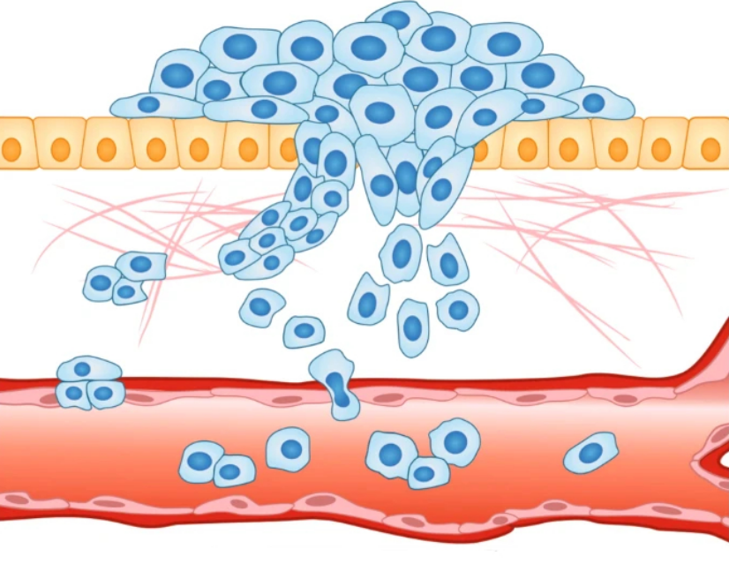
Bachelor Thesis: Continuous Modeling of Extracellular Matrix Invasion by Tumor Growth
Student: Maximilian Bing
Supervisor: Professor Vincent Heuveline
Interdisciplinary Center for Scientific Computing
Engineering Mathematics and Computing Lab
Heidelberg, Germany, May 27, 2024
[1]

Slide 2
Table of Contents
Introduction
Theoretical Basics
Modeling
Experiments and Results
Conclusion and Discussion

Slide 3
1. Introduction
Modeling Tumor growth plays cruical role in understanding the complex mechanisms governing development and professrion of cancer
Mathematical Oncology provides models to describe this process
Different Types of Models:
Continuous: focus on continuous quantities
Discrete: focus on discrete entities
Hybrid: combination of both approaches
Model by Anderson et al. used in this work to describe extracellular matrix invasion
Focus on varying parameters and dimensions
Outlook on varying ECM structure

Slide 4
2. Theoretical Background I
Malignant DNA mutations may cause diseases like cancer
Failure of complex system managing cell birth, proliferation and death
5 medical stages of Cancer:
Tumor Initiation: genetic mutations of healthy cells
Tumor Promotion: furher genetic alterations of affected cells
Tumor Progression: growth and proliferation, formation of local tumor
Tumor Invasion: invasion of surrounding tissue of tumor cells
Metastization: blood circulation entered, spread throughout body

Slide 5
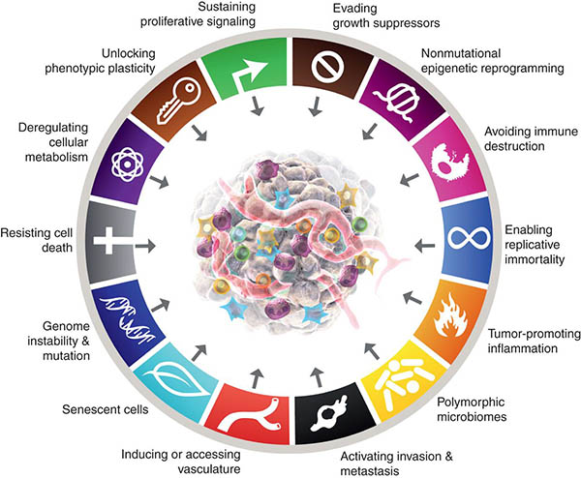
2. Theoretical Background I
Other organization principle Hallmarks of Cancer: fundamental characteristics acquired by cells as they become cancerous
Hallmarks incorporated in the model:
Sustaining proliferative signaling
Avoiding immune destruction
Activating invasion & metastasis
Resisting Cell Death
Evading Growth Suppressors
[2]

Slide 6
3. Aims of this Work
Investigate numerical model proposed by Anderson et al. To model tumor development at invasion stage
Examine how configuration of free parameters influences model’s results
Compare results across varying spacial dimensions
Explore effects of extracellular matrix geometry
Provide starting point to utilize this model for research in other areas

Slide 7
4. Modelling: Mathematical Derivation: ECM
Extracellular Matrix is degraded by matrix-degrading enzymes upon contact:
Partial e \partial = -delta me
Renewal of ECM molecules modeled by:
Ladsfjladsjf
Expression for ECM concentration e:
lateralds

Slide 8
4. Modelling: Mathematical Derivation: Tumor Cells
Motility of Tumor Cells subject to Haptotaxis and Random movement; flux of tumor cells:
Proliferation controlled by:
Mu_1 = …
Combine to yield expression for tumor cells:
\partial c \parical t = ….

Slide 9
4. Modelling: Mathematical Derivation: MDE
Motility of matrix-degrading enzymes subject only to random movement; flux of MDEs:
J = J_random
Production by tumor cells modeled with::
Mu_1 = …
Natural Decay modeled by:
djflasjdlfjdsa
Combine to yield expression for matrix-degrading enzyme concentration:
\partial c \parical t = ….

Slide 10
4. Modelling: Mathematical Derivation: Model
The previous assumptions and steps yield the system of partial differential equations:
With zero-flux boundary conditions:
All parameters are assumed to be positive real numbers

Slide 11
4. Modelling: Numerical Formulation I
Rescale spacial domain to unit domain Omega: unit line [0,1], unit square [0,1] x [0,1], unit cube: [0,1] x [0,1] x [0,1]
Non-dimensionalize variables:
C = c/co e = e/eo m=m/m0
Modify free parameters:
Dc = dc / d, gamma = chi e0/d

Slide 12
4. Modelling: Numerical Formulation II
Numerical model:
With zero-flux boundry conditions:
Variational Formulation:
Var formulation

Slide 13
5. Experiments & Results: Model Settings
HiFlow^{3} and Paraview are used to evaluated the numerical simulations
Using parameter estimates from [2] and [3] to non-dimensionalize time:

Slide 14
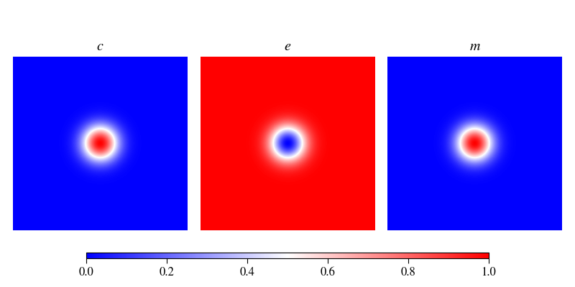
5. Experiments & Results: Initial Conditions I
Tumor Cell Density and Matrix-degrading Enzyme concentration:
Two cases for Extracellular Matrix structure:
Homogenous ECM
structure
Heterogenous ECM
structure

Slide 15
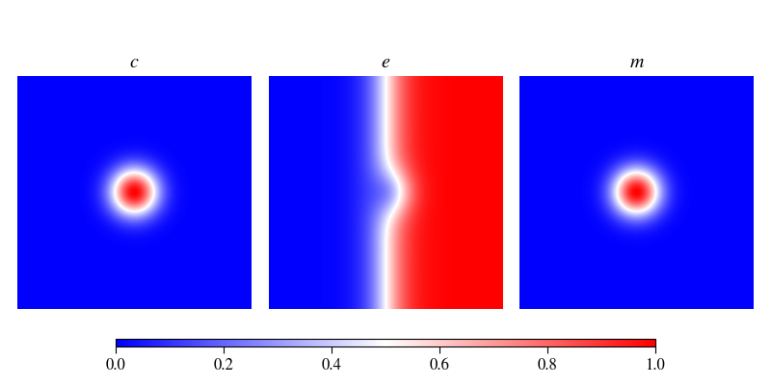
5. Experiments & Results: Initial Conditions II
For Extracellular Matrix structure two cases:
Homogenous ECM:
Heterogenous ECM:

Slide 16
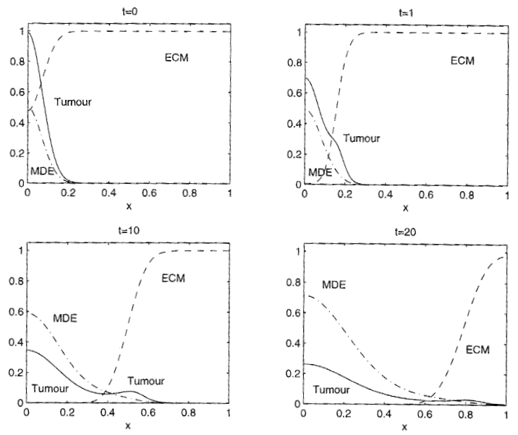
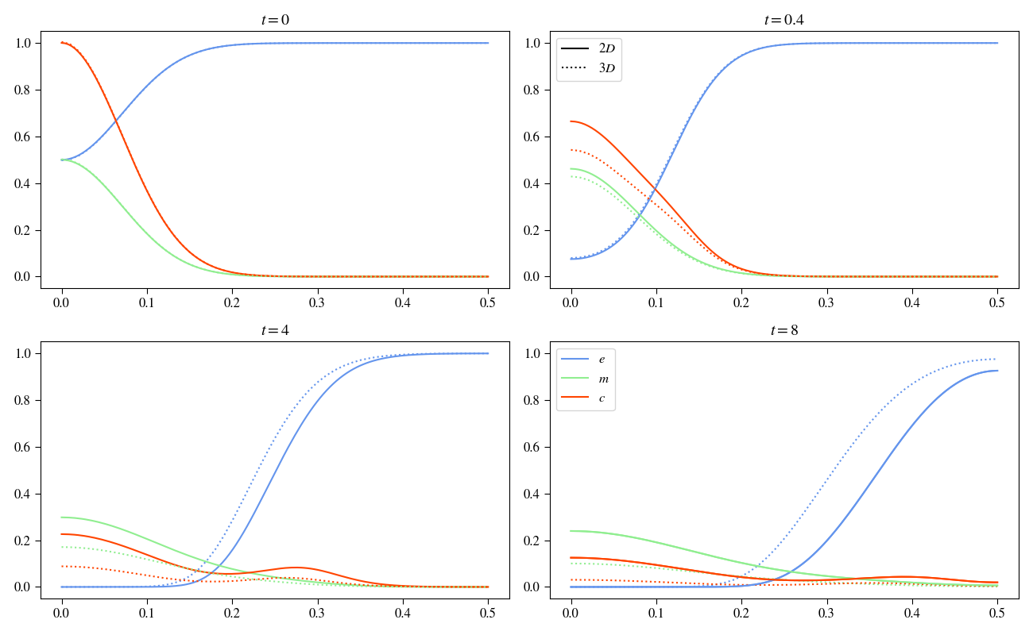
5. Experiments & Results: Dimension Variation I

Slide 17
5. Experiments & Results: Dimension Variation II
Main differences:
Matrix-degrading Enzyme concentration
Tumor Cell density at origin
Adjust parameters to make 2D and 3D simulations fit 1D experiment

Slide 18
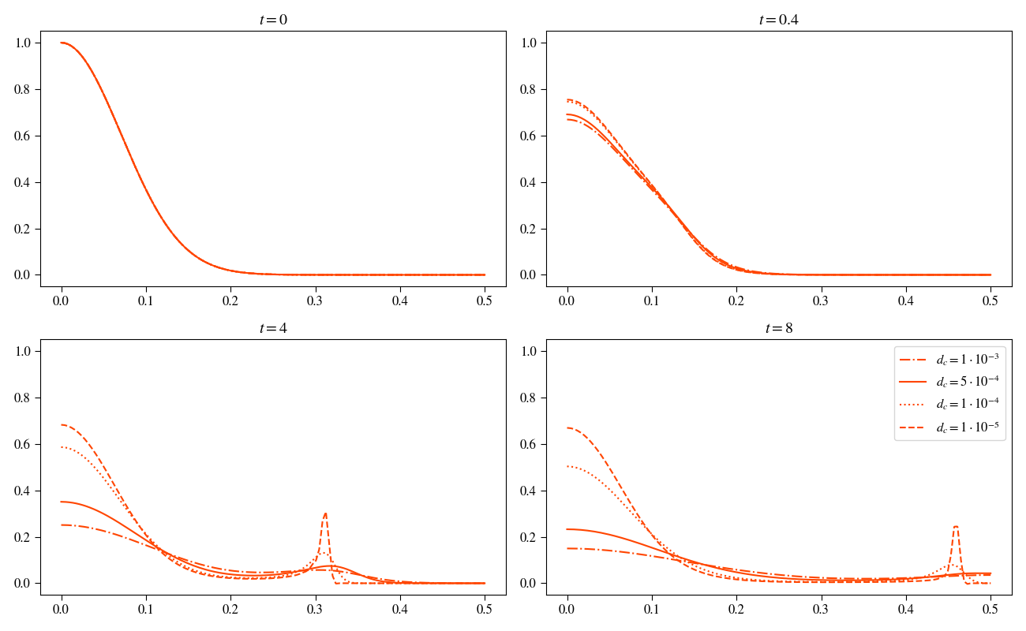
5. Experiments & Results: Dimension Variation III
Comparison of 2D experiments varying $d_c$
Use $d_c=5 10^{-4}$

Slide 19
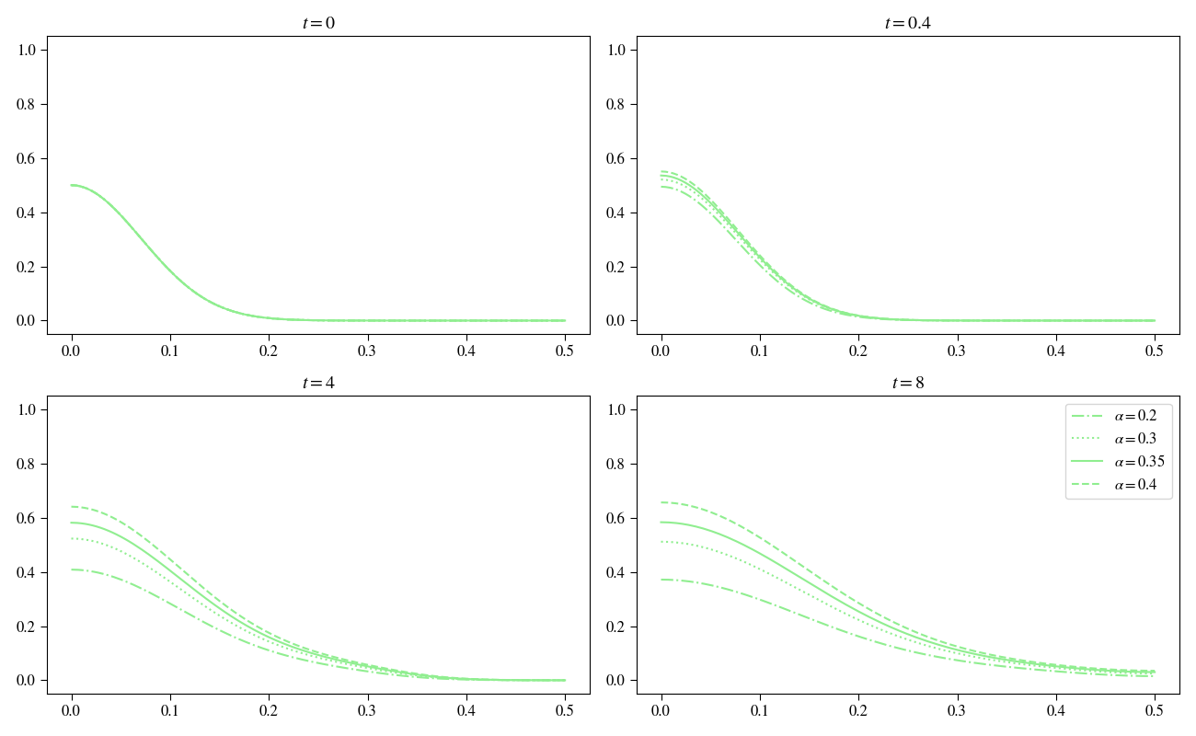
5. Experiments & Results: Dimension Variation VI
Comparison of 2D experiments varying $\alpha$
Use $\alpha=0.35$

Slide 20
5. Experiments & Results: Dimension Variation V
Insert image of 2D basecase without proliferation

Slide 21
5. Experiments & Results: Dimension Variation VI
Most significant variable tumor cell density c
Controls motility of tumor cells and matrix-degrading enzymes
Shape is imprinted on MDE concentration as well, since production
Going from 1D to 2D adjusting d_c, gamma, alpha, does the same hold for going from 2D to 3D

Slide 22
5. Experiments & Results: Dimension Variation VII
d_c:
Fromula for dimensions explained and applied
\gamma:
Does not work variablity of haptotaxis in local areas influence too high, Experimental evaulation
\alpha:
Concentration of tumor cells for increasing dimensions decreases, therefore increase alpha, non-linearity and local dependence on tumor cell concentration, Experimental evaluation

Slide 23
5. Experiments & Results: Dimension Variation VIII

Slide 24
5. Experiments & Results: Dimension Variation II

Slide 25
5. Experiments & Results: Dimension Variation II

Slide 26
5. Experiments & Results: Dimension Variation II

Slide 27
5. Experiments & Results: Dimension Variation II

Slide 28
5. Experiments & Results: Dimension Variation II

Slide 29
5. Experiments & Results: Dimension Variation II

Slide 30
5. Experiments & Results: Dimension Variation II

Slide 31
5. Experiments & Results: Dimension Variation I

Slide 32
5. Experiments & Results:

Slide 33
5. Experiments & Results:

Slide 34
5. Experiments & Results:

Slide 35
5. Experiments & Results:

Slide 36
5. Experiments & Results:

Slide 37
5. Experiments & Results:

Slide 38
5. Experiments & Results:

Slide 39
5. Experiments & Results:

Slide 40
6. Conclusion & Discussion

Slide 41
6. Conclusion & Discussion

Slide 42
Image Resources
[1]: https://www.nature.com/articles/s41416-020-01149-0
[2]: https://aacrjournals.org/cancerdiscovery/article-pdf/12/1/31/3052722/31.pdf

