Slide 1
Interactive Simulation
Blood-sucking simulator
Chris Stifter (Group 07)

Slide 2
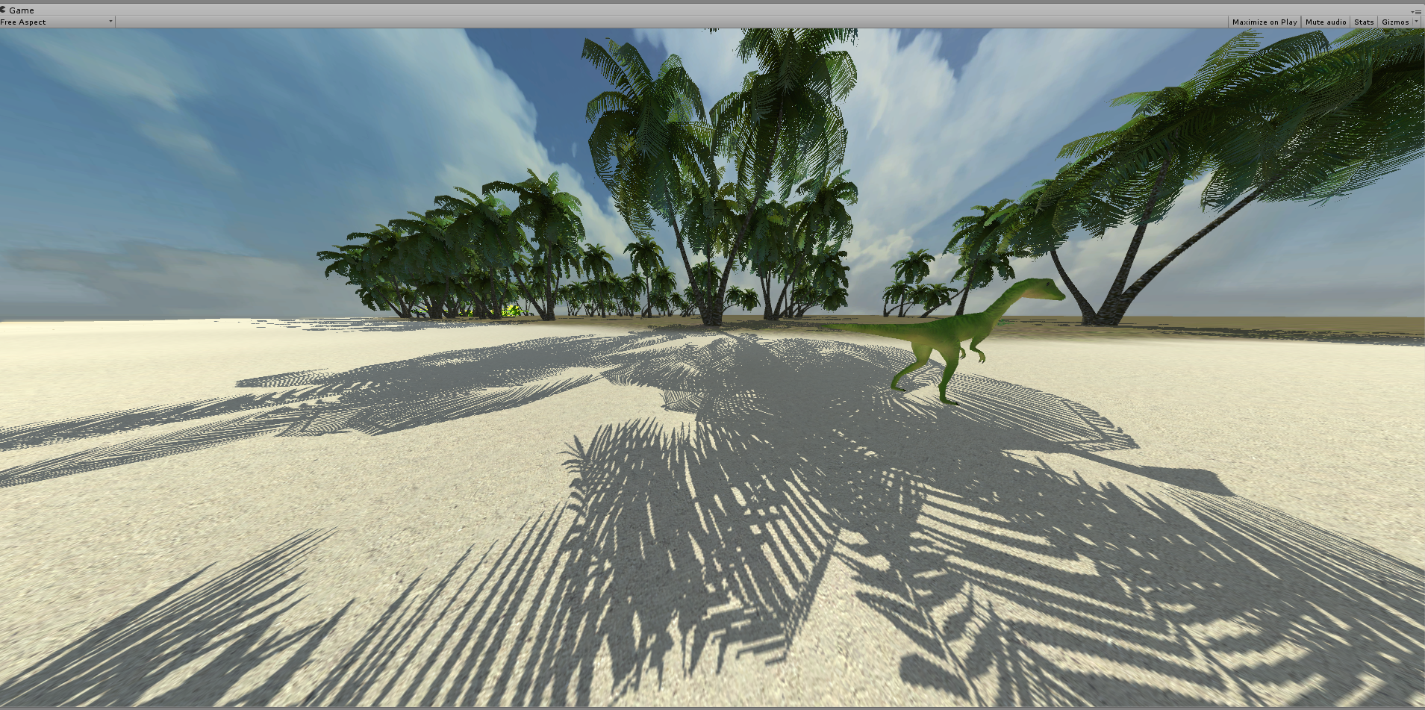
Interactive Simulation – Blood-sucking Simulator
What we've done
Created parts of an island as playground

Slide 3
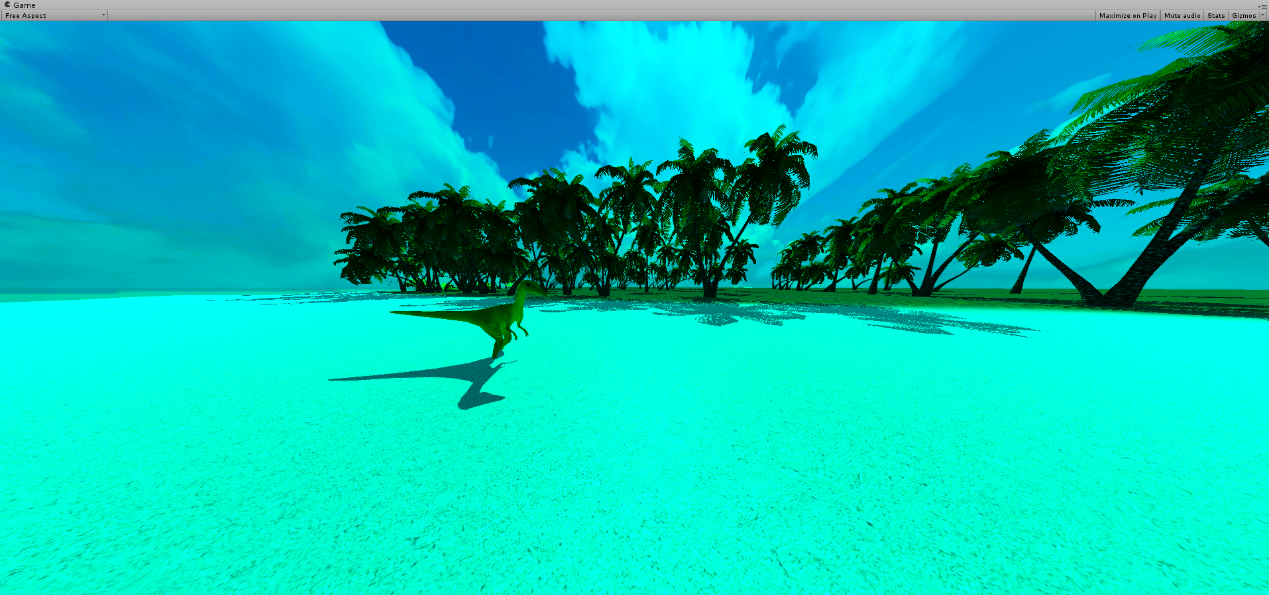
Interactive Simulation – Blood-sucking Simulator
What we've done
Mosquitoes don't see red light.

Slide 4
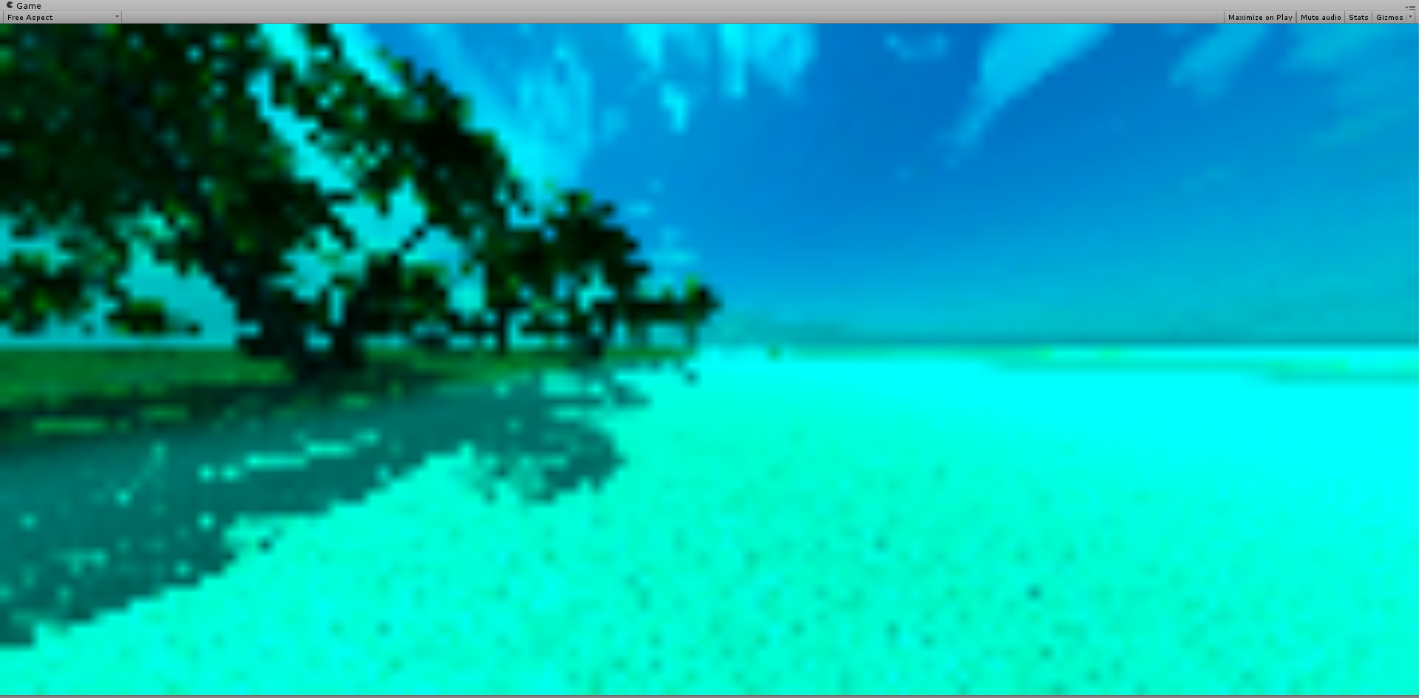
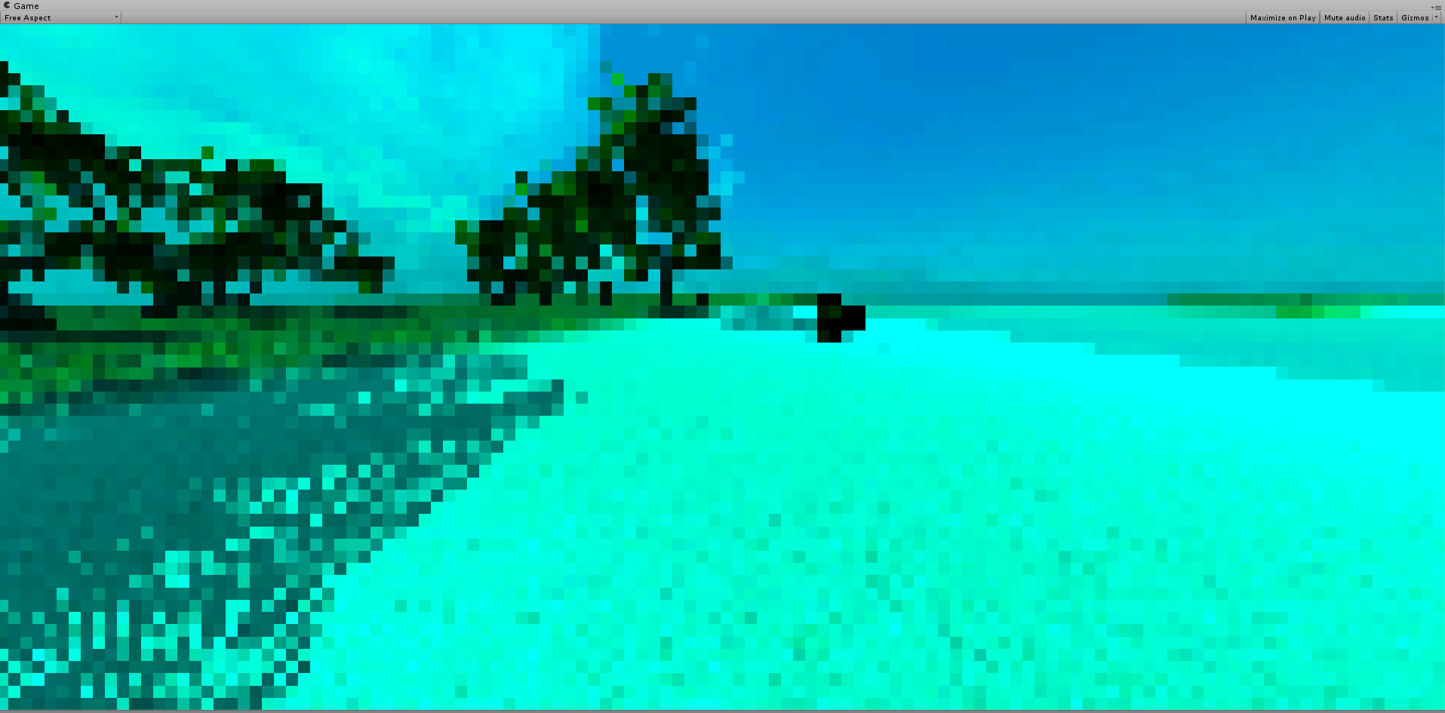
Interactive Simulation – Blood-sucking Simulator
What we've done
Mosquitoes see with far lower spatial resolution

Slide 5
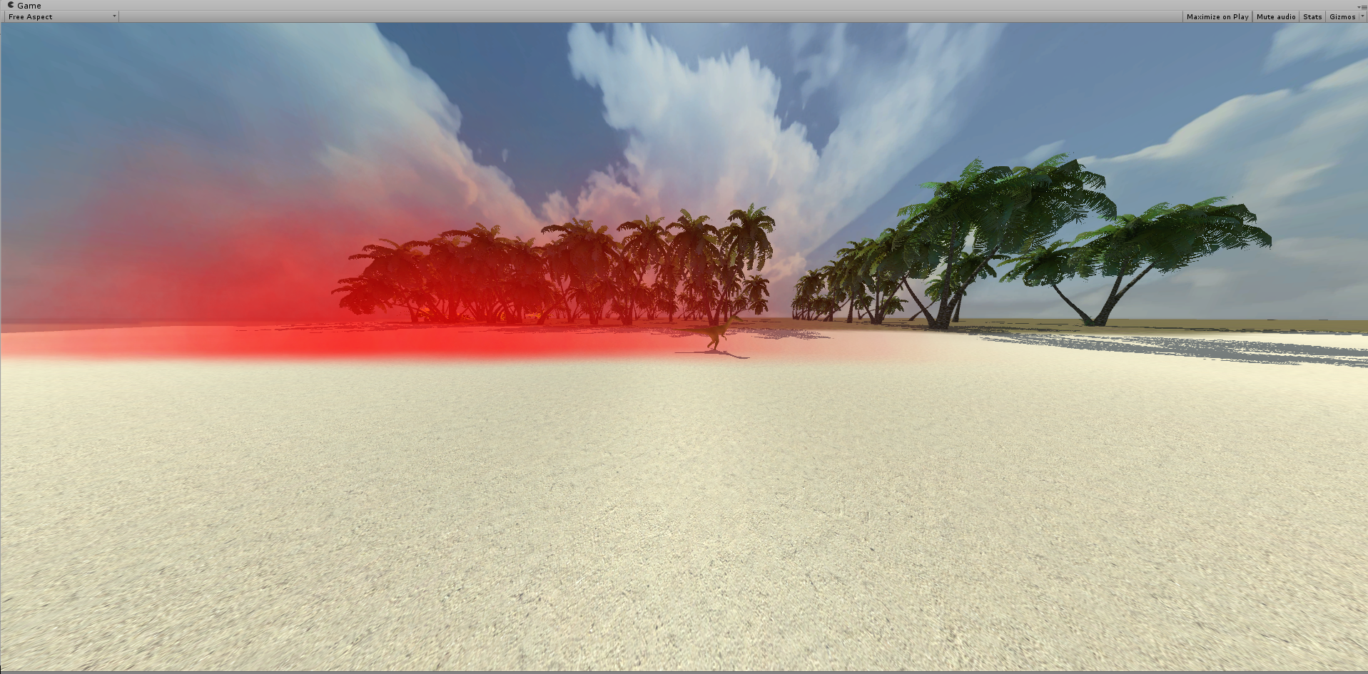
Interactive Simulation – Blood-sucking Simulator
What we've done
Started trying to adjust the particle system for usage as plumes

Slide 6
Interactive Simulation – Blood-sucking Simulator
Next steps
Flying controller
Adjust the scale
Overlay red smoke with green+blue picture

