Slide 1
Interactive Simulation
Micro & Macro
Exchange Your Eyes Simulator
University of Augsburg, Winter Semester 2015
Sebastian Lemp, Stefan Büttner
Notes:
Initially: Insect vision
Eye disease simulation

Slide 2
Motivation
Most simulations online:
2D stills
Adapted to suggestion of
Frank Zwick & Sven Fiebiger
GOTOXY-AV Media GbR
Raise awareness of
eye diseases
Obtain better understanding
of eye diseases

Slide 3
Concept
Scenario: Food shopping
Common and well known
Gamifyable
Focus on common
eye diseases
Exhibit various states
of the disease
Explore and alter diseases
through different parameters

Slide 4
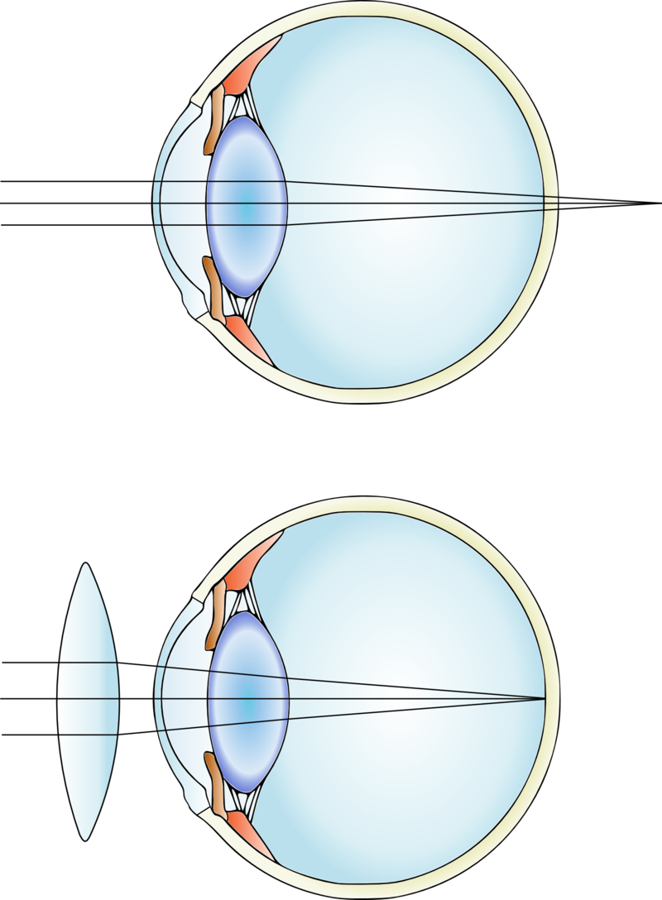
Implementation
Myopia & Hyperopia
Limit focal range
Use existing focal blur asset
Figure 1: Hyperopic eye
Notes:
Used Image Effects – Depth of Field Asset
Real-time depth of field difficult and expensive
Diopters: 1/f of correcting lens

Slide 5
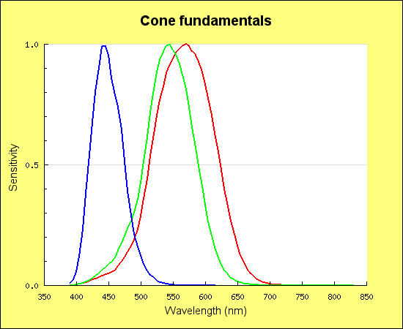
Implementation
Color vision deficiency
Implementation inspired
by Machado [1]
Individually adjustable
cone response curves
Figure 2: Human cone response functions.

Slide 6
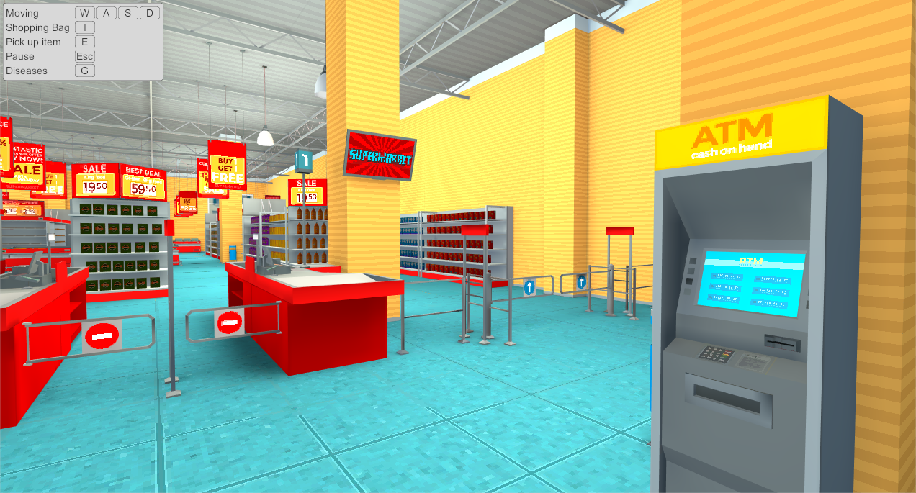
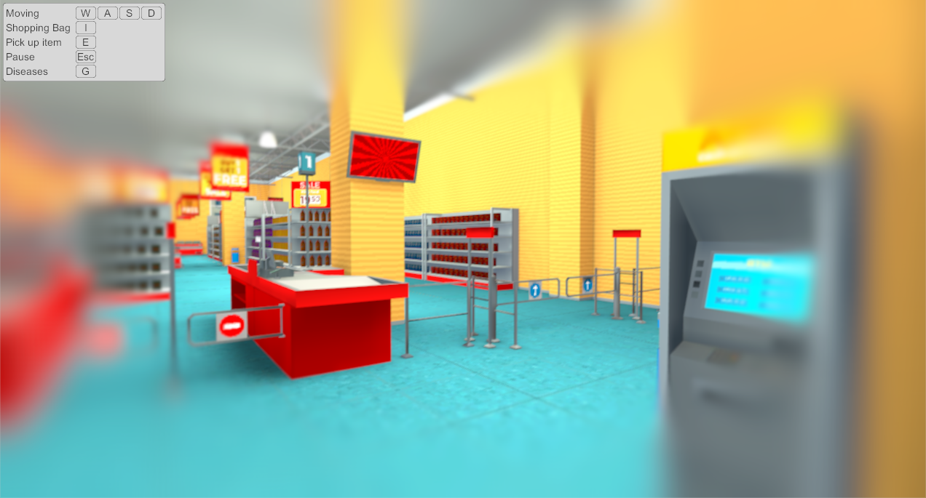
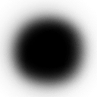
Implementation
Glaucoma
Implemented texture based blur

Slide 7
References
[1]
Gustavo M. Machado, Manuel M. Oliveira, and Leandro A. F. Fernandes. “A Physiologically-based Model for Simulation of Color Vision Deficiency”. In: IEEE Transactions on Visualization and Computer Graphics 15.6 (Nov. 2009), pp. 1291–1298.

