Slide 1
Interactive Simulation
Micro & Macro
Exchange Your Eyes Simulator
University of Augsburg, Winter Semester 2015
Sebastian Lemp, Stefan Büttner

Slide 2
Motivation
Interest in biological optical systems
Gain understading of the ways other species perceive the world in comparison to humans
See how human brain manages to process other views

Slide 3
Goals
Give the user the opportunity to experience the
Same environment through different eye systems.
The user should be able to choose from
these systems to solve a given task.

Slide 4
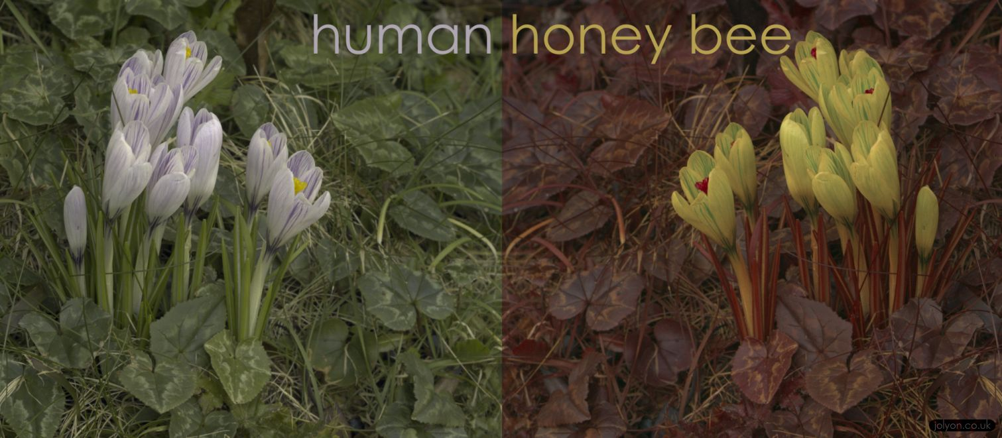
Elaboration
Simulate visual apparatus different of the human one
Visual complexity in processing the unusual images
Solve task(s) and choose from different eyes
Perhaps give the user the possibility to tweak eyes to better suit the task

Slide 5
To be continued...

