Slide 1
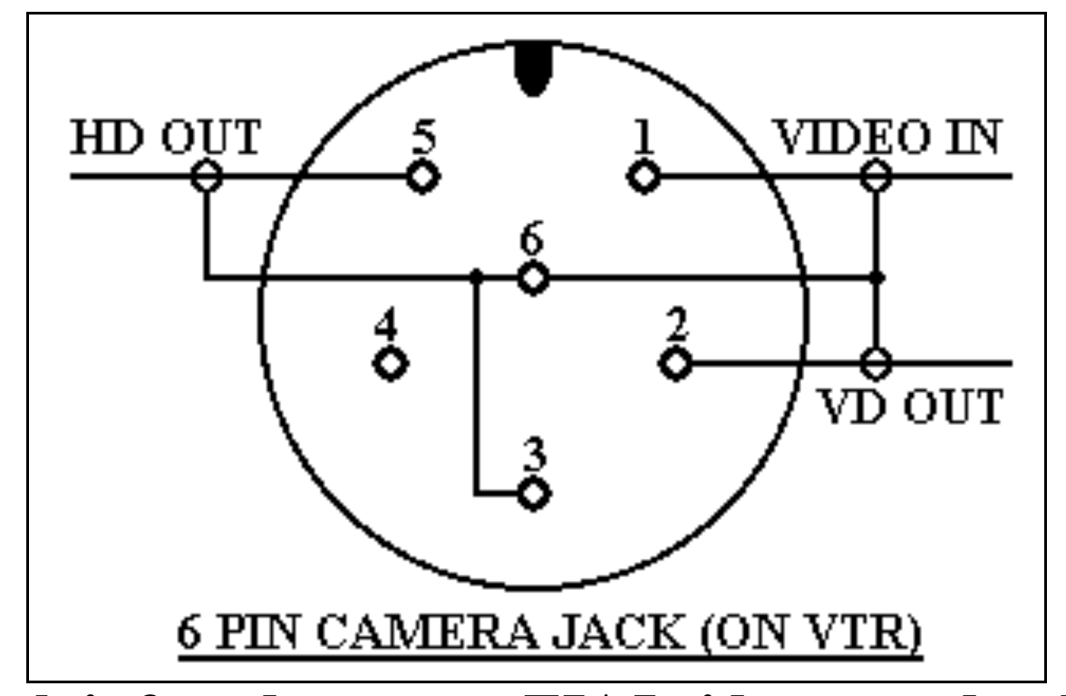
BLUE
GREEN
GREEN + YELLOW = FORWARD
BLUE + YELLOW = BACKWARDS
YELLOW

