Slide 1
Face Identification by Fitting a
3D Morphable Model using Linear Shape and Texture Error Functions
Sami Romdhani Volker Blanz Thomas Vetter
University of Freiburg
Supported by DARPA

Slide 2
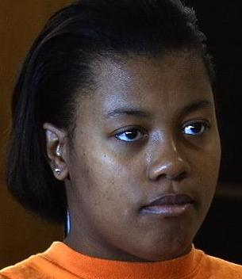
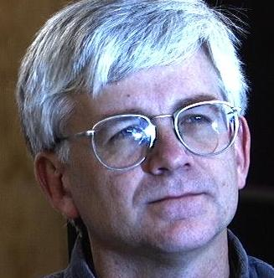
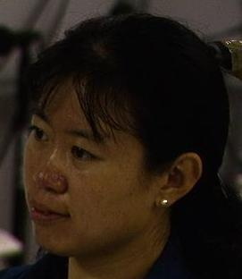
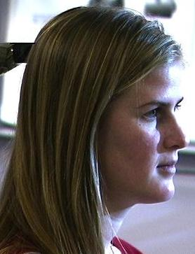
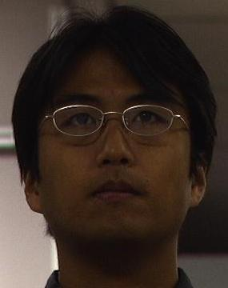
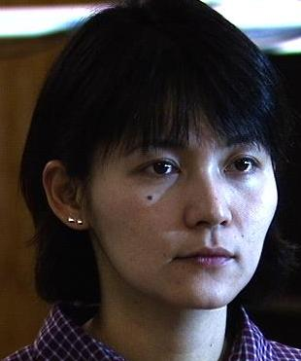
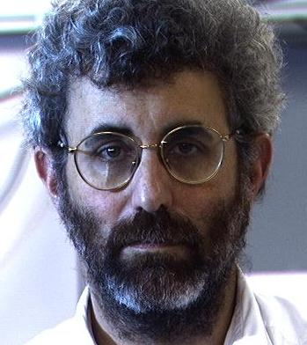
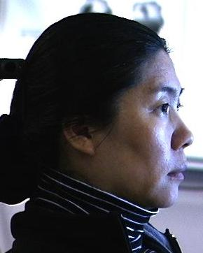
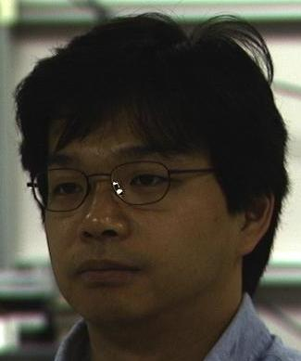
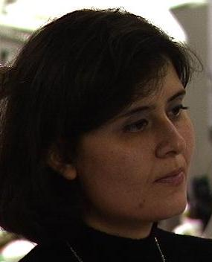
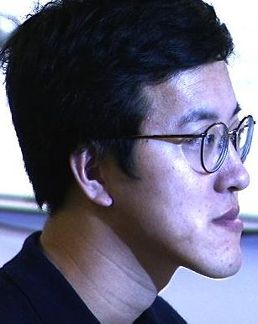

The Problem
Notes:
We are interested in recovering semantic information about faces such as : “What is the name of a person’s face ?”
However this INTRINSIC information is not readily available. It is mixed amongst other source of variations called extrinsic.
extrinsic variations : pose, illumination, presence of glasses, beards, cast shadows, specular highlights, …
Intrinsic variations : ethnicity, identity, …
An analysis of a face requires the separation of those source of variations. For this purpose, we need:
1. A generative model able to accurately account for all these variations
2. To be able to invert the image formation process: I.e. recover from one image its model parameters
In this paper we would like to identify people from a single image irrespective of the pose or illumination.

Slide 3
Menu
Historical Methods
3D Morphable Model
LiST : a Novel Fitting Algorithm
Identification Experiments on more than 5000 Images
Identification Confidence = Fitting Accuracy
Notes:
Here is the menu for the remaining 15 minutes:
I will first refresh your memory about the successful attempt at addressing such a problem and show what is their limitations
Then, I will present the 3D model that we used in our group which was presented at SIGGRAPH ’99, called the 3D Morphable Model.
Then, the novel fitting algorithm which is the centerpiece of this talk
I will present identification experiment carried out on more than 5000 images exhibiting combined pose and illumination variation
A benefit from our method is that we can know the confidence of an identification and I will show that this depends mostly on the fitting accuracy. This has interesting implications on future research.

Slide 4
Historical Methods : Active Appearance Model
Use of a generative model:
View based (2D), Correspondence based
ex: AAM of Cootes and Taylor
Drawbacks:
- small pose variation statistically modeled !
- large pose var. necessitates many models !
- illumination not addressed !
Notes:
I am now refreshing your memory about past successful attempts at addressing similar problems:
A common feature of successful FR methods is the use of a generative model.
A generative model is a mathematical formulation of the image formation process.
One of those, is the Active Appearance Model of Cootes and Taylor. It is a view-based and correspondence-based model where faces are represented as a sparse 2D shape and a texture map. This model suffers from several drawbacks :
As it is 2D, only very limited out-of-plane image variation can be modeled. Furthermore these variation are not explicitly modeled but rather are mixed with the ID parameters.
Large pose variation can only be handled by using several of those models.
Illumination variations are not addressed, probably because no information about the surface normal is incorporated into the model.
This model was never used to address our problem of combined pose and illum. var.

Slide 5
Historical Methods : Illumination Cone
Shape from Shading
= Recovering 3D shape from Illumination variations
ex: Illumination Cone of Georghiades,
Belhumeur & Kriegman
Limited use : up to 24° azimuth variation !
Drawback:
Impractical: requires many images
Restrictive assumptions : constant albedo,
lambertian,
no cast shadows
Notes:
Another method is often cited as an example for dealing with our problem: The Illumination Cone from Georghiades, Belhumeur & Kriegman. This method is a shape-from-shading method whereby 3D shape information is recovered from the shade of an object. Theoretically, this method can handle the problem of combined pose and illumination variation, however practically, it can only do so in a very limited range of pose variation: only 24 degrees of azimuth variation. This problem probably originates from the restrictive assumptions being made: constant albedo, lambertian objects, absence of cast shadows. Also, it is rather impractica as several images of a person at the same pose but different illuminations must be available.
General comment about those models: too simple to explain accurately the vast and complicated image formation process.

Slide 6
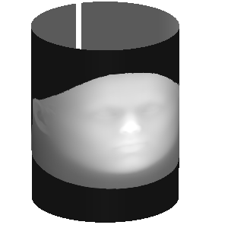
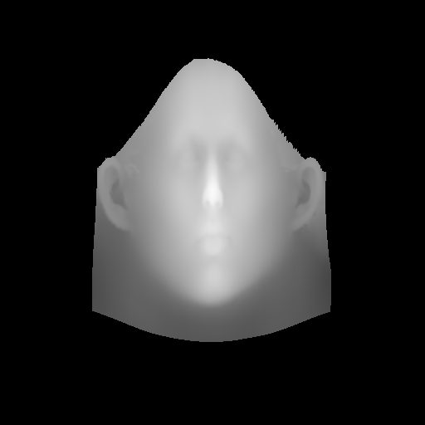

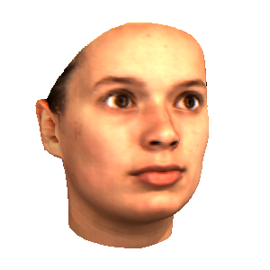
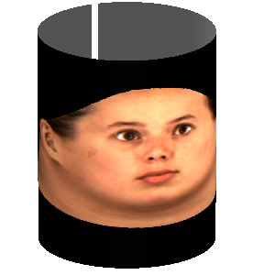
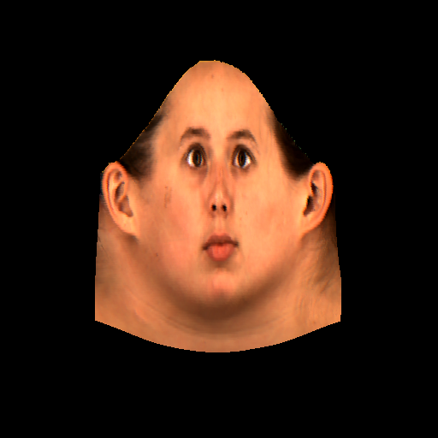

3D Morphable Model - Key Features 1
1. Representation = 3D Shape + Texture Map
3D Shape
Texture Map
Notes:
As an alternative we use a more complex model able to accurately generate photo-realistic images.
Its first feature is that faces are represented by a dense 3D shape and a texture map. As opposed to the AAM the shape is in 3D and it is densely sampled.

Slide 7
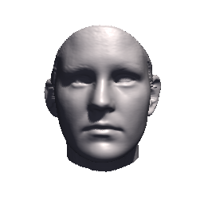
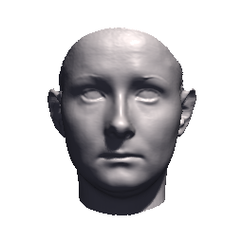
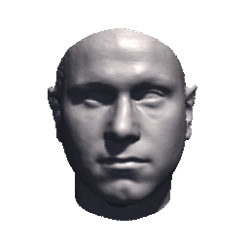
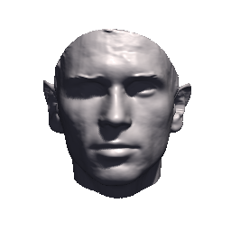
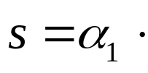

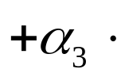



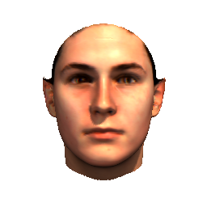
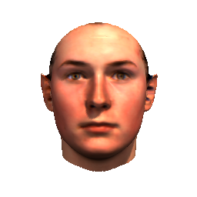
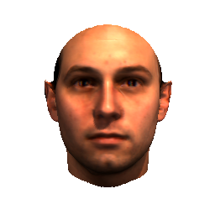
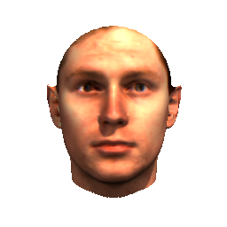
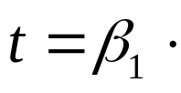

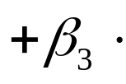


3D Morphable Model - Key Features 2
Accurate & Dense Correspondence
→ PCA accounts for intrinsic ID parameters only
...
...
Notes:
All the faces of a training set are put into dense correspondence allowing an accurate morphing between individuals. As a result, linear combination of individuals yields a realistic individuals.
Then, a principal component analysis can be meaningfully carried out over the shape and texture spaces.
Henceforth a small number of shape and texture PC coefficients are used to represent any plausible individuals.
As opposed to the AAM, these coefficients code identity only.
In the equations the variable in green are the parameters of the model which, in the Fitting algorithm, will be recovered from a single image.

Slide 8
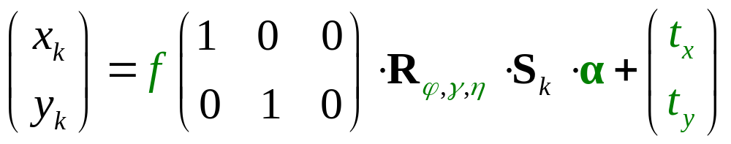
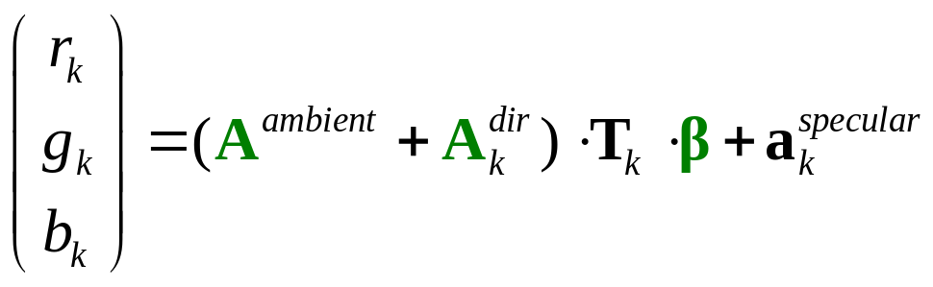
3D Morphable Model - Key Features 3
Extrinsic parameters modeled using Physical Relations:
- Pose : 3x3 Rotation matrix
- Illumination : Phong shading accounts for cast shadows and specular highlights
→ No Lambertian Assumption.
Notes:
The extrinsic parameters such as pose and illumination parameters are explicitly modeled using physic-based relations.
The pose is a 3x3 matrix and the size is modeled by the focal length.
The illumination is modeled using the Phong model able to represent specularities and cast shadows.
The matrices A are 3x3 diagonal matrices. The ambient light matrix is constant for all vertices, whereas the directed light matrix depends on the surface normal at the vertex k.

Slide 9






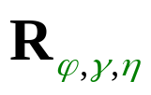
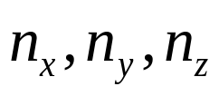


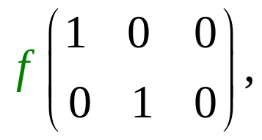




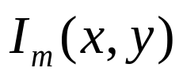
3D Morphable Model - Key Features 4
Photo-realistic images rendered using Computer Graphics
Notes:
Then the identity, pose and illumination models are used in a Computer Graphics rendering engine to produce photo-realistic images.
The shape and texture PC coefficients produce a 3D shape and illumination-less texture map.
The rotation matrix is used to put the 3D shape in the image frame. Then the normals are computed and used to update the texture map to reflect the illumination effects.
Then the rotated 3D shape is scaled, projected and translated into the 2D image.
Then a nonlinear warping function is used to interpolate at the image pixel locations the color of the face.
This function explicitly uses the correspondence by specifying where in the image a vertex should be drawn.

Slide 10
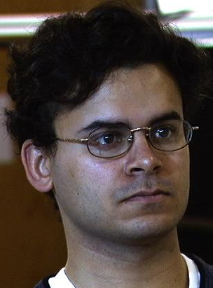
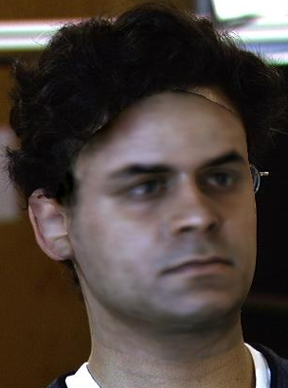

Model Fitting : Definition
Iterative
Model
Fitting
Model
Rendering
Notes:
Now, the model fitting problem is the inversion of the complex rendering engine just mentioned. This means, the recovery of the parameters of the model explaining an image.
Rho reference to the complete set of rendering parameters.

Slide 11
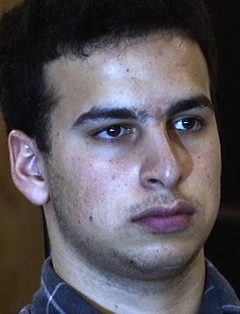
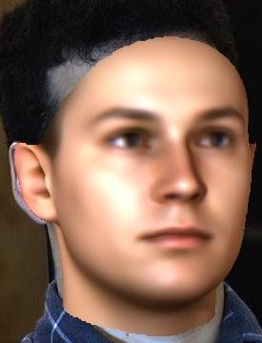
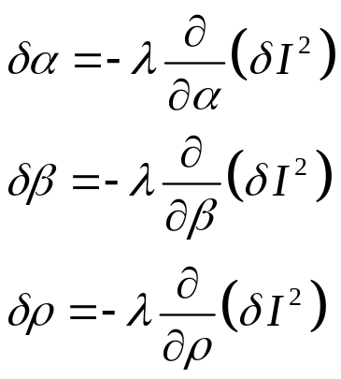

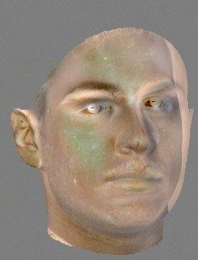
Model Fitting - History : Standard Optimization Techniques
Jones, Poggio 98 : Gradient Descent
Blanz, Vetter 99 : Stochastic Gradient Descent
Pighin, Szeliski, Salesin 99 : Levenberg-Marquardt
Input
Model Estimate
Difference
-
Notes:
I will now also refresh your memory about the most successful model fitting techniques applied to this problem.
The problem is in fact to be able to generate an image which is similar or ideally equal to the input image. This is an optimization problem, that of minimizing the difference between both images. Hence, it can be solved by standard minimization procedures such as gradient descent, stochastic gradient descent or Levenberg-Marquard.
Note that this is only a very sparse list of references, I’m sure it is possible to find many more.
The problem with this method is that it is slow as model derivatives must be computed at each iteration.

Slide 12
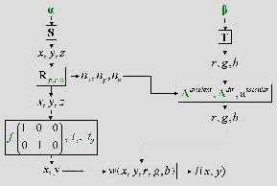
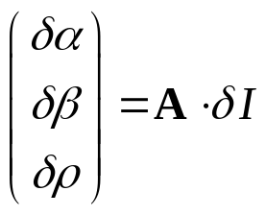
Model Fitting - History : Image Difference Decomposition
IDD introduced by Gleicher in 97
and used by Sclaroff et al. in 98, and Cootes et al. in 98
Input
Model Estimate
Difference
-
Notes:
In an attempt to avoid this problem, Gleicher introduced in 1997 a method called Image Difference Decomposition later used by Sclaroff and Cootes for the AAM.
The idea is to assume that
the derivatives are constant, I.e. the derivatives do not depend neither on the input image nor on the current estimate of the model.
and the model is linear.
This is equivalent in trying to fit the complex rendering engine described a few slides ago into a linear equation.
The problem is that unfortunately this assumption holds only in a very small domain of variation: I.e. with very limited pose variation and without light variation.
Hence it is not suited for our problem.

Slide 13
LiST : Non-linearity
2. Non-linear parameters
interaction
1. Non-linear warping
Notes:
So, in order to find an efficient fitting algorithm, we need to inspect closely the image formation process.
There are two sources of non-linearities:
First the warping function is a source of non-linearity in the modeled image.
The external parameters interaction is also non-linear

Slide 14


LiST : Shape & Texture Parameters recovery
Notes:
However,
The dependence between the 3D shape and the shape parameters, and
The dependence between the illumination-less texture and the texture parameters
Are linear.
It must be noted that there are about 100 shape parameters, 100 texture parameters but only less than 20 external parameters.
This means that if we can somehow inverse the correspondence computation and the influence of the external parameters (I.e. recover a 3D shape and illumination-less texture) then we can recover MOST of the parameters using simple linear relations.
The advantage is that these S and T matrix are the PCA matrix and that they are really constant. This fact is not an assumption as in the IDD approach.

Slide 15
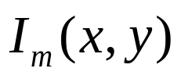

LiST
Notes:
So, now the question is : how to invert the warping function and how to recover the pose and illumination parameters.
We can compute a model image using thu current parameter estimation. For that image, we know where a vertex is projected.
As I said, the warping function says were to draw a vertex. This is what is called the correspondence problem.
So, it can be inverted by computing the correspondence between a model image and the input image…

Slide 16


LiST : Optical Flow
Optical Flow
Notes:
…This is usually performed using an optical flow algorithm.
So, OF yields correspondence between the two images, I.e. correspondence between the model vertices and the input image.
Therefore we can compute where a vertex is projected into the image frame and what is its color.

Slide 17

LiST : Rotation, Translation & Size Recovery
Lev.-Mar.
Optical Flow
Notes:
Then, to recover the pose parameters we use the correspondence just recovered, and the 3D shape of the previous iteration.
The aim is to find the pose parameters such as the 3D shape is projected onto the recovered correspondences. As this is a non-linear transformation, a non-linear optimization technique must be used. We used Levenberg-Marquard to solve this. Now, the key to understand is that there are only 6 parameters to optimize. As the search space is very small, this optimization is very fast. This is actually one of the fastest step of the algorithm.
Then, once the pose parameters are recovered, we can inverse the pose transformation and recover the 3D shape. This 3D shape is used to update the PC shape coefficients.

Slide 18
LiST : Illumination Recovery
Lev.-Mar.
Lev.-Mar.
Optical Flow
Notes:
As the illumination is also non-linear, exactly the same is applied to recover the illumination parameters, I.e. the illumination parameters are optimized such as the texture after the illumination transformation is as close as possible to the color extracted from the image.
Then, again, using the illumination parameters and the texture extracted from the image, the illumination process is inverted and an illumination-less texture is produced.
This illumination-less texture is then used to update the texture coefficients.

Slide 19
LiST : Discussion
Shape and Texture recoveries are interleaved
The recovery of one helps the recovery of the other
Takes advantage of the linear parts of the model
Recovers out-of-the-image-plane rotation
& directed illumination
5 times faster than Stochastic Gradient Descent
Drawbacks:
Still requires manual initialization
Still not fast enough
Notes:
So, the fundamental features of this fitting algorithms are the following:
Shape and texture are interleaved: 1) The recovery of the texture, produces a model image which resemble more to the input image and therefore at the next iteration the OF will be more accurate and 2) the recovery of the shape improves the correspondence and therefore improves the accuracy of the texture estimate.
This algorithm uses linear relation to recover 90% of the parameters
It is able to recover out of the image plane rotation and directed illumination.
It is faster than the Gradient descent algorithms.
But it still suffer from drawbacks:
The pose must be manually estimated, and
It is still not fast enough as on a 1Ghz machine it needs 8 min. The main source of slowness is the optical flow computation which takes 60% of the time.

Slide 20
Experiments : The CMU-PIE Face Database
Publicly available
Systematic pose & illumination variations
68 Individuals
4488 Images with combined
Pose & Illumination var.
884 Images with Pose var.
flashes
cameras
head
20
15
5
0
head
-5
10
-20
-15
5
-10
-5
0
0
Notes:
We tested our fitting algorithm on an identification application. We used the CMU-PIE face database which is publicly available and is the only one which systematically sample the pose and illumination sub-spaces, as you can see on this graph which shows the cameras in red and the flash light in blue.
This database is composed of 68 individuals.
We used two portions of this database: one containing more than 4000 images with pose & illumination variations,
And the other one containing more than 800 images with pose only variations.

Slide 21
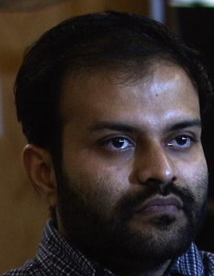
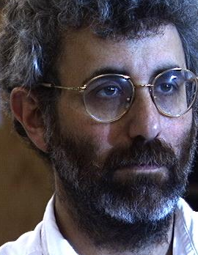
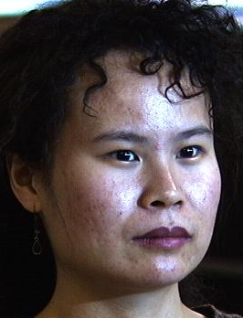
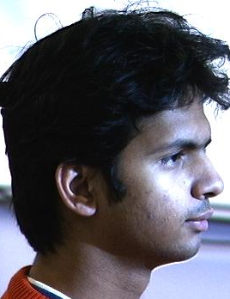
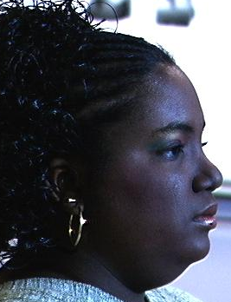
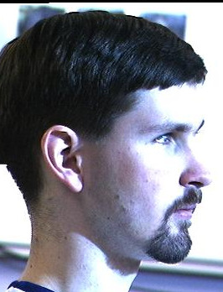
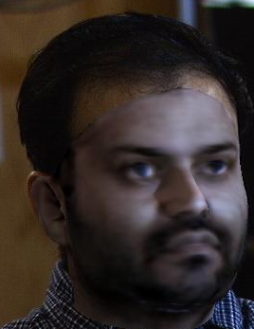





Experiments : Fitting
Notes:
Here are some example of fittings and an example of poor fitting at the end.
You see that despite the presence of specularities, of cast shadows, of glasses, of beards the fitting algorithm produces acceptable results.
The last fitting is poor presumably from the fact that there are too many pixels suffering from specularities.

Slide 22














Experiments : Identification across Pose
Notes:
Here is a graph comparing the identification performance of our algorithm with the most successful commercial package available: Visionic FaceIt.
We formed one gallery set containing one image per individual at the same pose and used the other pose in the probe set. The results are presented for the 13 galleries.
The experiments with FaceIt were conducted by CMU. You can see that our algorithm outperformed by far FaceIt.
We used a nearest neighbor classification rule on a concatenation of the shape and texture parameters.

Slide 23
Experiments : Identification across Illumination & Pose
Identification on 4488 images
across Pose & Illumination
averaged over Illumination
 | Front | Side | Profile
Front | 97 | 91 | 60
Side | 93 | 96 | 71
Profile | 65 | 71 | 86
Probe
Gallery
Notes:
This graph shows identification experiments on pose and illumination varying faces.
3 different experiments were performed for 3 gallery views.
Results were averaged over illumination conditions.

Slide 24
Identification Confidence : Theory
Can we be sure to have correctly identified someone ?
We think:
Identification Confidence depends mostly on the Fitting
Classification Support Vector Machine
Input: Mahalanobis distance from the average
    SSE over 5 regions of the face
Output: Good Fitting Y/N ?
Notes:
Unfortunately sometime the identification reported by the algorithm is wrong. We would like to know when it is wrong and when we have a pretty good confidence that the identity yielded is correct.
We think that the identification confidence depends mostly on the fitting result. The more accurate the fitting, the more confident we are about identifying a face.
Therefore we trained an SVM on 20 % of the fitting. The input was a small vector composed of the mahalanobis distance of the fitted parameters from the average and the sum of square errors of the pixel on 5 regions of the face: nose, eyes, mouth and surroundings. The output was our believe that the fitting is good (manually set).

Slide 25
Identification Confidence : Result
Identification vs. Fitting Score
100
95.1 %
35
97.4 %
90
30
83.7 %
80
76.5 %
25
70
20
Identification Percentage
58.9 %
% of Experiments
60
15
50
43.2 %
10
40
38.2 %
30
26.8 %
5
29 %
33 %
12 %
6 %
4 %
7 %
7 %
3 %
20
2
1.25
0.75
0.25
-0.25
-0.75
-1.25
-2
0
Fitting Score = SVM Output
The model is good
we only need to improve the fitting accuracy
Notes:
We computed this fitting score for the 4488 pose & illumination fitting and sorted them out into bins. In this graph, the average of the identification performance in each bins is ploted along with the number of fittings per bin.
You can see that there is a clear correlation between the fitting score and the identification performance. So, our belief that the ID Confidence depends mostly on the fitting score is correct.
This has a major impact on our research. It means that the model is suited to identification and we only need to improve the fitting to improve ID performances.

Slide 26
Conclusions
Novel Fitting Algorithm :
Use of Optical Flow to recover a Shape Error
Recovers most of the parameters linearly
Recovers a few non-linear parameters using Lev.-Mar.
State of the art identification performances across
Pose & Illumination
Drawbacks:
Still not fast enough
Still requires manual initialisation

