Slide 1
STUTOR
ESE team 8

Slide 2
Overview
Couple of scenarios
Filter search
Bootstrap design
… ?

Slide 3
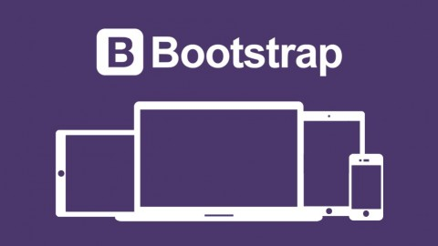
Bootstrap
Bootstrap is an excellent set of carefully crafted user interface elements, layouts, and javascript tools, freely available to use in your next web design project.

Slide 4
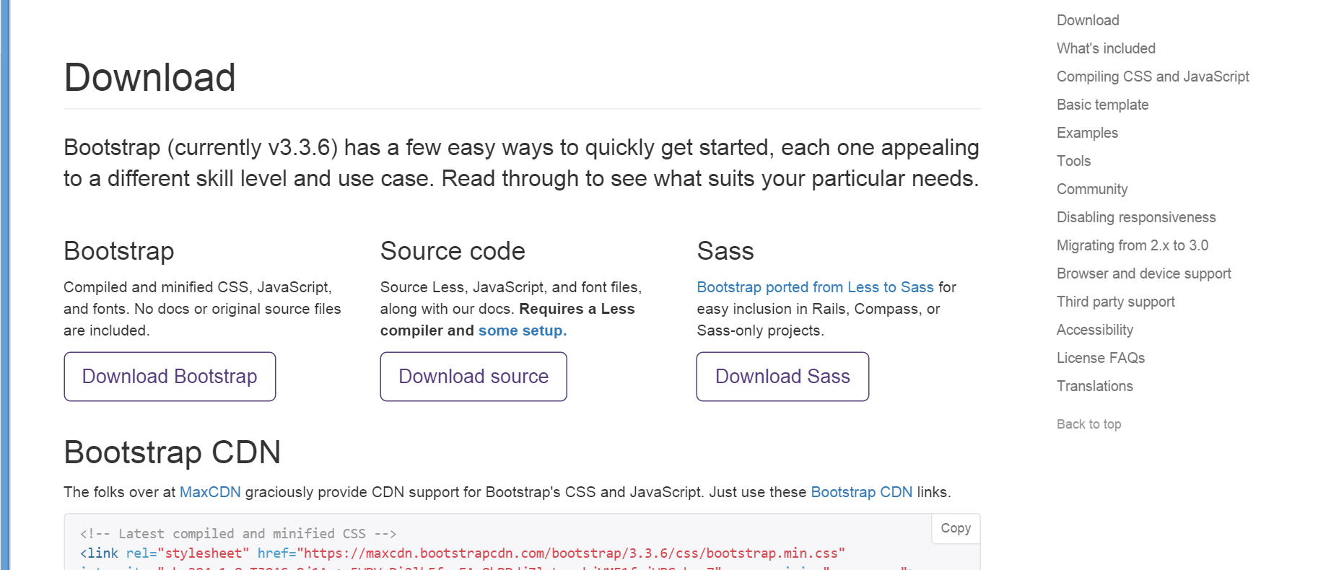
Where to start?
http://getbootstrap.com/

Slide 5
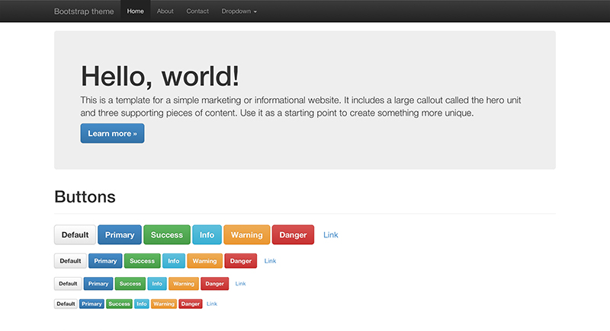
What it has to offer? Well-designed elements

Slide 6
What it has to offer? Responsive design

Slide 7
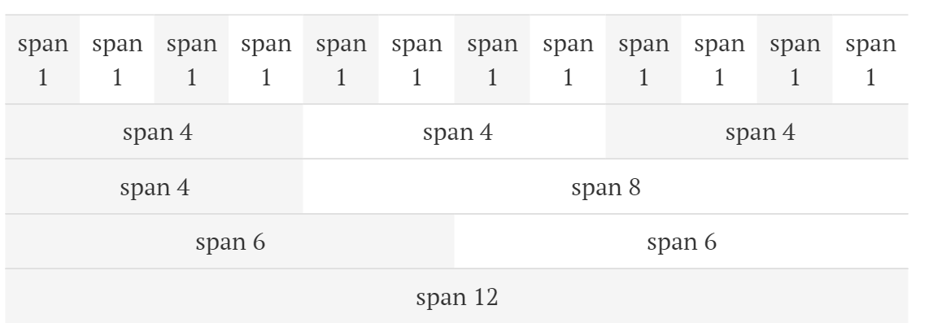
What it has to offer? Grid system

