Slide 1
Alma Mater Studiorum Università di Bologna
DevOps Demo
PhD Student: Nicola Ghiselli
nicola.ghiselli@unibo.it
Sistemi Distribuiti M
CdS Laurea Magistrale in Ingegneria Informatica I Ciclo - A.A. 2019/2020

Slide 2
Steps
Starter Kit Project
Fork
Fork Configuration (i.e. Travis-CI)
Fork Development
Pull Request

Slide 3
Starter Kit Project
GitHub User: unibo-distributedsystems
https://github.com/unibo-distributedsystemsm
GitHub Repository: DevOps-SeminarDemo
https://github.com/unibo-distributedsystemsm/DevOps-SeminarDemo

Slide 4
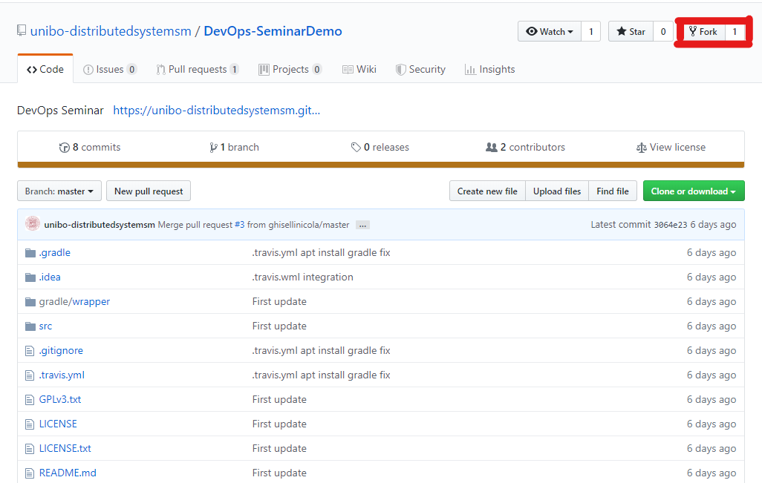
Fork
Mail: nicola.ghiselli@unibo.it
Repo: https://github.com/unibo-distributedsystemsm/DevOps-SeminarDemo

Slide 5
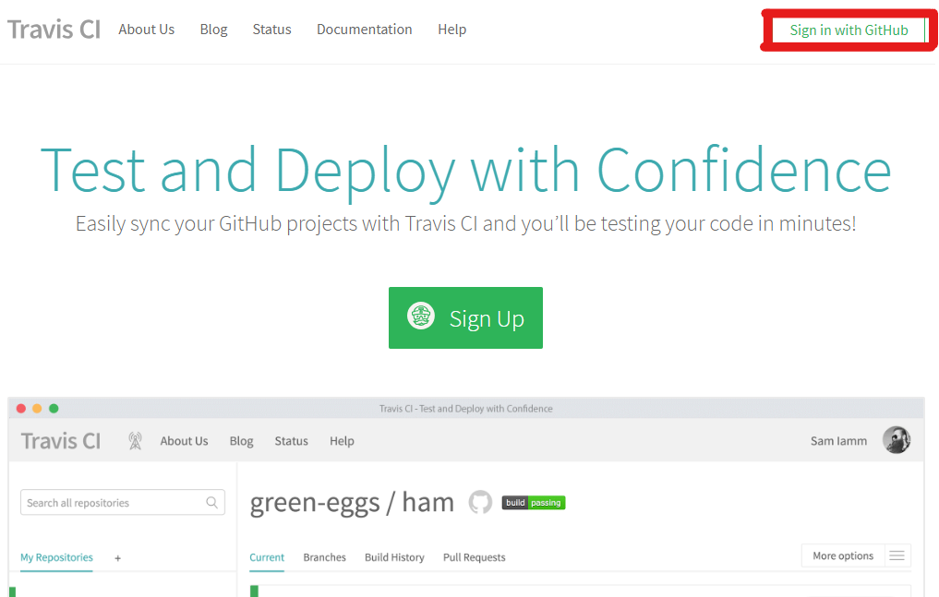
Fork Configuration
Travis Sign in: https://travis-ci.org/
Travis Set Up: https://docs.travis-ci.com/user/tutorial/

Slide 6
Fork Development
Add feature(s):
Branch
Development
Set of commit
Set of push
Merge branch with master

Slide 7
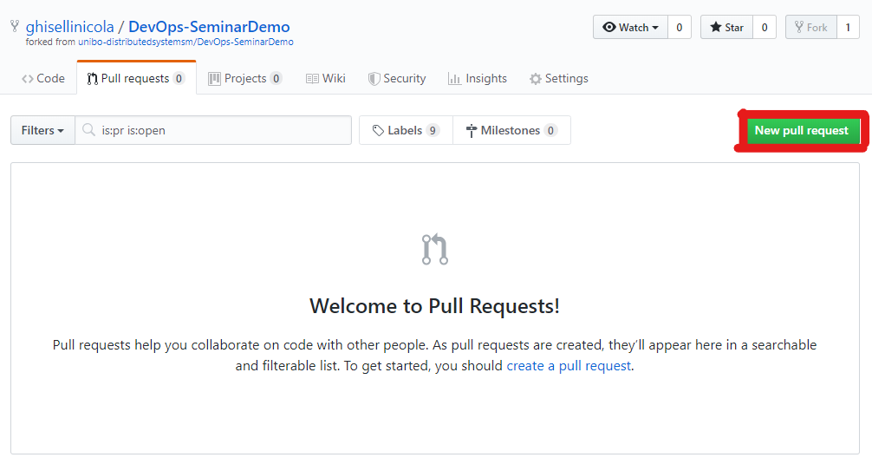
Pull Request
Add brief activity description
Mail: nicola.ghiselli@unibo.it

Slide 8
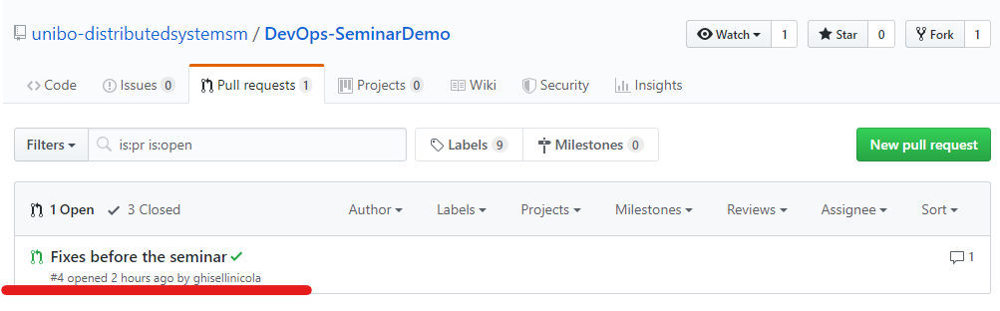
Pull Request Evaluation

Slide 9
Alma Mater Studiorum Università di Bologna
Questions?
PhD Student: Nicola Ghiselli
nicola.ghiselli@unibo.it
Sistemi Distribuiti M
CdS Laurea Magistrale in Ingegneria Informatica I Ciclo - A.A. 2019/2020

