Slide 1
Agentic AI in public administration

Slide 2
Goal
Build an agentic assistant for Romanian e-gov scenarios
Demo: Support at least 2 flows: Carte de identitate (CI) and Ajutor social
Keep human-in-the-loop and reuse the same agents, chat widgets for a unified interface.
Reuse existing national APIs, systems – just add LLMs and agents on top.

Slide 3
Agentic architecture: A2A (Agent-To-Agent)
Entry / Intent Agent Human/Operator prompts → talks to LLM → decides domain, which agent to call next.
Domain agents:
  CI Agent
  Social Aid Agent
  Other use-cases outside the demo ..
Shared service agents:
  Doc Intake Agent: OCR → canonical docs
  Scheduling Agent
  Case Agent
  Operator Agent (the public administration operator)
  Knowledge Agents
The UI works as follows: it gets a sequence of steps to update panels in real time from the Agentic AI system.

Slide 4
Agents Overview
Doc Intake Agent
  reads uploaded documents through discussion with the users (both people and gov operators).
  normalizes OCR labels with LLM and tries to create canonical documents
  updates application statues after uploading by speaking with CI Agent/Social Aid Agent.
  Respond to the users if clarifications must be made.
Case Agent
  Handles statuses of cases opened
  Notify users for completion or clarifications needed
  Handles payment operations
Scheduling Agent
  for CI it will use the government hub → https://hub.mai.gov.ro/
  for social → local city hall slots, databases.
  same agent, two backends even for the demo.
Operator Agent
  This is the human operator on the public administration side.
  Handle cases and statuses through natural prompts, e.g., list/claim/complete tasks
  Handles communications back to people for clarifications.
Entry Agent
  calls LLM to classify Romanian user message
  extracts entities (CNP, slot_id, email)
  routes to the right agent
CI Agent
  Handles the “Carte de identitate” case decides the eligibility, etc.
  Handles requirements, missing documents, with user in the loop.
  Speaks with the Scheduling Agent for finding a schedule.
Social Aid Agent
  Handles the Social Aid cases
  checks social-specific documents, if all the eligibility conditions are met.
  uses local regulations of the city where the user lives.
Knowledge Agents
  ai-aflat.ro – API to query national laws knowledge
  Local city hall / government /etc resources by API or static documents handled by RAG

Slide 5
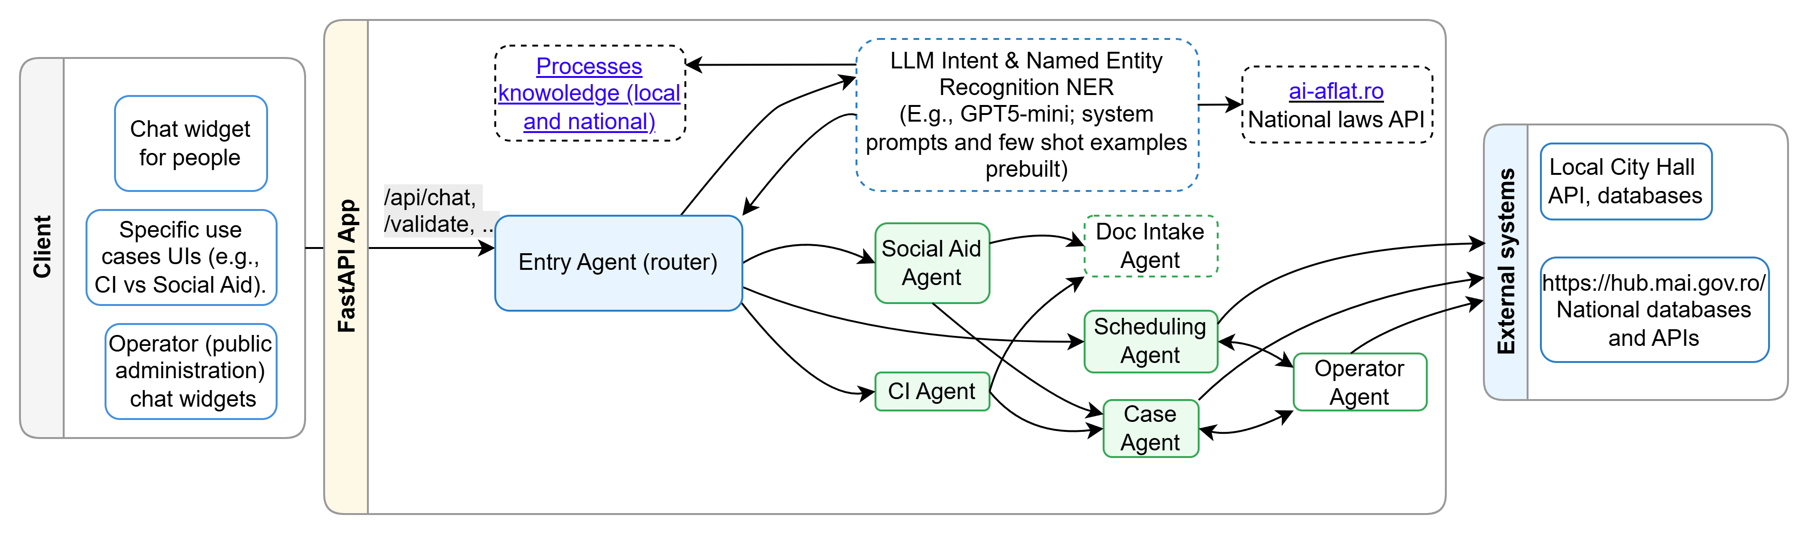
Agentic architecture: A2A (Agent-To-Agent)
Notes:
- The dashed entities are reused in the current prototype. The idea is to share as much as possible the systems, including the externally deployed ones (on the right side)

Slide 6
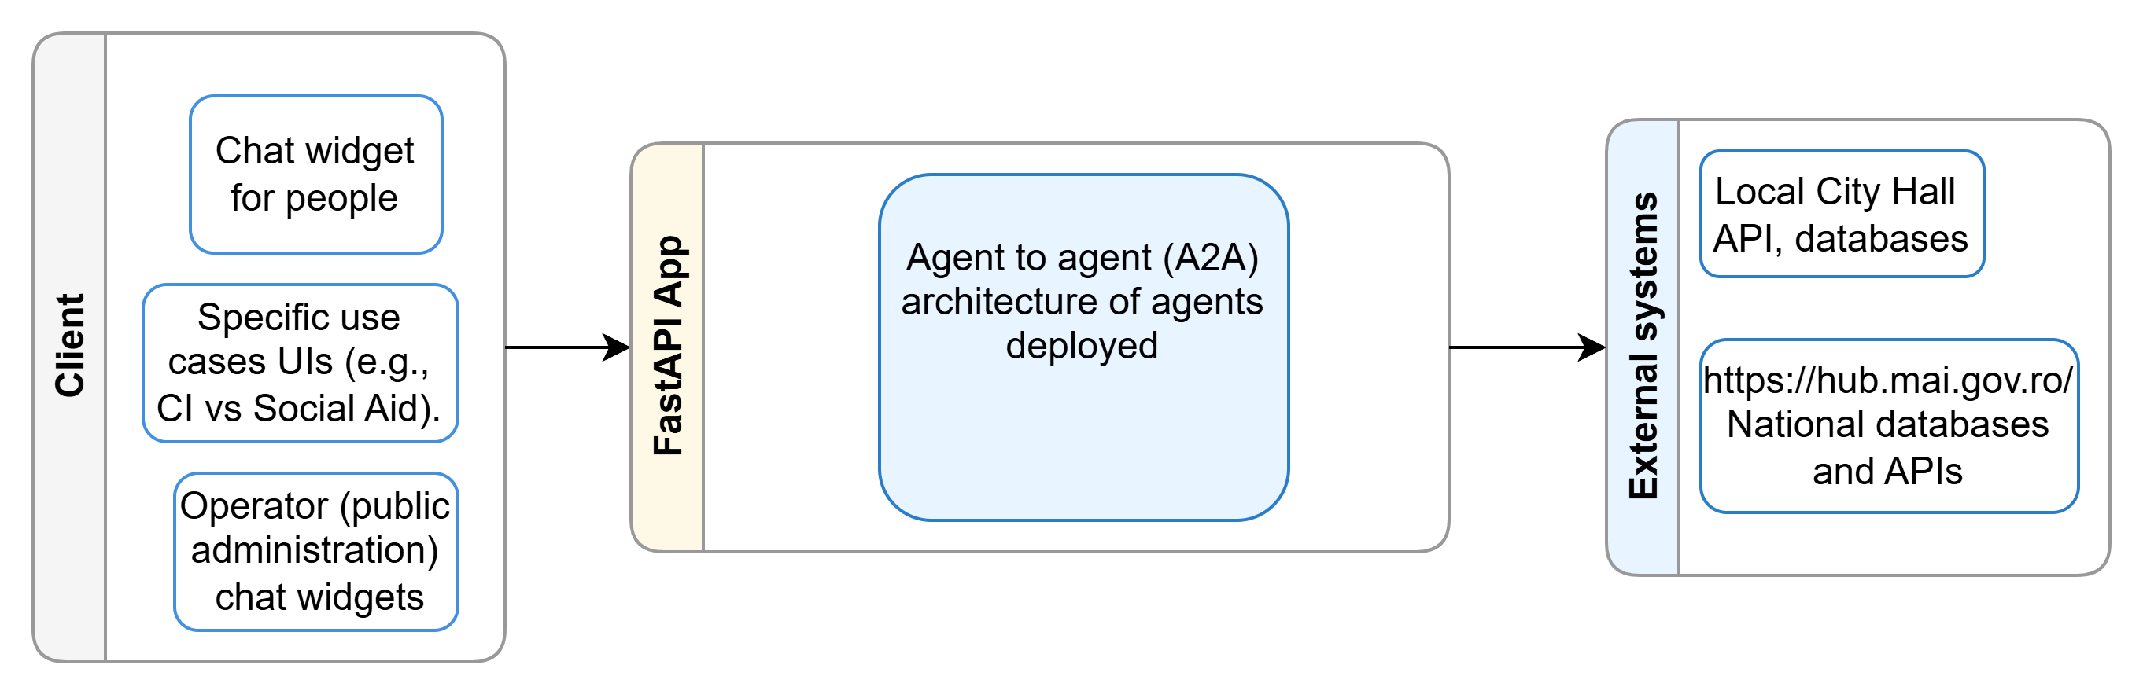
OR.. Split in two : first speak as general systems

Slide 7
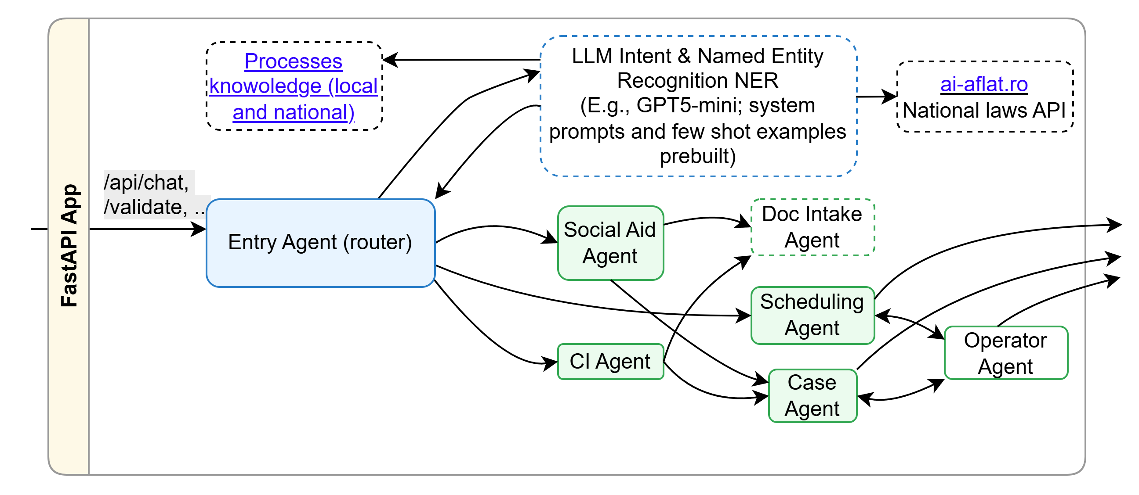
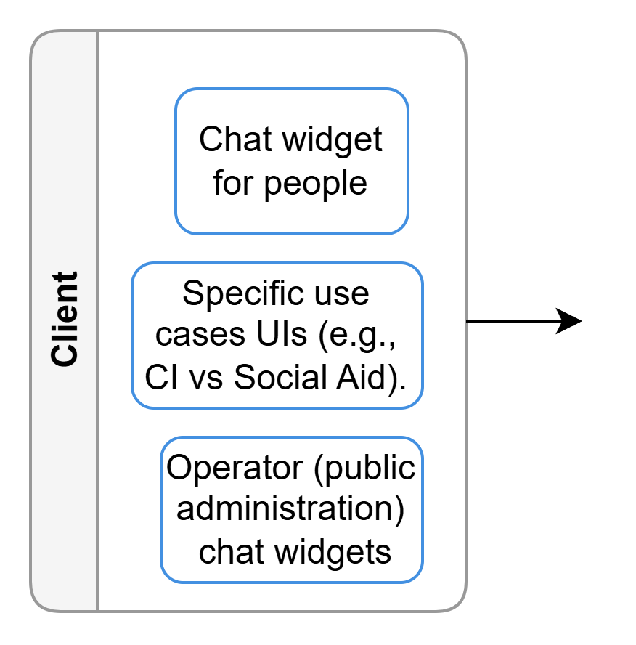
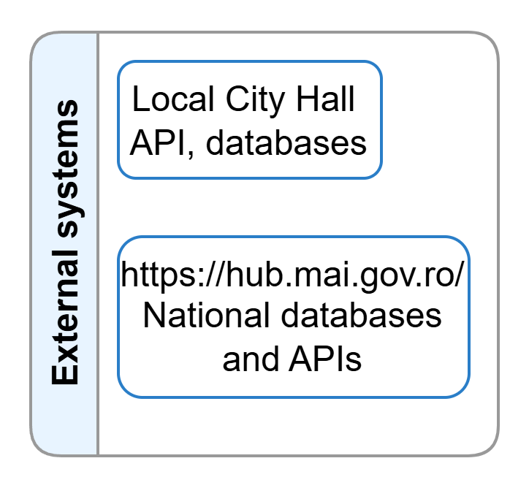
Then… present better the middle

Slide 8
Motivation for LLMs: Regex/NLP vs LLM (per agent)
Entry Agent
  regex fails on: “am nevoie de ajutorul ăla de la primărie”
  LLM: understands it’s social → intent: "social”
CI Agent
  regex fails on OCR labels like “certificat copil”, “extras CF”
  LLM: maps to the correct labels: cert_nastere, dovada_adresa
Social Aid Agent
  regex fails on “venitul minim… ăla pentru cei cu probleme”
  LLM: maps to social domain
Scheduling Agent
  regex/classic NLP expects “slot id/day/hour” something very clear
  LLM can understand “ia primul de miercuri” and let the agent pick index 0 available.
Operator Agent
  regex /classic NLP expects “claim task 10”, where “10” is the ID, or something clear.
  LLM can understand “preia tu tasku’ 10 pe numele meu”
Check a full suite of examples by double-click here:

Slide 9
Implementation status
https://github.com/unibuc-cs/AI-for-public-administration.git
Completed
  ✅ FastAPI app with 3 main UIs: user CI, user Social, operator
  ✅ Local mock for Primărie and CEI-hub-like endpoints
  ✅ Chat widget that accepts steps (toasts, slots, cases, tasks)
  ✅ Agents already factored logically in code (entry, domain, operator)
To do
  🔄 Swap regex intents with LLM intent + entity extraction
  🔄 Finalize social checklist JSON
  🔄 Move doc-intake normalization to LLM
  🔄 Add per-domain DB wiring (CI vs Social)
  🔄 Polish operator empty states (done)

