Slide 1
Heatwave analysis summary
Climate Change & Environment Risk Data Unit, DAPM, UNICEF

Slide 2
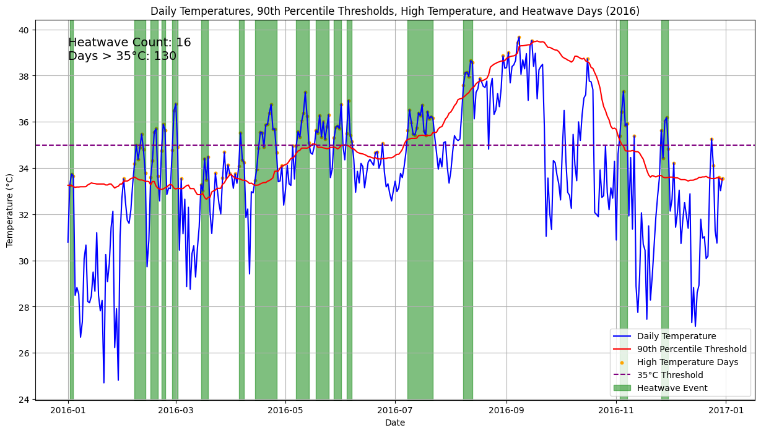
Heatwave Indicators
Heatwave: Any period of three days or more when the maximum temperature each day is in the top 10 per cent of the local 15-day average between 1960 and 1990.
Heatwave duration: Average length of heatwave event (Number of days).
Heatwave severity: Average exceedance in degrees Celsius of the heatwave threshold for each event.
Extreme high temperature: Annual average number of days in which 35°C is exceeded.
ERA5 Temperature data at lat :-11.871, lon:-50.283

Slide 3
Historic Mean and Definitions
Historic mean values (between 1960-1990)
Heatwave Frequency : 6.16 (times)
Heatwave Duration : 4.68 (days)
Heatwave Severity : 1.9 (°C)
Extreme Temperature Days : 25.2 (days)
Standard deviation
Heatwave Frequency : 2.91
Heatwave Duration : 0.85
Heatwave Severity : 0.88
Extreme Temperature Days : 51.68
Suggested definitions :
High : > Mean + 1STD (about upper 16%)
Very High : > Mean + 2 STD (upper 2.5%)
Extreme High : > Mean + 3 STD (upper 0.15%)

Slide 4
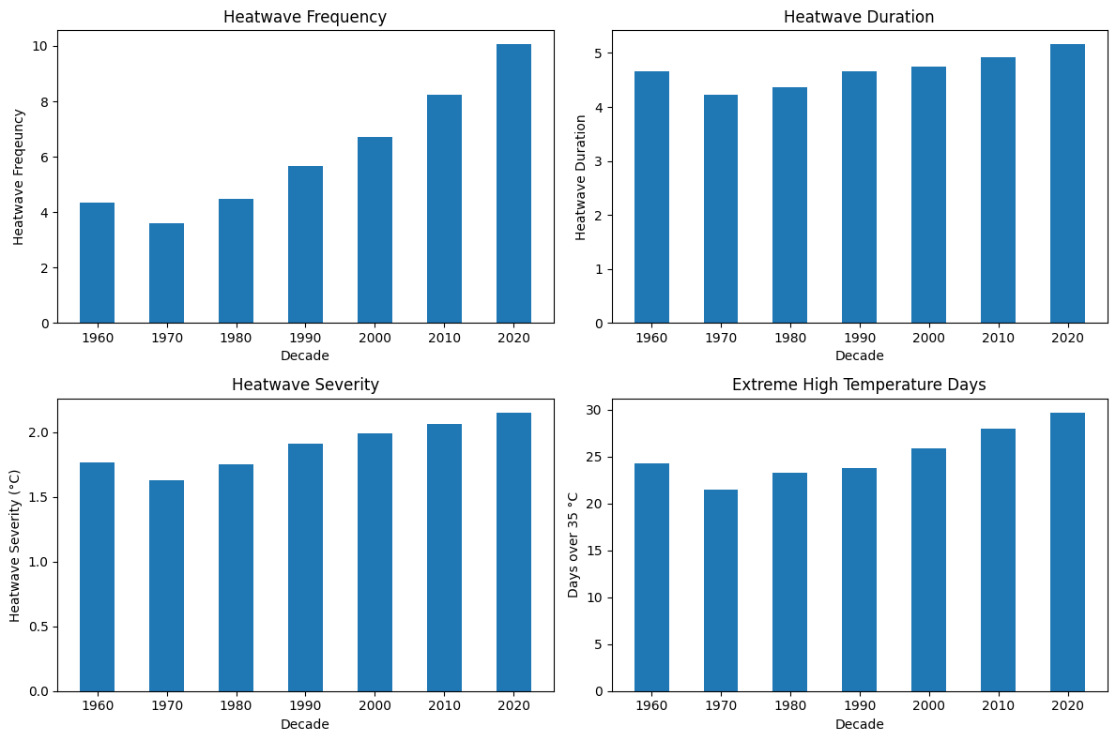

Slide 5
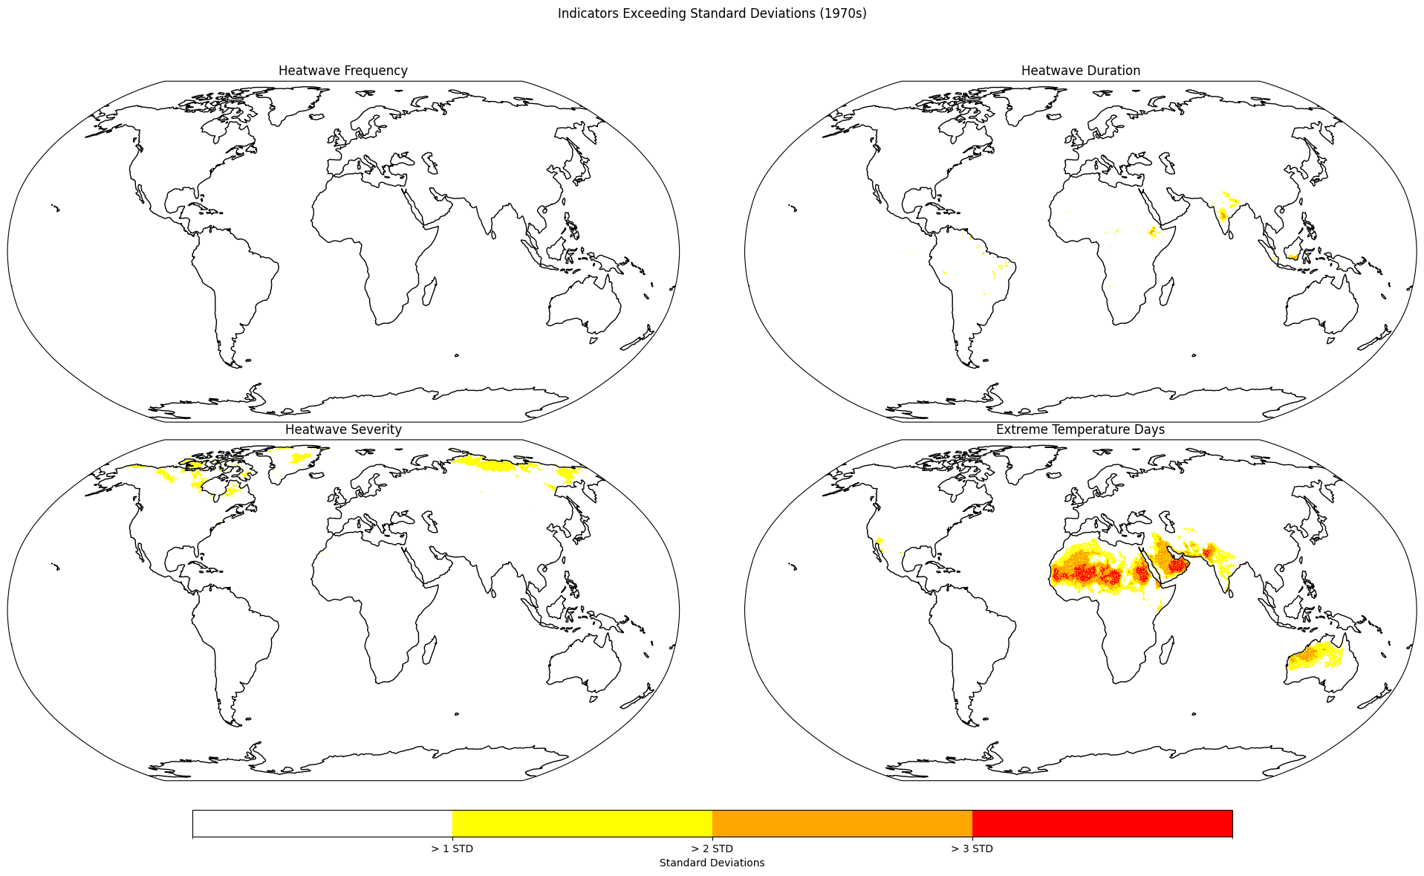

Slide 6
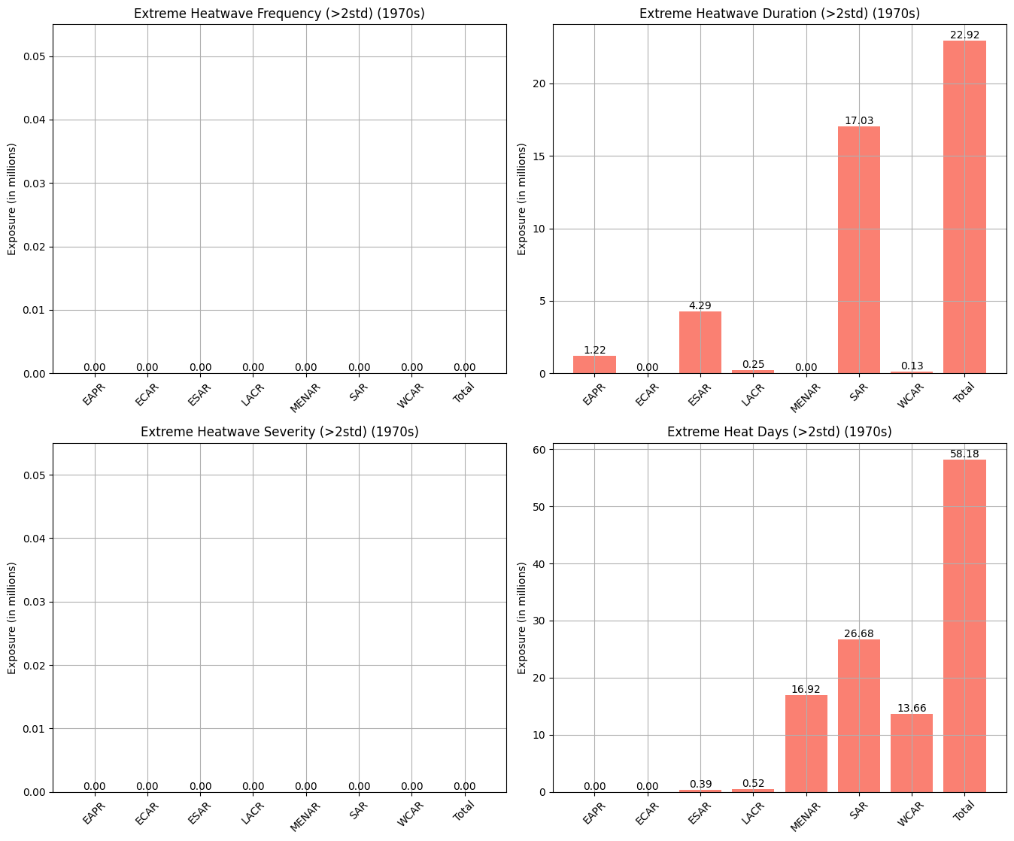

Slide 7
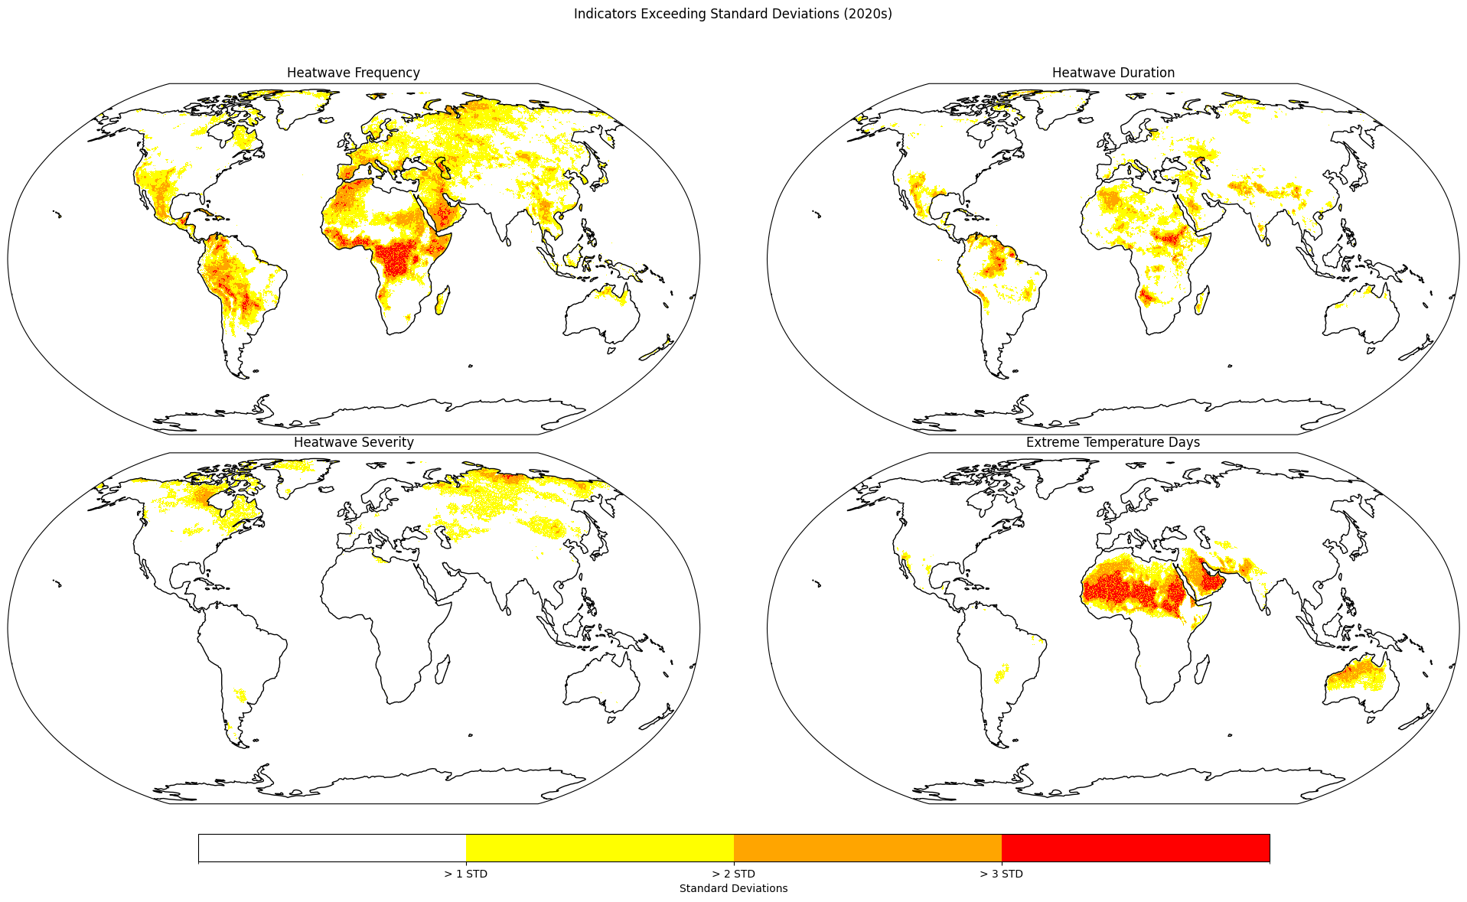

Slide 8
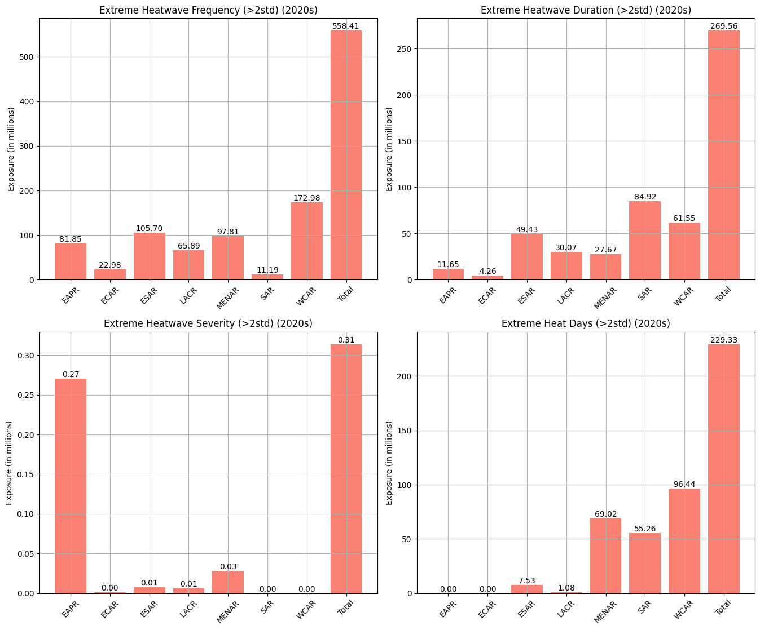

Slide 9
Child Population Exposure
UNICEF Programme Region | Extreme Heatwave Frequency (>2std) (2020s) | Extreme Heatwave Duration (>2std) (2020s) | Extreme Heatwave Severity (>2std) (2020s) | Extreme Heat Days (>2std) (2020s)
EAPR | 81850060 | 11653911 | 269990 | 0
ECAR | 22983683 | 4260074 | 1072 | 0
ESAR | 105701185 | 49431571 | 7811 | 7530592
LACR | 65889488 | 30068369 | 6255 | 1077961
MENAR | 97805883 | 27671711 | 28486 | 69015854
SAR | 11193367 | 84922516 | 0 | 55264306
WCAR | 172982461 | 61550380 | 0 | 96440055
Total | 558406127 | 269558532 | 313614 | 229328768
Table: Number of children living in areas exposed to extreme heatwave indicators in the 2020s

Slide 10
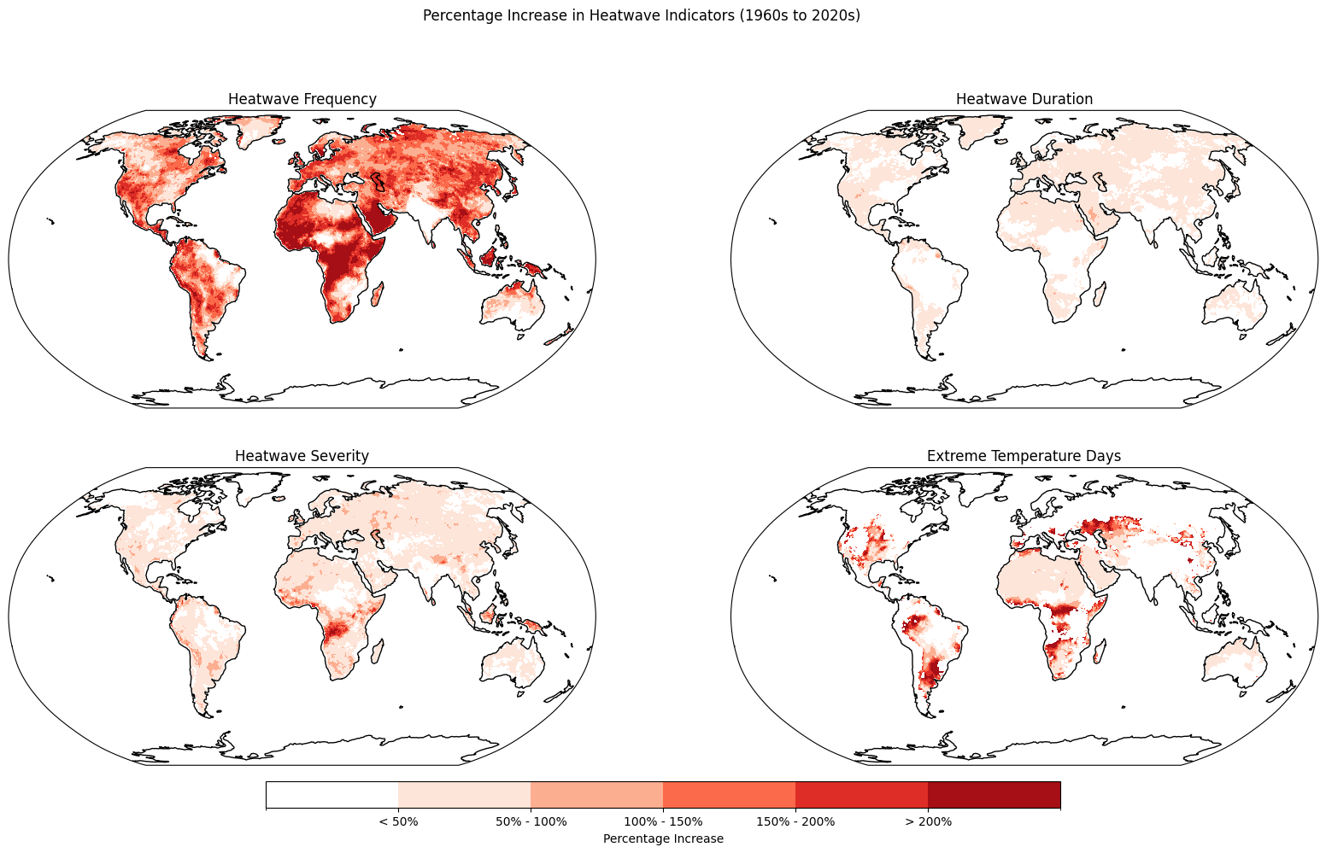

Slide 11
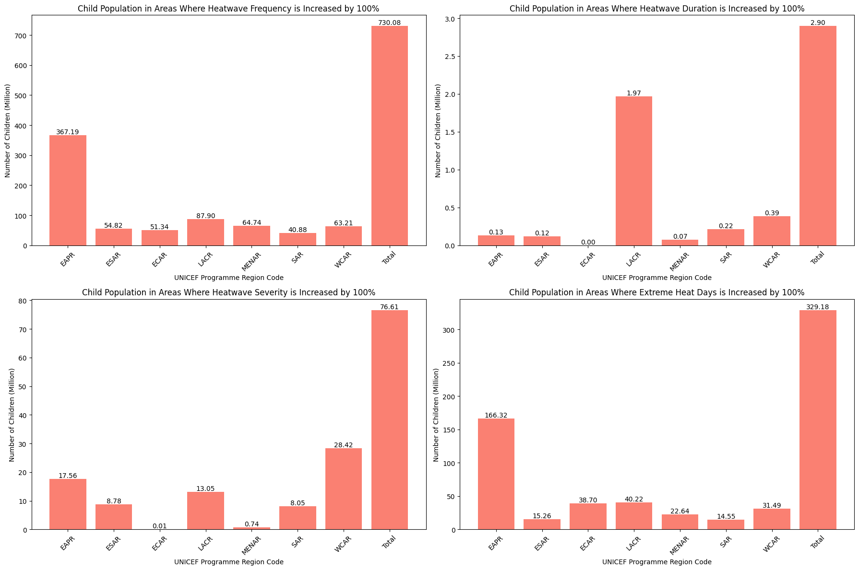
1970s

Slide 12
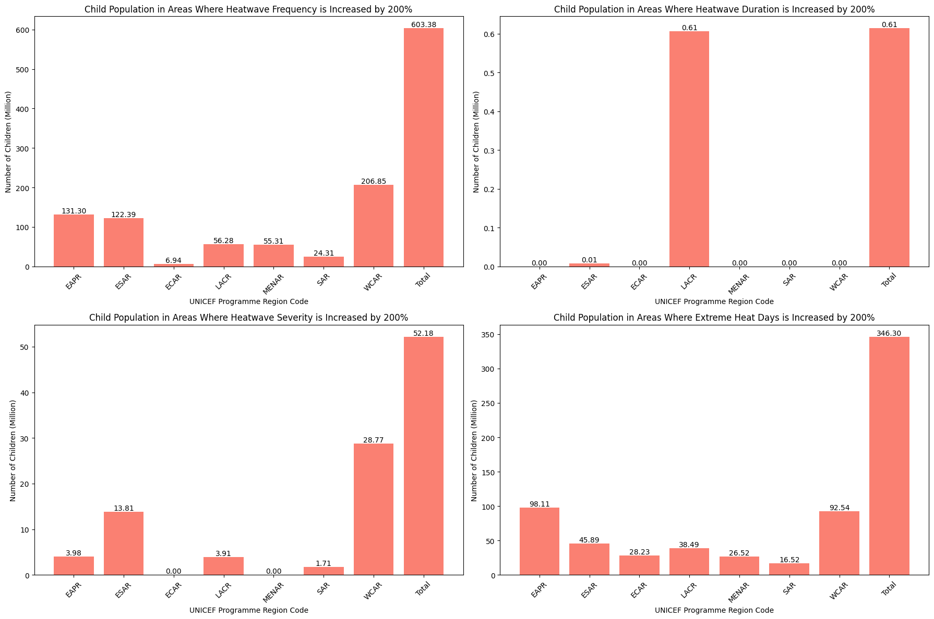
2020s

Slide 13
Child Population Exposure
region_unicef_programme | heatwave_frequency_increased_by_100% | heatwave_duration_increased_by_100% | heatwave_severity_increased_by_100% | extreme_heat_days_increased_by_100%
East Asia and Pacific | 308651586 | 63568 | 25287779 | 130398300
Eastern and Southern Africa | 192938370 | 430231 | 38417076 | 62256647
Europe and Central Asia | 54732955 | 0 | 3579 | 36866590
Latin America and the Caribbean | 108922355 | 2827091 | 16425517 | 47922691
Middle East and North Africa | 146312964 | 114962 | 1332330 | 41412969
South Asia | 59565881 | 282678 | 9230949 | 24656009
West and Central Africa | 245497909 | 1364346 | 115996345 | 122561058
Total | 1116622020 | 5082876 | 206693575 | 466074264
Table: Number of children living in areas exposed to significant increases in heatwave indicators in the 2020s

