Slide 1

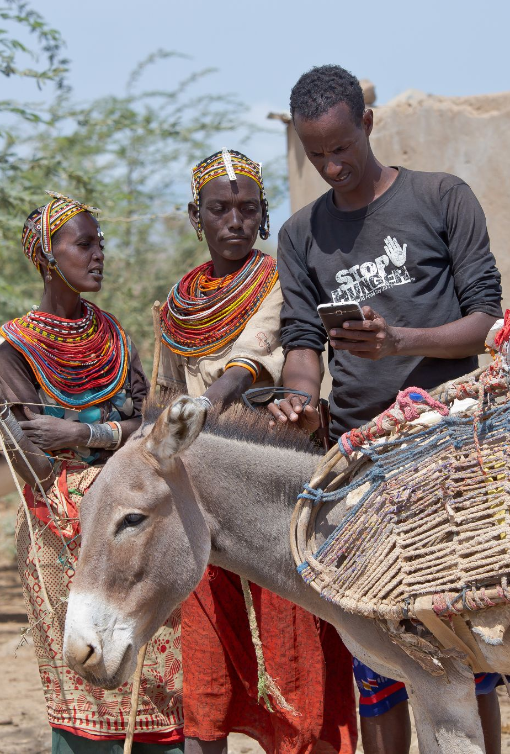
12 November 2021
Overview of the Digital Public Goods Toolkit
Created with support of the UNICEF Office of Innovation, as a co-champion of the Digital Public Goods Alliance. This document is licensed under the Creative Commons Attribution-ShareAlike 4.0 International (CC BY-SA 4.0). You can participate in its continued development and request changes at https://github.com/unicef/publicgoods-toolkit

Slide 2
Introduction
Community and Ecosystem
Policy
Open-Source Readiness
Procurement
Adoptability Assessment
Content

Slide 3
INTRODUCTION
The DPG Toolkit is a pragmatic, operations-focused guide to implementing Digital Public Goods (DPGs) at the country level.
It’s intended for decision makers, project team leaders, and project team members in government and UN-affiliated agencies, although any organization interested in creating DPGs – including commercial companies – can benefit and contribute.
The full toolkit is at https://github.com/unicef/publicgoods-toolkit
It is a 1.0 version and open to contributions, questions, and comments at the link above.
Notes:
The DPG toolkit gives pragmatic advice on how to evaluate communities and ecosystems, and their value; various aspects of policy at the national and agency level, such as cybersecurity and privacy; how to build open source readiness in your agency to create successful open source DPGs; suggestions for improving procurement, esp in working with vendors around open source; and how to assess an existing open source product (and project) for adoption.

Slide 4
These slides are edited summarizations of the DPG Toolkit, presented in the following format:
INTRODUCTION
Key Recommendations
Outcomes/benefits
Examples
Notes:
Note that there are a few recommendations that don’t have specific examples. This is because a few recommendations stem either from years of experience across numerous open source projects -- rather than one explicit reference -- and thus didn’t lend themselves to a clear example, or they stem from a few projects that the authors were not permitted to publicly reference.
Also note that most recommendations lead to multiple benefits. We’ve made some of those linkages clear here in our visualizations, but not all of them due to the complexity. For example, as we outline benefits here, the fact that Estonia holds trademark on the DPG X-Road most helps to create a level + trusted playing field for all partners, but it also creates conditions for a strong contributory ecosystem and perhaps even better security, as participants know their investments are protected and are thus more likely to put more resources to such items.
Lastly, the notes for these slides are rough and generally just include more details about the examples. These notes are not intended to be a substitute for reading the full toolkit.

Slide 5
INTRODUCTION
DPG Goals
Sharing and re-use
Local knowledge, local support
Adapt to agency and environment
Cooperative maintenance
Incremental commitments
Multi-party sustainability
Notes:
Our strategic objectives are to increase:
the discoverability and sustainability of DPGs
institutional support
LMIC capacity for implementation and creation

Slide 6
COMMUNITY + ECOSYSTEM
Note how a community generally follows a project ‘archetype’
Lutece as a Controlled Ecosystem
Improved planning + expectation setting
Encourage commercial participation for adoption + sustainability
DPG Mojaloop’s business directory + investment in commercial success
Build local knowledge + support
Multi-party, long-term sustainability through
co-operative maintenance
Look for diverse resource-committing participants
DPG Mifos’ support of over 55 diverse commercial business
Think how resourcing options can differ across a project’s stages
GeoNode: seed funding from World Bank, ongoing + increasing investment from partners and new contributors
Incremental commitments
Notes:
Lutece is an open source platform for municipal digital services. It was created by the City of Paris, which serves as a ‘benign dictator’ of its Controlled Ecosystem archetype, in which a tightly controlled core is supported by broad, innovative extensions around it, such as the 400+ customized plug-ins for Lutece created and shared by other cities and organizations. With this project type, you wouldn’t expect to be able to change the core platform very easily. If you were evaluating a vendor to help you implement the platform, you also wouldn’t expect to see them contributing much to that area – maybe just to configuration documentation,-- but you would expect to see them contributing/creating multiple extensions
Mojaloop’s vision for inclusive digital financial services requires broad commercial support of – and success with – its interoperable payments platform. They invest in commercial participants’ success by advertising their services through a Mojaloop business directory and hosting networking events, training, and other business development activities. Incentives are aligned: more commercial success means more adoption, more adoption means more growth and more development, etc. This investment in commercial success can also open up opportunities for local businesses, giving them the same access to project know-how that larger, regional firms have.
MIFOS has a broad array of supporting commercial actors, from custom development services to hosting, business consulting, deployment support. The existence of these diverse contributors indicates a higher likelihood of long-term sustainability, and growth potential. These companies done their research and are betting at least some portion of their business on MIFOS’s success. They see value in continued collaboration and co-operative maintenance.
GeoNode started with seed funding from the World Bank, and in the past 6.5 yrs, that’s been about $1-1.5 million. However, that funding was quickly matched and surpassed by new partners who found value in GeoNode – web-based, open source software that enables organizations to easily create catalogs of geospatial data and for users to access, share, and visualize that data.

Slide 7
POLICY
Use DPG standard license, establish copyright ownership early + do not mix in proprietary materials
DPG MOSIP’s choice of Mozilla Public License 2.0
No licensing surprises
Path for strong contributory ecosystem
Decide early on using trademark to help manage trust
Estonia holds trademark on DPG X-Road
Level, trusted playing field for all participants, including commercial actors
Do not rely on security through obscurity
Opportunities for collaborative funding for security, e.g. Open Source Technology Investment Fund
More sustainable security
Notes:
MOSIP wanted to attract diverse, committed commercial participants to support customization, broad adoption + build a strong contributory network around the project to keep development going. Chose the ‘weak’ copyleft Mozilla Public License 2.0 in order to protect the software commons around MOSIP while permitting development of proprietary, supporting software that interacts w/ MOSIP’s digital ID → broader adoption.
Estonia manages trademark for X-Road, even though it’s now developed by an international consortium (Nordic Institute for Interoperability Solutions). This control helps Estonia protect trust in its original X-Road investment (and helps others protect their ongoing investments too). Gives participants, esp commercial actors, a level and trusted playing field -- and protects against hard forks, which could erode investment value and create unfair advantage
Secrecy does not equal security. Open collaboration can make it easier to direct collective resources to building more secure software (as opposed to waiting for a vendor to invest + trusting vendor to do the right thing). Opens up opportunities for collaborative investment, esp as adoption grows. There are a growing number of public efforts to invest in open source security as well, like the Open Source Technology Investment Fund. External investors might also be interested in specifically funding security work as their investment compounds due to nature of open source re-use.

Slide 8
POLICY
Build for ‘high bar’ cybersecurity + privacy regulation
DPG MOSIP’s security + privacy practices; DPG Primero’s children’s rights-based approach in design and deployment
Trust + broader adoption beyond national borders
Protection of the most vulnerable
Use the power of gov’t procurement + collaboration with academia
DPG OpenMRS + government/academic partnerships
Grow local innovation, talent + support
Path for strong contributory ecosystem
Separate open-source DPG software from DPG data in the minds of high-level decision makers
Avoid problematic misconceptions
Notes:
MOSIP’s design principles around security + privacy – reflected in its technical architecture + approach to handling vulnerabilities, etc. – has led to its adoption across countries with different regulatory environments (India, Guinea, Sri Lanka, etc). Primero is another example here -- helps social services, humanitarian and development workers manage protection related data; works with significant volumes of very sensitive information about children and their families. UNICEF collaborated with other agencies to create a rights-based approach to data management early in the design process so security, privacy, and rights-supporting decisions could be reflected in the product's software architecture. The project also uses Data Protection Impact Assessments -- a GDPR requirement -- during the design stage of deployment customization to meet requirements of specific local regulation as well as specific needs of local aid workers, government agencies, and vulnerable populations.
UNICEF approached data protection and privacy extremely carefully with the DPG Primero, an open source platform that helps social services, humanitarian and development workers manage protection- related data, with live deployments in thirteen countries and dozens of others underway. UNICEF is deeply concerned about children’s data rights and protection and adheres to the Responsible Data for Children principles, which they helped create. As you might imagine, the Primero platform works with significant volumes of very sensitive information about children and their families. UNICEF collaborated with other agencies to create a general rights-based approach to data management early in the design process so security, privacy, and rights-supporting decisions could be reflected in the product’s architecture. However, as legal frameworks and other needs differ across deployments, the team instituted an additional step of creating Data Protection Impact Assessments (see below) during the design stage of deployment customization to be sure they were fully meeting the requirements of local regulation as well as of local aid workers, government agencies, and the vulnerable populations they serve. -
In Rwanda, Partners in Health (PIH) and the Kigali Institute of Science and Technology have a partnership to train students to further develop and implement OpenMRS, while the Rwandan Development Board pairs graduates with seed capital and mentorship to help them create new health IT support businesses to service over 400 clinics across the country. These students and new businesses contribute to OpenMRS.

Slide 9
OPEN SOURCE READINESS
Assess areas of ‘adjacent value’ in in valuation or cost/benefit analyses
Partner contributions + surrounding commercial activity for GeoNode approximately doubled the lead investment’s value
Ensure full value of open-source investment is understood
Evaluate your team
against open-source ‘readiness’ models to guide capacity development
Common language + framework to help team navigate typical growth paths
Identify small-scale, lower-risk investments for open- source, skill-building experiments
Understand + address capability gaps early while steadily building team and cross-agency support
Notes:
[NOTE: You can talk about MSFT + readiness model as an example – see https://mcaffer.com/2019/02/Open-source-engagement – but I don’t have great illustrative stories based on a more specific history other than the obvious trajectory of the company from fighting against open source to being a champion, using it (e.g. Azure), owning GitHub… a specific team-based story would be useful here]
Looking only at the cost of writing code themselves versus the value received from sharing costs with partners, it's estimated that the GeoNode project brought around a 200% return on investment (as of 2017).
But the real value of open source development to the World Bank's Global Facility for Disaster Reduction and Recovery (GFDRR), the leading org behind GeoNode, was the self-sustaining open source GeoNode community that emerged and the benefits that community continues to deliver – ‘adjacent value’ that’s not easily captured by looking the FTE and other costs around writing/maintaining code.
For example, a consortium of U.S. government agencies quickly picked up development work on the core of GeoNode – valued at over $1 million USD -- which permitted GFDRR to tune its resource investments to features it specifically needed, rather than the broader software. GFDRR’s direct and in-kind investment in GeoNode over the six and a half years was ~ $1.0–$1.5 million USD; a conservative estimate of partner investments in the same period is approximately $2 million USD.
Companies began providing commercial support, helping to grow further investment in GeoNode that continues to outpace the original lead investment.
A growing user base made it easier to identify and prioritize areas for improvement – another area of ‘adjacent value’ not captured in traditional cost/benefit frameworks.

Slide 10
PROCUREMENT
Structure contracts around iterative development (e.g. modular contracting with agile development)
Apply the right vendor to the right task
California’s use of modular contracting in overhauling Child Welfare system
More flexibility with less risk (incremental commitments + no vendor lock-in)
Employ Open Source Quality Assurance Practices (OSQA) to get full benefits of open source
Reduced risk: spot + solve problems quickly
Ensure you have the ability to deploy, (re)distribute, and modify the software under a DPG standard license
Better support local, small businesses
All DPGs!
Sharing + re-use
Conduct FOSS-specific outreach early in the RFP cycle + be clear about open-source requirements
Attract open- source experienced vendors, not just government software vendors
Broaden relationships with vendors with open-source experience
Notes:
California's modular contracting approach in overhauling some legacy systems in their Child Welfare system enabled them to work with
multiple smaller vendors to dramatically reduce their delivery timeline from years to months. Helped them to put the right vendor to the right task and to make incremental commitments to vendors, with flexibility to find a new vendor if something went amiss
There’s a reason for standardized set of open source licenses in the DPG standard – adhering to these and being clear in the RFP and procurement process means projects won’t encounter problematic IP issues from vendors or other open source project participants, and will grow the software commons-based digital public goods infrastructure.

Slide 11
ADOPTABILITY ASSESSMENT
Review functionality, tech quality, support availability, sustainability + user responsiveness.
Choosing a product that meets your needs, from scale to security
Look for documentation on reporting security problems; security patch releases; updated dependencies + CVEs
DPGs MIFOS + DHIS2’s documentation of CVEs and reporting process for security issues
Higher likelihood of an as-secure-as-possible product
Assurance of extensibility, ability to work with legacy data + scalability
Ensure data portability (import/export) + availability of programmable interfaces (APIs)
DPG Primero + data portability;
DPG MOSIP’s APIs + commercial support
More flexibility, less vendor lock-in
Better able to plan M&O budget
If possible, work with vendors that have contributed to the product
Reduced risk, along with ability to have influence on product
Notes:
The financial inclusion DPG Mifos has a Common Vulnerability Exposure [CVE] related to the Mifos-Mobile Android Application for MifosX. Such public documentation (even though the problem is fixed) is a sign of a mature project that takes security seriously and is willing to enlist the support of global security researchers and developers to build a better product. DHIS2 also publishes its CVEs, along with a clear process for reporting vulnerabilities.
Data portability – Primero is open about its export capabilities in its support documentation. It might not be all you need, but at least it’s clear: “All export options will allow you to have a copy of your data, but some will be easier to import back into a Primero instance than others. In particular, JSON, CSV, Excel, and Custom exports will export in a format which can be directly imported back into Primero without the need to manipulate headers, making them convenient options for data backups. Other options such as the List View and PDF exports do not afford this convenience.”
APIs-- The digital ID DPG MOSIP has an “API first” approach as part of its guiding architectural principles. Extensibility is essential for adoption of the MOSIP ID framework into local systems – a full end-end solution requires components well beyond MOSIP’s scope, components that are to come from these commercial partners. Many of these could be custom to particular implementations, such as an additional data processing step or integration of biometric data like fingerprints. Standard, well-documented APIs make it relatively easy for new + legacy components to be integrated and for products to scale. And indeed, MOSIP has a thriving community of several dozen commercial partners, such as systems integrators and biometric solution providers, many of whose businesses rely on APIs integration with MOSIP.
On the final point - in an ideal world, there would be an array of vendors from which to choose when you’re considering implementing an open source product and need implementation and/or development support. In that case, a review of their contributions to the project would give you great insight into their capabilities and reputation. Choosing to work with a productive, high-contributing vendor would give some assurance that you’re working with a vendor who knows the product well -- thus less risk -- and probably has some recognition and influence in the project, which could be an added benefit. However, this is not always the case.

Slide 12

Thank you
@DPGAlliance

