Slide 1

What's new in CLDR 2.0
Steven R. Loomis
IBM

Slide 2
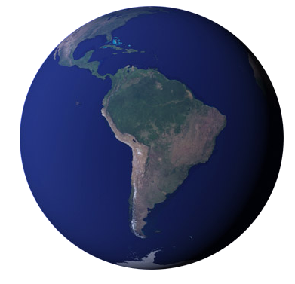
Unicode: Global Foundation
System of standards
Encodes all modern languages
Free flow and interchange of textual data
Image: NASA’s Earth Observatory
Notes:
Let’s discuss those expectations…

Slide 3
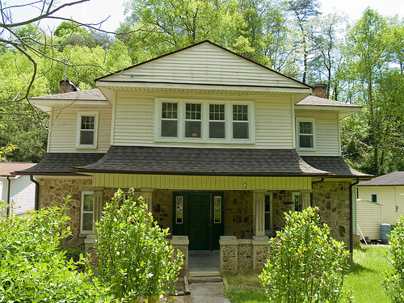
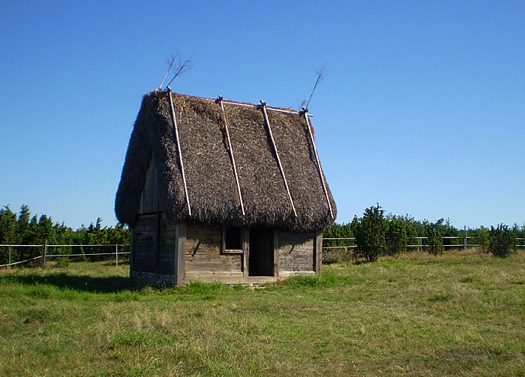
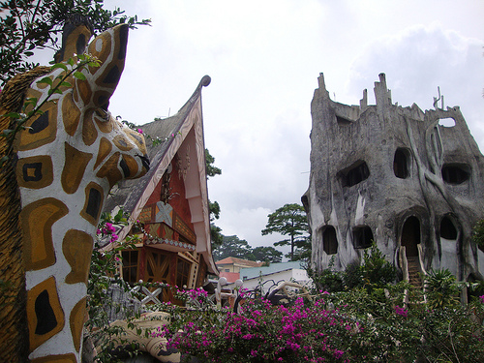
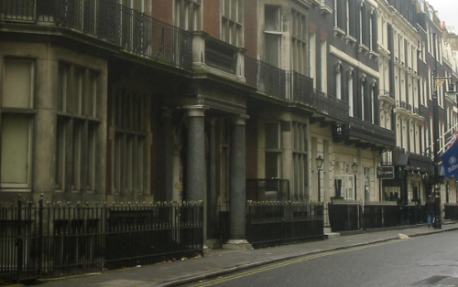
Challenge: Local Needs
Process, interchange, display all text using modern standards (including Unicode)
Provide the user with a localized experience that matches their own cultural and linguistic expectations
Photo Credits: james.thompson,Per Ola Wiberg ~ Powi, Tom Ravenscroft, Steven R. Loomis
Notes:
Let’s discuss those expectations…
Photos:
http://www.flickr.com/photos/jwthompson2/139445633/
http://www.flickr.com/photos/powi/2880154511/
http://www.flickr.com/photos/43391993@N03/4241003185/

Slide 4
Localization: A moving target
Often difficult to determine the “best” translation.
Increasingly sophisticated platforms
Emerging markets
Constantly changing user expectations, geopolitical and linguistic landscape

Slide 5
The Need for Common Data
How do you spell the 12th month of the year in Catalan:
Desembre, decembre, or desembre?
Operating systems and application software can have much variation in locale data.
It is time consuming to keep this data up to date.
It is difficult to get complete agreement on correctness.
Notes:
ca_ES: desembre, Desembre, decembre

Slide 6
General Scope
Dates/time formats
Number/currency formats
Measurement Units
Collation Specification: Sorting, Searching, Matching
Names for Languages, Territories, Scripts, Timezones, Currencies,…
Characters used by a language
…
Notes:
Note: notion of a “letter” differs by language: æ and ä considered “forms of the same letter” in Swedish.
(not a laundry list)

Slide 7
Common Locale Data Repository
(CLDR) History
IBM Cultural Information Repository: 1990s
  Java 1.1 (via Taligent): 1997
  International Components for Unicode (ICU): 1999
  Universal Locales for Linux: 2001
CLDR 1.0: 2003 (part of the OpenI18N LADE workgroup)
CLDR 1.1: 2004 (sponsored by the Unicode Consortium)
Many subsequent versions…

Slide 8
History

Slide 9
Locale Data Markup Language
(LDML)
XML Interchange Format
Transformed into forms optimized for use by ICU, POSIX, OpenOffice, dojo, others…
Unicode Technical Standard #35
<dayWidth type="wide">
<day type="sun">Sonntag</day>
<day type="mon">Montag</day>
<day type="tue">Dienstag</day>
<day type="wed">Mittwoch</day>
<day type="thu">Donnerstag</day>
<day type="fri">Freitag</day>
<day type="sat">Samstag</day>
</dayWidth>

Slide 10













Who uses CLDR?
ICU
…

Slide 11
CLDR Vetting Process
Data Submission Phase:
Data is entered via Survey Tool or Bug Report form
Vetting Phase:
Users vote for their preferred forms, make use of e-mail and forums to resolve conflicts.
Resolution Phase:
CLDR Technical Committee verifies data and corrects remaining conflicts.
Final Candidate, Release:
Final data is tested and then released. Process starts over.

Slide 12

CLDR Vetting
Swedish: “Bamileke”
Bamilekespråk or bamilekéspråk
or bamilekiskt språk?

Slide 13
CLDR Conflict Resolution
Compare data from different platforms and experts.
Different user levels for different types of vetters:
  Sponsored, known experts: More weight given in conflict, higher confidence of result.
  Guest: Anyone may apply.
Data marked with different confidence levels according to type of conflict and type of vetter
Notes:
Some applications may not want to take in provisional or unconfirmed data, however it is made available if they do wish to.

Slide 14
Anatomy of a Unicode Locale ID
Optional: only use where needed
sl
-Latn
-IT
-fonipa
-u
-co-phonebk
-ca-buddhist
Buddhist Calendar
Phonebook Collation
Unicode Locale Extension
Variant(s) [digit4/alphanum5..8]
Italy - ISO 3166 [alpha2] or UN M49* [digit3]
Latin - ISO 15924 script codes [alpha4]
Slovenian - ISO 639-1/2 [alpha2 or alpha3*]
*only if no alpha2

Slide 15
Unicode Locale IDs
de-AT-u-co-phonebk
  German in Austria, Collation: Phonebook Style
IETF BCP 47+
  Key: 2 characters (co)
  Type: 3-7 characters (phonebk)
The <ldmlBCP47> element maps long and short key and type names into IETF BCP 47 format.

Slide 16
Locale Inheritance
Minimize duplication of data
Decrease maintenance cost
Final fallback: “root” locale
fr_CA
1 234,57 $
root
LTR
fr
Janvier, Février…
fr_LX
1.234,57 €

Slide 17
Specialized Inheritance
Further reduce cost/effort
Coordinate translations in related sublocales
Identify places to save translation costs for Applications
es_MX
Mexico
es_419
Latin American Spanish
root
es_AR
Argentina

Slide 18
No Cross Script Inheritance
sr_Cyrl
Serbian Cyrillic
sr_Latn does NOT inherit from sr !
Avoid “ransom note effect” if some are/aren't translated.
zh_Hant (Traditional Chinese) doesn't inherit from zh (Simplified Chinese)
sr
Serbian
(Cyrillic by default)
root
sr_Latn
Serbian Latin

Slide 19
Draft Status
There are four draft values, indicating where this data field is in the vetting process.
Implementations may choose which draft values they will accept for different types of data and locales.
  approved: A supermajority of votes.
  contributed: A bare majority of votes.
  provisional: A majority of votes, but no quorum.
  unconfirmed: Insufficient votes.

Slide 20
Alternate Values
An element can have alternative forms.
  <language type="az">Azerbaijani</language>
  <language type="az" alt="short">Azeri</language>
alt= is also used in the vetting process.
  <… alt=”proposed-ZZZ” draft=”unconfirmed” > …
Notes:
Sometimes it’s hard to have one single ‘best’ value.

Slide 21


<localeDisplayNames>
Translated display names and formatting patterns for languages, territories, scripts, variants, keywords, keyword types, measurement systems.
code | English | German | …
de | German | Deutsch | …
fr | French | Französisch | …
nl_BE | Flemish | Flämisch | …
… | … | … | …

Slide 22
<exemplarCharacters>
Main: Letters used in the language.
  German: a-zßäöü
Auxiliary: Letters used in foreign and technical words.
  German: à-âå-ïñ-ôø-ûÿāăēĕīĭōŏœūŭ
Notes:
http://unicode.org/repos/cldr-tmp/trunk/diff/by_type/misc.exemplarCharacters.html
Add slide with example: Slovak.

Slide 23
<exemplarCharacters>
Punctuation
  English:
  !"#%&'()*,-./:;?@[\]{}§°¶‐–—‘’“”†‡…′″⟨⟩
Index: Head letters that appear in an index.
  Slovak:
  A Ä B C Č D Ď E F G H I J K L Ľ M N
  O Ô P Q R S Š T Ť U V W X Y Z Ž
Notes:
fix bold
Add slide with example: Slovak.

Slide 24
<delimiters>
English | “quotation” | ‘alternate’
German | „quotation“ | ‚alternate‘
Japanese | 「quotation」 | 『alternate』

Slide 25
<dates>
Gregorian, Buddhist, Islamic, Japanese…
Format/Parse of dates & times
  Eras, Years, Months … Timezones…
Relative day/time translations ( “Yesterday”, “Tomorrow”, … )
Notes:
dozen+ calendars

Slide 26

Fixed and Flexible Formats
Fixed
Flexible
Full | Thursday, October 14, 2010
Long | October 14, 2010
Medium | Oct 14, 2010
Short | 10/14/10
 | English | Japanese
Year + Abbr. Month | Oct 2010 | 2010年10月
Abbr. Month + Day + Weekday | Fri, Oct 15 | 10月15日(金)
Notes:
dozen+ calendars
Custom fomats

Slide 27
Date Formatting in CLDR
Two contexts, format vs. standalone.
For each context: wide, abbreviated, or narrow.
 | Wide | Abbreviated | Narrow
Format | Μαρτίου | Μαρ | Μ
Standalone | Μάρτιος | Μαρ | Μ

Slide 28
Time Zone Display Names
Based on Olson time zone database
  Also have stable short IDs based on UN/LOCODE
  “brfen” = “America/Noronha” or “Brazil/DeNoronha”
Metazones: group of equivalent zones
Leverage Country names where possible
Notes:
Metazones reduce translation overhead dramatically. (181 vs 408 raw zones)

Slide 29
(French)
Generic Non-Location | HEC Heure de l’Europe centrale
Specific Non-Location | HAEC heure avancée d’Europe centrale
RFC 822 | +0200
Localized GMT | UTC+02:00
Generic Location | (France)

Slide 30
<numbers>
Format/Parse
  Decimal, Scientific, Currency, Percentages, Custom
  Example: 1234.567 (binary) → 1.234,567 (French)
Includes localized decimal, grouping separators, currency symbols, etc.

Slide 31
Currencies
 | English | Serbian
USD | $35.72US dollar / US dollars1 US dollar2 US dollars5 US dollars | 35.72 US$амерички долар / долара1 амерички долар2 америчка долара5 америчких долара
EUR | €35.72euro / euros1 euro2 euros5 euros | 35.72 €евро / евра1 евро2 евра5 евра

Slide 32
<units>
Currently: Year, Month, Week, Day, Hour, Minute, Second
English | Czech
1 hour | 1 hodina
1 hr | 1 hod.
2 hours | 2 hodiny
2 hrs | 2 hod.
5 hours | 5 hodin
5 hrs | 5 hod.

Slide 33
<listPatterns>
English | Japanese
John and Mary | 鈴木、田中
John, Mary, and Ted | 鈴木、田中、渡辺

Slide 34
<posix>
Yes and No strings and expressions used for compatibility with POSIX
Used by POSIX locale generation tools to generate the LC_MESSAGES section correctly.

Slide 35
Rule Based Number Format (RBNF)
 | 12,345
English | twelve thousand three hundred forty-five
German | zwölftausenddreihundertfünfundvierzig
Italian | dodicimilatrecentoquarantacinque
(Many improvements to the data)

Slide 36
Text Segments
UAX #29 and locale-specific tailorings
User Character Breaks | |I| |l|i|k|e| |a|p|p|l|e|s|.| |(|D|o| |y|o|u|?|)|
Word Break Opportunities | |I| |like| |apples|.| |(|Do| |you?|)|
Line Break Opportunities | I |like |apples. |(Do |you?)
Sentence Breaks | |I like apples. |(Do you?)|
Notes:
Word/Line break opportunities shows where a word or line break COULD (not MUST) occur.

Slide 37
Transforms
キャンパス | kyanpasu
Αλφαβητικός Κατάλογος | Alphabētikós Katálogos
биологическом | biologichyeskom

Slide 38
Supplemental Data I
Likely Subtags: hi⇔hi-Deva-IN
Territory↔Language↔Script:
  Côte d’Ivoire: 49% French, 11% Baolé, …
  French: 54,449,130 in France, 10,102,379 in Côte d’Ivoire, …
  Serbian ⇔ Cyrillic Script, Latin Script, …
Territory → Currency
Botswana: South African Rand [ZAR] from 1961-1976,
Botswanan Pula [BWP] from 1976-present, …
Territory Containment (UN M.49):
Central America [013] = Belize + Costa Rica + …

Slide 39

Supplemental Data II
Zone → Tzid: Windows Timezone IDs to Olson
Language Plural Rules:
Arabic: “zero”, “one”, “two”, “few” (3-10), “many” (11-99), …
Character Fallback Substitutions:
<U+20B9> (Indian Rupee Sign) → “Rs.”
Aliases: cmn (Mandarin) → zh (Chinese)

Slide 40
<collations>
Unicode Collation Algorithm (UTS #10)
Tailoring of DUCET for languages
Root tailoring
  Spaces, Punctuation, Symbols, Currencies, Numbers in groups.
  U+FFFE lowest weight, U+FFFF highest.
  Only spaces and punctuation ignorable.
Notes:
DUCET still available as a keyword

Slide 41
<collations> New Features
Search Collator
  Korean, Arabic, Hebrew (but located in Root)
  Assigns primary weights to make searching easier (i.e. consider several different ALEF as equivalent)
“Import”
  Simplify maintenance
  Many European Languages import “European Ordering Rules”

Slide 42
Collation example
German | Swedish
01: Åkersberga | 02: Alingsås
02: Alingsås | 04: Oskarshamn
03: Äppelbo | 07: Utting
04: Oskarshamn | 06: Üttfeld
05: Östersund | 08: Zwickau
06: Üttfeld | 01: Åkersberga
07: Utting | 03: Äppelbo
08: Zwickau | 05: Östersund

Slide 43
What's Ahead
CLDR v21 ( not 2.1 ) – December, 2011
CLDR v22 (not 2.2) – June, 2012
Structural changes to support new types of data
(while keeping compatibility for existing users)
Continual improvements to the voting process and policies
Speed and reliability improvements to the Survey Tool

Slide 44
Questions?
Unicode CLDR web site:
http://unicode.org/cldr
LDML specification:
http://unicode.org/reports/tr35
srloomis@us.ibm.com
Thanks to Mark Davis and the CLDR-TC for comments and content for this and previous presentations.

