Slide 1
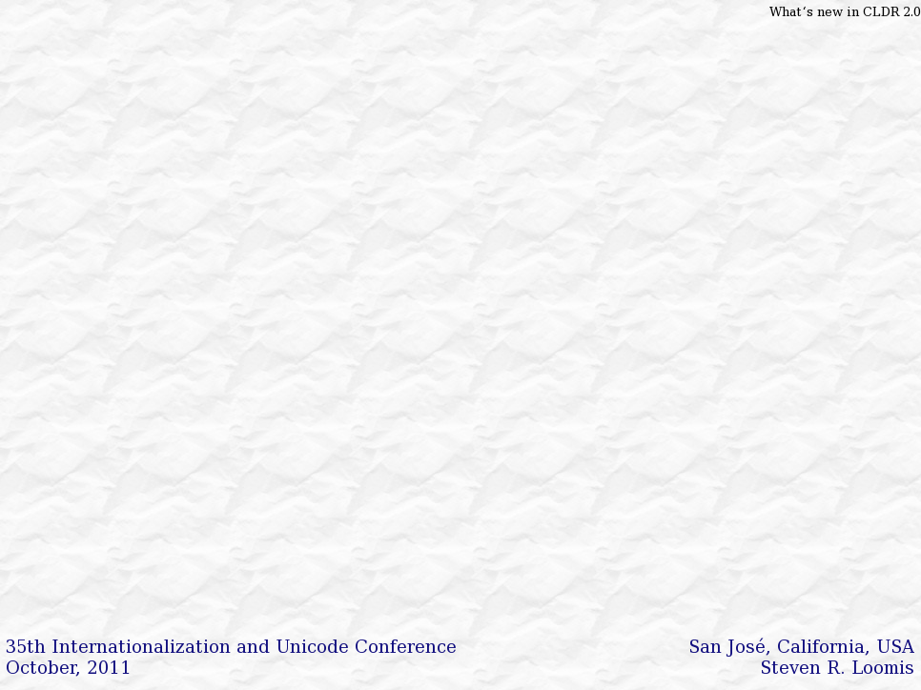
What’s new in CLDR 2.0
Steven R. Loomis
IBM San José Globalization Center of Competency

Slide 2

Unicode: Global Foundation
  System of standards
  Encodes all modern languages
  Free flow and interchange of textual data
Photo: NASA Earth Observatory

Slide 3
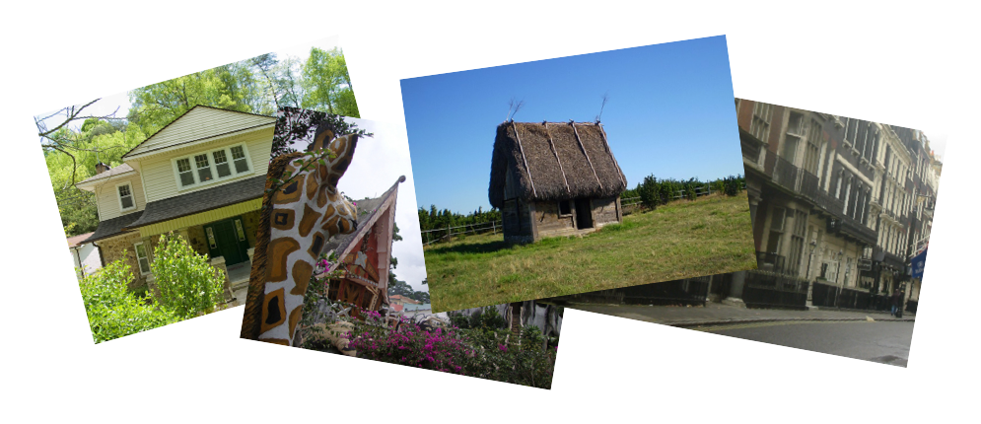
Challenge: Local Needs
  Process, interchange, display all text using modern standards including Unicode
  Provide the user with a localized experience that matches their own cultural and linguistic expectations.
Photo Credits: james.thompson,Per Ola Wiberg ~ Powi, Tom Ravenscroft

Slide 4
Localization: A moving target
  Often difficult to determine the “best” translation.
  Increasingly sophisticated platforms
  Emerging markets
  Constantly changing user expectations, geopolitical and linguistic landscape
Photo Credits: james.thompson,Per Ola Wiberg ~ Powi, Tom Ravenscroft

Slide 5
The need for Common data
  Different operating systems and application software can have much variation in locale data.
  It is time consuming to keep this data up to date.
  It is difficult to get complete agreement on correctness.
Photo Credits: james.thompson,Per Ola Wiberg ~ Powi, Tom Ravenscroft

Slide 6
Unicode CLDR (Common Locale Data Repository)
  Dates
    2010年10月
  Numbers
    €12,35
  Units & Relative
    3 hours
    4 hours ago
  Characters
    а б в г д …
…
  Names for: Languages, Regions, Scripts, Time zones, Currencies…
  Sorting, Searching, Matching
  Language matching
…
Notes:
Next version: 2.0 (May)

Slide 7













Who uses CLDR?
ICU
…
Many companies, organizations, and individuals contribute to CLDR data and structure

Slide 8
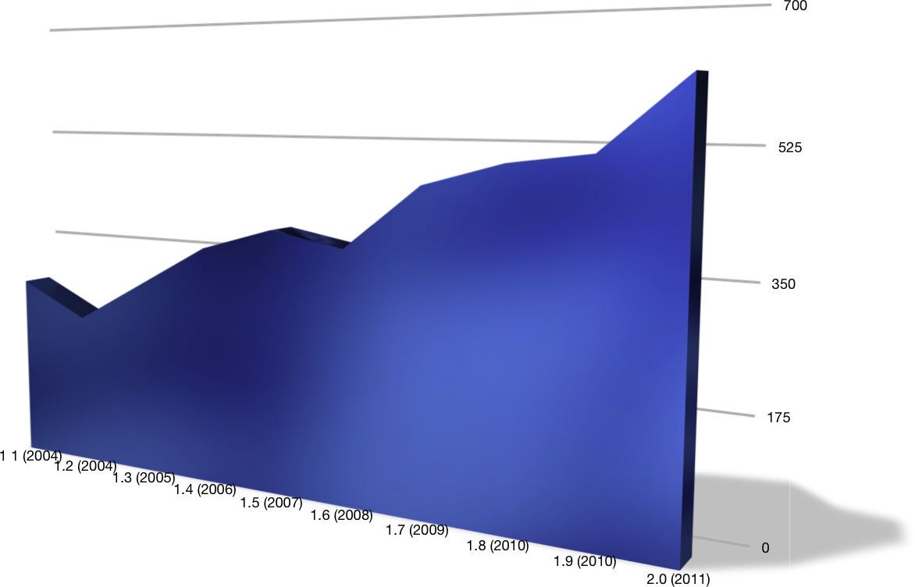
History of CLDR Locales
Notes:
IBM Cultural Information Repository: 1990s
Java 1.1 (via Taligent): 1997
International Components for Unicode (ICU): 1999
Universal Locales for Linux: 2001
CLDR 1.0: 2003 (part of the OpenI18N LADE workgroup)
CLDR 1.1: 2004 (sponsored by the Unicode Consortium)
Many subsequent versions…

Slide 9
Locale Data Markup Language
XML Interchange Format
<dayWidth type="wide">
<day type="sun">Sonntag</day>
<day type="mon">Montag</day>
<day type="tue">Dienstag</day>
<day type="wed">Mittwoch</day>…
In products, use optimized format.
ICU, POSIX, OpenOffice, dojo, others…
Notes:
ICU compiles to binary resources
DOJO compiles down to JSON blobs
etc

Slide 10














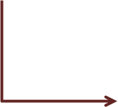
Anatomy of a Unicode Locale ID
Optional: only use where needed
sl
-Latn
-IT
-fonipa
-u
-co-phonebk
-ca-buddhist
Buddhist Calendar
Phonebook Collation
Unicode Locale Extension
Variant(s) [digit4/alphanum5..8]
Italy - ISO 3166 [alpha2] or UN M49* [digit3]
Latin - ISO 15924 script codes [alpha4]
Slovenian - ISO 639-1/2 [alpha2 or alpha3*]
*only if no alpha2

Slide 11
Unicode Locale/Language ID
  UTS #35 Unicode Locale Data Markup Language (LDML)
  Based on BCP 47 + RFC 6067 + language-subtag-registry
  Some restrictions & extensions
    Both '_' and '-' as separators
    No extlang, no irregular (grandfathered) tags
      Uses “zh” for compatibility, not “cmn”, etc.
    Private use codes defined
      “ZZ” for Unknown Region

Slide 12






Locale Inheritance
  Minimize duplication of data
  Decrease maintenance cost
  Final fallback: “root” locale
fr_CA
1 234,57 $
fr
Janvier, Février…
1.234,57 €
root
fr_LX

Slide 13
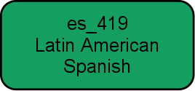
Specialized Inheritance
  Further reduce cost/effort
  Coordinate translations in related sublocales
  Identify places to save translation costs for applications
es_MX
Mexico
root
es_AR
Argentina

Slide 14






No Cross Script Inheritance
sr_Cyrl
Serbian Cyrillic
sr
Serbian
(Cyrillic by default)
root
sr_Latn
Serbian Latin
  sr_Latn does NOT inherit from sr !
  Avoid “ransom note effect” if some are/aren't translated.
  Similarly, zh_Hant (Traditional Chinese) doesn't inherit from zh (Simplified Chinese)

Slide 15
Locale Display Names
code
English
German
…
de
German
Deutsch
…
fr
French
Französisch
…
nl_BE
Flemish
Flämisch
…
…
…
…
…
  Translated display names and formatting patterns
  languages, territories, scripts, variants, keywords, keyword types, measurement systems, ...

Slide 16
Exemplar Characters
Main: Letters used in the language
aä b-oö p-s ß t uü v-z
Auxiliary: Foreign and technical letters
áàăâåā æ ç éèĕêëē … œ úùŭû ū ÿ
Index: "Head" letters
A Ä B C Č D Ď E F G … X Y Z Ž
Punctuation
- ‐ – — , ; : ! ? . … ‘ ' ’ ′ ″ “ " ” ( ) [ ] / @ & # …
Notes:
http://unicode.org/repos/cldr-tmp/trunk/diff/by_type/misc.exemplarCharacters.html
Add slide with example: Slovak.

Slide 17
Delimiters
English
“quotation”
‘alternate’
German
„quotation“
‚alternate‘
Japanese
「quotation」
『alternate』

Slide 18
Fixed/Flexible Date Formats
Fixed
Full
English
Japanese
Thursday, October 14, 2010
Year +
Abbr-Month
Oct 2010
2010年10月
Long
October 14, 2010
Medium
Oct 14, 2010
Abbr-Month + Day + Weekday
Fri, Oct 15
10月15日(金)
Short
10/14/10
Flexible
Notes:
dozen+ calendars
Custom fomats

Slide 19
Time Zone Formatting
Generic NL - Short
HEC
Generic NL - Long
Heure de l’Europe centrale
Specific NL - Short
HAEC
Specific NL - Long
Heure avancée d’Europe centrale
RFC 822
+0200
Localized GMT
UTC+02:00
Generic Location
France

Slide 20
Unit Formatting
English
Czech
1 hour
1 hodina
1 hr
1 hod.
2 hours
2 hodiny
2 hrs
2 hod.
5 hours
5 hodin
  Year, Month, Week, Day, Hour, Minute, Second
  With plural support
5 hrs
5 hod.

Slide 21
Relative times
English
Yesterday
Tomorrow
3 days ago*
In 3 days*
…
* New in CLDR 2.0, with plural support

Slide 22
Rule Based Number Formatting
#
12,345
English
twelve thousand three hundred forty-five
German
zwölftausenddreihundertfünfundvierzig
Italian
dodicimilatrecentoquarantacinque
  Many improvements to the data
Notes:
12,345
twelve thousand three hundred forty-five
zwölftausenddreihundertfünfundvierzig
dodicimilatrecentoquarantacinque

Slide 23
Currencies
English
Serbian
USD
US dollar /
US dollars
$35.72
1 US dollar
2 US dollars
5 US dollars
амерички долар / долара
35.72 US$
1 амерички долар
2 америчка долара
5 америчких долара
EUR
euro / euros
€35.72
1 euro
2 euros
5 euros
евро / евра
35.72 €
1 евро
2 евра
5 евра

Slide 24
List Patterns
English
Japanese
A and B
Ａ、Ｂ
A, B, and C
Ａ、Ｂ、Ｃ

Slide 25
Text Segments
User Character
|I| |l|i|k|e| |a|p|p|l|e|s|.| |(|D|o| |y|o|u|?|)|
Word
|I| |like| |apples|.| |(|Do| |you?|)|
Line
I |like |apples. |(Do |you?)
Sentence
|I like apples. |(Do you?)|

Slide 26
Transforms
キャンパス
kyanpasu
Αλφαβητικός Κατάλογος
Alphabētikós Katálogos
биологическом
biologichyeskom

Slide 27
Collation Example
German
Swedish
Pick examples that are different than English. Slovak words with "ch" or Swedish vs German with a-umlaut
01: Åkersberga
02: Alingsås
02: Alingsås
04: Oskarshamn
03: Äppelbo
07: Utting
04: Oskarshamn
06: Üttfeld
05: Östersund
08: Zwickau
06: Üttfeld
01: Åkersberga
07: Utting
03: Äppelbo
08: Zwickau
05: Östersund

Slide 28
Collation (Sorting/Matching)
  Unicode Collation Algorithm (UTS #10)
  Tailoring (Customizing) for languages
  Root tailoring
    Rearrange groups:
      Spaces, Punctuation, Symbols, Currencies, Numbers, Latin, Cyrillic, Greek, ... CJK
    U+FFFE lowest weight, U+FFFF highest.
Notes:
DUCET still available as a keyword

Slide 29
Collation New Features
  Search Collator
    Korean, Arabic, Hebrew (but located in Root)
    Assigns primary weights to make searching easier (i.e. consider several different ALEF as equivalent)
  “Import”
    Simplify maintenance
    Example: Many European Languages will import “European Ordering Rules”
Notes:
DUCET still available as a keyword

Slide 30


CLDR Process
Data Submission
Vetting
Resolution / Verification (Technical Committee)
CLDR.zip
Final Testing / Release
Notes:
Data Submission Phase:
Data is entered via Survey Tool or Bug Report form
Vetting Phase:
Users vote for their preferred forms, make use of e-mail and forums to resolve conflicts.
Resolution Phase:
CLDR Technical Committee verifies data and corrects remaining conflicts.
Final Candidate, Release:
Final data is tested and then released. Process starts over.
Compare data from different platforms and experts.
Different user levels for different types of vetters:
Sponsored, known experts: More weight given in conflict, higher confidence of result.
Guest: Anyone may apply.
Data marked with different confidence levels according to type of conflict and type of vetter

Slide 31
What's Ahead?
  CLDR v21* – December, 2011
  CLDR v22* – June, 2012
  Structural changes to support new types of data
  (while keeping compatibility for existing users)
  Continual improvements to the voting process and policies
  Speed and reliability improvements to the Survey Tool
  (*Note: CLDR 21 follows CLDR 2.0 - change in version numbering scheme.)

Slide 32
Questions?
CLDR
http://unicode.org/cldr
LDML
http://unicode.org/reports/tr35
Author
srloomis@us.ibm.com
Thanks
Mark Davis and others on the CLDR-TC for comments and content.

