Slide 1
Globalizing Software
Markus Scherer & Mark Davis

Slide 2
Presentation Goals
Gain fundamental understanding of globalization
Become able to advise users of existing software
Know how to find more information

Slide 3
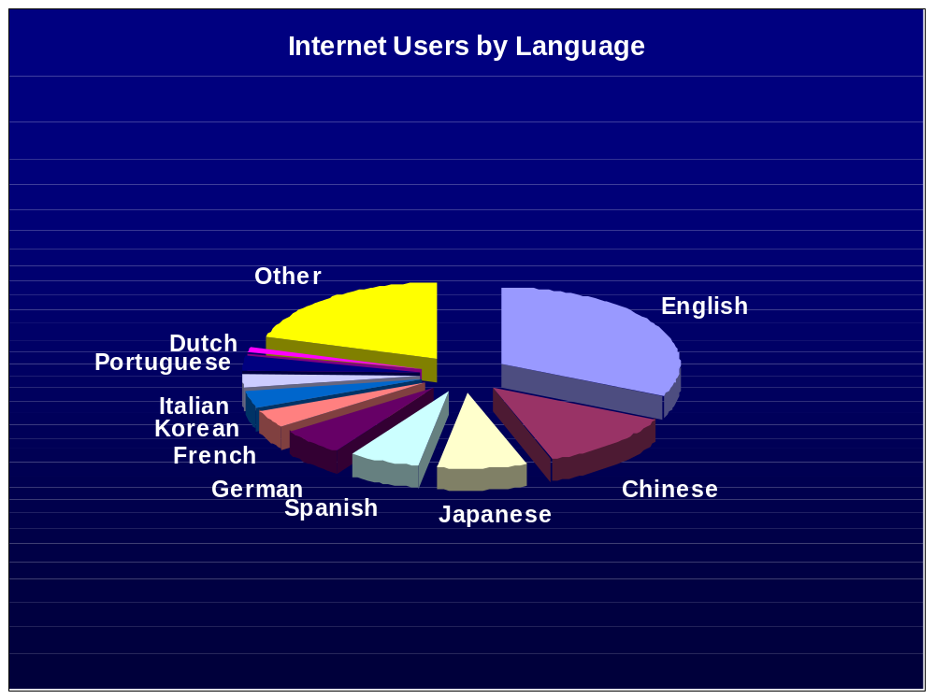
International Markets
Notes:
Source: Internet World Stats – Usage and Population Statistics
http://www.internetworldstats.com/stats7.htm
©Copyright 2005, Miniwatts International, Ltd. All rights reserved.

Slide 4
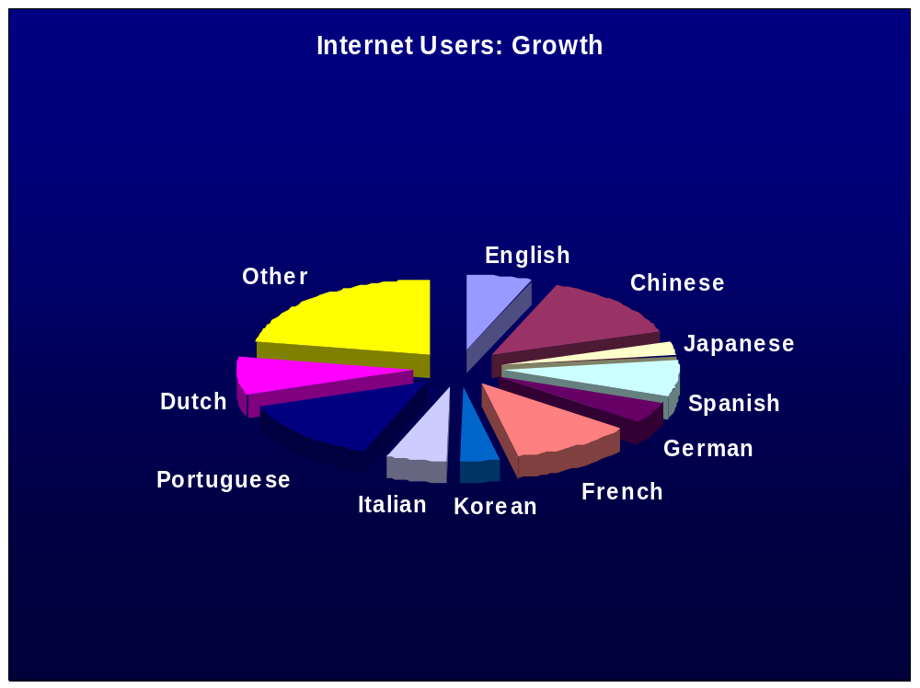
International Markets 2
Notes:
Source: Internet World Stats – Usage and Population Statistics
http://www.internetworldstats.com/stats7.htm
©Copyright 2005, Miniwatts International, Ltd. All rights reserved.

Slide 5
Globalization & Localization
Globalization
Single character set
Single executable
Single install
Single server serves all clients in all languages
Localization
Based on globalized software
Adds specific translations and adaptations for particular languages and markets
Globalized software can be localized without code changes

Slide 6
Isolated System Model
For example, using cp932 (Shift-JIS) for text
Not prepared to deal with other data sources

Slide 7
Connected System Model
Arbitrary data sources, any language, any place, any code page
Character set mismatch causes data corruption
Data format mismatch causes data corruption

Slide 8
What is Unicode?
Unicode provides a unique number for every character
أساسًا، تتعامل الحواسيب فقط مع الأرقام
ユニコードは、すべての文字に固有の番号を付与します
יוניקוד מקצה מספר ייחודי לכל תו
Η κωδικοσελίδα Unicode προτείνει έναν και μοναδικό αριθμό για κάθε χαρακτήρα
Notes:
Samples from http://www.unicode.org/standard/WhatIsUnicode.html

Slide 9
Why Unicode?
Avoids data corruption
Single encoding for text in all languages
Makes software globalization possible
  Vastly reduces development cost
  Vastly reduces maintenance, update and support cost

Slide 10
Non-Globalized Component
Does not use Unicode
Hard-coded date/time
formatting & parsing
Hard-coded number & currency
formatting & parsing
Hard-coded collation (sorting/searching/matching)
Other hard-coded operations
Hard-coded literals

Slide 11
Convert to Unicode
Unicode
Dates & times
Numbers & currencies
Collation
Literals
Unicode can be UTF-8 or UTF-16

Slide 12
Hard-Coded
Date/Time Formatting & Parsing
Unicode
Dates & times
Numbers & currencies
Collation
Literals
date → month + “/” + day + “/” + year

Slide 13
Reroute to Service:
Date Formatting / Parsing
Unicode
Dates & times
Numbers & currencies
Collation
Literals
2005年12月14日水曜日
date
14. Dezember 2005
….

Slide 14
Hard-Coded
Number Formatting & Parsing
Unicode
Dates & times
Numbers & currencies
Collation
Literals
<currency, number> → “$” + integer + “.” + decimals

Slide 15
Reroute to Service:
Number Formatting / Parsing
Unicode
Dates & times
Numbers & currencies
Collation
Literals
1 234,57руб.
<currency,
number>
1,234.57 Rubles
…

Slide 16
Hard-Coded
Collation (Sorting)
Unicode
Dates & times
Numbers & currencies
Collation
Literals
A < Ä < B < Z

Slide 17
Reroute to Service:
Collation
Unicode
Dates & times
Numbers & currencies
Collation
Literals
Ä < Z
<string1,
string2>
Z < Ä
…

Slide 18
Hard-Coded
String Literals
Unicode
Dates & times
Numbers & currencies
Collation
Literals
menuItem
.setTitle(“File”)

Slide 19
Reroute to Service:
Translated Resource Lookup
Unicode
Dates & times
Numbers & currencies
Collation
Literals
“File”,
German
Resource Manager
“Datei”
Chinese
French
…
German
…

Slide 20
Services
Charset Conversions
Formatting & Parsing
  Date & time
  Messages
  Numbers & currencies
Translated Names
  Languages, Regions (Countries), Scripts, Timezones, Currencies
Calendar, Time Zone, Date/Time conversions
Collation
  Searching, Sorting, Matching
Segmentation
  word, line, …
Transforms
  Normalization
  Casing
  Transliterations
Unicode Regular Expressions
Complex-Text Display / Input
…

Slide 21
Globalization Preferences
Example Standard
Language en_US (or en-US) RFC 3066 (or successor)
Territory AU ISO 3066
Currency EUR ISO 4217
Timezone Australia/Melbourne TZDB
Calendar islamic-civil CLDR Calendar ID
Custom Date yyyy-mmm-dd CLDR Pattern Format
VAT 08.23% (books) App/Country-Specific
15.73% (food)
… … …
Exact Composition Depends on System Requirements!

Slide 22
Incremental System Migration
Large system: Change components incrementally
Adapters between modified and original components
Unicode bus between modified components
Adapter
Unicode bus

Slide 23
Code Page Adapter
Unicode ⊃ Code Page
Characters missing in code page:
  Escape (e.g., XML/HTML: &#x20AC;) or
  Error (if handshake possible) or
  Downgrade (replacement character)
Conversion
Unicode
Code Page

Slide 24
Neutral Data Formats
Do not use localized formats for internal data
E.g. monetary value
  $123.4 → USA? Australia? Zimbabwe?
  Interchange complete data: include currency code
  Use <numeric value, currency code> e.g. <1.234×10², USD>
Neutral Formats
  Faster processing
  Unambiguous
  Convert (format/parse) at User Interface boundaries
  en_US: $123.40 en_AU: US$123.4 hi_IN:$१२३.४०

Slide 25
Unicode Overview
Unicode Text Encodings
Unicode Gives Characters Meaning and Behavior
  Data
  Algorithms
Case Mapping
Forms of Text
Right-To-Left and Bi-Directional Text
Sorting, Searching, Matching
Security
Common Locale Data Repository

Slide 26

Unicode Text Encodings
UTF-16
In-memory strings, best for processing
Java, .Net, Windows, MacOS X, JavaScript, inside browsers, …
String aa=“a\u00E4”;
UTF-8
Storage & Protocols
.txt, .html, .xml, …
<?xml version="1.0" encoding="UTF-8"?>
Notes:
UTF-16: Sequence of 16-bit code units. Widely used for in-memory strings, for processing. Can be byte-serialized for storage and protocols. Then the “UTF-16” charset implies an initial flag (Byte Order Mark) for the endianness. “UTF-16BE” and “UTF-16LE” are charset names for byte serializations with explicitly endiannesses.
UTF-8: Sequence of 8-bit code units, that is, byte-based by design. Most common form for text storage and protocols, but clunky for processing.
The Unicode Encoded Logo: http://www.unicode.org/consortium/uniencoded.html
There are other charsets for Unicode, designed for particular purposes. For example, simpler processing (UTF-32), transmission in 7-bit email (UTF-7), lower number of bytes per code point (SCSU & BOCU-1), etc. None of these is as common as UTF-8/16, and each of them trades off their specific advantages for disadvantages in other areas. (Mostly, simplicity and statefulness vs. compactness.)

Slide 27
Unicode Text Encoding Examples
Character | Code Point | UTF-16 | UTF-8
a | U+0061 | 0061 | 61
ä | U+00E4 | 00E4 | C3 A0
σ | U+03C3 | 03C3 | CF 83
א | U+05D0 | 05D0 | D7 90
٣ | U+0663 | 0663 | D9 A3
カ | U+30AB | 30AB | E3 82 AB
退 | U+9000 | 9000 | E9 80 80
𡯁 | U+21BC1 | D846 DFC1 | F0 A1 AF 81
Notes:
Range of code points: U+0000..U+10FFFF. Almost all characters, by frequency of occurrence, fall into the range U+0000..U+FFFF which is the “BMP” (Basic Multilingual Plane).
UTF-16 encodes all BMP code points with a single 16-bit code unit. The other (“supplementary”) code points are encoded with pairs of 16-bit code units (“surrogates”).
UTF-8 encodes only ASCII code points (U+0000..U+007F) with a single 8-bit code unit (byte). All other characters are encoded with sequences of 2, 3, or 4 bytes.

Slide 28
Unicode Gives Characters Meaning and Behavior: Data
Ideographic
Uppercase
不 与
a ξ ँ ై
A Ξ
Quotation_Mark
Alphabetic
٣→3
৪→4
੫→5
" ' « » ‘ ’ 『 』
Numeric_Value
Notes:
ξ U+03BE GREEK SMALL LETTER XI
Ξ U+039E GREEK CAPITAL LETTER XI
ँ U+0901 DEVANAGARI SIGN CANDRABINDU
ై U+0C48 TELUGU VOWEL SIGN AI
٣ U+0663 ARABIC-INDIC DIGIT THREE
৪ U+09EA BENGALI DIGIT FOUR
੫ U+0A6B GURMUKHI DIGIT FIVE

Slide 29
Unicode Gives Characters Meaning and Behavior: Algorithms
Case mapping
Case folding & Case-insensitive comparison
Collation
Bidi
Normalization
Line Breaking
…

Slide 30
Case Mapping
ǳ ↔ ǲ ↔ Ǳ
Heiß → HEISS → heiss
όσος ↔ ΌΣΟΣ
topkapı istanbul ↔_{tr} TOPKAPI İSTANBUL
Notes:
Some letters have special titlecase forms.
Case mappings can change the string length and may depend on context and/or language.
Case mapping operations lose information and may not round-trip.

Slide 31
Forms of Text
ä U+00E4
= a+¨ U+0061 + U+0308
Equivalent text – equivalent behavior
Same display (for supported repertoire)
Normalization generates unique forms

Slide 32
Right-To-Left and Bi-Directional Text
آي.بي.إم. (IBM)، أبـل (APPLE)، هِيـْولِـت بـاكـرد (Hewlett-Packard)، مايكروسوفت (Microsoft)، أوراكِـل (Oracle)، صن (Sun)
…
إيزو ١٠٦٤٦ (ISO 10646)
Text stored in logical order: No special consideration for processing, only for UI and for legacy encoding conversion
RTL text (mostly Arabic and Hebrew) flows from right to left
Embedded numbers and LTR text flow right to left
Line break preserves reading order
Selection: Contiguous text ≠ contiguous display

Slide 33
Sorting, Searching, Matching
Binary order A < C < Z < a < c < z < Ç
  Code Point Order (same as UTF-8 binary comparison)
  UTF-16 Order (Java String binary comparison)
  Refinements, usually only for matching, not sorting
    Case-insensitive
    Matching equivalent forms of text
Language-sensitive collation
a < A < c < C < Ç < z < Z

Slide 34
Collation: UCA + Language Tailorings
Context-sensitive, language-sensitive
  china < China < chinas
  æ ≅ a+e
  c < d < ... k < ch < l
  Adding/removing trailing character can change sorting considerably
String → Sequence of weights; not reversible
Attributes: Lowercase first, ignore case or punctuation, …
Notes:
The mapping from strings to sort keys (sequences of weights) is not reversible because many strings compare equal and must therefore map to the same sort keys.
UCA is UTS #10: Unicode Collation Algorithm

Slide 35
Security: Spoofing with Look-Alikes
Olive – 01ive
ICU – 1CU
Ham – Harn
Paypal – Paypаl
Not new with Unicode, but more opportunities due to more characters
UTR #36: Unicode Security Considerations
Notes:
Letters O and l and I vs. digits 0 and 1
Letter m vs. two letters rn
Latin a vs. Cyrillic а
Many legacy codepages included Latin characters and characters from one or more other scripts. For example, the Paypal spoof is possible in ISO-8859-5 (Latin/Cyrillic) as well.

Slide 36
Common Locale Data Repository (CLDR)
Industry standard for locale data
Adoption brings consistency across industry
Display names for languages, countries, currencies, etc.
Date/time/number formats and data for parsing
Language tailorings for collation and text segmentation

Slide 37
Globalization Service Libraries
On Windows only, use Win32 or .Net APIs
In Java, use ICU4J
Other platforms/cross-platform in C/C++, use ICU4C
Other programming languages have wrappers for ICU or are planning to integrate ICU, e.g., PHP, Python

Slide 38
What is ICU?
International Components for Unicode
Globalization / Unicode / Locales
Mature, widely used set of C/C++ and Java libraries
  Basis for Java 1.1 internationalization, but goes far beyond Java 1.1
Very portable – identical results on all platforms / programming languages
  C/C++: 30+ platforms/compilers
  Java: IBM & Sun JDK
  You can use: C/C++ (ICU4C), Java (ICU4J), C/C++ with Java (ICU4JNI)
Full threading model
Customizable
Modular
Open source – but non-restrictive
Notes:
International Components for Unicode (ICU) is a mature set of widely used C/C++ and Java libraries. They are portable to many environments and platforms. There are 3 sub-projects of ICU. There is ICU4C, which is written in C and C++. There is ICU4J which is written in Java. There is ICU4JNI, which is a Java wrapper around certain ICU4C API functions (charset conversion and collation).
ICU is distributed under the X license. The license allows ICU to be incorporated into a wide variety of software projects using the GPL license, while also allowing ICU to be incorporated into non-open source products. You can read the license on ICU’s web site for details.

Slide 39
Who uses ICU?
Products Within IBM
  All 5 major software brands
  Many other related software applications
  Used on all IBM operating systems
Other Companies and Organizations
  Adobe, Apple (Mac OS X), Avaya, BEA, BroadJump, Business Objects, Caris, CERN, Cognos, Debian Linux, Gentoo Linux, HP, Home Depot, Inktomi, JD Edwards, Macromedia, Mathworks, MKS, Mozilla, NCR, OpenOffice, Parrot, PayPal, Python, QNX, Rogue Wave, SAP, Siebel, SIL, Software AG, Sun Microsystems (Solaris, Java), SuSE Linux, Sybase, Virage, webMethods, Wine, Leica Geosystems GIS & Mapping LLC., Xerox, Yahoo!
  ...and many more
Notes:
ICU is used throughout IBM. It is also used by many other companies and organizations. Many of these companies and organizations also participate in improving ICU.

Slide 40
ICU Features
Unicode text handling
Charset conversions (700+)
Collation & Searching
Locales from CLDR (250+)
Resource Bundles
Calendar & Time zones
Complex-text layout engine
Unicode Regular Expressions
Breaks: word, line, …
Formatting
  Date & time
  Messages
  Numbers & currencies
Transforms
  Normalization
  Casing
  Transliterations
Notes:
In addition to basic Unicode standard conformance, both the ICU Java library (“ICU4J”) and the C/C++ libraries (“ICU4C”) also provide a full set of internationalization features listed above.
Notes on C/C++ vs. Java
ICU C/C++ and Java APIs do differ slightly due to the differences of programming languages. Sometimes the feature development in ICU4C leapfrogs ICU4J or vice versa by 1-2 releases.
Though JDK already supports codepage conversion natively in Java, there are more character conversion features available in ICU4C than in JDK. ICU4C character set conversion features are available to Java users via ICU4JNI.
Since ICU is open source and closely tracks the Unicode Standard, ICU can support changes and additions to the Unicode Standard much more quickly than Java. Java support for Unicode is tied to major releases of the JDK, and can lag the Unicode Standard by a year or more.

Slide 41
Architecture Overview 1
Locale Based Services
  Locale is an identifier, not a container
  Keywords for variants: de@collation=phonebook
Resource inheritance: shared resources
root
Language
en
de
zh
Script
Hant
Hans
Region
US
IE
DE
CH
TW
CN
CN
TW
Notes:
Unlike POSIX locale model, the locale in ICU is just a light-weight identifier. The locale Ids are composed of language, country and variant information. It follows the ISO-639 and ISO-3166 standards for the naming. For example, Italian and Italy are designated as it_IT. Starting with ICU 2.8, script and keyword codes have been added to locale IDs to better reflect the use of cultural conventions. Script codes are a refinement on the language code and are inserted before the country/region code for a proper data hierarchy and fallback handling. Keywords identify conventions that are partly or wholly orthogonal to language and region; for example, the phonebook style of German collation applies to all German-speaking countries.
All the locale-sensitive ICU services use the locale information to determine language and other locale specific parameters of their function. Other parts of the library use the locale as an indicator to customize their behavior. The ICU service data uses the locale ID as a key to map to data. The service data can be added, removed or modified without source code changes. The locale object also defines the concept of a default locale. The default locale is the locale, used by many programs, that regulates the rest of the computer's behavior by default. It is set to the system locale on the platform at startup time in ICU.
Just like in Java, the resource management mechanism adopts the resource bundle inheritance model based on locales. This is important since any information that exists in the parent resource bundle is not duplicated in the child resource bundle. The look up mechanism works such that if a specific resource is not found in the requested bundle, we will try to locate the resource in a more general bundle, eventually falling back to the default locale. If the resource can’t be found in the default bundle either, the "root" bundle is used to locate this resource. Finally, if it also does not exist in “root”, an error will be returned to the requester.

Slide 42
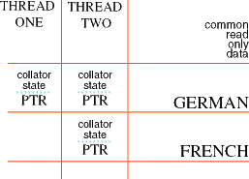
Architecture Overview 2
Open and Close Service Model
  Open a service object, use it many times, close it when done
  Better performance by avoiding setup costs per operation
ICU Threading Model
  Multiple service objects in use simultaneously
  with same or different attributes
  Large resources shared in read-only cache
  Compatible with Java threading model
Notes:
The "open and close" model supports multi-threading. It enables ICU users to use the same kind of service for different locales, either in the same thread or in different threads. For example, a thread can open many collators for different languages, and different threads can use different collators for the same locale simultaneously. Constant data can be shared so that only the current state is allocated for each editor. When a service object of a previously requested locale is instantiated, a small chunk of memory is used for the state of that service object, with pointers to the same shared, read-only data. Thus, the majority of the memory usage is shared. When any service is closed, then the chunk of memory is de-allocated. Other connections that point to the same shared data stay valid.
Thus, the normal mode of operation is to:
Open a service with a given locale.
Use the service as long as needed. However, do not keep opening and closing a service within a tight loop.
Clone a service if it needs to be used in parallel in another thread.
Close any clones that you open as well as any instances of the services that are owned.

Slide 43
Architecture Overview 3
Data Driven Services
  Customize at build-time or run-time
  Interchange with other platforms;
    same results on each
  Rule-based
    Collation, Word-breaks, Transforms
  Pattern-based
    Date/Time/Number/Message formatting
  Table-based
    Character Conversion
Notes:
The ICU services are data driven so you can customize any ICU services either at build-time or run-time. For example, you can add a user defined collation sequence for en_US to overwrite the system collation service behavior for en_US locale. This can be done either by providing a user package and roll that into the package tools at build-time, or you can create a collator instance by specifying the collation sequence at run-time. Since ICU is ported to many platforms, you are guaranteed to get the same results of any ICU services on the ported platforms.
The data format of each service varies depending on its functionality. Some are rule based, e.g. collation and break iteration. Some are pattern based, e.g. number/date formatting. The rule based objects typically contain more complicated and larger textual description of the service behavior where as the pattern based objects are usually more light-weight. In addition, we also have table-based objects such as character set converters.

Slide 44
Architecture Overview – ICU4J
Supplement for Java
Core globalization (no character conversion or regular expressions)
  We do supply complex text support for Sun
Modularized: products may add just needed functionality
Usually drop-in replacement for JDK functionality
  Changing the import statements is usually all that is needed
Notes:
The Java library is a .jar file which is used in addition to the normal Java APIs. Most of the core internationalization classes in Java have enhanced counterparts in ICU4J. Notable exceptions are character conversion and regular expressions, where Java support is largely sufficient. Sun Java uses ICU’s layout engine for complex text (for example, for Indic scripts).
As Java is used more on small and embedded platforms like cell phones and other handhelds, it may be necessary to ship only the necessary parts of ICU4J for a smaller footprint. ICU4J can be built for sets of specific services, which generates smaller .jar files.

Slide 45
Character Set Conversion
Precise alias information:
  When you ask for “Shift-JIS”, you can request the precise definition by platform (e.g. Windows, IBM, Java, … )
Runtime customizations allowed for:
  illegal sequences
  undefined characters
Notes:
Alias Information: For many common charsets, there are multiple names in common use. ICU supports aliases from many standard and platform sources. Different platforms use substantially different conversion tables for the same common charset names. ICU allows the specification of both a charset name and an identifier for a platform or a standard to select the appropriate table.
Buffer Management: The conversion API automatically keeps track of multi-byte characters across buffer boundaries. This means that when the first few bytes for a character are in one buffer and the next ones in the next buffer (where each buffer is passed into the converter in consecutive function calls), the converter keeps enough state to treat the whole sequence properly. This simplifies the data handling for the caller compared to many other conversion APIs.
Customizations: ICU converters distinguish between illegal sequences (illegal byte combinations) and undefined characters (legal sequences with no defined mappings). They are handled with callback functions that can be selected and completely overridden by the application.
Unicode Text Compression: ICU includes converters for two encodings that provide a measure of compression. Both SCSU (Standard Compression Scheme for Unicode) and BOCU-1 (Binary-Ordered Compression for Unicode) provide good byte-per-character ratios for Unicode text. Unlike general-purpose compression methods (like zip) which are not limited to text, these encodings use at least one byte per text character and do not remove duplicate contents parts. Therefore, they achieve lower compression, but are simpler and are usable for very short texts.

Slide 46
Collation: Sorting, Searching and Matching
Fast international comparison for string search; fully UCA compliant
  Compressed sort keys, optimized string comparison, sublinear string search
  Incremental sortkeys used for radix sorting
Precise binary sortkey stability over time (library versioning)
Notes:
ICU has a full implementation of the Unicode Collation Algorithm (UCA), which gives a default ordering for all of Unicode. Language-specific tailorings – where necessary because of differences to the Unicode default – are provided based on the Common Locale Data Repository (CLDR). Collation can be further customized with a large set of runtime attributes, for example to sort uppercase letters before lowercase ones or to sort numbers according to their numeric value.
String comparisons are very fast, sort keys are compressed for short length (saves space in large index tables), and uncompressed sort keys can be retrieved incrementally for efficient sorting of large blocks of strings. Efficient, language-sensitive searching in strings is supported with a Boyer-Moore implementation which uses the collation service for comparisons.
In order to achieve absolute stability of sort keys, which is important for large databases, a fixed version of ICU4C can be used for collation, while using a current version of ICU4C for other processing. ICU4C is built so that multiple version can be used in the same process. (This is not available in Java.)
The Unicode collation data and the language tailoring data are loaded from build-time-customizable data files, as with other ICU services. In addition, an application can supply collation rules at runtime and instantiate a custom collator with them.

Slide 47
Calendar & Time Zones
International Calendars – Islamic, Buddhist, Hebrew, Japanese
  Required for correct presentation of dates in some countries
Olson timezone support with localizations
Notes:
ICU provides many calendars for proper calculation of dates and localized display strings for months, days, etc. In addition to the Gregorian calendar, ICU also supports several others that are common in some countries.
Some of the calendar calculations include: adding a day, a week, a month and so forth. The calendars also provide a way to convert dates between calendar types. For example, you can convert a date from the Japanese calendar to a date in the Gregorian calendar and vise versa.
Time zone data is derived from the latest version of the industry-standard Olson database and includes historic data for points of time in the past. Time zone names are localized for formatting and parsing (for example, “Pacific Standard Time” or “Mitteleuropäische Zeit”).

Slide 48
Unicode Regular Expressions
Full Regex Implementation
  C/C++ only: Java 1.4 has own package (though not as powerful)
All Unicode 4.1 Properties
  Supported through UnicodeSet
Good performance
  Competitive with non-Unicode regex
Notes:
Regular expressions are widely used for text analysis, for example for finding complicated patterns, analyzing log files or extracting data from large lists.
ICU4C has a full implementation of a regular expression engine, with a C++ API similar to JDK 1.4’s Java regular expression classes, and also a C API. ICU additionally supports all Unicode properties and follows the Unicode Regular Expression guidelines (Unicode Technical Standard #18) for working in Unicode.
At the same time, the performance of the implementation is competitive with common regular expression engines that are not designed to handle Unicode text.

Slide 49
References
Unicode: http://www.unicode.org/
IBM software globalization: http://ibm.com/software/globalization
ICU docs & papers: http://icu.sourceforge.net/docs/
ICU: http://ibm.com/software/globalization/icu
ICU (IBM intranet): http://icu.sanjose.ibm.com/

Slide 50
Q & A

Slide 51
Backup Slides

Slide 52
Thought Experiment: Alternative to Unicode
Could have tagged pieces of text with code pages
À la ISO 2022
Like tagging each integer value with whether it is encoded with 1’s complement or 2’s complement
Too hard to use, too many problems
Instead: One single encoding for all languages

Slide 53
Architecture Overview – ICU4C
Simple Error Handling
  Thread safe
  Works in C and C++
C/C++ subset for portability
Version Management
  Multiple versions of ICU4C in the same process memory space
  Data and library versioning
String Buffer Management
  Preflighting and overflow protection
Flexible
  Allows Loading and Unloading ICU4C libraries
  Runtime settable memory allocation and mutex functions
Notes:
There are additional architecture features in ICU4C:
Error handling:In order for ICU to maximize portability, only a subset of the C++ language are used in ICU so we can compile ICU4C correctly on older C++ compilers and provide a usable C interface. Thus, there is no use of the C++ exception mechanism in the code or Application Programming Interface (API). To communicate errors reliably and support multi-threading, ICU uses an error code parameter mechanism. Every function that can fail takes an error-code parameter by reference. This parameter is always the last parameter listed for the function. ICU enables you to call several functions (that take error codes) successively without having to check the error code after each function. Each function usually must check the error code before doing any other processing, since it is supposed to stop immediately after receiving an error code.
Version management:Starting ICU 2.0, a versioning management mechanism is put in place such that the application can use multiple versions of ICU on the same computer at the same time. A program can keep using ICU 2.0 collation, for example, while using ICU 2.2 for other services. This allows applications to use older versions of services for exact bit-for-bit fidelity, while linking to newer versions to access new features. In addition, both the ICU data and libraries are versioned to ease the configuration and release management of using ICU.
String buffer management:In ICU, strings are either terminated with a NUL character (code point 0, U+0000) or their length is specified. In the latter case, it is possible to have one or more NUL characters inside the string. The C APIs are designed such that the user can retrieve the preflighting information so typical user cases can use stack buffer for performance or allocate additional space to recover from previously failed operation due to buffer overflow.

Slide 54
ICU4J: Supplement for Java
CLDR (Common Locale Data Repository)
  More fully supported locales than Java
Up-to-date globalization: standards-compliant; latest Unicode
  Supplementary character (GB 18030, JIS X 213, HKSCS)
    Java 5 adds handling of supplementary characters
  Full properties – JDK has only a fraction
  Unicode Collation Algorithm
  Local calendars (Islamic, Japan,…); more time zone localizations
  Currencies, String Search, Internationalized Domain Names
  Transforms: Case, Scripts, Normalization
Much shorter release cycle and quicker support for Unicode standard
Notes:
Java 5 (JDK 1.5) fully supports only 16 languages and 21 locales (see http://java.sun.com/j2se/1.5/docs/guide/intl/locale.doc.html). ICU uses CLDR 1.3 data, which supports many more languages and locales (see http://www.unicode.org/cldr/repository_access.html).
Unicode support, while available in Java itself, is much more complete in ICU. ICU supports many more Unicode properties for proper and efficient text handling, and implements Unicode standards for collation (sorting & searching) and word and line breaking and others. Complete case mapping operations, including case folding for case-insensitive comparisons, are available in ICU, as well as Unicode Normalization. In addition, ICU closely follows the latest Unicode releases while Java updates Unicode support only every few years.
Unicode supplementary characters (those with code points above U+FFFF) have long been supported with ICU functions. Java 5 adds similar functions, following the general ICU model (using int instead of char for single code points, and regular Strings otherwise), and updates relevant internal implementations.
In addition, ICU provides for a wider range of globalization functionality, including non-Gregorian calendars, script transliterations, and enhanced locale IDs (allowing script codes like in sr_Cyrl and service-specific selectors like in de@collation=phonebook).

Slide 55
Unicode Text Handling 2
All Unicode 4.1 properties
  direct API
    values, names, enumerations
  UnicodeSet
    Fast, compact set operations (union, intersection, …)
    Pattern-based (both Perl & POSIX syntax for properties)
      \p{greek} vs. [:greek:]
    All properties:
      [\p{lowercase}-[a-z]]
      [\p{greek} & \p{uppercase}]
Notes:
ICU provides direct API access to almost all Unicode properties – except for those defined in Unicode’s Unihan.txt (numeric values for Han characters are supported). The properties are designed for efficient text processing without hardcoding large lists of characters in applications, which is especially important given the large and growing number of characters in Unicode. For example, Unicode properties can be used to determine the script of characters and strings (Latin vs. Cyrillic etc.), to find out whether a character is alphabetic, a math symbol, or ignorable in many processes, or to support efficient handling of equivalent forms of text (via the quick check properties).
In addition to direct APIs, which return a value for a single code point, ICU also provides the UnicodeSet class (in both C++ and Java, with a C wrapper). A UnicodeSet holds a set of Unicode code points and Unicode strings and can be populated with characters that have combinations of properties, using a simple pattern syntax. ICU services like regular expressions and transliterations make extensive use of UnicodeSets.

Slide 56
Formatting
Date & time: 8 formats per locale by default
Messages
  Completely localizable, plural support
Numbers & currencies
  Scientific Notation, Spelled-out (checks, etc.)
  Full Orthogonal Currency support
    INR In Hindi: रु१,२३४.५७
    INR In English: Rs. 1,234.57
    INR In German: Rs. 1.234,57
Recent Additions
  List available currencies API
  Short and stand-alone month/day names
Notes:
ICU provides classes for formatting and parsing of the entities that are most important for application globalization: dates, times, numbers, currencies, and general, translatable messages (with reorderable inserts). Because of the shared heritage, the C++ and Java ICU classes are very similar to the JDK classes. In addition to the large amount of CLDR-based, locale-specific formats used by ICU, an application can supply its own custom pattern strings.
Special features include:
Message format patterns support the selection of proper plural forms by the translator in a single format string.
Numbers can be “spelled out” in a number of languages, formatting 212 as “two hundred twelve” for example (like on checks).
A value in any currency can be formatted for any language, with localized display strings for many combinations of languages and currencies.
A monetary value (number+currency) can be parsed with one object, rather than having to explicitly try to match each possible currency.

Slide 57
Transforms
Unicode Normalization
  Highly optimized for performance
  performance utilities: concatenation, detection, comparison
Casing (upper, lower, title, folding)
General Transforms
  Script transliterations
  Half-width/Full-width, Hex, etc.
  Chain transforms together, filter source characters
  Rule-based, customizable at runtime.
String Prep: NFS, Internationalized Domain Names (IDN)
Notes:
ICU provides many text transformations (to and from Unicode) with two different types of APIs: Dedicated APIs with specific classes, functions and signatures, and generalized transforms using the “Transliterator” classes. Aside from actual transliteration, the latter also support many other operations like case mapping and normalization. An application can provide custom rules for special text transforms.
The script transliterations in ICU are between Latin and most modern scripts, with special support for transliteration between different Indic scripts. Other script pairs are usually handled with a pivot through Latin. Han characters can be transliterated to Pinyin, but not the other way around, because that would require more sophisticated linguistic software.
IDNA is supported with a dedicated API that implements the operations specified in the internet standards for International Domain Names. These functions are used in software that deals with domain names in protocols and user interfaces.

Slide 58
Segmentation: word, line & sentence
Fast state-table implementation
Customizable
  Rule-based – customizable at runtime
  Special customizations, e.g. Thai
Recent Additions:
  Uses new UText API
    Discontinuous text
    Buffering
    Usable with UTF-8, UTF-16 or UTF-32
Notes:
When text paragraphs are displayed or printed, each paragraph needs to be broken into multiple lines. Software designed for European languages often uses very simple methods to do this, mostly by looking for spaces. Similarly, when a word is selected through a double-click, the word boundaries are often determined by checking for spaces and certain punctuation characters like a comma, period or question mark.
This does not work for globalized software: Some writing systems do not use spaces, and many have special punctuation characters. ICU implements “break iterators”, based on Unicode default algorithms and data, for finding boundaries between characters, words and sentences and for finding line break opportunities. For Thai, a dictionary is used for word and line breaks.
An application can also supply custom break iteration rules, which get “compiled” into an efficient state table.
The word boundary detection supports the distinction of boundaries after actual words from boundaries following spaces, punctuation, or hard line breaks.

