Slide 1
Collation in ICU
Mark Davis, Vladimir Weinstein, Andy Heninger
IBM Globalization Center of Competency

Slide 2
Collation = Sorting Order
How hard can it be?
  A < B < C < …
Complications
  Languages are complex and varied
  Unicode is a big set of characters
  Performance is crucial
Notes:
Collation is the process of putting strings in order, according to the rules of the language.
So, how hard can alphabetical order be? Just put B after A and C after B, right?
Unfortunately, collation is quite complicated. Most languages do not sort strings in the same order, and the conventions that people have developed are often tricky to deal with. Sorting all Unicode characters in a uniform and consistent manner presents its own challenges. And doing this all with good performance is absolutely required

Slide 3
Varies By:
Language
  Swedish: z < ö
  German: ö < z
Usage
  Dictionary: öf < of
  Telephone: of < öf
Customizations
  A < a
  a < A
Versioning
  Fixes
  New Gov. Stds
  New Characters
Notes:
Languages differ significantly in how they sort. Moreover, even with the same language, the usage will vary. Here are examples from German Dictionary order and German Telephone book order.
Sometimes the case ordering (upper first vs lower first) is mandated by the government, as in Denmark. But often it is simply a customization, one that depends on the particular customer choices.
One of the trickiest areas is Versioning. Over time, collation order will vary. There may be fixes that are discovered as more information becomes available; there may be new government or industry standards for the language that require changes; and finally, new characters are added to Unicode all the time. While they may not be required for a given language, they must be added to the default ordering for the entire range.

Slide 4
Strength Levels
Base characters: a < b
Accents: as < às < at
  ignored if there is a L1 character difference
Case: ao < Ao < aò
  ignored if there is a L1 or L2 difference
Punctuation: ab < a-b < aB
  ignored* if there is a L1, L2, or L3 difference
Tie-breaker: NFD code point order
Notes:
A basic feature of collation for most languages is the notion of levels. When you compare two words, for example, the most important feature is the base character: such as the difference between an A and a B.
Accent differences are typically ignored, if there are any differences in the base letters.
Case differences (uppercase vs. lowercase), are typically ignored, if there are any differences in the base or accents.
* Punctuation is variable. In some situations a punctuation is treated like a base character. In other situations, it should be ignored if there are any base, accent, or case differences.
The IDENTICAL level is a tie-breaker. If there are no other differences at all in the string, the the NFD code point order is used.

Slide 5
Context Sensitivity
Contractions
  H < Z, but CZ < CH
Expansions
  OE < Œ < OF
Both
  カー < カイ
  キー > キイ
Notes:
Beyond the concept of levels, there are additional complications because of the way languages work.
First are contractions, where two (or more) characters sort as if they were a single base character. In the case you see, CH acts like a character after C.
Second are expansions, where a single character sorts as if it were two (or more) characters in sorting. In the example here, an Œ ligature sorts as if it were O + E.
Both of these can be combined: that is, two (or more) characters may sort as if they were a different sequence of two (or more) characters. In this case, for Japanese, a length mark sorts like the vowel of the previous syllable: as an A for KA and as an I (English ē sound) for KI.

Slide 6
Canonical Equivalence
  Å ≡ Å
  ≡ A + º
  x + . + ^ ≡ x + ^ + .
  ự ≡ u + ’
  ≡ ư + .
  ≡ ụ + ’
  ≡ u + . + ’
  ≡ u + ’ + .
Notes:
There are a number of cases in Unicode where the same sequence of characters can be represented in different ways. For more information on what this means, see Unicode Technical Report #15.
For collation, sequences that are canonical equivalent must sort the same. Here are some examples, where we use the triple-bar (≡) to mean “sorts the same”.
For example, the angstrom symbol was encoded for compatibility, and is canonically equivalent to an A-ring. The latter is also equivalent to the decomposed sequence of A plus the combining ring character.
Order of certain combining marks in many cases is also irrelevant, so these must be sorted the same, as in the second example.
In there third example, we have a composed character that can be decomposed in five different ways, all of which are canonically equivalent.

Slide 7
Oddities
Normal accents
  cote < coté < côte < côté
    first accent difference determines order
French accents
  cote < côte < coté < côté
    last accent difference determines order
Logical Order Exception (Thai, Lao)
  เ ก sorts like ก เ
Notes:
Then we come to the oddities.
Normally, all differences in sorting are assessed going from the start to the end of the string. If all of the base characters were the same, the first accent difference determines the final order. In the example, the first accent difference is on the o, so that is what determines the order.
In French and a few other languages, however, it is the last difference that determines the order.
A second issue comes up with Thai and Lao. These scripts are unusual in Unicode in they are not stored in logical order, but in visual order. That means that in the analysis of text, including sorting, a small number of letters have to be reordered.

Slide 8
Merging Database Fields
F1 = LastName, F2 = FirstName
Sequential
Weak 1st
Merged
F1, then F2
F1 (L1), F2
L1, L2, L3
diSilva, John
diSilva, Fred
di Silva, John
di Silva, Fred
dísilva, John
dísilva, Fred
diSilva, John
dísilva, John
di Silva, John
di Silva, Fred
diSilva, Fred
dísilva, Fred
diSilva, John
di Silva, John
dísilva, John
diSilva, Fred
di Silva, Fred
dísilva, Fred
Notes:
Levels get a bit tricky. Look at the case of database fields.
The simplest way to sort is field by field. This gives us the results in column one, for example. The problem with this approach is that high level differences in the second field are swamped by minute differences in the first field.
A second way to do this is to ignore all but high-level differences in the sorting of the first field. This gives us the results in column 2. The problem with this is that all but the base characters in the first field will come out in essentially random order.
The correct way to sort is to merge the fields in sorting. Using this technique, all differences in the fields are taken into account, and the levels are considered uniformly:
Accents in all fields are ignored if there are any base character differences in any of the fields
Case in all fields are ignored if there are base character differences in any of the fields.
Etc.

Slide 9
Customizations
Parameters that change collation behavior
  Choice of language (locale)
  Runtime choices
Examples to follow
Notes:
In practice, there are additional features of collation that people need control over. The most obvious is that different languages have different behavior.
In addition, there are many customizations that people use in practice.

Slide 10
Parametric Customizations
Strength
  Base
  Base+Accent
  Base+Accent+ Case
  &c.
Case:
  A < a
  a < A
Punctuation:
  di Silva < diSilva
  diSilva < di Silva
Notes:
There are a number of common choices that need customization at runtime:
The Strength is the number of levels that are to be considered in comparison. This is most important when the collation mechanism is used for searching, as we will discuss later. It is important not to over-specify the levels, as it costs in performance and memory consumption.
For case differences, some dictionaries and authors use uppercase before lowercase or while others use the reverse.
A common choice is whether to treat punctuation (including spaces) as base characters or not. We see in this example what difference this makes in the examples on the next slide.

Slide 11
Punctuation (Alternates)
Base Character
di silva
di Silva
Di silva
Di Silva
Dickens
disilva
diSilva
Disilva
DiSilva
Ignoreable
Dickens
di silva
disilva
di Silva
diSilva
Di silva
Disilva
Di Silva
DiSilva

Slide 12
Extended Customizations
User-defined
  “&” ≡ “ampersand”
Merging tailorings
  Iranian + French
Script Order
  b < ב < β < б
  β < b < б < ב
Numbers
  A-10 < A-2
  A-2 < A-10
Notes:
User-defined rules: For example, in an index an author may wish to have symbols sorted as if they were spelled out
Merging Tailorings: is the process of merging rules from different tailorings to produce a new tailoring. In such an approach, generally one is the “master” in cases of conflicts.
Script Order: determines which scripts come first. Note: this cannot be done with an extra strength level.
Numbers: If numbers are sorted alphabetically, “10” comes before “2”. This can be customized, but is much trickier than it sounds because of ambiguities with recognizing numbers within strings. Once recognized, they can be preprocessed in place into a format that allows for correct sorting, such as a textual version of the IEEE numeric format:<Sign ExpSgn Exp, Mantissa Terminator>. The following table shows an example of transforming numbers into such an internal format which will collate according to numeric order.
Original Reformatted
123456 ++05,123456+
123 ++02,123+
23 ++01,23+
12.3 ++01,123+
0.123 +-01,123+
0 +-00,0+
-123456 -+05,123456+

Slide 13
Collation also used for:
Searching
  ignore case, accent options
Selection
  Return all records where
    Jones ≤ name < Smith
Graphemes
  What a user considers a “character”
  Regular expressions (Level 3)
    See UTR #18, UTR #29
Notes:
The same collation behavior has application in other realms than sorting.
Searching should behave the same. For example, if v and w behave the same in Swedish sorting, then they should do so for searching. For searching, the ability to set the maximal level that should be considered is very important.
For selection, the comparisons between the endpoints of a range uses collation
Graphemes (what a user considers to be a character in the language) are also generally coordinated with collation. For example, where “ch” sorts as a separate letter, it also gets treated as a separate letter in other contexts.

Slide 14
UCA
UTS #10: Unicode Collation Algorithm
  Levels, Expansions, Contractions, Punctuation, Canonical Equivalence, etc.
  Default ordering: all Unicode code points
  Provides for tailoring to given languages
  Also see: The Unicode Standard, §5.17: Sorting and Searching
Aligned with ISO 14651
Notes:
The Unicode Consortium has established a standard for collation, in Unicode Technical Standard #10, abbreviated as UCA. It provides for all the features that we have discussed, plus for a default ordering for every Unicode code point. It also provides for tailoring, which is customizing the default ordering.
There is additional background information in Section 5.17 of the Unicode book.
The UCA is aligned with ISO 14651. N.B. not same as ISO 14652: the latter is not recommended.

Slide 15
APIs
String Compare
Sort Keys
  Incremental sort keys
String Search
Special-Purposes
  Sortkeys that bracket “Smith”
    X <= Smith* < Y
  Merged sortkeys
Notes:
There are two main APIs for collation in practice. These are string comparison and sort keys.
String comparison is obvious. You pass in two strings, and get a result.
Sortkeys are an interesting optimization. By preprocessing the string, you can get faster comparison.
String search is coordinated with collation; if in a given language “w” sorts at the same primary and secondary level as “v”, then a case-insensitive search should find either one.
Other special-purpose APIs are useful, such as:
Return two sort keys that will “bracket” on top and bottom all strings that start with “Smith”.
Form a merged sort-key

Slide 16
Sort Keys
Transform string into series of bytes which will binary-compare
  a: 06 C3 01 20 01 02 00
  A: 06 C3 01 20 01 08 00
  á: 06 C3 01 20 32 01 02 02 00
  ab:06 C3 06 D7 01 20 20 01 02 02 00
  b: 06 D7 01 20 01 02 00
Level 1
Level 2
Level 3
Notes:
A sort key is a way to preprocess strings so that comparison operations are much faster. It transforms each string into a series of bytes named sort keys, which can be later binary compared.
Here is an example. We transform the following strings into the corresponding byte sequences. The bytes are broken into ranges, separated by a 01 byte separator.
The first level is the sequence of bytes before the first 01. It represents the ordering of the base characters.
The second level is the sequence of bytes after the first 01 and before the second. It represents the accent differences, as you see on the third line.
The third level is the sequence of bytes after the second 01 and before the third. It represents the case differences.

Slide 17
String Compare vs. Sort Keys
Same results in either case
SC faster for single comparisons
  average 5 to 10 times!
SK faster for multiple comparisons
  index once
  binary compare many times
Notes:
The implementation of sort keys and string compare must ensure that precisely the same results are returned, whichever is used for string comparison.
Simple string comparison is faster for single comparisons. Typically there is a considerable difference in performance, in our experience 5 to 10 times faster. You can see why this is the case, since quite often a difference is found between strings before all the characters are processed.
Sort keys are faster for multiple comparisons. Since binary comparison is blindingly faster than string comparison, whenever you have more than about 10 comparisons — and can afford the storage — it is faster to use sort keys.

Slide 18
String Search
Naïve Approach
  key matches in target at <x, y>
  iff target.substring(x, y) ≡ key
Boundary Complications
  Ignorables: “a” matches in “(a)”?
    at <0,2> & <1, 2> & <0,3> & <1,3>?
  Contractions: “c” matches in “churo”?
  Normalization: “å” matches in “a¸˚”?
Notes:
String search can (and should) be consistent with collation. There are, however, a number of complications.

Slide 19
WARNING 1: Basics
Not aligned with character set or repertoire
  Latin-1: Swedish and German sorting differs
Not code point (binary) order
  Binary: Z < a < v < w
  English: Z > a
  Swedish: v ≡ w
Not a property of strings
  With same database
    Swedish user: view/select
    German user: view/select
Notes:
There are a number of common misperceptions about collation.
Collation is not aligned with character sets or repertoires of characters. Swedish and German share most of the same characters, for example, but have very different sorting orders.
Collation is not code point (binary) order. The simplest case of this is capital Z vs. lowercase a.
Beginners may complain about Unicode that a particular character is “not in the right place in the code chart”. That misunderstands the role of the character encoding in collation. While the Unicode Standard does not gratuitously place characters such that the binary ordering is odd, the only way to get the correct order is to use collation.
Collation is not a property of strings. Consider a list of cities, with each city correctly tagged with its language. Despite this, an English user will expect to see the cities all sorted according to English order, and not expect to see an O with a slash appear after Z.

Slide 20
WARNING 2: Operations
Order not preserved under concatenation / substringing
  x < y ↛ xz < yz
  x < y ↛ zx < zy
  xz < yz ↛ x < y
  zx < zy ↛ x < y
Notes:
One very important issue to get right is that collation is not preserved under concatenation or substringing.
For example, the fact that x is less that y does not mean that x plus z is less than y plus z.

Slide 21
WARNING 3: Dependence
Collation is a relation over strings
  Sort keys embody part of that relation
Thus, comparing sort keys from different tailorings (or parameters) gives undefined results.
  C < CH < D
  May move binary value for D
Notes:
Sort keys are a preprocessing of keys according to a given set of collation rules. From different rules or parameters, you get different binary sequences. Thus in general you can’t compare sort keys that are generated from different rules or parameters.
For example, when using a tailoring that inserts new values between characters, an implementation of collation could change the binary values after the insertion. Then the binary value of D would be different than the default value.

Slide 22
WARNING 4: Stability
Stable Sort
  Records with equal comparison come out in original order
  Property of algorithm, not comparison
Semi-Stable Comparison
  x ≠ y → x ≢ y
  Property of comparison, not algorithm
  Degrades performance
  Doesn’t do what people think (or really want)!
Notes:
One very common confusion centers around the notion of stability.
A stable sort is one where records with equal comparison come out in original order. This is a property of the sorting algorithm, not the comparison mechanism. For example, a bubble sort is stable, while a quicksort is not. This is a useful property, but cannot be accomplished by modifications to the comparison mechanism or tailorings.
A Semi-Stable collation is different. It is a collation where strings that are not binary equal will not be judged to be equal. This is a property of comparison, not the sorting algorithm. In general this is not a very useful property; it’s implementation also typically requires extra processing in string comparison or an extra level in sort keys, thus degrades performance to little purpose.

Slide 23
Implementation Details
Many possible implementations
ICU as example here.

Slide 24
What is ICU?
Internationalization libraries for C, C++, Java*
  Open source – non-viral
  Sponsored by IBM
  Sun’s Java licenses an earlier ICU version; ICU4J updates it.
Unicode standard compliant
  full supplementary support
Cross-platform; extensible and customizable
High performance and thread-safe
  Multiple locales in same thread – simultaneously
http://oss.software.ibm.com/icu/
Notes:
ICU (International Components for Unicode) is a collaborative, open-source development project jointly managed by a group of companies and individual volunteers throughout the world, using the Internet and the Web to communicate, plan, and develop the software and documentation. It is sponsored and used by IBM.
Comprehensive support for the Unicode Standard is the basis for multilingual, single-binary software. ICU uses the most current versions of the standard, and provides full support for supplementary characters.
As computing environments become more heterogeneous, software portability becomes more important. ICU lets your produce the same results across all the various platforms you support. It offers great flexibility to extend and customize the supplied system services.
For more information, see the ICU website.

Slide 25
ICU Features
Unicode text handling
Character set conversions (700+)
Collation & Searching
Locales (170+)
Resource Bundles
Calendar & Time zones
Complex-text layout engine
Breaks: character, word, line, & sentence
Formatting
  Date & time
  Messages
  Numbers & currencies
Transforms
  Normalization
  Casing
  Transliterations
Notes:
In addition to basic Unicode standard conformance, both ICU4J and ICU4C also provide a full set of internationalization features listed above.
Notes on C/C++ vs. Java
ICU C/C++ and Java APIs do differ slightly due to the differences of programming languages. Sometimes the feature development in ICU4C leapfrogs ICU4J or vice versa by 1-2 releases.
Though JDK already supports codepage conversion natively in Java, there are more character conversion features available in ICU4C than in JDK. ICU4C character set conversion features are available to Java users via ICU4JNI.
Since ICU is open source and closely tracks the Unicode Standard, ICU can support changes and additions to the Unicode Standard much more quickly than Java. Java support for Unicode is tied to major releases of the JDK, and can lag the Unicode Standard by a year or more.

Slide 26
Java
Sun licensed and includes an early version of ICU collation in Java
Latest ICU Java version:
  Dramatically faster
  Much lower in memory consumption
  Halved sortkey length
  Many additional features

Slide 27
ICU/Java Collation Architecture
L1-3, contractions, expansions, …
Locale tailorings
Fully rule-based specification
Arbitrary runtime user customizations
  & ‘?’ = ‘question mark’
  & ‘$’ = ‘dollar sign’
  & z < ‘george’
Notes:
The ICU / Java Collation architecture offers a wide range of features for collation, as you see here.

Slide 28
ICU Collation I
Full UCA compliance
  Full supplementary character support
Solid performance
Small sort-keys
Small Memory Footprint

Slide 29
ICU Collation II
Parametric control
Tailorable to any language
Multiple Versions simultaneously

Slide 30
Memory Requirements
Flat-file (memory mapped)
  speeds initialization
  reduces memory footprint
  (next slide)
Delta Tailoring
  Single copy of UCA (≈80K)
  Small delta files per locale
Notes:
ICU had already provided for pre-processing tailoring rules, but as of version 1.8 we flattened all of the data, replacing use of pointers and allocated chunks of memory by using a single chunk of memory with offsets to different parts. See next slide. This reduces memory consumption and speeds initialization.

Slide 31
Memory Mappable
Old: separate allocations
New: offsets within mem-map
Notes:
This shows a illustration of how the data is structured. This allows for fast initialization, since the entire structure of a collation table can be stored on disk, ready to use, then memory mapped in.

Slide 32
Delta Tailoring
“a”
UCA
not
FR
not
code
found
found
synthesized
Notes:
By leaving gaps in UCA, we allow our tailoring data to be quite small. We first look up in the tailoring table, which contains a small number of characters and their weights. These weights always fall between the weights used in the UCA. If we fail to find the characters in the tailoring table, we look in the UCA. If we fail to find it in the UCA, then we synthesize weights.
This latter step is used for CJK ideographs and any unassigned code points.

Slide 33
Sort Key Compression
Common weights are 1-byte
  Primary, secondary, tertiary, quarternary
Sequences are compressed
UTF-16 Values for “Märk Davis” (22 bytes)
  004D 00E4 0072 006B 0020 0044 0061 0076 0069 0073 0000
Sort Key (L3, ignorable punctuation - 19 bytes)
  2F 17 39 2B 1D 17 41 27 3B 01
  77 96 0A 01
  8F 80 8F 07 00
Notes:
Sort keys are compressed to about half of other collation systems (Windows, Solaris, etc), or smaller.
The most common weights at each level require only a single byte. In addition, certain sequences are compressed.
Here, for example, are the Unicode values for the string “Märk Davis” (I threw in the accent just for illustration).
There are 22 bytes in the original.
In the Sort key, there are 10 bytes in the primary. This includes the separators, plus one byte for each of the base values.
In the secondary, there are 4 bytes. One byte is a separator, all the weights before the accent compress into one byte. The accent is one byte, and all the weights after the accent compress into one byte.
In the tertiary, there a 5 bytes. One for the uppercase M, one for the remaining letters, one for the uppercase D, one for the remaining letters, and a terminator.

Slide 34
Simultaneous Multiple Versions
Programs can link against different versions of ICU, simultaneously!
Preserves exact binary order over time.
ICU 2.6.2
App
ICU 2.8
ICU 3.0
Notes:
In the following slides we will discuss a number of different issues around processing.

Slide 35
Performance: Coding
Avoided unnecessary function calls.
  Example: strlen too expensive!
Avoided excess object creation
  Reduce, Reuse, Recycle
Fast-pathed common cases
Used stack memory buffers
  (with expansion if necessary)
Made inner loops as tight as possible
Notes:
One of the major features was performance, and I will discuss some of these changes first. The first area was in terms of basic coding style, as you see here.

Slide 36
Performance: Algorithmic
Checks for identical prefixes
Tolerant of most unnormalized text
  invokes normalization rarely
Compressed sort keys
Incremental length/normalization
FCD format
Notes:
The second area of changes for performance was algorithmic changes. We won’t go into these in detail (some are discussed in the backup slides).

Slide 37
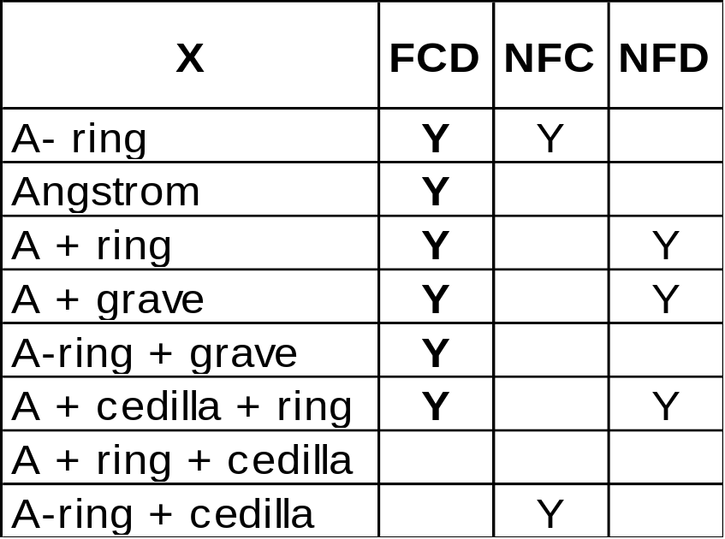
Fast C or D (FCD)
Accepts all NFD, most NFC, without normalization
Notes:
In practice, most data that is encountered is in normalized form already.
By the way we structure our data, we can process a wide range of normalized or unnormalized text without invoking normalization. When we do hit a case that requires normalization, we drop into special code to deal with it. This maximizes our performance for normal text.
The exact text that we can accept without dropping into normalization we call FCD. All text that is normalized according to NFD is accepted, plus most cases of NFC. There are a few cases of NFC that do still require processing.
The key feature that allows this to be done is called canonical closure. For more information, see Vladimir Weinstein’s talk.

Slide 38
Perf: ICU vs. Windows, glibc
Function: Full UCA!
String comparison: comparable
  ≈ 20% worse to 400% better
Sort keys: much shorter
  ≈ half as long
Warning: speed comparisons are approximate!
  Depends on data, parameters, features, CPU
Notes:
Comparisons are difficult, since so much depends on the machine, the parameters, etc. Here, though, is a rough comparison. For more information, see the ICU site.
ICU offers the full UCA for all locales, with tailorings according to the language.
In String comparison, we vary from about a fifth worse to about 4 times better.
In Sort keys, our focus is primary on speeding the final comparison and reducing the memory footprint. ICU produces sort keys that are about half the length of the sort keys produced by Windows.
The above figures are for the C version.

Slide 39
Perf: ICU vs. Java
Function: Full UCA!
String comparison: faster
  ≈ 2-3 times better
Sort keys: shorter
  ≈ half as long
Also available: JNI version
Warning: speed comparisons are approximate!
  Depends on data, parameters, features, CPU
Notes:
Comparisons are difficult, since so much depends on the machine, the parameters, etc. Here, though, is a rough comparison. For more information, see the ICU site.
ICU offers the full UCA for all locales, with tailorings according to the language.
In String comparison, we are about 2-3 times faster; and we plan further performance work in the next version.
In Sort keys, our focus is primary on speeding the final comparison and reducing the memory footprint. ICU produces sort keys that are about half the length of the sort keys produced by Windows.

Slide 40
More Information
ICU
  http://oss.software.ibm.com/icu/
Design Document
  http://oss.software.ibm.com/cvs/icu/icuhtml/design/collation/
Latest Version of these slides
  http://www.macchiato.com
Notes:
For more information, see the ICU web page, or the collation design document.

Slide 41
Q & A

Slide 42
Backup Slides
Not used in the presentation, except in response to questions

Slide 43
WARNING 5: Math. Relation
S = {Unicode Strings}
Reflexive
  ∀a ∊ S: a ≤ a
Antisymmetric
  ∀a, b ∊ S: a ≤ b & b ≤ a → a = b
Transitive
  ∀a, b ∊ S: a ≤ b & b ≤ c → a ≤ c
Total
  ∀a, b ∊ S: a ≤ b ∨ b ≤ a
Notes:
All implementations of collation must ensure that they obey the basic mathematical requirements for a full ordering, as described here.

Slide 44
Identical Prefixes
Sorting / Searching Databases
  Many comparisons to “close” strings
  Check initial prefixes with binary compare
  Drop into collation loop at first difference
  Complication…
Notes:
In searching and sorting data, there are many comparisons to fields that are “close” to other fields. For example, for a binary search, most of the comparisons are to strings that are nearly the same, since you get progressively closer to the final value.
To take advantage of this, in string comparison we check for initial prefixes with binary comparisons. Once we find a difference, we drop into the collation loop.
However, there is a complication.

Slide 45
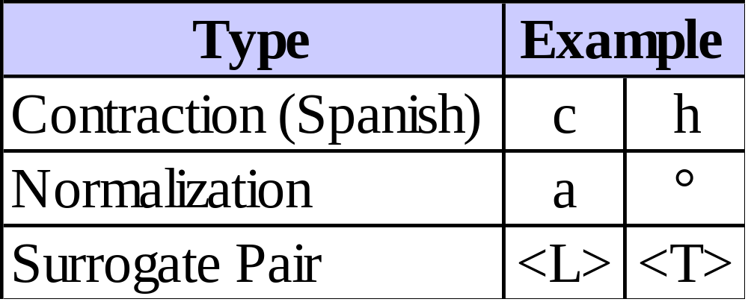
Initial Prefix Complication
Need to backup if in “bad” position:
Notes:
There are certain circumstances where an initial binary comparison goes too far. For example, it may end up in the middle of a contraction, or a case that may require normalization, or in the middle of a surrogate pair (in UTF-16).

Slide 46
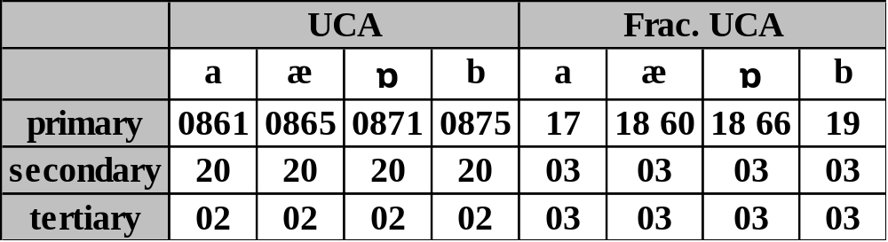
Fractional UCA
Fractional weights for compression
Gaps for tailoring, future UCA additions
Only stores differences in tailoring file
Reduces memory footprint
Notes:
One of the more significant changes we made was to the basic structure of the UCA.
UCA does not require a particular set of values in sort keys, as long as the comparison results are correct. We modify the UCA values to produce “fractional” values, where there are a variable number of bytes in weights for compression.
In addition, we leave gaps between all of the UCA values, so that future versions can be stable.

Slide 47

Exceptional Values
Normal weight storage
Special Weight Storage
  NOT_FOUND, EXPANSION, CONTRACTION, THAI, …
Notes:
One of the common mechanisms we use to save storage is exceptional values. Normally, we can store all the weights (primary, secondary, and tertiary) in 32 bits. There are some cases that require special processing (such as compression), use a special value. These are distinguished by having the value “F” in the very top nybble. In such a case, the next nybble is a TAG value that indicates the type of special value, and the remaining 24 bits are interpreted according to the tag.

