Slide 1
Implementation Issues
Mark Davis
2003-09-24

Slide 2
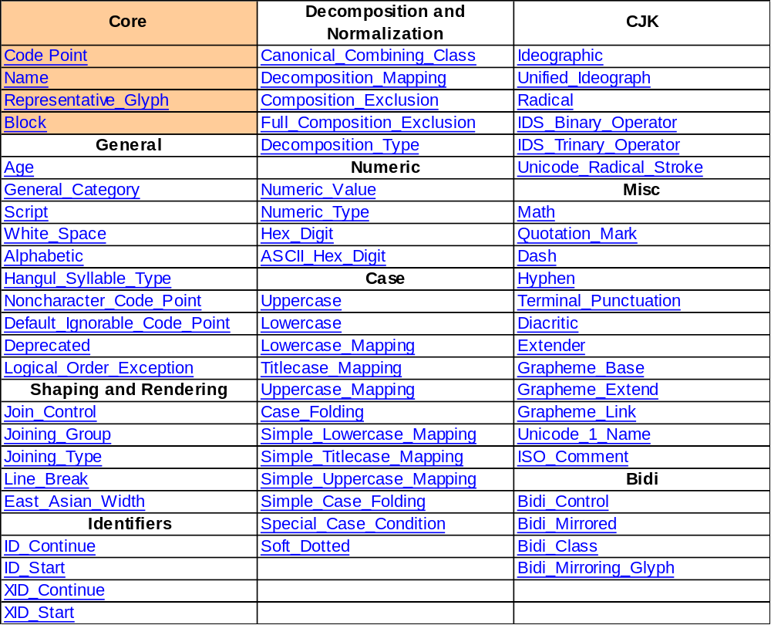
Properties

Slide 3
Behavior
Bidirectional Algorithm (Arabic/Hebrew)
Linebreak, User-Character, Word,…
Normalization
Collation
Regular Expressions
Programming Identifiers
…

Slide 4
Scripts, not Languages
.
a
Armenian
Italian
English
English
Russian
German
¨
।
Greek
Marathi
English
Hindi
Russian
Gujarati

Slide 5
Size Doesn’t Matter
Text storage size is approximately the same for all languages
In real data, other data dominates
Compression available if needed
  ZIP
  SCSU
  BOCU

Slide 6
Normalization
Produces Unique Form
Comparison, Matching, Counting
Used in
  Collation
  International Domain Names
  W3C Character Model (Web)
  Network File System
  …

Slide 7
Transcoding: ISCII - Unicode
ISCII
  Halant + Halant
  Halant + Nukta
  INV halant RA
  ATR
  EXT
Unicode
  Halant + ZWJ
  Halant + ZWNJ
  SPACE virama RA
  Not in plain text
  Not required

Slide 8
Unicode = Lingua Franca
Transcoding = Converting from one character encoding to another
Many standards / systems defined in terms of Unicode
  C#, Java, XML, …
cp1252
GB18030
Unicode
SJIS
ISCII
ISCII

Slide 9
Transliteration
Round-trip Transliterations श ↔ śa
  Ideal published form
  Unique source sequence → unique target
Best-Fit Transliterations श → sa
  For limited environments
Keyboard Transliterations श ← ssa
  Limited to QWERTY keys
Indic-Indic
  not simple mapping; “holes”

Slide 10

Keyboards
One key → many characters
Many keys → one character
→
क
0915
्
094D
ष
0937
→
à
00E0
`
a

Slide 11
Supporting Sequences
Keyboards
Fonts
Selection

Slide 12
Fonts
Required Glyphs, Positioning
Sequences Necessary to produce them
Context (e.g. in OpenType)
क
0915
्
094D
ष
0937

Slide 13
Selection
Use appropriate boundaries for user-characters
Arrow keys, mouse selection, etc

Slide 14
Unicode Stability
Encoding. Once a character is encoded, it will not be moved or removed.
Name. Once a character is encoded, its character name will not be changed.
Normalization. Once a character is encoded, its canonical combining class and decomposition mapping will not be changed in a way that will destabilize normalization.
Identity. Once a character is encoded, its properties may still be changed, but not in such a way as to change the fundamental identity of the character.
Property Value. The structure of certain property values in the Unicode Character Database will not be changed.

Slide 15
Locale Data
(examples)

Slide 16
Q & A

